Slide 1

Grammar Comparative and Superlative Adjectives
8th grade

Slide 2



Outcomes
01
02
03
differentiate
construct
comparative and superlative forms
between comparative and superlative adjectives
apply
comparative and superlative adjectives effectively

Slide 3
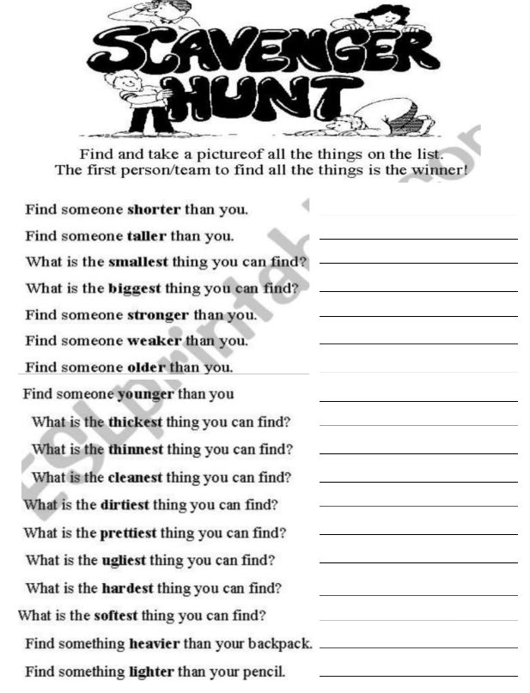
Warm up
Examples:
_______ is stronger than me.
________ is taller than me.
A ______ is lighter than my pencil.
The _______ is heavier than my backpack.
The _______ is the biggest thing in class.
The _______ is the dirtiest thing in class.

Slide 4
What is an adjective?
An adjective is a word that describes a noun or pronoun, giving more information about it, like its size, color, shape, quality, …

Slide 5

Pair-up Interviews
Link to Life – Comparative Adjectives
1. Which is better: watching movies at home or going to the cinema? Why?
2. Is wearing hoodies more comfortable than wearing jackets?
3. Who is taller in your family: you or your sibling?
4. Which is funnier: your best friend or a family member?
5. Is math more interesting than science for you? Why?
6. Which sport do you think is more exciting: soccer or basketball?
7. Which is safer: walking to school or taking a bus?
8. Which is more delicious: pizza or burgers?
9. Which is worse: forgetting your lunch or forgetting your homework?
10. Which would be cooler: flying like a superhero or swimming like a dolphin?

Slide 6
Pair-up Interviews
Link to Life – Superlative Adjectives
1. What’s the most exciting thing you’ve done this year?
2. Who is the funniest person in your class?
3. What is the best movie you’ve seen recently?
4. Who do you think is the most talented singer right now?
5. What’s the hardest subject in school for you?
6. Who is the kindest teacher you’ve ever had?
7. What is the most beautiful place you’ve ever visited?
8. Where would you love to go for the most relaxing vacation?
9. What’s the craziest trend you’ve seen on social media?
10. What is the worst food you’ve ever tried?

Slide 7
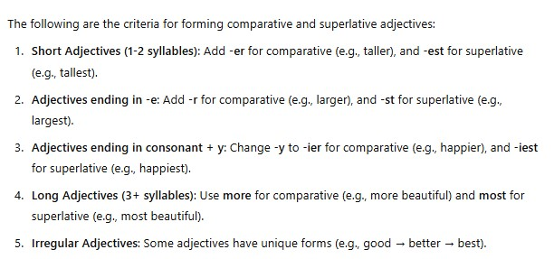

Slide 8
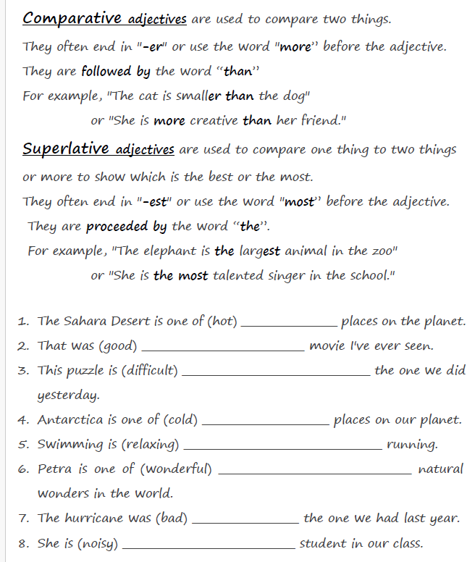

Slide 9
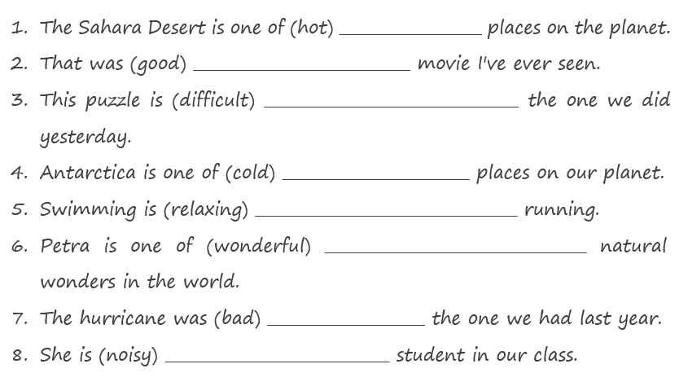
Feedback
the hottest
the best
more difficult than
the coldest
more relaxing than
the most wonderful
worse than
the noisiest

Slide 10
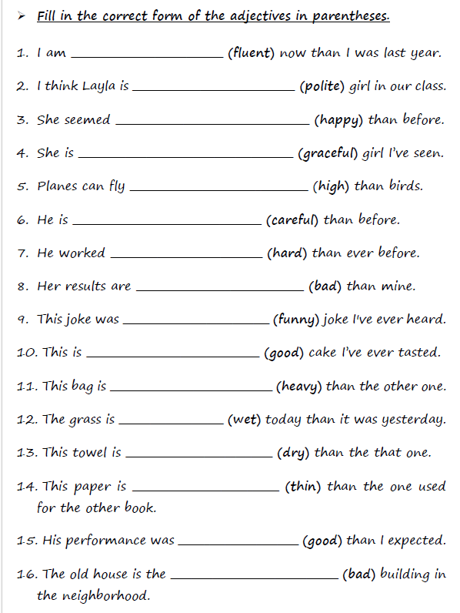

Slide 11
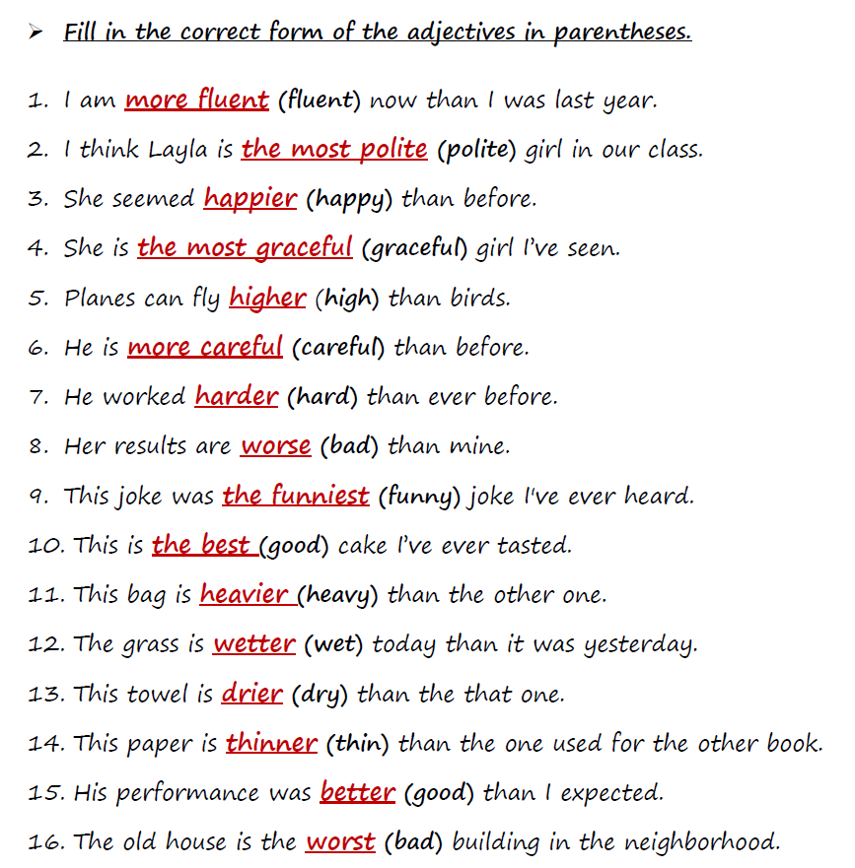

Slide 12

Critical Thinking
Why do advertisers often use superlative adjectives (e.g., ‘the best,’ ‘the most effective’) instead of comparative forms (e.g., ‘better,’ ‘more effective’)?
How does this choice affect how we perceive products or services?

Slide 13
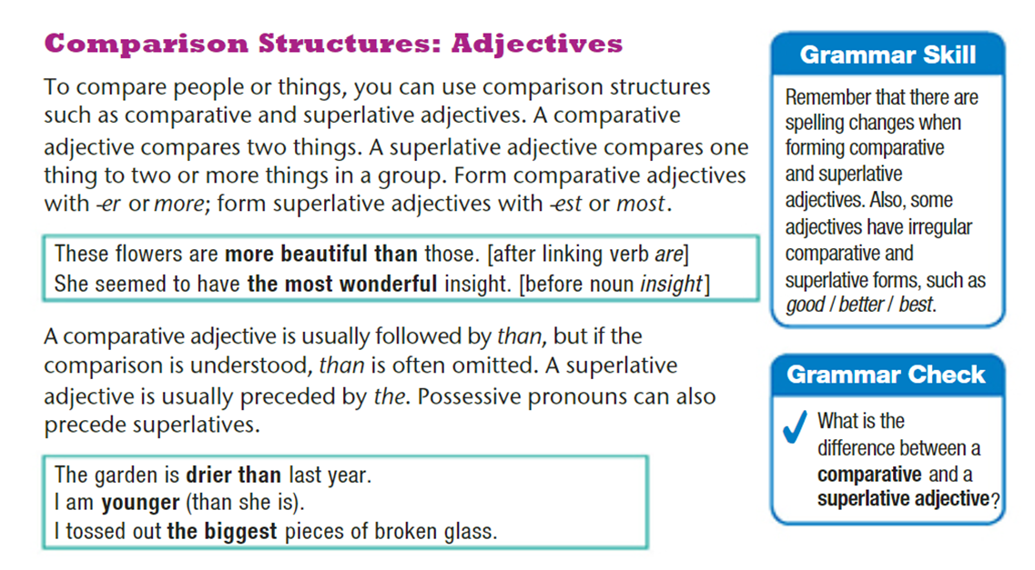
Student Book p.46

Slide 14
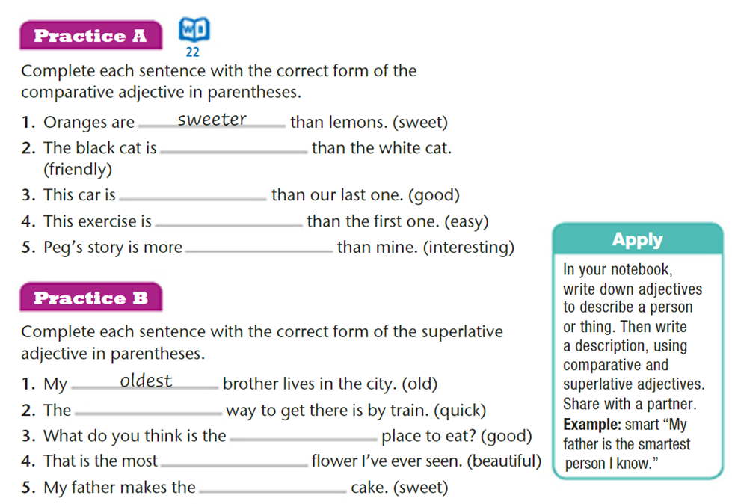
Student Book p.46

Slide 15
Student Book p.46
friendlier
better
easier
interesting

Slide 16
Student Book p.46
quickest
best
beautiful
sweetest

Slide 17
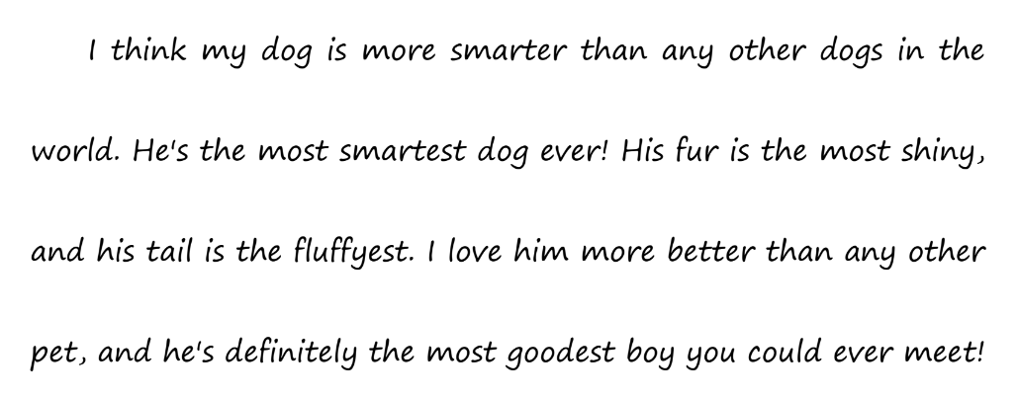
Fix the Mistakes

Slide 18
Fix the Mistakes
shiniest
fluffiest
best

Slide 19


https://www.liveworksheets.com/rm211367bv
https://www.liveworksheets.com/ff7160zy
https://www.liveworksheets.com/ia1280726em
https://www.liveworksheets.com/yp300764yi
https://www.liveworksheets.com/zh1097023rx
For More
Practice
https://www.liveworksheets.com/xs22491nr
https://www.liveworksheets.com/vy674520pi
https://www.liveworksheets.com/zy1326sp
https://www.liveworksheets.com/gl218702un

