Slide 1

Unit 3 – Reading 1
Vocabulary and Comprehension
Grade 8

Slide 2
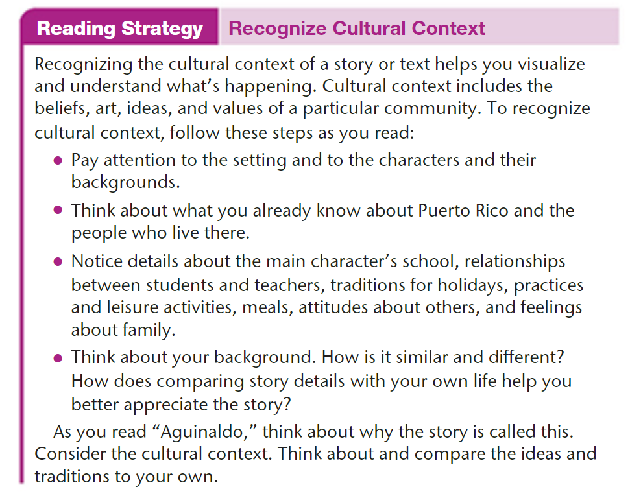
p.129

Slide 3
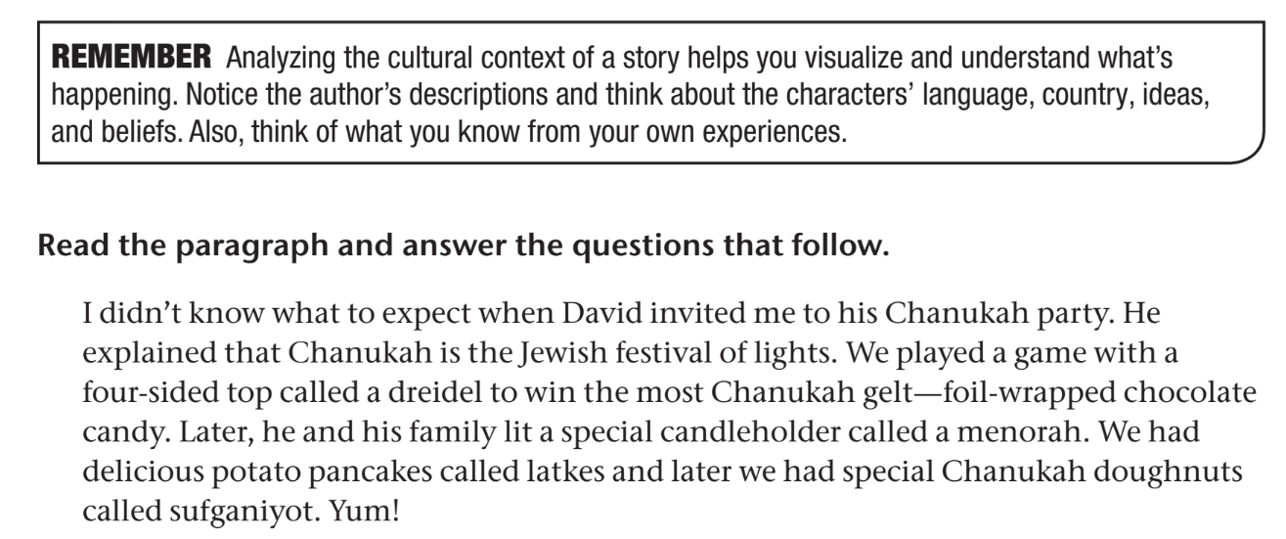
Workbook p.68

Slide 4
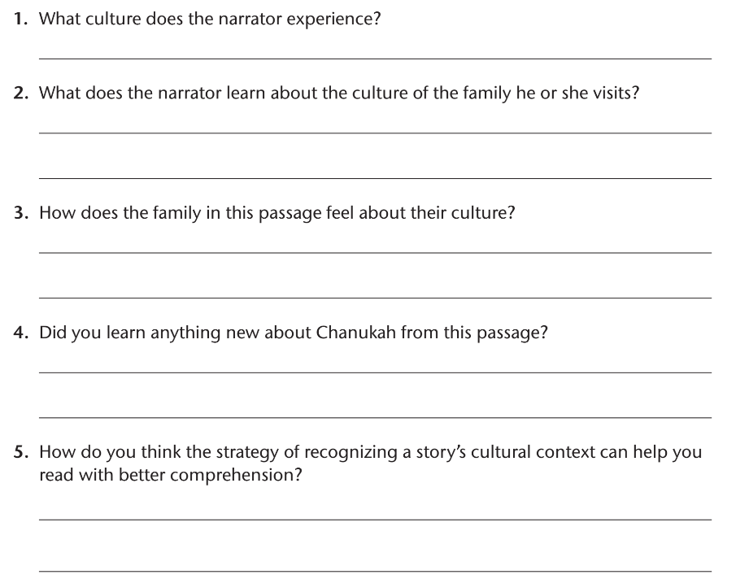
Workbook p.68

Slide 5
Workbook p.68
Jewish culture
The narrator learns that Chanukah is the Jewish festival of lights and how to play dreidel. He/she also sees a menorah being lit and tries new foods, like latkes and sufganiot.
The Jewish family is proud of their culture and makes efforts to celebrate their traditions.
(Write your own answer.)
Understanding the cultural context helps the reader picture the action in the story and understand the characters.

Slide 6
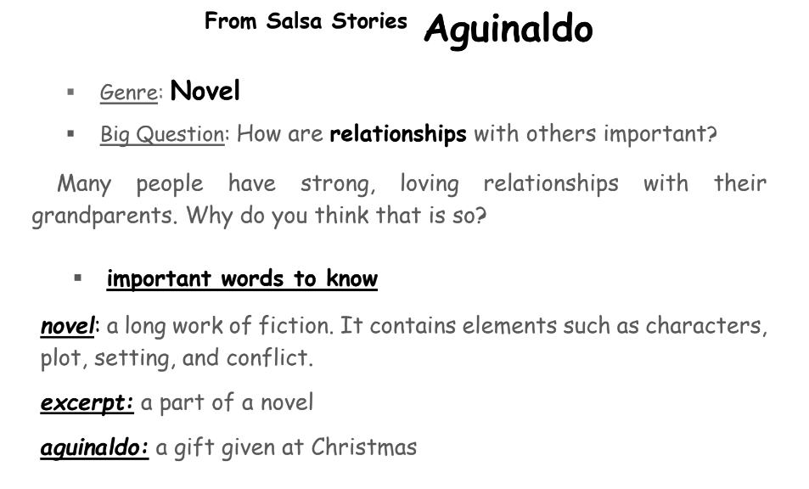
Aguinaldo – Introduction

Slide 7
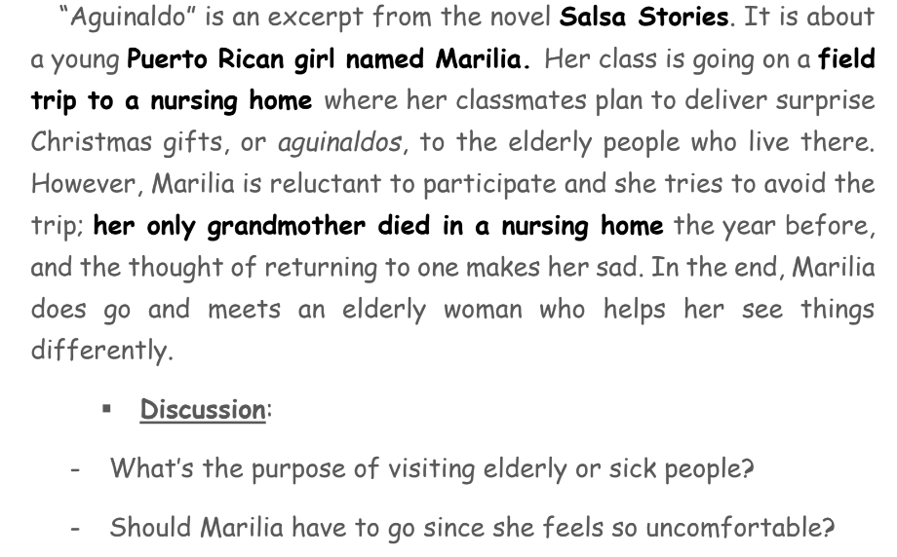
Aguinaldo – Introduction
Does

Slide 8
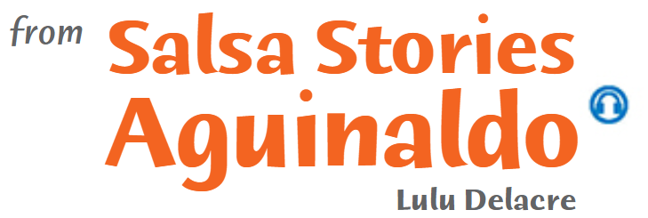
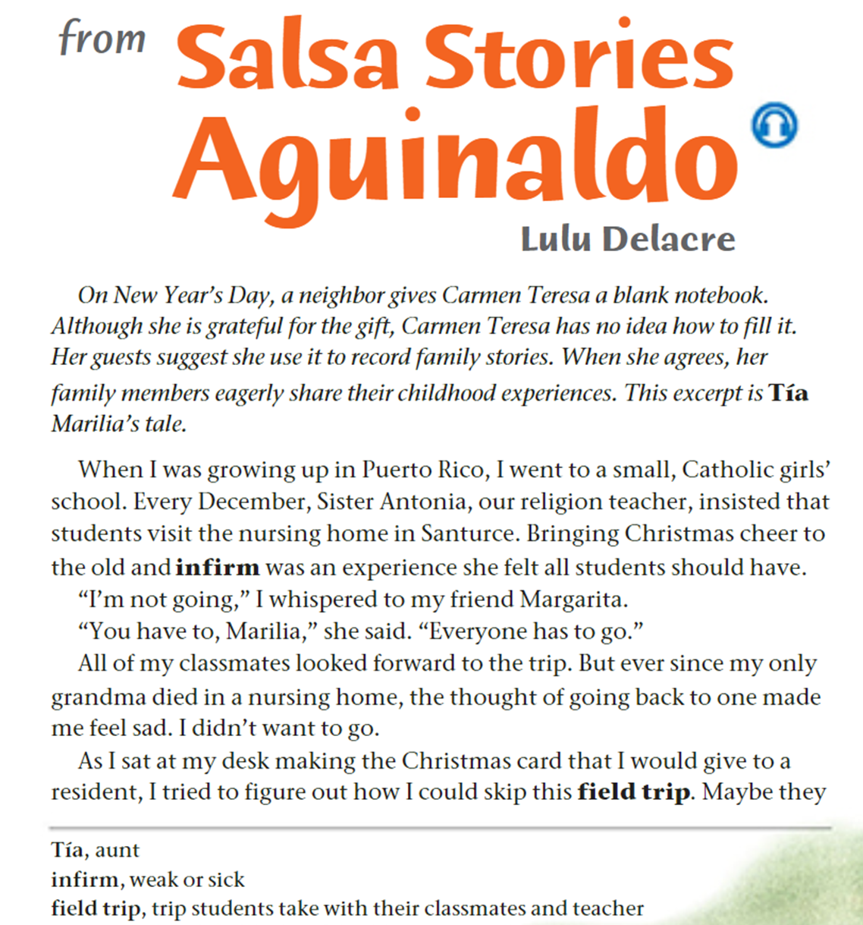


p.130

Slide 9
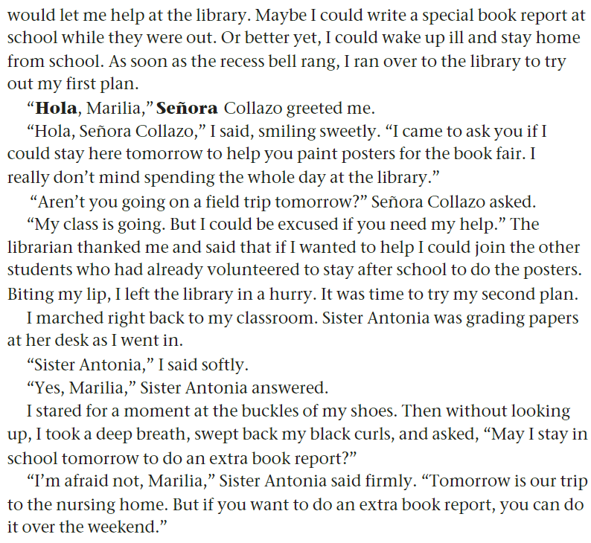
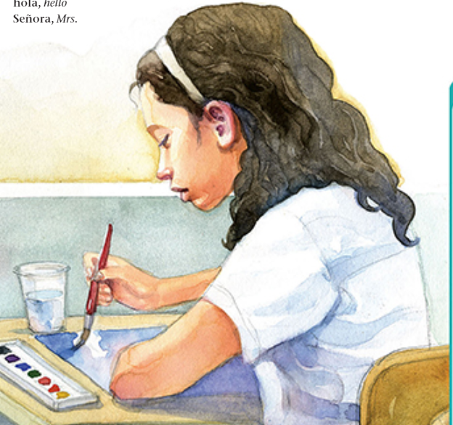
p.131

Slide 10
Questions on pages 130+131
1. Where do the characters live?
2. What do students have to do every December? How does Marilia react to this?
3. What happens to the two plans Marilia comes up with to get out of going? What do you think will happen next?
4. From what you’ve read, why do you think Marilia doesn’t want to go? Explain.
5. Find some vocabulary words related to Hispanic culture.

Slide 11
Answers
1. The characters live in Puerto Rico.
2. The students must visit a nursing home and cheer elderly people up. Marilia is reluctant to go because her grandmother recently died in a nursing home.
3. Marilia’s plans of helping teachers instead of going on the trip do not work. I think …
4. Marilia doesn’t want to be reminded of her grandmother, who died in a nursing home.
5. Tía – hola – Señora - aguinaldo

Slide 12
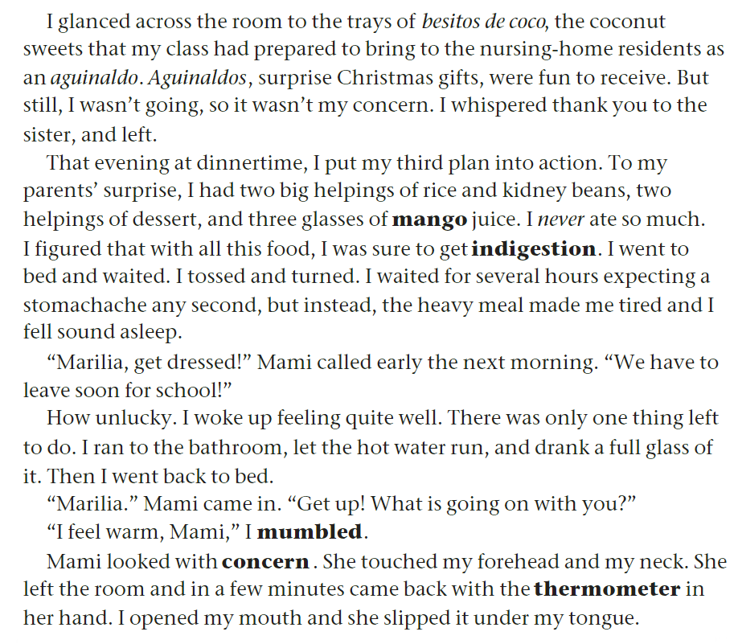
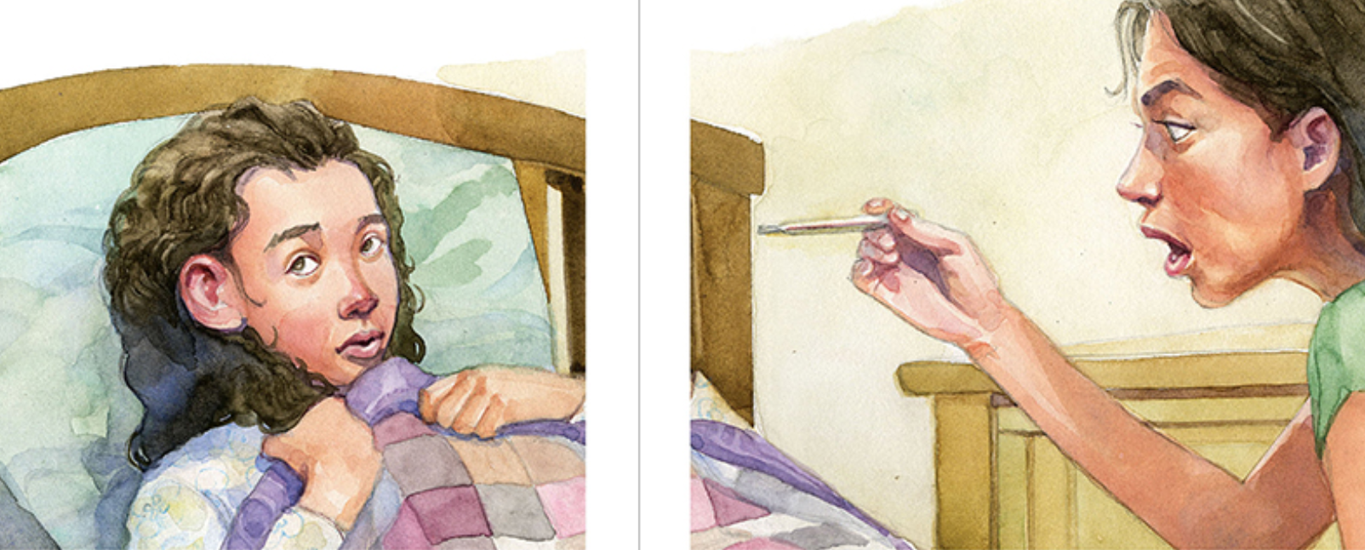
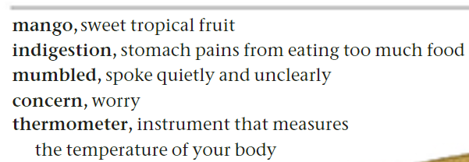
p.132

Slide 13
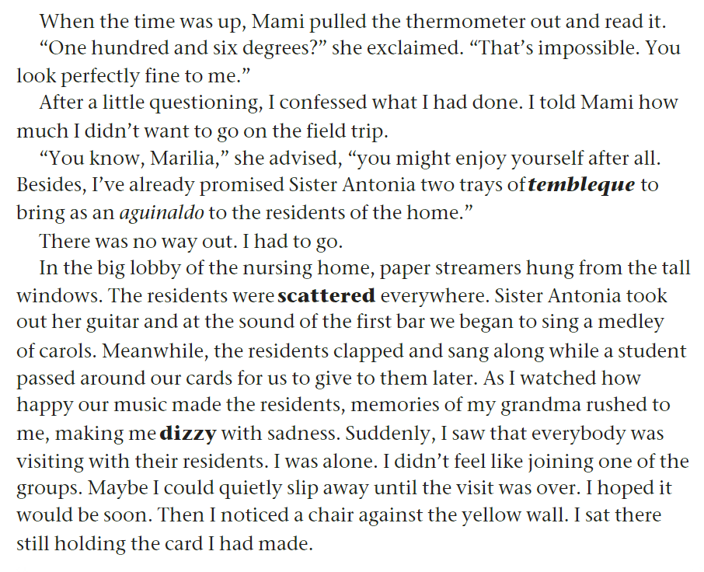
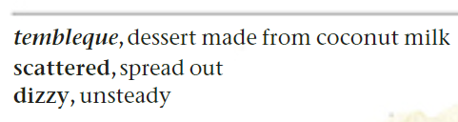
p.133

Slide 14
Questions on pages 132+133
What aguinaldos does Marilia’s class plan to distribute to the residents of the nursing home?
What happens to Marilia third plan to get out of going?
3. How does Marilia feel when she goes to the nursing home? Why?
4. How would you feel about being at the nursing home if you were Marilia? Explain.
analyzing cultural context
5. What can you tell about family relationships in Puerto Rico from this story?
6. What cultural tradition is the plot of this story based upon?
7. What does the tradition of visiting nursing home residents tell you about Marilia’s cultural background?

Slide 15
Answers
1. Marilia’s class plans to take a tray of besitos de coco (coconut cookies).
2. Marilia’s third plan also fails. Marilia doesn’t get indigestion after eating too much, and she eventually discusses her fears with her mother.
3. Marilia is sad when she goes to the nursing home because it reminds her of her grandma.
4. If I were Marilia, I would …
5. Extended families have close relationships. Marilia was very close to her grandmother.
6. The story is based on bringing aguinaldos to nursing home residents in December.
7. Puerto Rican people care for the elderly and have great respect for them.

Slide 16
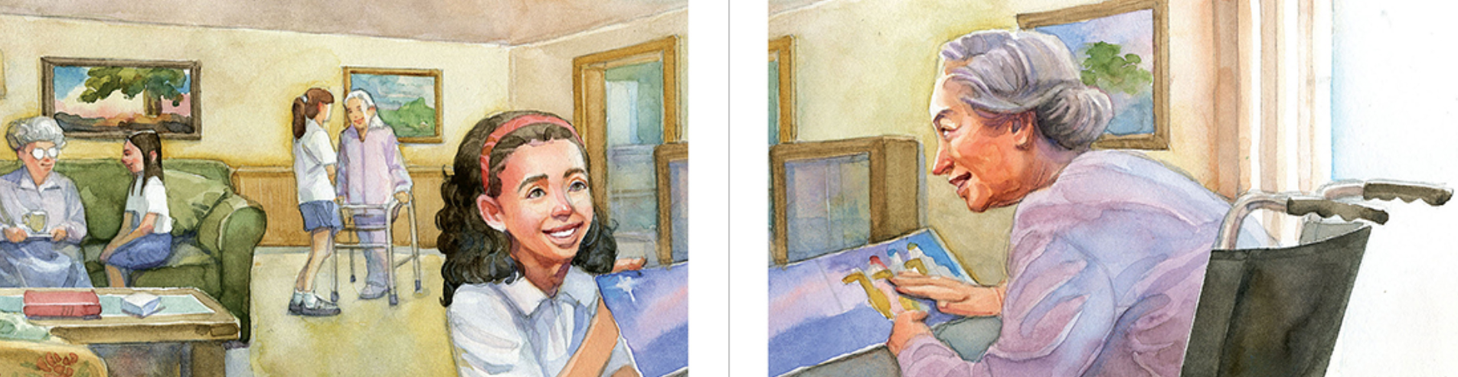
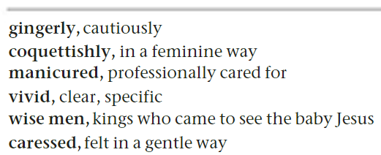
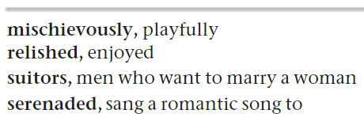
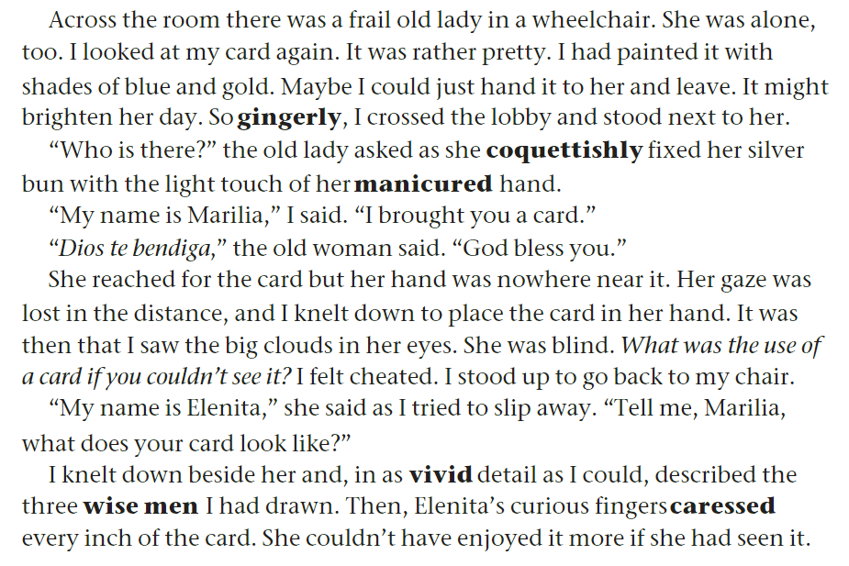
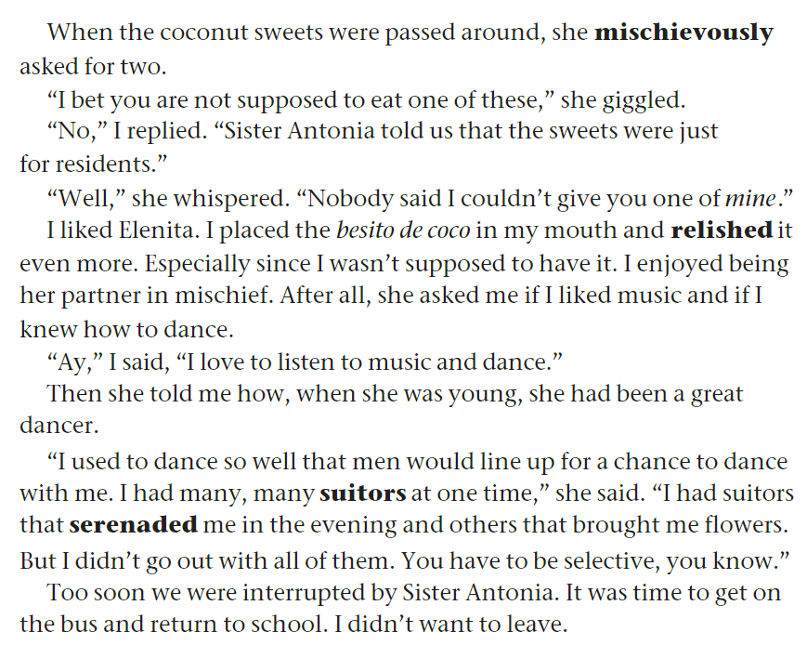
pp. 134+135

Slide 17
Across the Curriculum: Science
Like Elenita, many people around the world suffer from blindness (the inability to see). The leading causes of serious blindness include cataract, glaucoma, age-related degeneration, and eye conditions that occur in children, for example through a vitamin A deficiency. Age-related blindness is increasing throughout the world, as is blindness brought about by uncontrolled diabetes.
More than 82% of all people who are blind are aged 50 years or older, although they represent only 19% of the world’s total population. Blindness and other less serious forms of visual impairment can strike anyone, but over 90% of the visually-impaired live in developing countries.75% of all blindness can be prevented or treated.

Slide 18
Questions on pages 134+135
Why does Elenita ask Marilia to describe the card?
How does Marilia feel at the end of the trip?
How do you know that Marilia changed her mind about the field trip?
4. What is the irony of Marilia’s trip to the nursing home?
5. How would you feel about Elenita if you were Marilia? Explain.
6. Marilia and Elenita are very different in age. Do you think it’s possible for young and old people who are not relatives to have something in common? Explain your point of view.
7. What do the following pronouns refer to?
her (line 3 p.134) she (line9 p.134) it (last line p.134) it (line 7 p.135) them (line 17 p.135)

Slide 19
Answers
1. Elenita asks Marilia to describe the card because she is blind and can’t see it. Also, she wants Marilia to talk to her.
2. Marilia is sad to leave the nursing home. She wants to stay with her new friend, Elenita.
3. Marilia began having fun with Elenita and enjoyed visiting her.
4. The irony of Marilia’s trip to the nursing home is that instead of hating the visit, she actually enjoyed it.
5. I would …
6. In my point of view,
7. a frail old lady – the old woman – the card – besito de coco – suitors

Slide 20
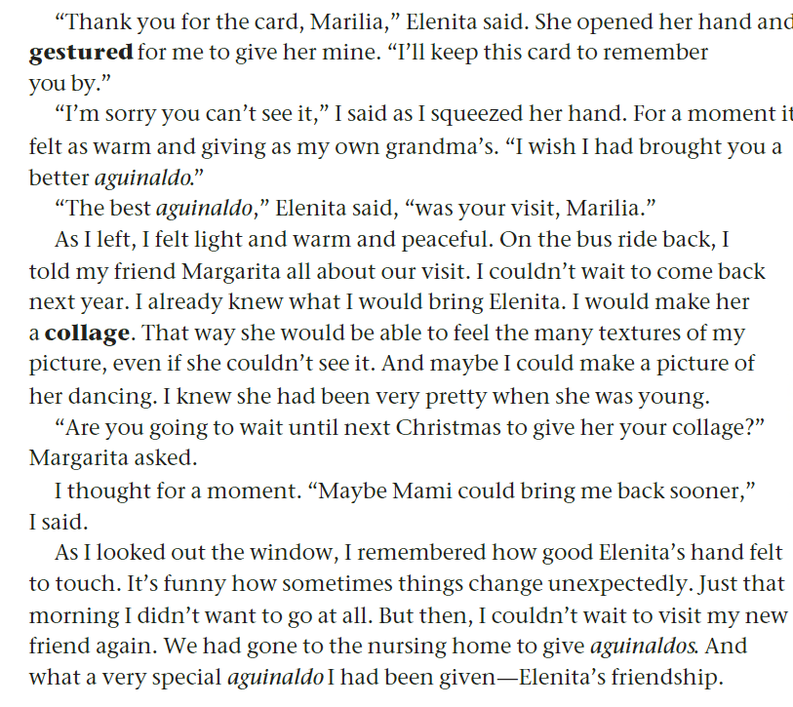
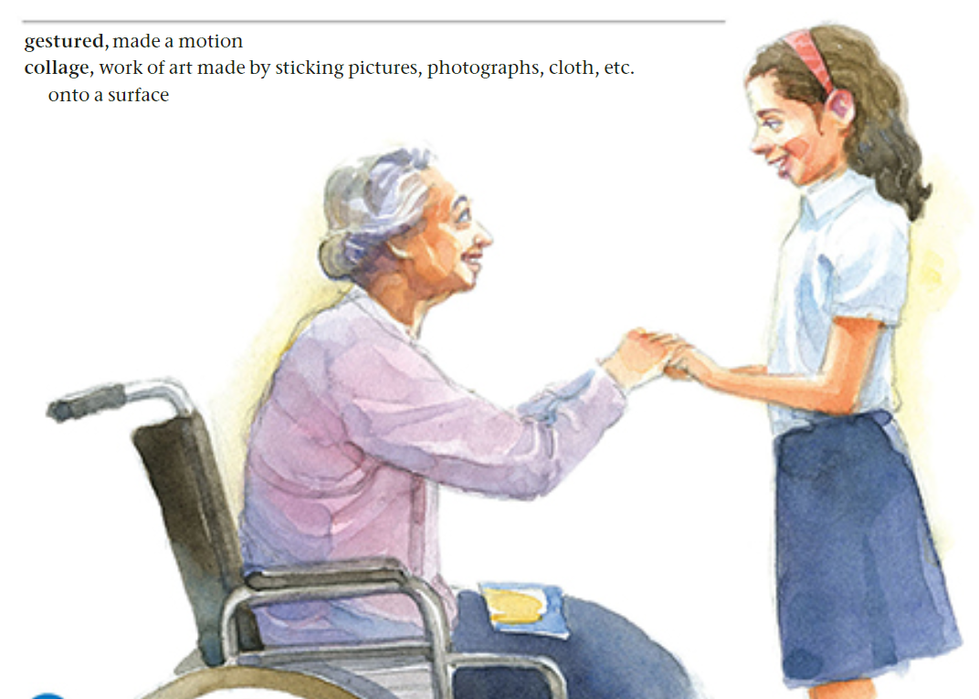
pp. 136

Slide 21
Questions on page 136
Look back at the story. Identify one instance of foreshadowing.
The idea of giving an Aguinaldo is very important to understanding this story. At first, the Aguinaldo is a besito de coco. However, at the end of this story, the Aguinaldo is something else. What do you think it is?
Why does Marilia have positive feelings when she leaves the nursing home?
4. What reason does Marilia give for what she’s going to bring next year?
5. Why do you think Marilia chose this experience to put in Carmen Teresa’s notebook? What did she want to share with her family about the nursing home residents?
6. How do you think Marilia’s experience at the nursing home might affect her the next time she is very reluctant to do something?
7. How are relationships with others important? In what ways did Marilia help herself by reaching out to Elenita? Has someone ever reached out to you when you needed a friend? Explain.

Slide 22
Answers
1. At the beginning of the story we learn that the nursing home residents will receive surprise Christmas gifts. This is a clue, or foreshadowing, that in addition to the aguinaldos, there may be other surprise gifts, including the new friendship between Marilia and Elenita.
2. The Aguinaldo is the gift of friendship between Marilia and Elenita.
3. Marilia made a new friend and overcame her grief over her grandma.
4. Marilia says she will bring a collage because although Elenita is blind, she can feel the textures.
5. Marilia wanted to share this experience because the students’ visit cheered up the residents, and in Marilia’s case, helped develop a new friendship.
6. I think when someone is afraid to do something but tries it anyway, it gets easier the second time, so Marilia will overcome her reluctance next time.
7. (write your own answer.)

Slide 23
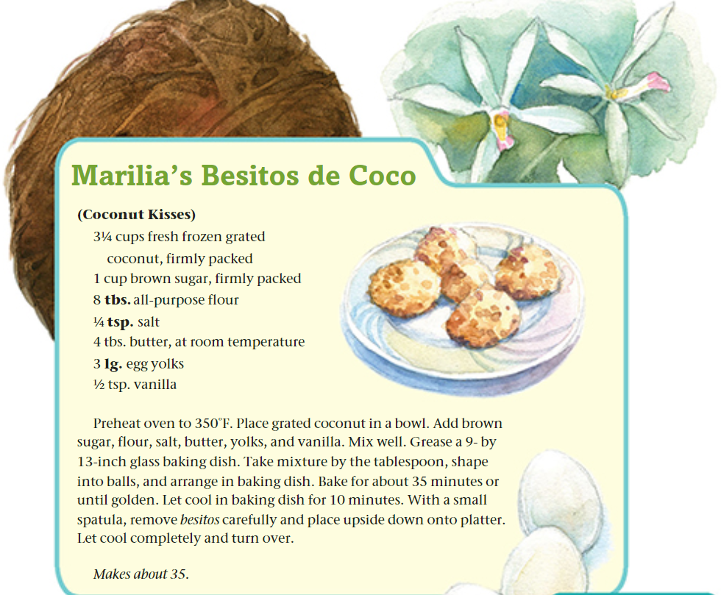
pp. 137
Describe a special recipe that you like to share with friends.

Slide 24
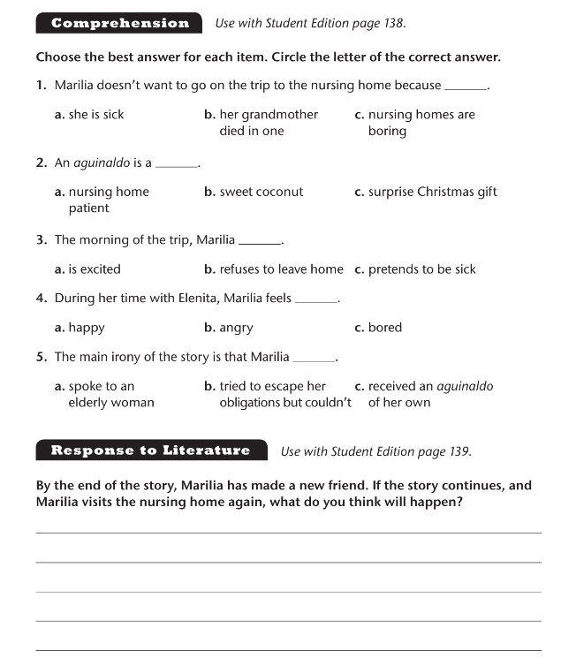
Workbook p.69

Slide 25
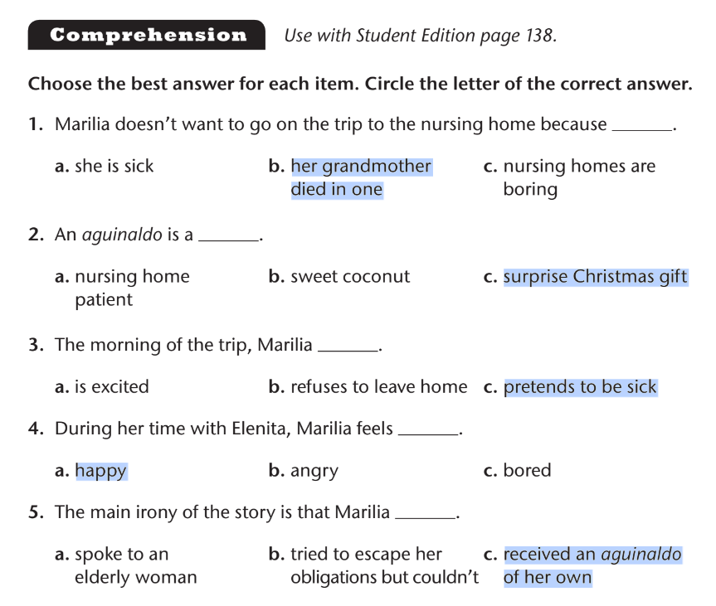
Workbook p.69

