Slide 1
Phonics

Slide 2
Outcomes
01
02
03
Identiy letter h
Write uppercase and lowercase of letter h
Appreciate the act of being respectful

Slide 3
Warm up
https://www.youtube.com/watch?v=yCPi-_vOKCA

Slide 4


Pre-assessment
1:00 min
IRS
Which picture start with letter c?
1
2

Slide 5
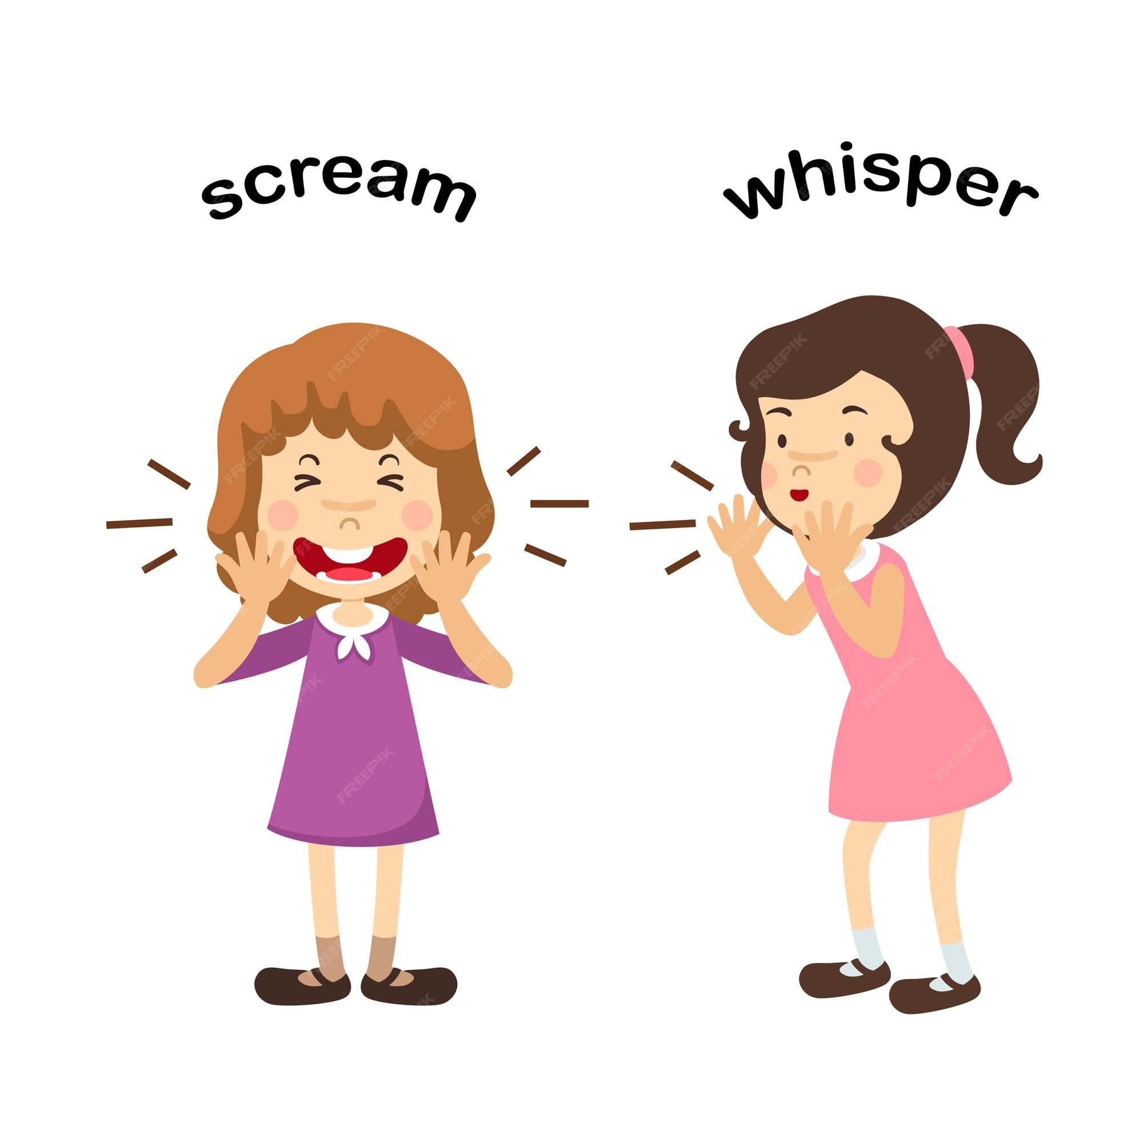
Hh

Slide 6
Let’s sing together
https://www.youtube.com/watch?v=NtUSMBzacQ0

Slide 7

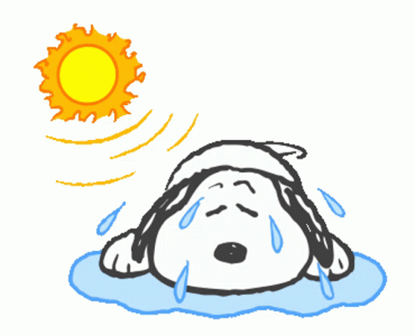

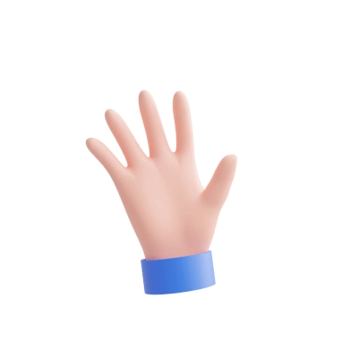
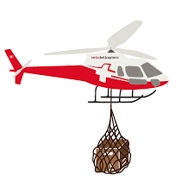
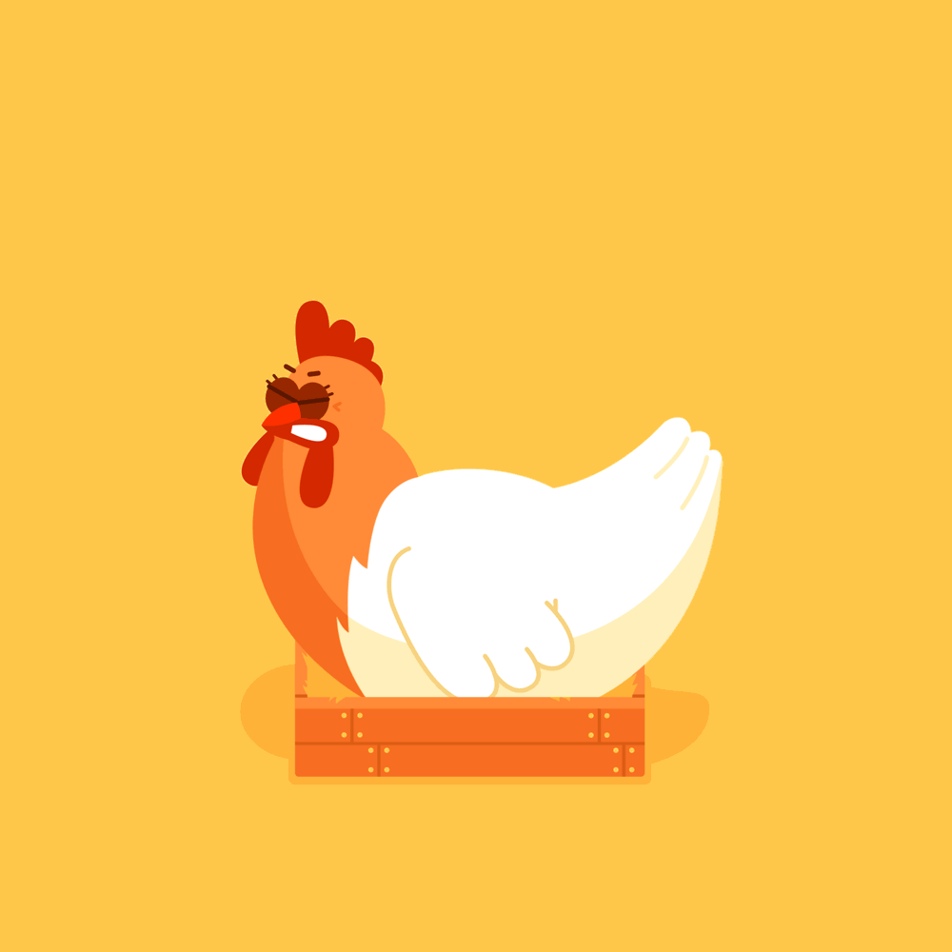
hot
hop
hippo
hen
hand
helicopter

Slide 8
How to write the letter?
https://www.youtube.com/watch?v=c7YZo4aSAnU

Slide 9
Group work
2:00
Match each word with its correct picture.

Slide 10
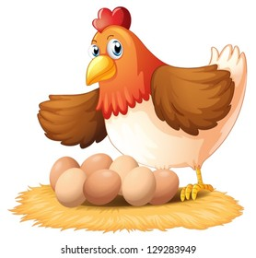
2: 00 min
IRS
Critical thinking question
I am a bird, but I can’t fly very high.
I give you something that you can fry.
What am I?
Hen

Slide 11
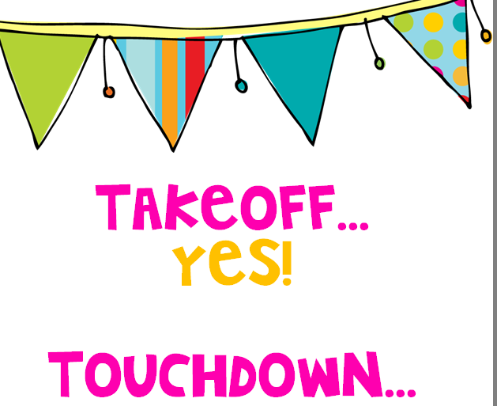
Take off- Touch down
Take off if the given word has letter h
Touch down if the given word doesn't have letter h.

Slide 12

2:00
Random pick
Real life application
Look around you and find 2 things with h?

Slide 13
Differentiation n3.
Write two words with letter h : 1. -------------------------------. 2. -------------------------------.

Slide 14
Differentiation n2.
Unscramble the letters to make a proper word: h t a h t o n e h --------------- ---------------- ---------------

Slide 15
Differentiation n4.
Match the word with the picture: hand hen

Slide 16
Differentiation n1.
Circle the words with letter c :
hat | mop | hop | car

Slide 17
https://wordwall.net/resource/12546916/letter-h

Slide 18
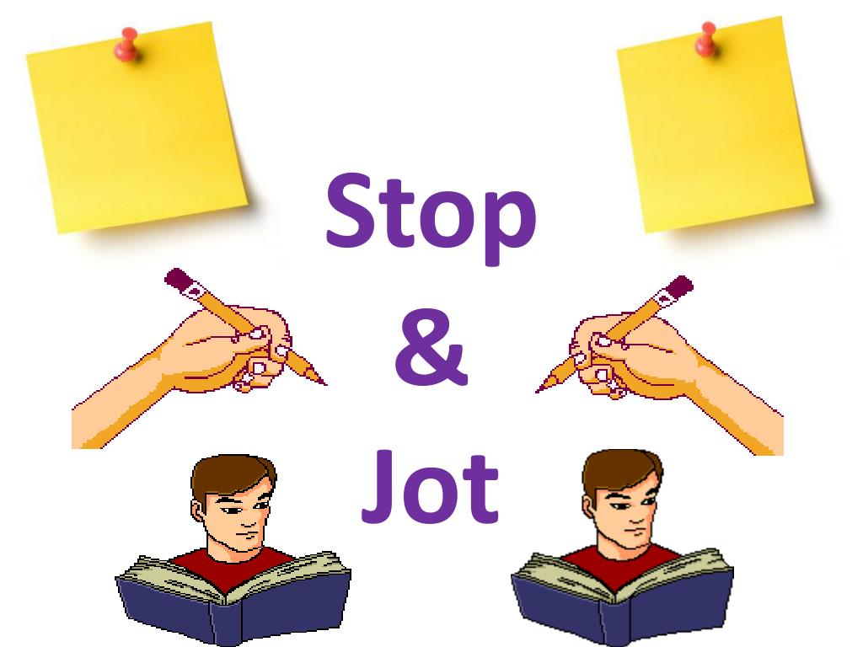
Jot Thoughts/Random Pick
Write words with letter h

Slide 19
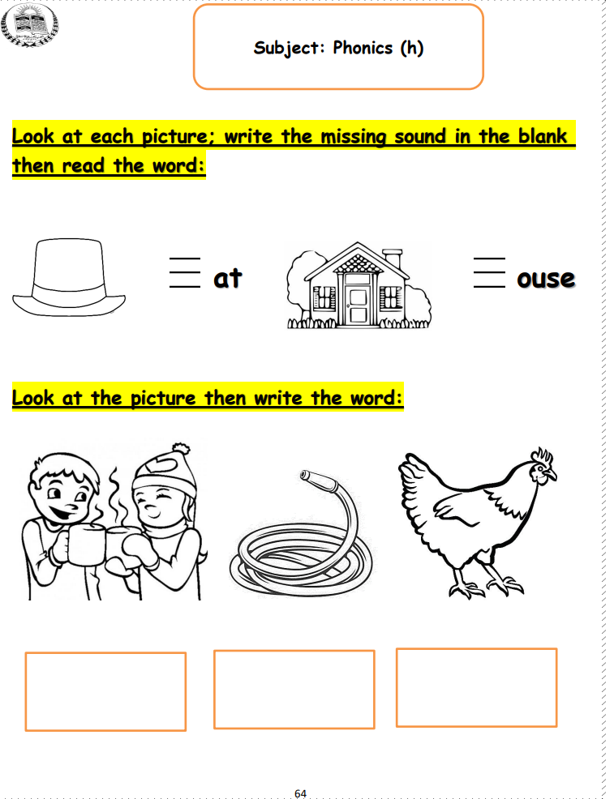

Slide 20
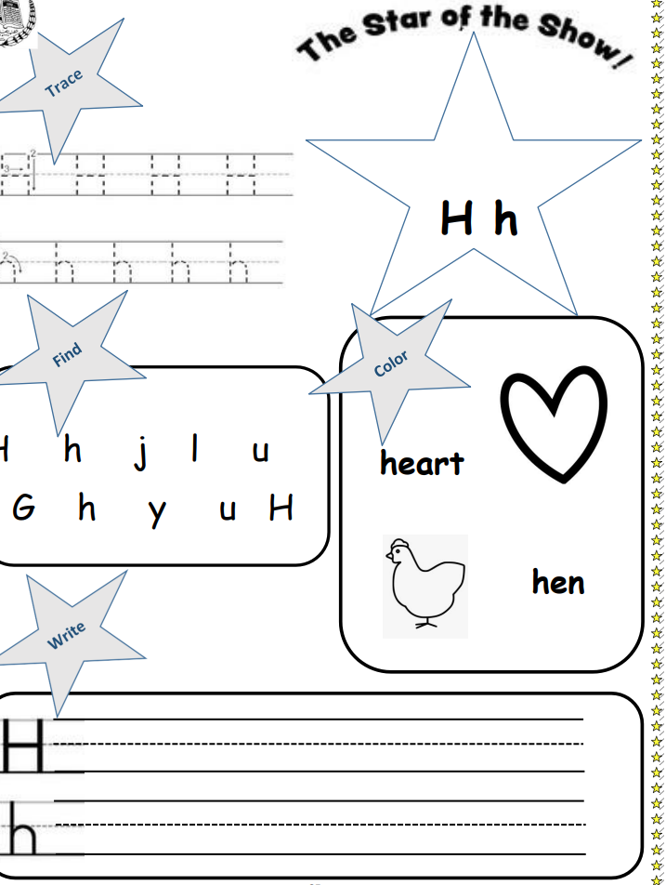

Slide 21

2:00
IRS
Summative Assessment
Which of the fowling has letter h?
1
2

