Slide 1
Phonics

Slide 2
Outcomes
01
02
03
Identiy letter c
Write uppercase and lowercase of letter c
Appreciate the act of helping others

Slide 3
Value
https://www.youtube.com/watch?v=UIhsxeYHXeU

Slide 4
Pre-assessment
1:00 min
IRS
Which word has the short vowel o?
1
2
pot
bat

Slide 5
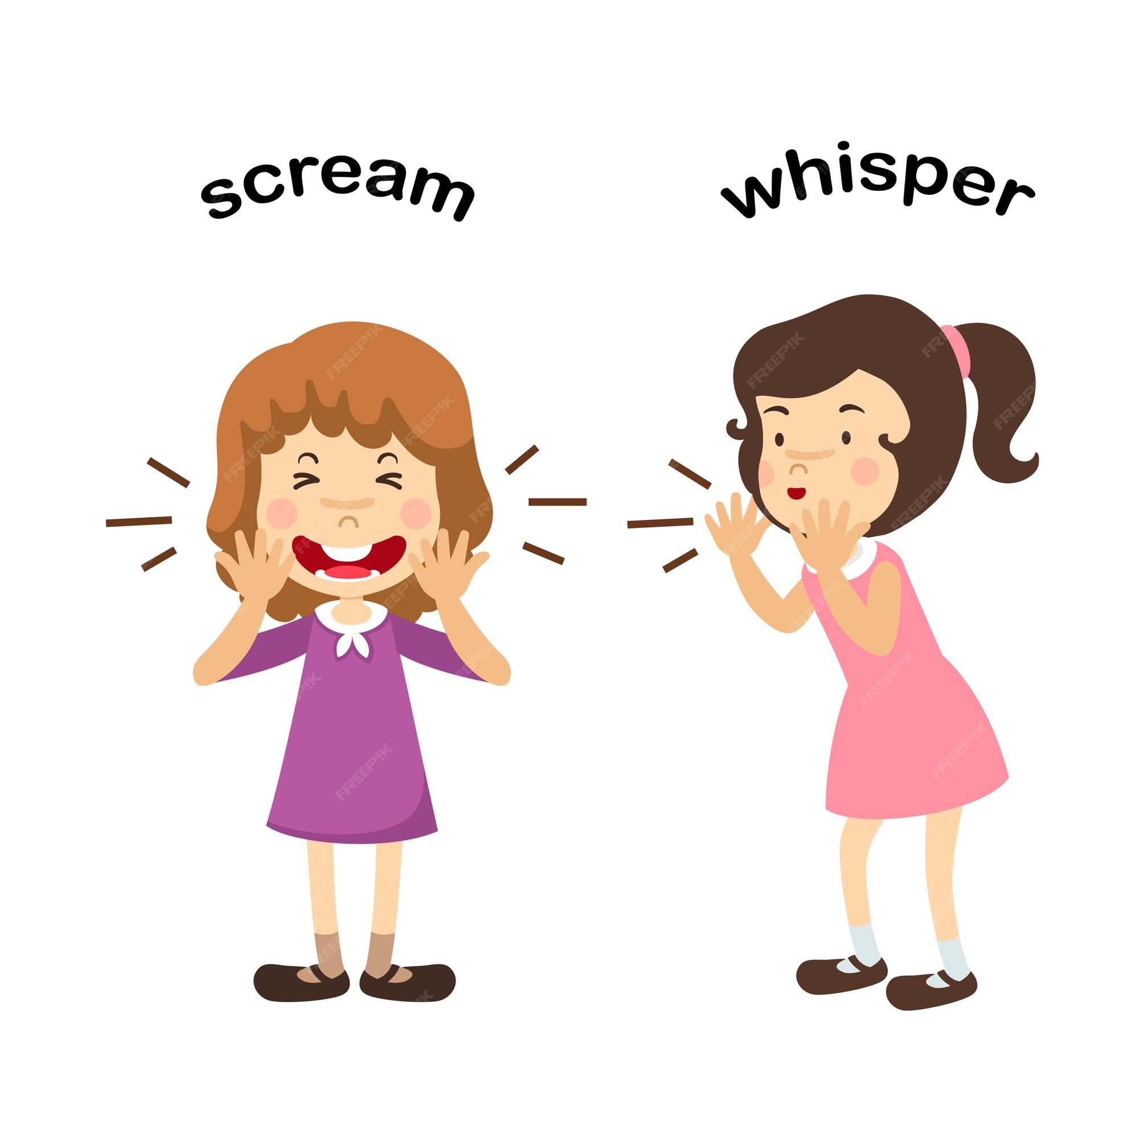
Cc

Slide 6
Let’s sing together
https://www.youtube.com/watch?v=1dhzPuT6jm0

Slide 7
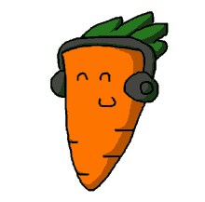

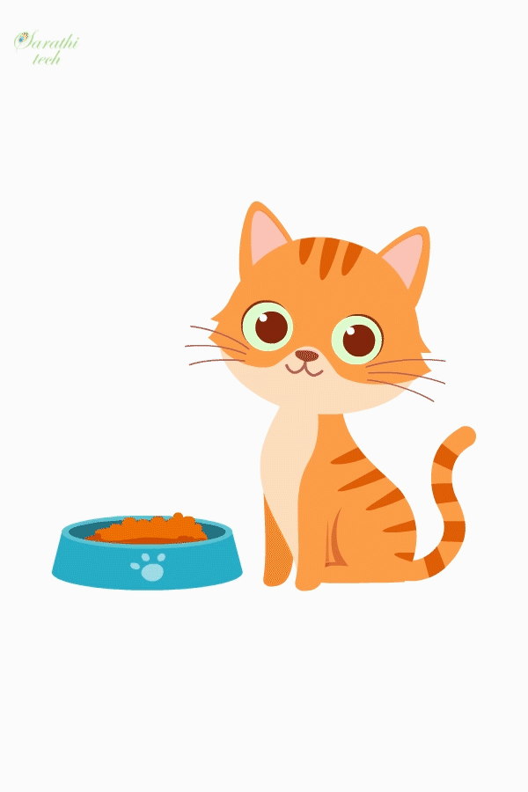

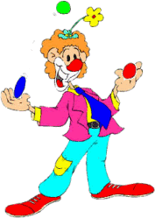

cat
carrot
car
cup
clown
cap

Slide 8
Can you think of more words with the letter c?

Slide 9
How to write the letter?
https://www.youtube.com/watch?v=xpM6EcggWcM

Slide 10
2:00
Rally Robin
Round Table
Match each word with its correct picture.

Slide 11

2: 00 min
IRS
Critical thinking question
I change my shape from day to night. I float in the sky.
What am I?
cloud

Slide 12

2:00
Random pick
Real life/Rally Coach
Look around you and write as much word as you can with letter c.

Slide 13
Differentiation n3.
Write two words with letter c : 1. -------------------------------. 2. -------------------------------.

Slide 14
Differentiation n2.
Unscramble the letters to make a proper word: c t a c p a c p u --------------- ---------------- ---------------

Slide 15


Differentiation n4.
Match the word with the picture: cap cup

Slide 16
Differentiation n1.
Circle the words with letter c :
cup | mop | cat | car

Slide 17
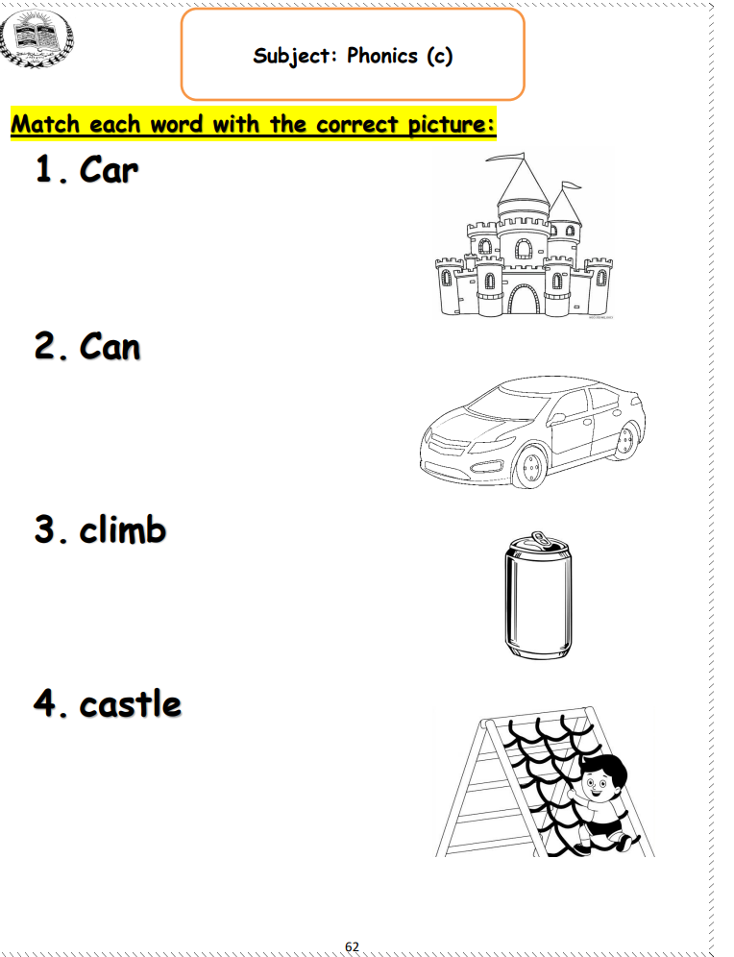

Slide 18
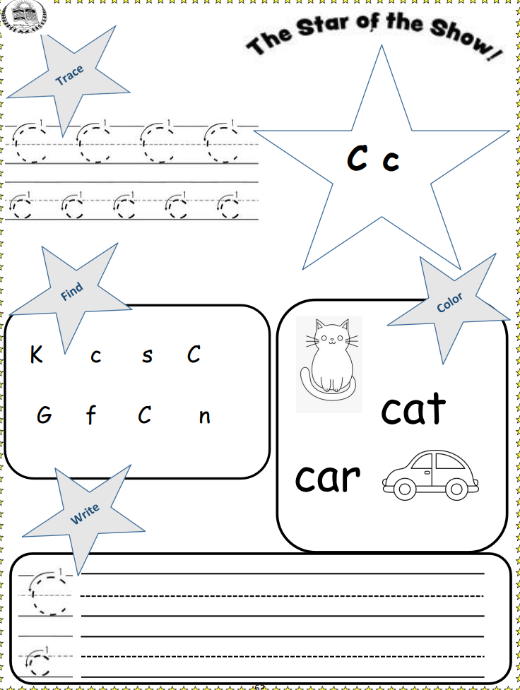

Slide 19
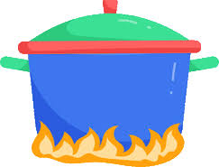
2:00
IRS
Summative Assessment
Which of the fowling has letter c?
1
2

