Slide 1
Plural pronouns

Slide 2
Warm up
2:00 mins
https://www.youtube.com/watch?v=qndNmowSDQg

Slide 3
Outcomes:
01
02
03
1:00 mins
Value: appreciate the act of not being selfish.
Use Plural pronouns in sentences.
Identify Plural pronouns and the be verb used with them.

Slide 4
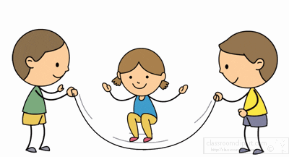
Pre-assessment
1:00 min
IRS
To talk about the kids in the picture, we say…………………………….
1. They are playing.
2. We are playing.

Slide 5
Plural pronouns
We use them to talk about more than one person.

Slide 6
Let’s listen to a song
https://www.youtube.com/watch?v=IXjfcEmqAHc

Slide 7

I use We when I talk about myself and others.:
We

Slide 8

We are + noun.
We are students.
Now, it is your turn to give an example.

Slide 9
We are + adjective.
We are nice.
Now, it is your turn to give an example.

Slide 10


Real life application/ Critical thinking
Use the plural pronoun (we) to describe yourselves in the classroom

Slide 11

I use they when I talk about others.
They

Slide 12
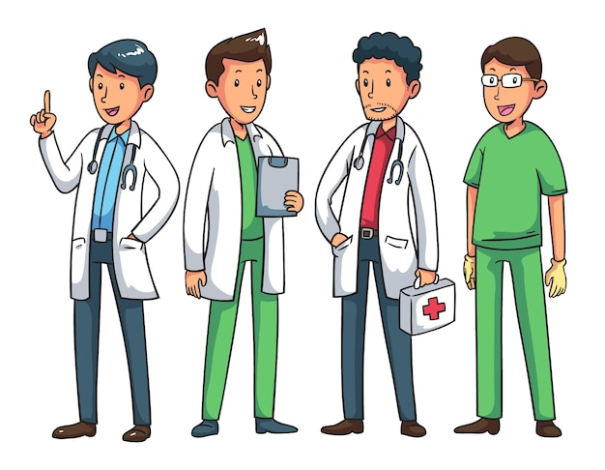
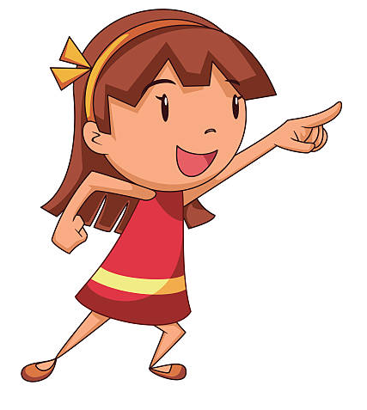
They are + noun.
They are doctors.
Now, it is your turn to give an example.

Slide 13
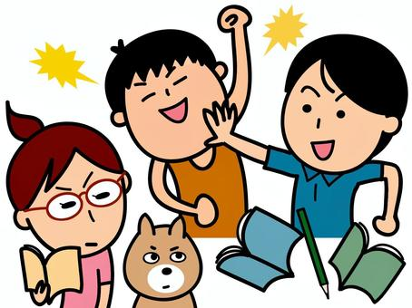
They are + adjective.
They are noisy.
Now, it is your turn to give an example.

Slide 14
Group work
3:00 min
Unscramble the words to form sentences.

Slide 15
Feedback
2:00 mins
Random pick
We are good.
They are my friends.

Slide 16
Negative
We
They
are
not

Slide 17

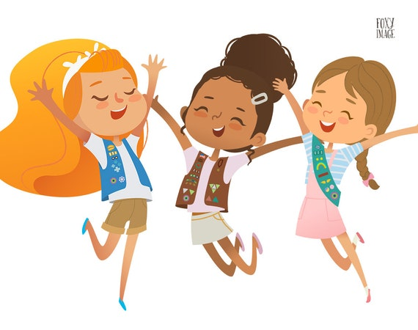
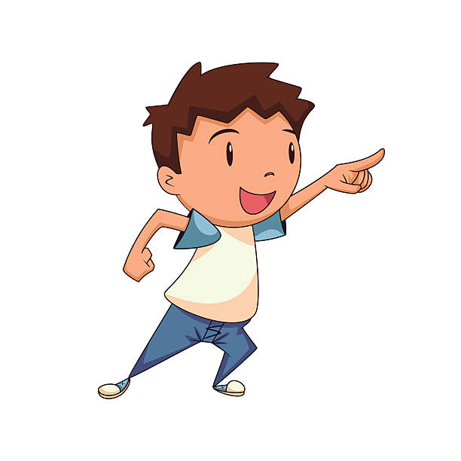
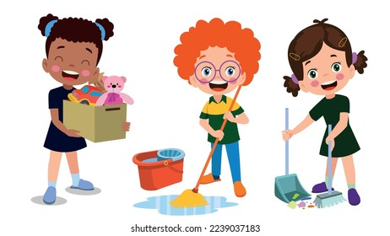
Examples
We are not sad.
They are not lazy.

Slide 18

Describe the picture you got to your friend using
they+ negative form
Share with your classmate

Slide 19
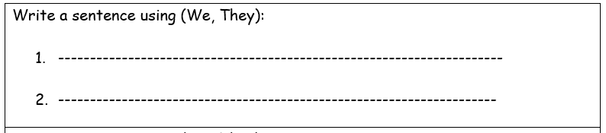
Differentiation no. 3

Slide 20
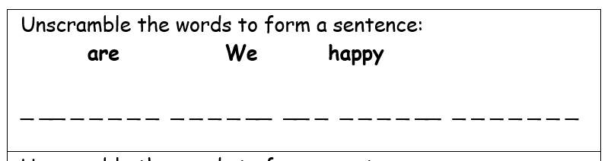
Differentiation no. 2

Slide 21
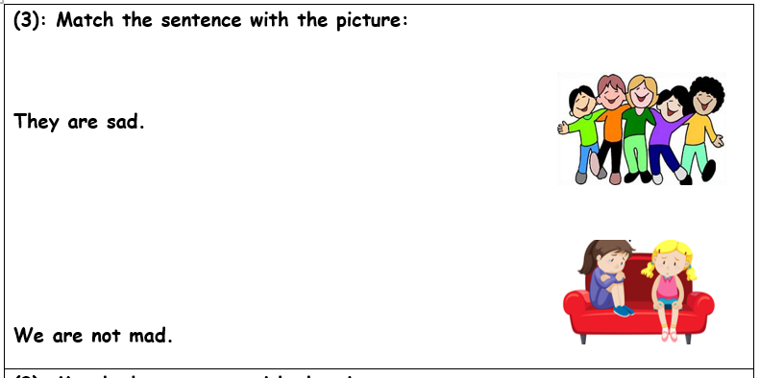
Differentiation no. 4

Slide 22
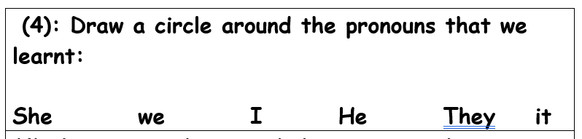
Differentiation no. 1

Slide 23
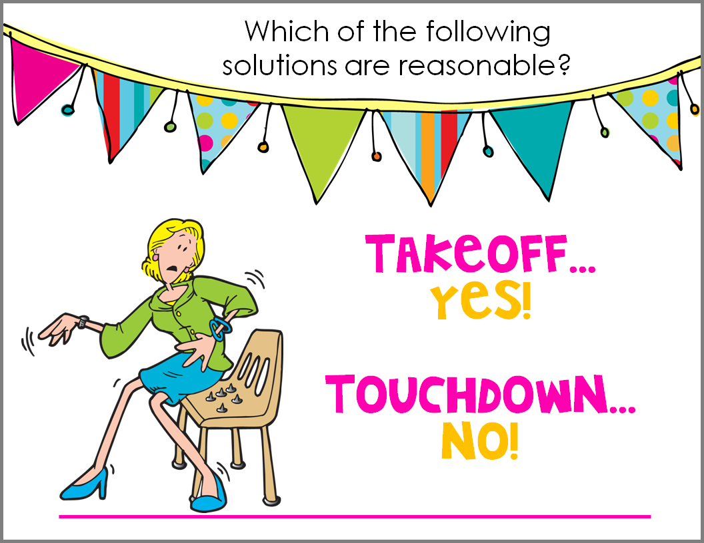
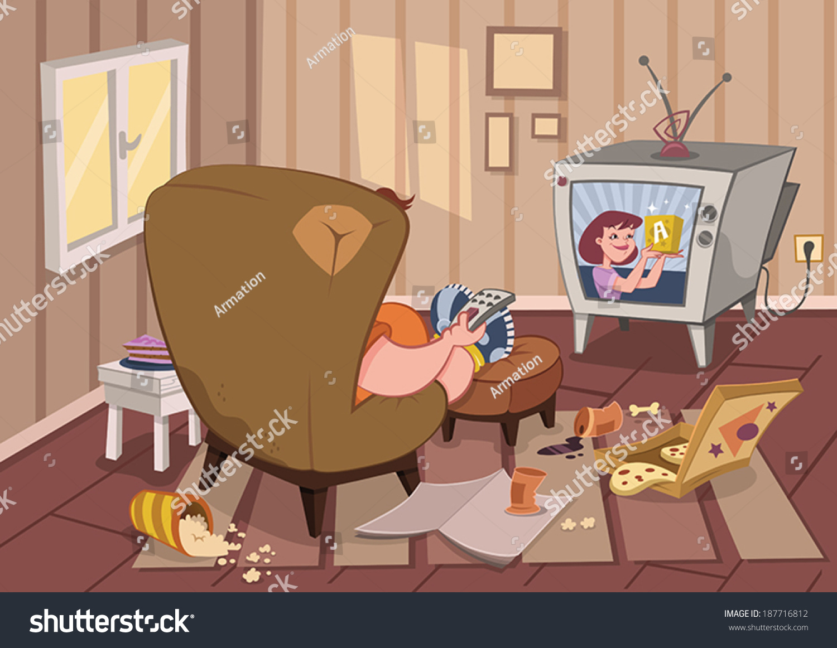
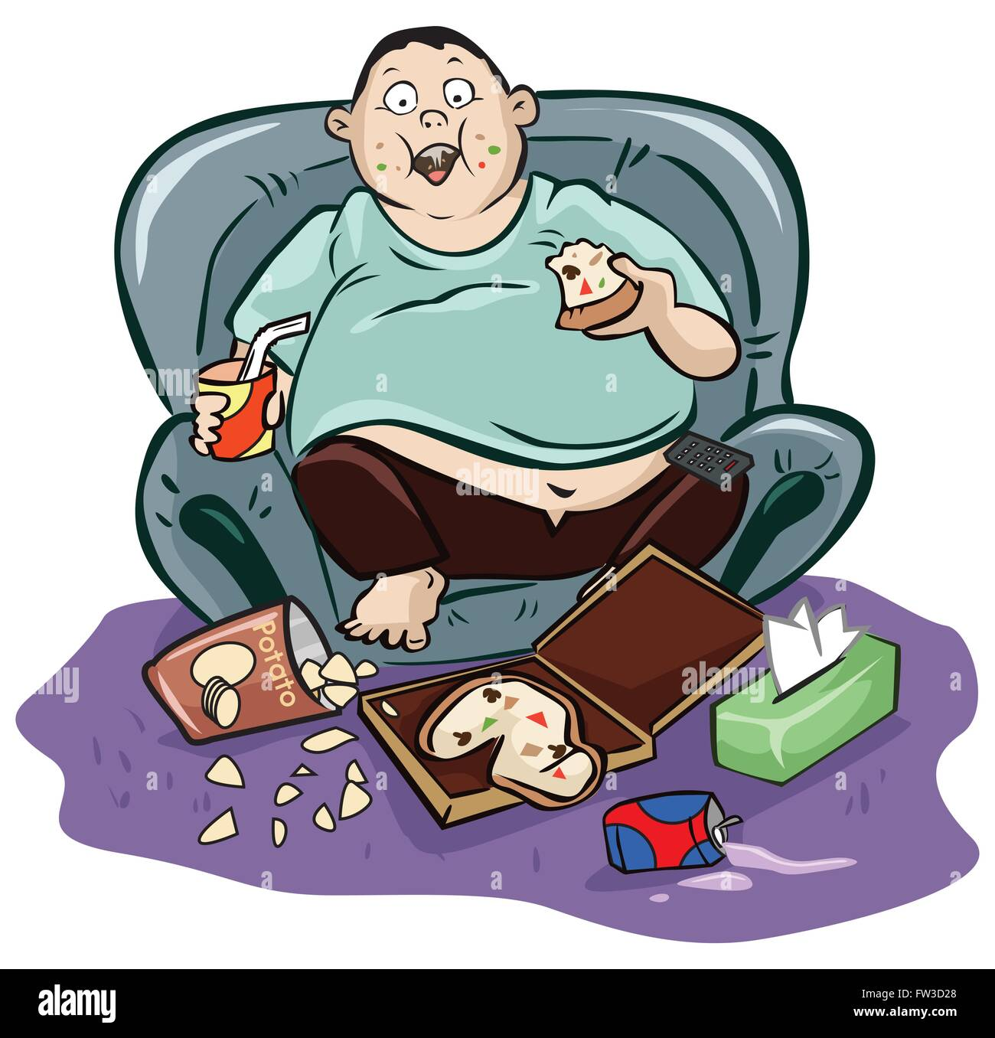
Take-off if the sentences you hear apply to the people in the picture. Touch down if not
They are dirty.
They are not slim
They are sad.
They are clean.

Slide 24
Let’s play a game.
https://wordwall.net/resource/11754580/pronouns

Slide 25
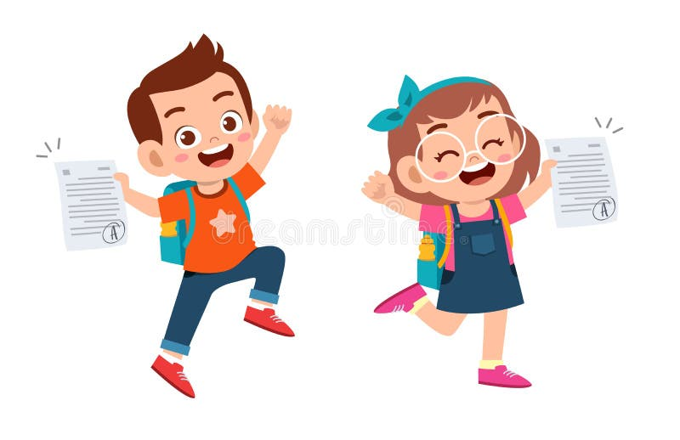
We…………….. Good students.
Summative assessment
1. are
2. is

Slide 26
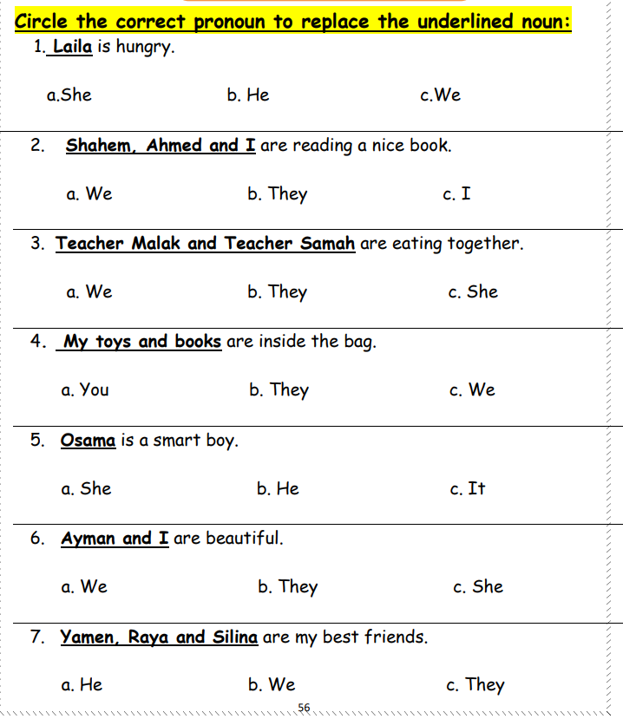

Slide 27
Contractions

Slide 28
Outcomes:
01
02
03
1:00 mins
Identify the contractions of the plural pronouns and be verbs.
write the contractions correctly.
Value: appreciate the act of not stealing.

Slide 29
Warm up
3:00 mins
https://www.youtube.com/watch?v=Dkt0xe_n0h0

Slide 30
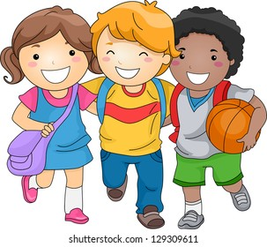
Pre-assessment
………………………….. are friends.
1. we
2. I

Slide 31
Let’s listen to a song
https://www.youtube.com/watch?v=wWvSw9iW3m8

Slide 32
Remember:
I use we when I talk about I and others.
I use they when I talk about others.

Slide 33
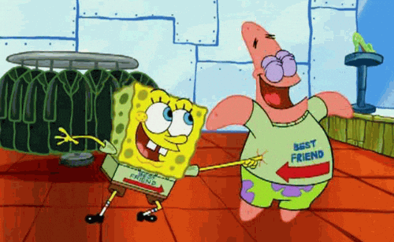
In groups, think of 3 sentences to describe yourselves.
Example:
We are smart.

Slide 34

we are
Let’s write on the mini board with the teacher.
We’re

Slide 35
They are
Let’s write on the mini board with the teacher.
They’re

Slide 36
Critical thinking question/ buzz in
What do you think is the correct contraction for are not ?
are not

Slide 37
are not
Let’s write on the mini board with the teacher.
aren’t

Slide 38

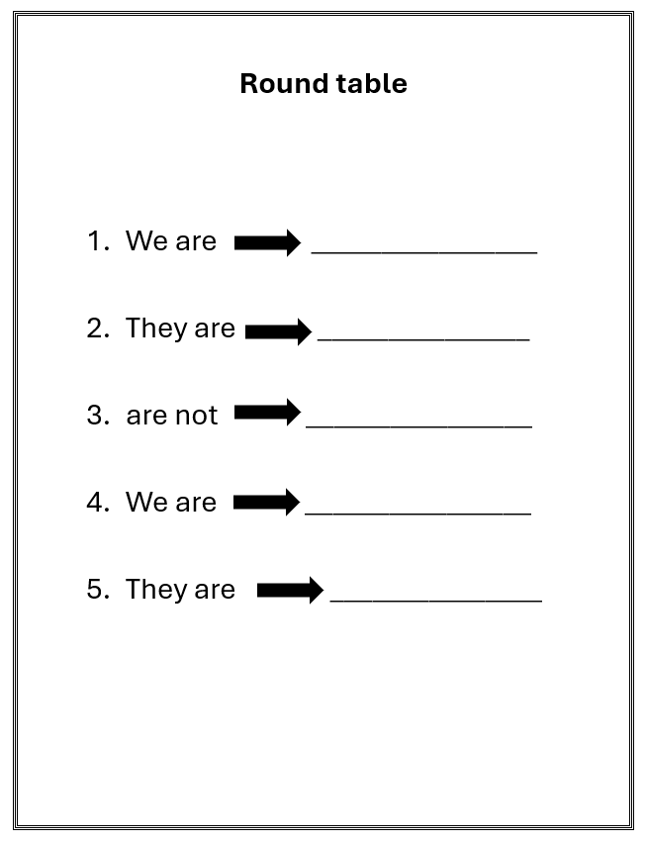
Round table
Do the following contractions.

Slide 39
Real life application
Let’s describe yourselves and your families' using contractions.

Slide 40
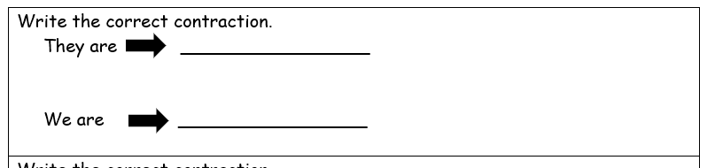
Differentiation no.3

Slide 41
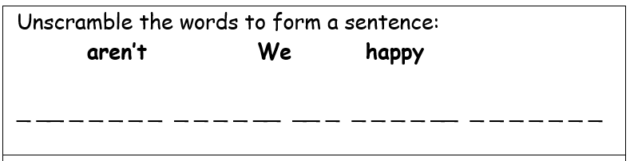
Differentiation no. 2

Slide 42
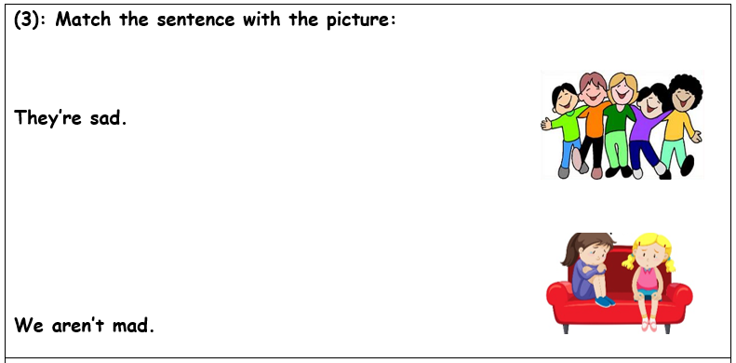
Differentiation no. 4

Slide 43
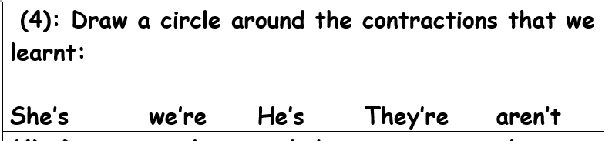
Differentiation no. 1

Slide 44
Let’s play a game
https://create.kahoot.it/details/c52e965f-e0f6-44e8-963b-14d9125d8c31

Slide 45
They are …………..
Summative assessment
1:00 min
IRS
1. theyre
2. they’re

Slide 46
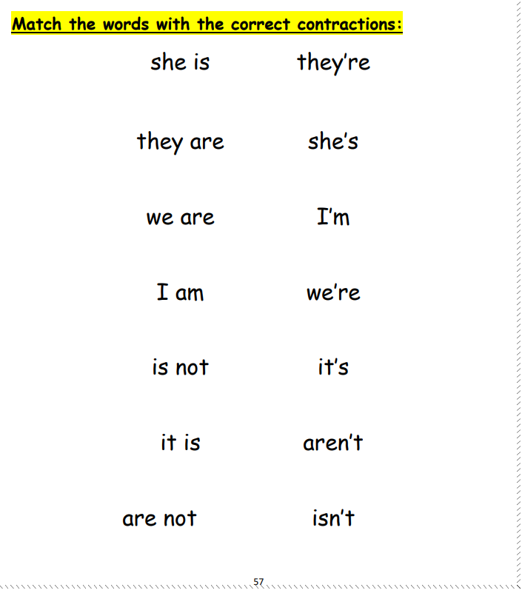

Slide 47
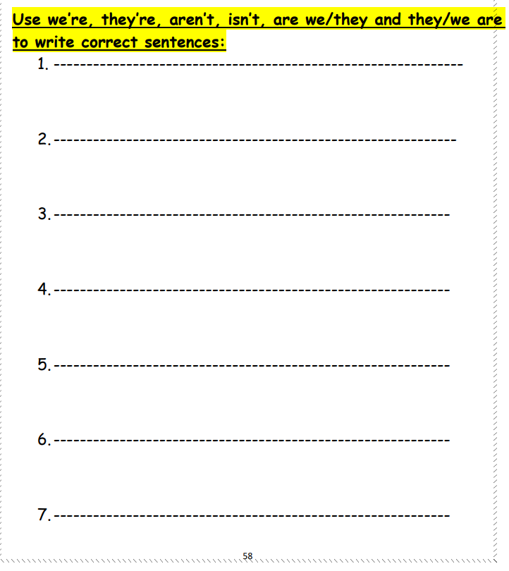

Slide 48
Question Form

Slide 49
Warm up
5:00 mins
https://www.youtube.com/watch?v=FaoevMkMu1M

Slide 50
Outcomes:
01
02
03
1:00 mins
Value: appreciate the act of believing in themselves.
Identify the question form.
Use the question form correctly.

Slide 51
Pre-assessment
1:00 min
IRS
The correct answer to the question is
Are we students?
1. yes, we are
2. No, we aren’t

Slide 52
Let’s listen to a song
2:00 mins
https://www.youtube.com/watch?v=wWvSw9iW3m8

Slide 53
Remember:
I use we when I talk about I and others.
I use they when I talk about others.

Slide 54
We are
We’re
They are
They’re
are not
aren’t

Slide 55
Question form

Slide 56

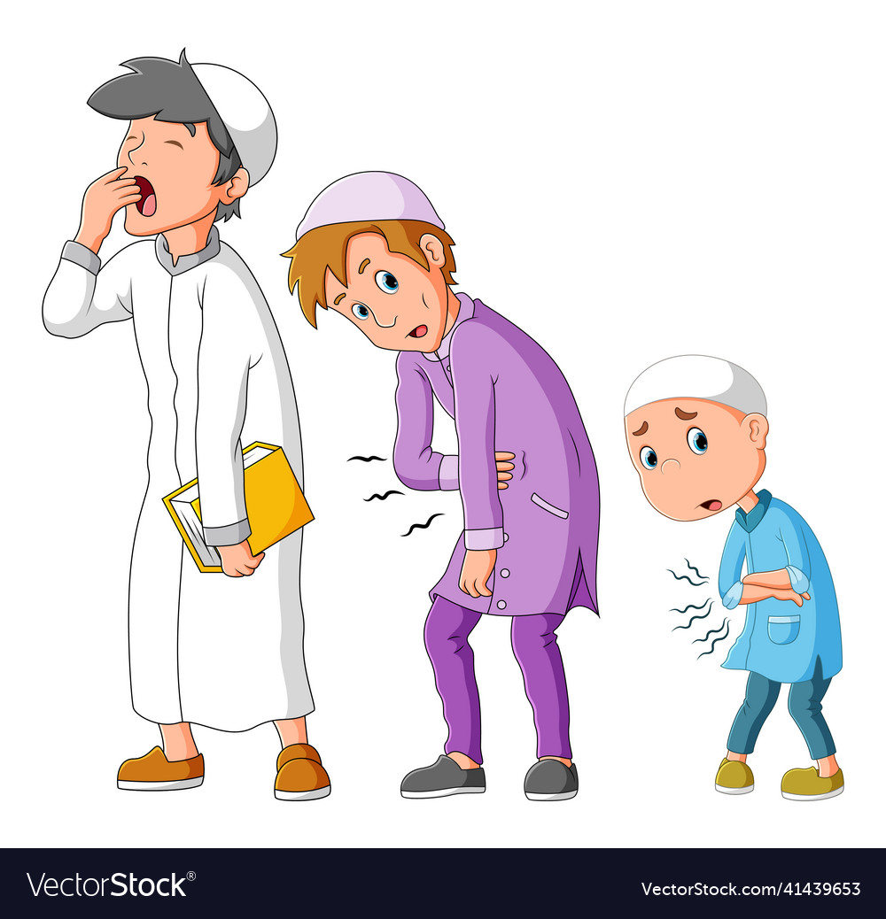
Are they hungry?
Yes, they are
No, they aren’t

Slide 57
Are we trachers?
Yes, we are
No, we aren’t

Slide 58
Group work
3:00 min
Unscramble the words to form sentences.

Slide 59
Feedback
2:00 mins
Random pick
Are we good?
Are they my friends?

Slide 60
Real life application
2:00 mins
Random pick
Ask questions to one of your friends and let them answer.

Slide 61
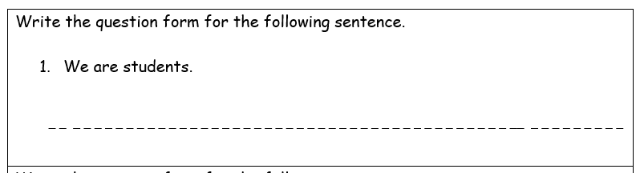
Differentiation no. 3

Slide 62
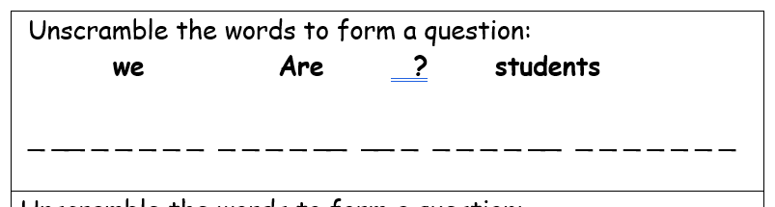
Differentiation no. 2
2:00 mins
Random pick

Slide 63
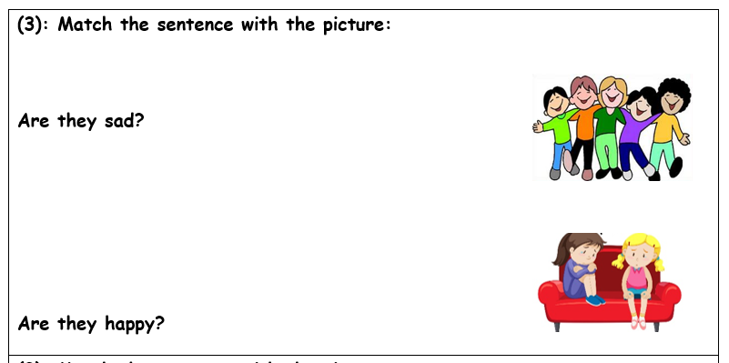
Differentiation no. 4
2:00 mins
Random pick

Slide 64
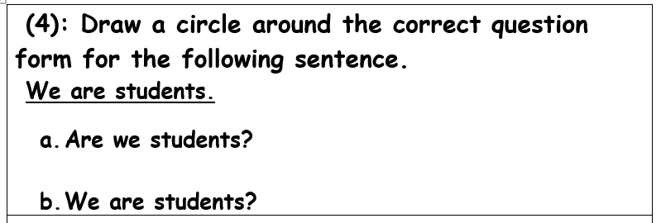
Differentiation no. 1

Slide 65
They are nice …………..
Summative assessment
1:00 min
IRS
1. Are they nice?
1. They are nice?

Slide 66
