Slide 1
Phonics

Slide 2
Outcomes
01
02
03
Identiy short vowel i
Read short “i” CVC words correctly
Appreciate the act of charity

Slide 3
Warm up
https://www.youtube.com/watch?v=RUSCz41aDug

Slide 4
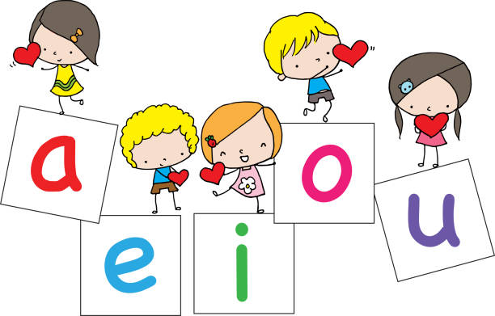
Pre-assessment
IRS
What do we call them?
1.
vowels
2.
consonants

Slide 5
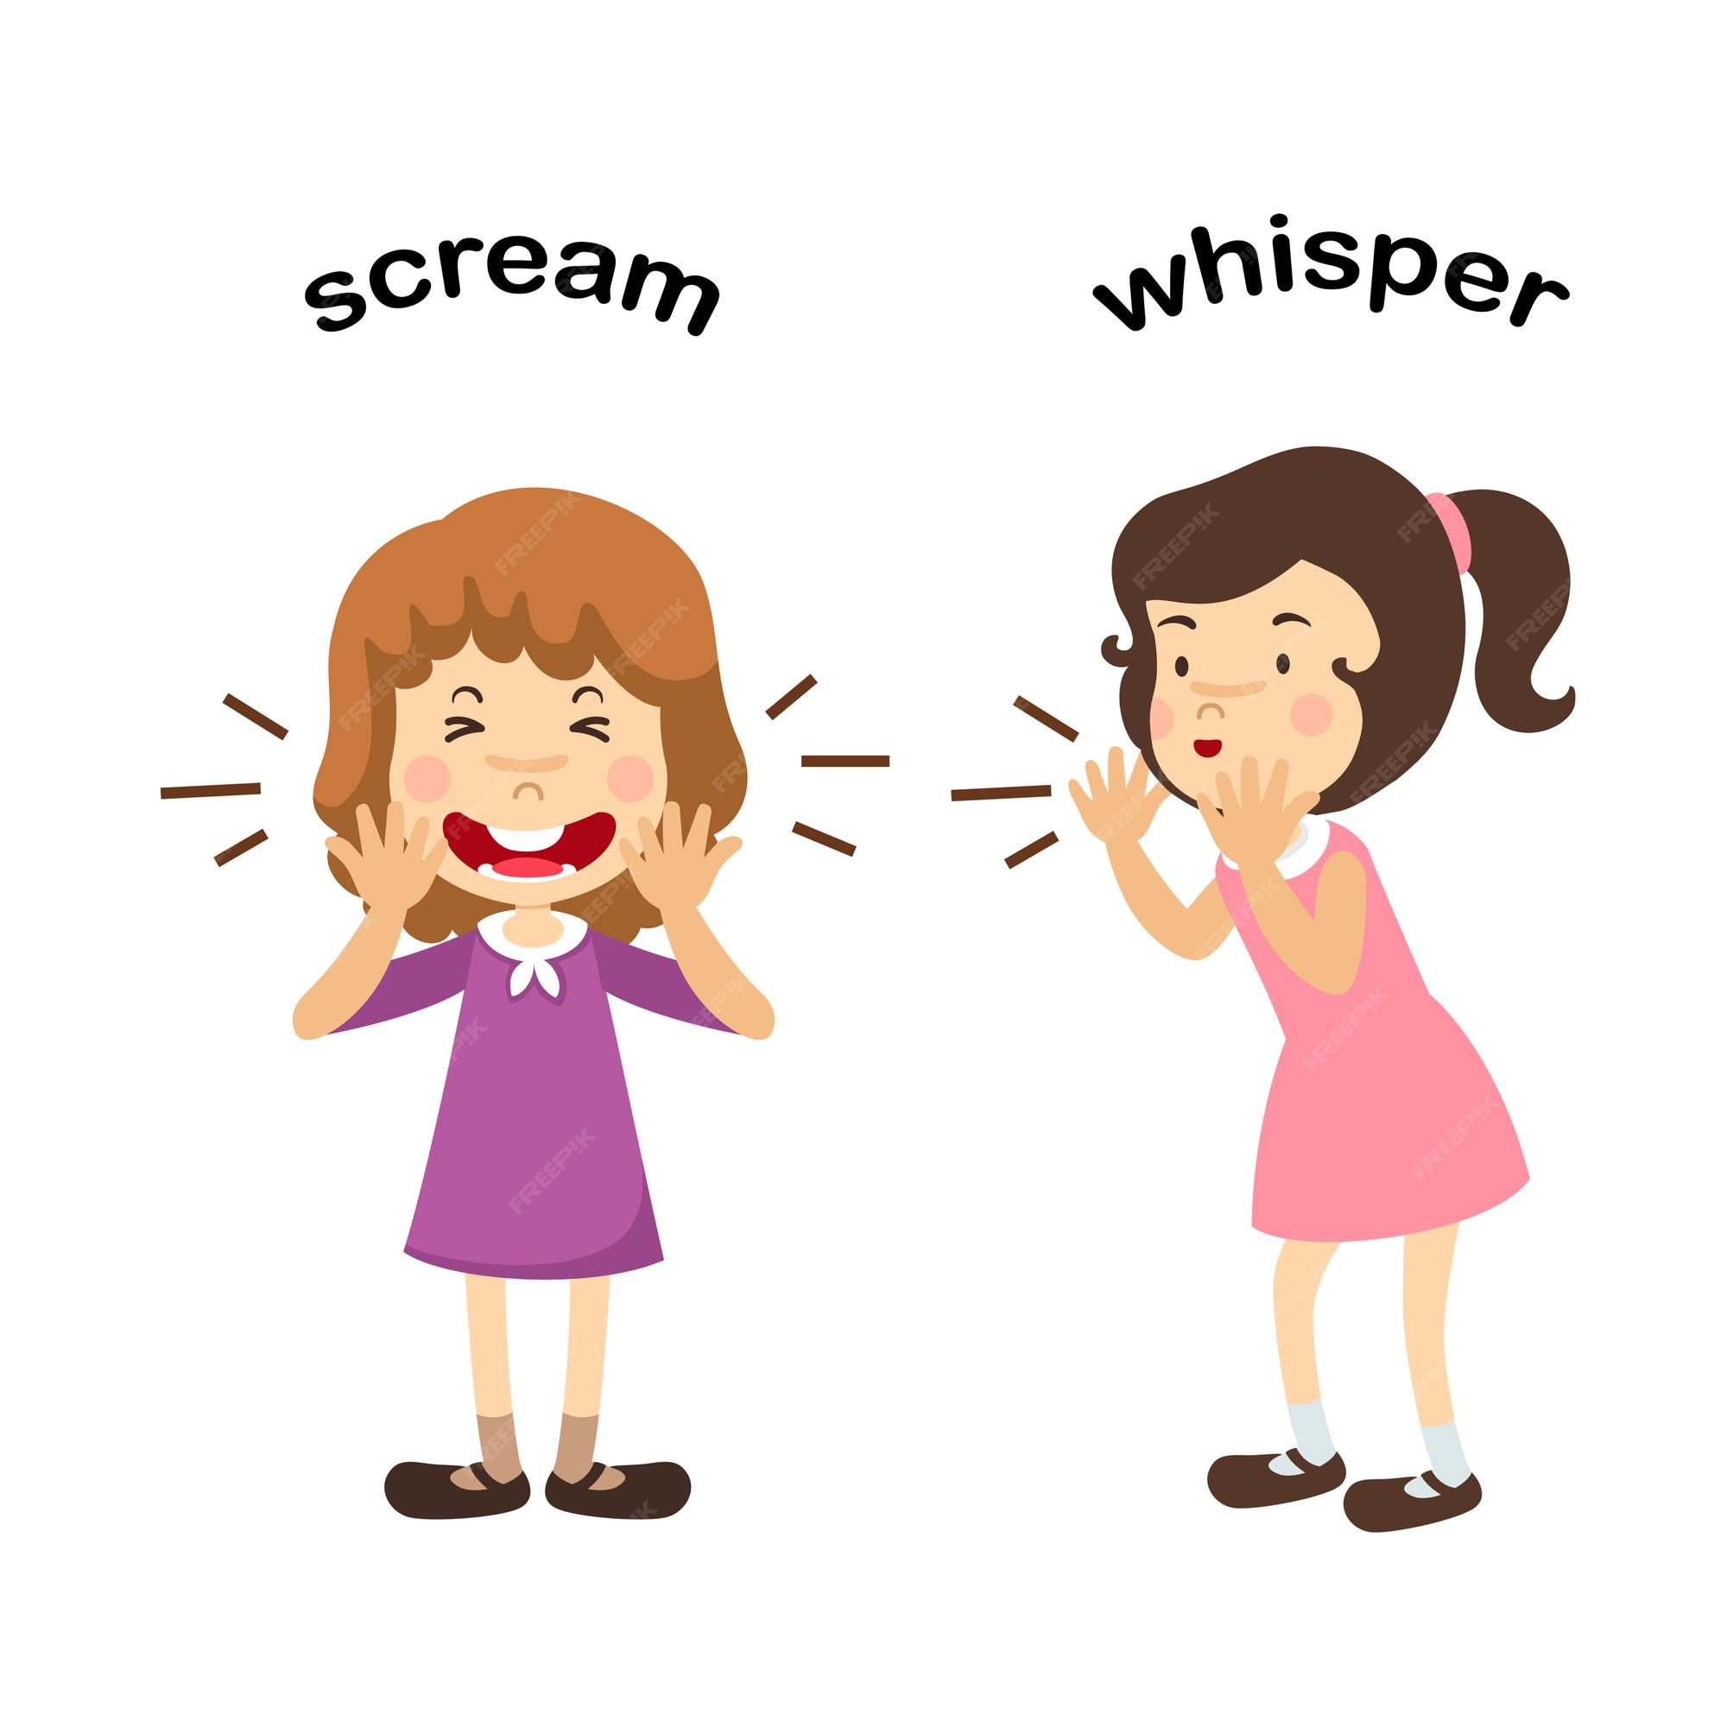
Short i
1:00 min

Slide 6
Let’s sing together
2:00 min
https://www.youtube.com/watch?v=ExNHyIYyF48

Slide 7

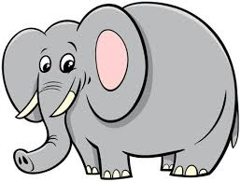


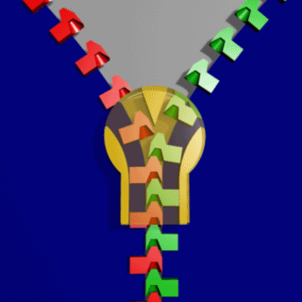

Random pick
six
big
bib
lip
zip
bin

Slide 8
Can you think of more words with short i?
2: 00 min
Random pick

Slide 9
1. Take of if you know 3 words that has the short vowel /i/.
2. Touch dawn if you cant think of a word.
“Take off – Touch dawn”

Slide 10
1. Think (Individual)
👉 “Which short ‘i’ word is the most useful in your life? Why?”
2. Pair (Discussion)
Example answers:
  “I chose sit because I sit in class to learn.”
  “I chose pin because I need pins to fix papers.”
  3. Share
“Think-Pair-Share”

Slide 11
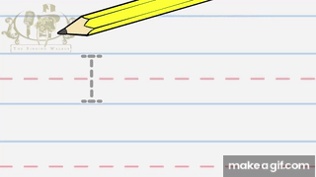
Let’s write upper case I (Capital I)

Slide 12
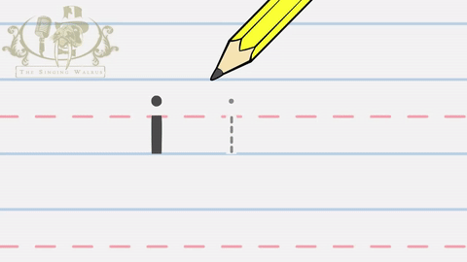
Let’s write lower case i (small i)

Slide 13
2:00
Jot thoughts
Group work
Think of words with the letter /i/
Write as many words as you can on a sticky note.

Slide 14
2:00
Random pick
Real life application
“What do you like to do when you sit at home? Can you use a short ‘i’ word to tell us?”

Slide 15
Real life application - answer
“I sit and sip milk.”
“I sit with my fish.”
“I sit and win a game.”
2:00
Random pick

Slide 16
Differentiation n1.
Write two words with short i : (1) 1. -------------------------------. 2. -------------------------------.

Slide 17
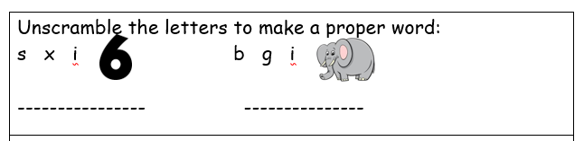
Differentiation n2.

Slide 18
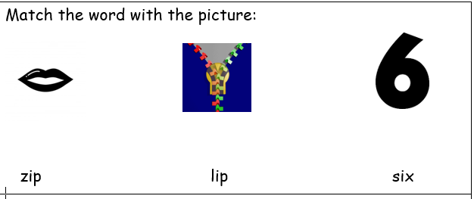
Differentiation n3.

Slide 19
Differentiation n4.
Circle the words with letter i :
bib | mop | pig | red

Slide 20

2: 00 min
Buzz In
Critical thinking question
I hold your memory for you to view it more than once. I make you happy or sad sometimes.
I have colors and you can share me with others.

Slide 21
Summative Assessment
Which word has the short vowel /i/:
Hat
Hit
IRS

Slide 22
Let’s play a game
https://create.kahoot.it/details/cdeb6542-0fdf-41dc-a60c-66902cf69694

Slide 23
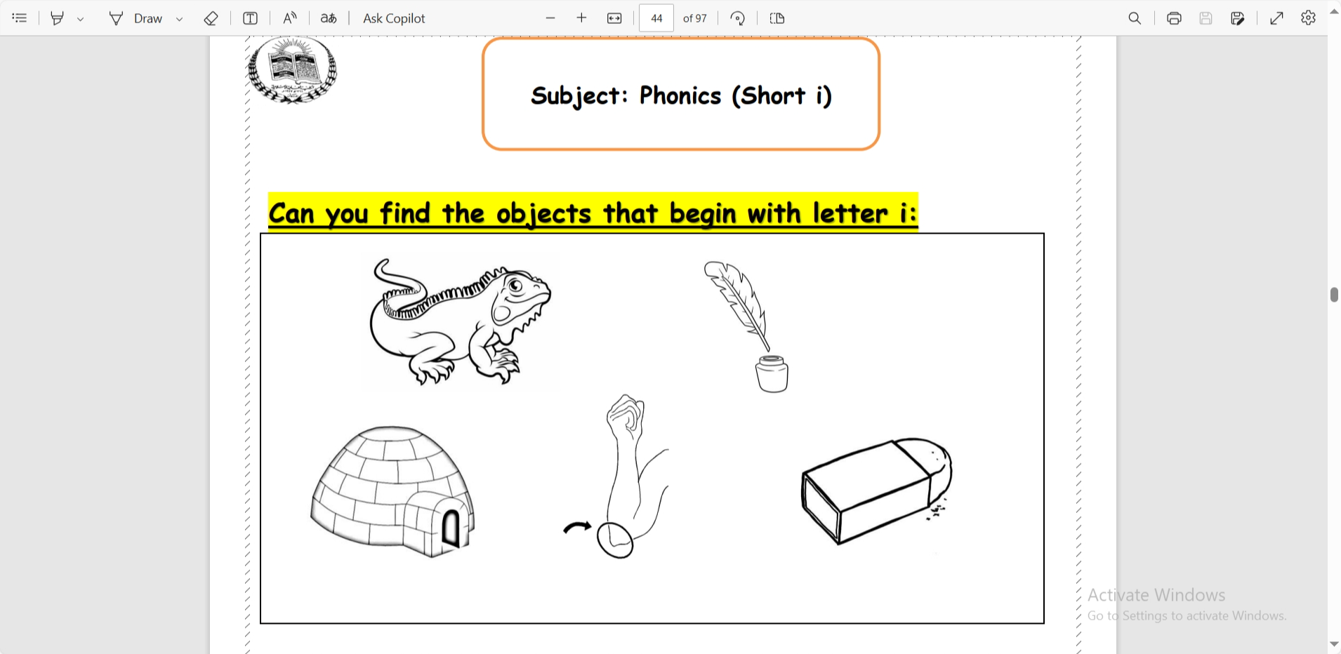

Slide 24
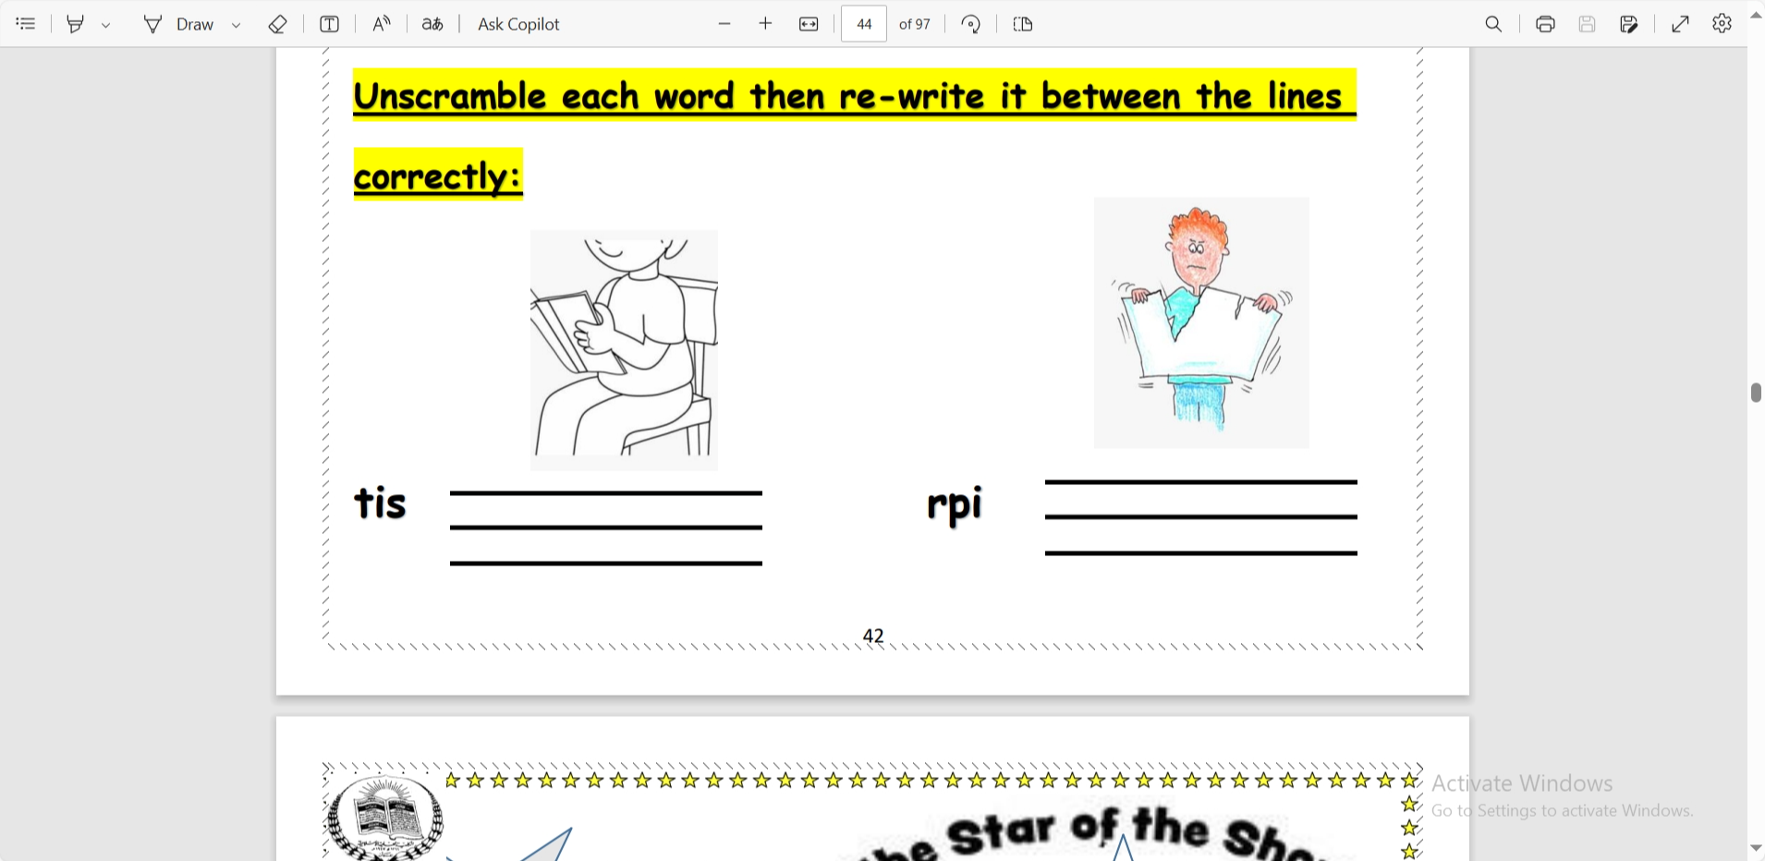

Slide 25
