Slide 1
Phonics

Slide 2
Outcomes
01
02
03
Identiy short vowel o
Write uppercase and lowercase of short o
Appreciate the act of helping others

Slide 3
Warm up
https://www.youtube.com/watch?v=isdsMlk9AL4

Slide 4

Pre-assessment
1:00 min
IRS
What do we call theses?
1. vowels
2. consonants

Slide 5
Let’s listen to a song
https://www.youtube.com/watch?v=RUSCz41aDug&t=1s

Slide 6
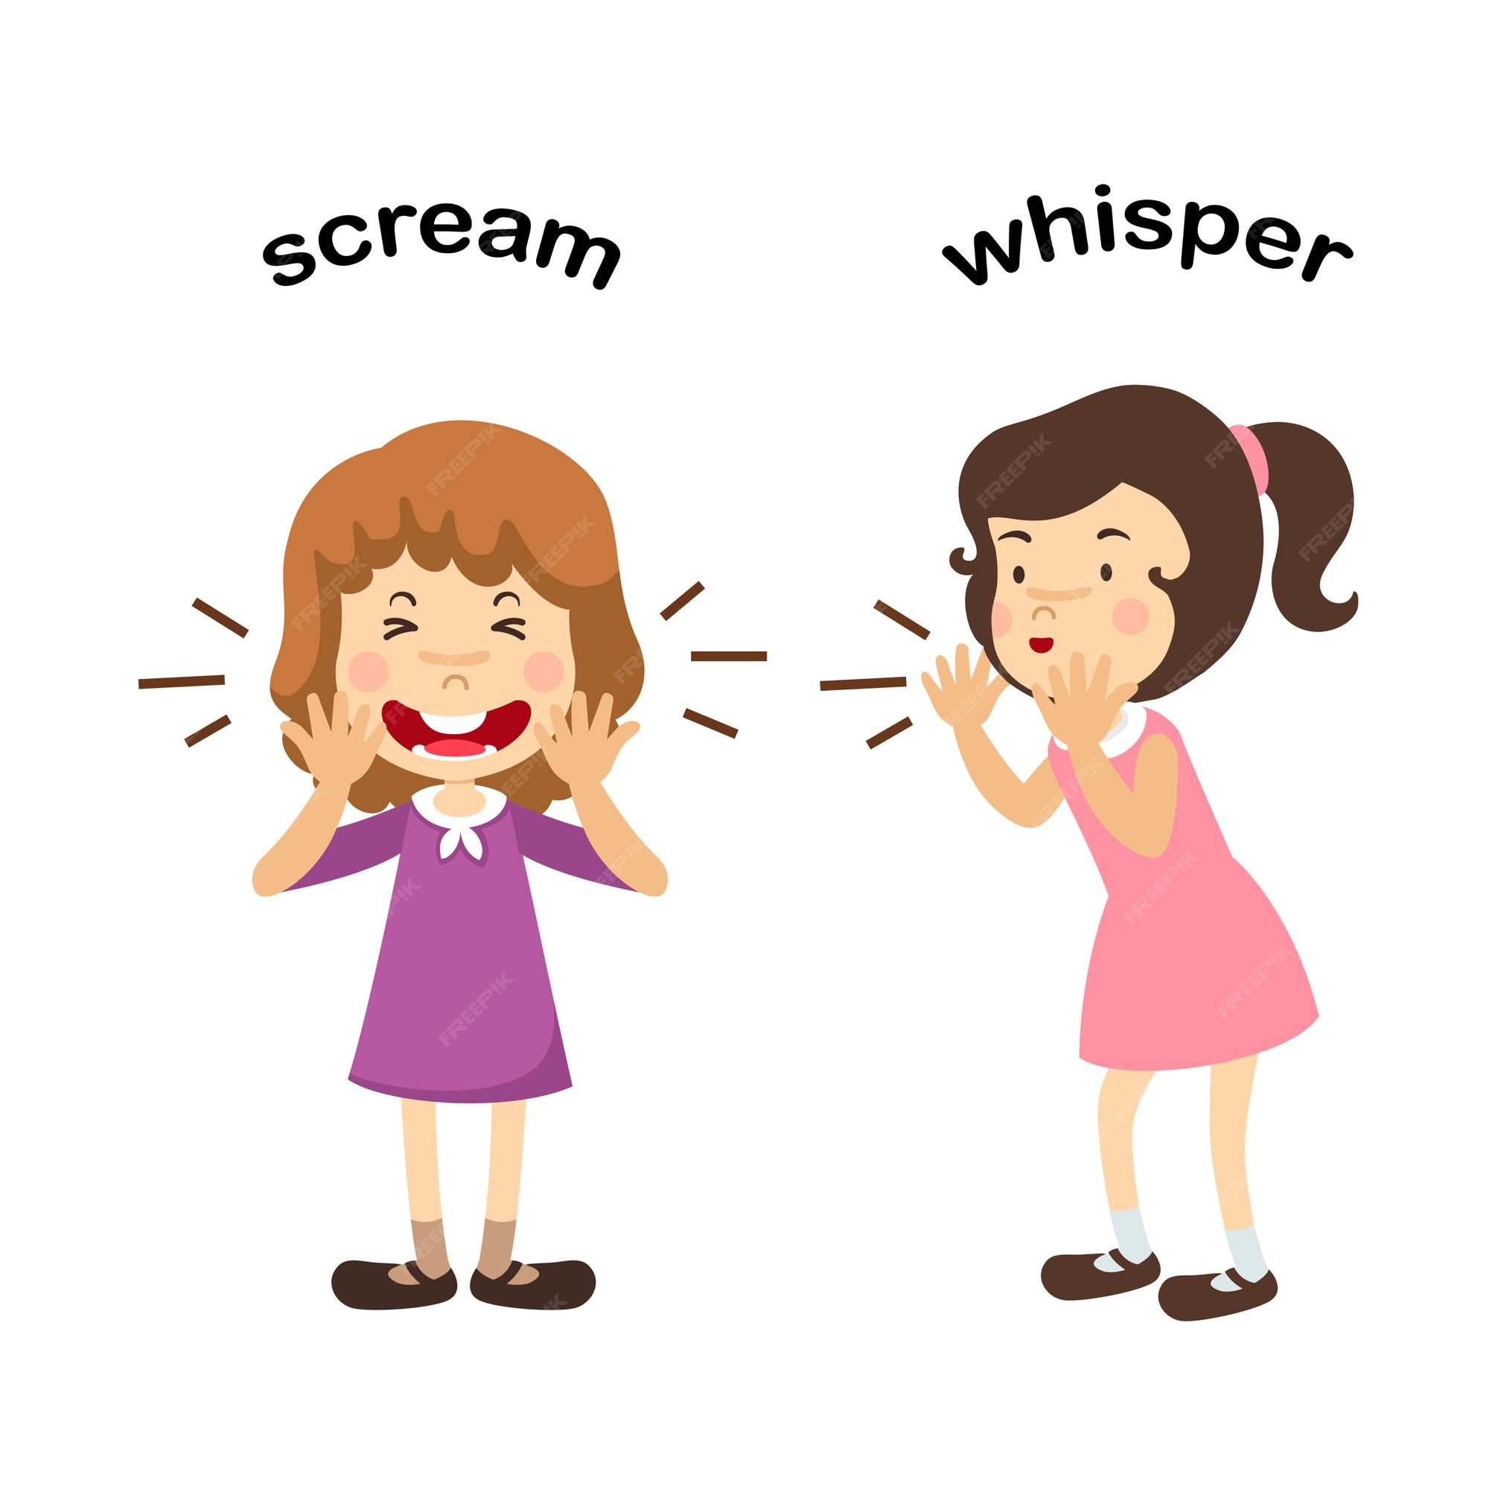
Short o
1:00 min

Slide 7
Let’s sing together
2:00 min
https://www.youtube.com/watch?v=_t8uSTn4ruU

Slide 8
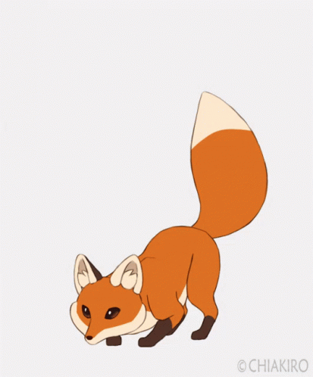

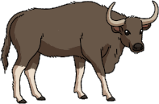
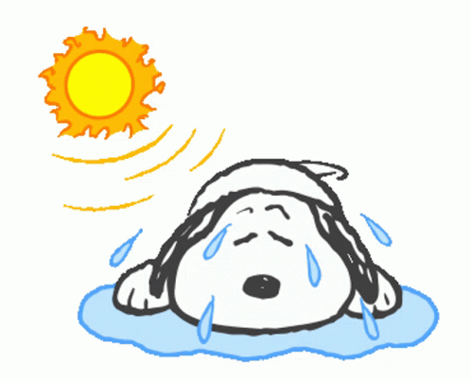


2:00 min
Random pick
ox
On/ off
fox
hot
frog
pot

Slide 9
2: 00 min
Random pick
Can you think of more words with short o?

Slide 10
Let’s write upper and lower case o
https://www.youtube.com/watch?v=UmpV-h9Imj4

Slide 11
Round table
Match each word with its correct picture.

Slide 12
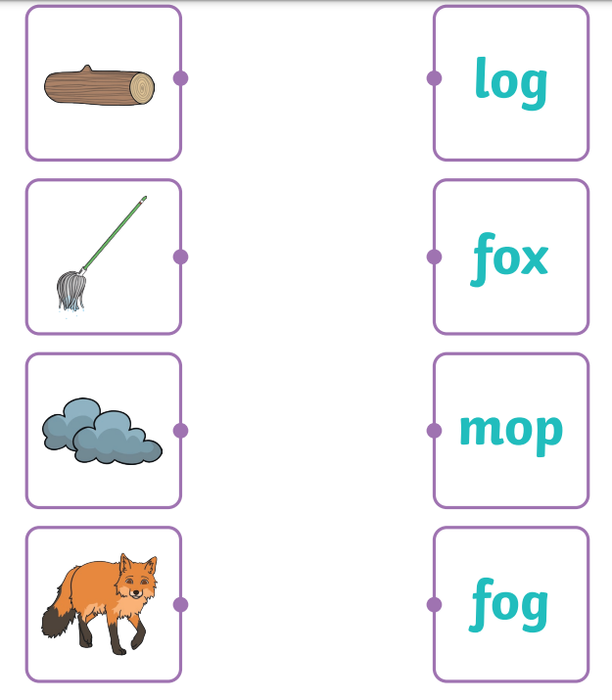
feedback

Slide 13

2:00
Random pick
Real life application/Rally Robin
Think of something in your house that has short o.

Slide 14
Differentiation n3.
Write two words with short o : 1. -------------------------------. 2. -------------------------------.

Slide 15
Differentiation n2.
Unscramble the letters to make a proper word: h t o p t o --------------- ----------------

Slide 16

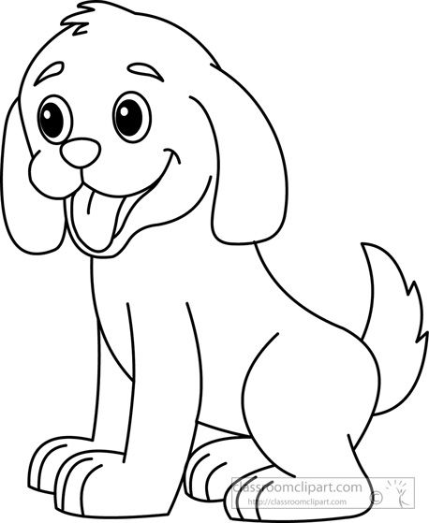
Differentiation n4.
Match the word with the picture: dog frog

Slide 17
Differentiation n1.
Circle the words with letter e :
bed | mop | leg | pot

Slide 18

2: 00 min
IRS
Critical thinking question
I come from a tree, but I am not a leaf. I am hard and brown.
What am I?

Slide 19

Summative assessment
2: 00 min
IRS
Which of the following pictures has a short o in it?
1.
2.

