Slide 1


Unit : Unit 1 Reading 1
Lesson : Phonics
Major : English
Grade : 1

Slide 2



Islamic Educational College Date : / To /
Major:
Grade:
Unit:
Lesson:
Outcomes
01:00 minutes
Warm-Up
At the end of this lesson, students are expected to:
Recognize the sound of the short e.
Read and write words with short e.
Pre-assessment
Presentation
Formative assessment
Feedback
Differentiation
Linking to life
Critical Thinking
Closure

Slide 3


Islamic Educational College Date : / To /
Major:
Grade:
Unit:
Lesson:
Outcomes
03:00 minutes
Warm-Up
Give me 5 family members:
Pre-assessment
Presentation
Formative assessment
Feedback
Differentiation
Linking to life
Critical Thinking
Closure

Slide 4
Take off – touch down: (Pre- Assessment)
Take off if the word has a short /a/ vowel
Pat
Rat
Men
Sat
mat
Mop
Cup

Slide 5

Islamic Educational College Date : / To /
Major:
Grade:
Unit:
Lesson:
Outcomes
02:00 minutes
Presentation:
Warm-Up
Pre-assessment
Read the following words:
Presentation
Formative assessment
Red | bed | ten
men | hen | leg
Feedback
Differentiation
Linking to life
Critical Thinking
Closure
IRS
Magic Boards

Slide 6

Islamic Educational College Date : / To /
Major:
Grade:
Unit:
Lesson:
Outcomes
02:00 minutes
Presentation:
Warm-Up
Pre-assessment
Presentation
1
2
3
Formative assessment
Feedback
Differentiation
Linking to life
Critical Thinking
Closure
IRS
Magic Boards

Slide 7

Islamic Educational College Date : / To /
Major:
Grade:
Unit:
Lesson:
Outcomes
02:00 minutes
Presentation:
Warm-Up
Pre-assessment
1
2
3
Presentation
Formative assessment
Feedback
Differentiation
Linking to life
Critical Thinking
Closure
IRS
Magic Boards

Slide 8
Islamic Educational College Date : / To /
Major:
Grade:
Unit:
Lesson:
Outcomes
03:00 minutes
Listen to the song:
Warm-Up
Pre-assessment
Presentation
https://www.youtube.com/watch?v=y1VTHOfIO4E&t=24s
Formative assessment
Feedback
Differentiation
Linking to life
Critical Thinking
Closure

Slide 9
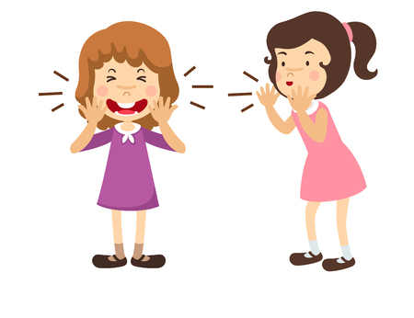
Islamic Educational College Date : / To /
Major:
Grade:
Unit:
Lesson:
Outcomes
05:00 minutes
Presentation
Warm-Up
whisper and release
Pre-assessment
Presentation
Formative assessment
Feedback
e
Differentiation
Linking to life
Critical Thinking
Closure

Slide 10
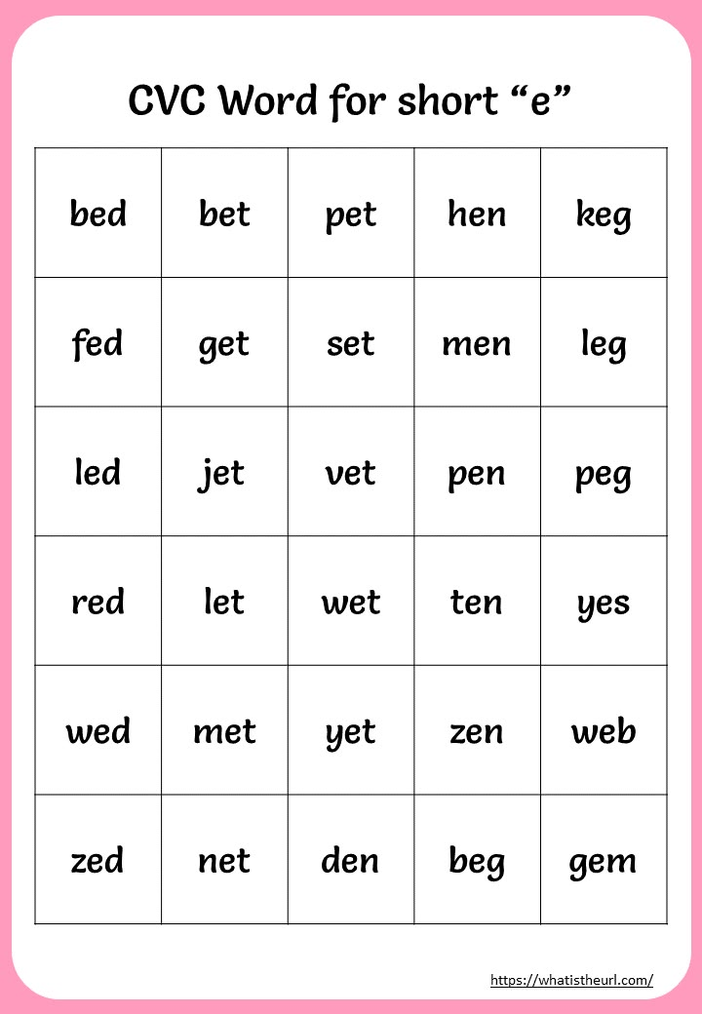
Islamic Educational College Date : / To /
Presentation
Major:
Grade:
Unit:
Lesson:
Outcomes
05:00 minutes
Warm-Up
Pre-assessment
Presentation
Formative assessment
Feedback
Differentiation
Linking to life
Critical Thinking
Closure

Slide 11

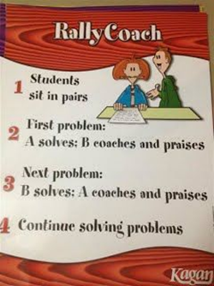
Islamic Educational College Date : / To /
Major:
Grade:
Unit:
Lesson:
Outcomes
03:00 minutes
Formative Assessment
Warm-Up
Unseen Dictation
Pre-assessment
Presentation
Formative assessment
Feedback
Differentiation
Linking to life
Critical Thinking
Closure
IRS

Slide 12

Islamic Educational College Date : / To /
Major:
Grade:
Unit:
Lesson:
Outcomes
02:00 minutes
Feedback
Warm-Up
Pre-assessment
Presentation
Formative assessment
Feedback
Differentiation
Linking to life
Critical Thinking
Closure
Random Pick

Slide 13


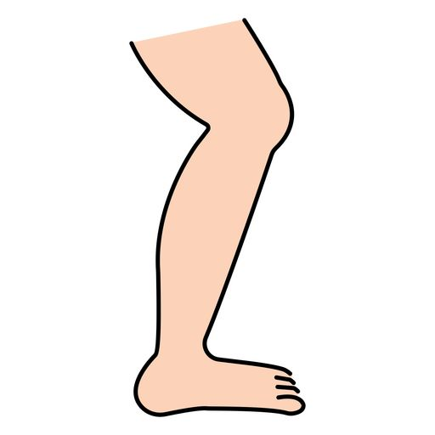
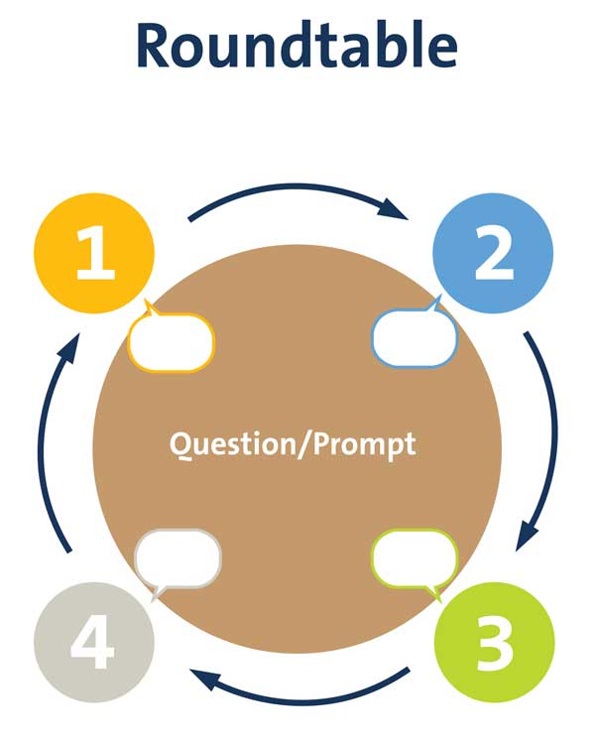

Islamic Educational College Date : / To /
Major:
Grade:
Unit:
Lesson:
Outcomes
Write the missing letter:
01:00 minutes
Warm-Up
1
M____n
Pre-assessment
Presentation
T___n
2
Formative assessment
Feedback
L____g
Differentiation
3
Linking to life
Critical Thinking
Closure
R____d
4
Random Pick

Slide 14
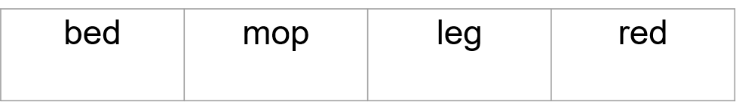
Islamic Educational College Date : / To /
Major:
Grade:
Unit:
Lesson:
Outcomes
01:00 minutes
Warm-Up
Pre-assessment
n.1
Presentation
Circle the words with letter e:
Formative assessment
Feedback
Differentiation
Linking to life
Critical Thinking
Closure
Random Pick

Slide 15
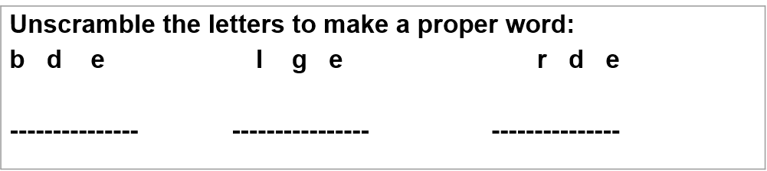
Islamic Educational College Date : / To /
Major:
Grade:
Unit:
Lesson:
Outcomes
01:00 minutes
Warm-Up
n.2
Pre-assessment
Presentation
Formative assessment
Feedback
Differentiation
Linking to life
Critical Thinking
Closure
Random Pick

Slide 16
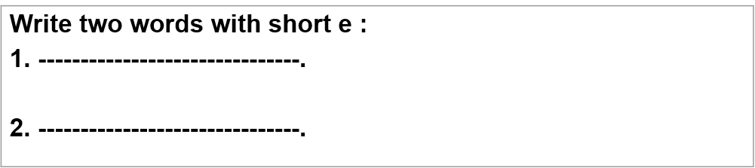
Islamic Educational College Date : / To /
Major:
Grade:
Unit:
Lesson:
Outcomes
01:00 minutes
Warm-Up
Pre-assessment
Presentation
n.3
Formative assessment
Feedback
Differentiation
Linking to life
Critical Thinking
Closure
Random Pick

Slide 17
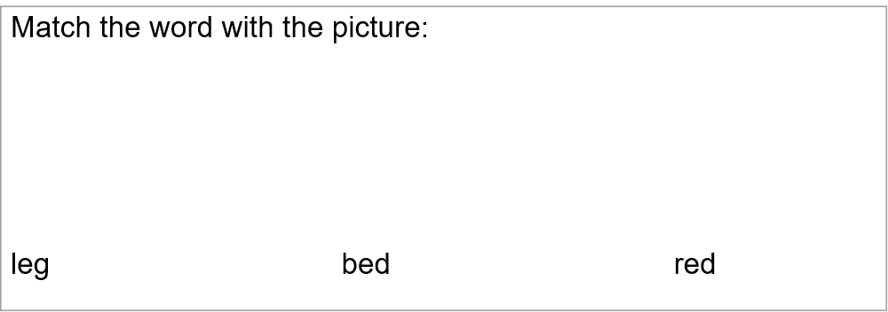
Islamic Educational College Date : / To /
Major:
Grade:
Unit:
Lesson:
Outcomes
01:00 minutes
Warm-Up
Pre-assessment
n.4
Presentation
Formative assessment
Feedback
Differentiation
Linking to life
Critical Thinking
Closure
Random Pick

Slide 18
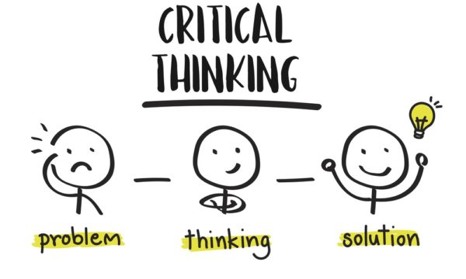
Islamic Educational College Date : / To /
Major:
Grade:
Unit:
Lesson:
Outcomes
01:00 minutes
Warm-Up
How is the word bed different from bad?
Pre-assessment
Presentation
Formative assessment
Feedback
Differentiation
Linking to life
Critical Thinking
Closure

Slide 19

Islamic Educational College Date : / To /
Major:
Grade:
Unit:
Lesson:
Outcomes
01:00 minutes
Warm-Up
What if the a comes at the beginning of the word . Is it short e?
Pre-assessment
Presentation
egg
Formative assessment
Feedback
Differentiation
Linking to life
Critical Thinking
Closure
BUZZ IN

Slide 20
Islamic Educational College Date : / To /
Major:
Grade:
Unit:
Lesson:
Outcomes
02:00 minutes
Summative assessment:
Warm-Up
Pre-assessment
Which word has the short /e/ sound:
Man
Hen
Presentation
Formative assessment
Feedback
Differentiation
Linking to life
Critical Thinking
Closure
IRS
Magic Boards

Slide 21


Islamic Educational College Date : / To /
Major:
Grade:
Unit:
Lesson:
Outcomes
02:00 minutes
Warm-Up
What did you learn today?
Pre-assessment
Presentation
Formative assessment
Feedback
Differentiation
Linking to life
Critical Thinking
Closure

