Slide 1
Vocabulary 4
R1

Slide 2
Warm up
https://www.youtube.com/watch?v=GkipANiBspE

Slide 3
Intended outcomes:
Identify the vocabulary words.
01
03
Helping elderly
02
Use the words in sentences correctly.
At the end of this lesson students are expected to:

Slide 4
Pre-assessment /IRS
I use the pronouns she and he to talk about …....................
Boys and girls
2. animals

Slide 5
01
He
I use the pronoun ……………… to talk about a boy.

Slide 6
Examples
He can hop on one leg.
He studies his homework in weekends.
He talks to his teacher nicely
Now your turn!

Slide 7
She
I use the pronoun …… to talk about a girl.

Slide 8
Examples
She is a beautiful girl.
Now your turn!
She is playing with her sister

Slide 9

Real life application
Say one sentence about your mom and another about your dad using the pronouns He/She

Slide 10
about
Today we will learn ………………… nouns

Slide 11
Let’s talk about some new words today.
Examples
He wants to ask the teacher about his marks.
Today we’re going to learn about addition.
Now your turn!

Slide 12
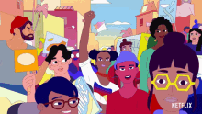
People

Slide 13


Examples
There are so many people here
People work in different jobs.
Now your turn!

Slide 14

Letter

Slide 15

Examples
I wrote a letter to my mom.
The received a letter from my best friend.
Now your turn!

Slide 16

Real life application Critical thinking/ Buzz in
Have u ever written a letter, if so, to whom did you write it? Why did you write it?

Slide 17
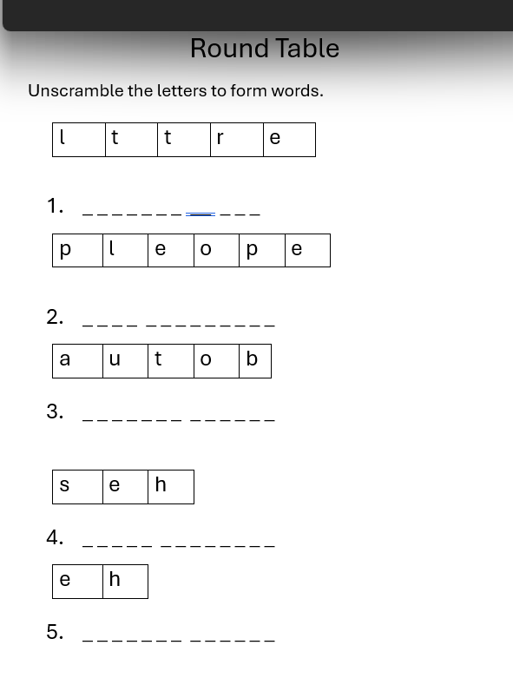
Group work/Round Table

Slide 18

Take off- touch down
Take off if you hear one of the words we took in the following sentences. Touch down if not.

Slide 19
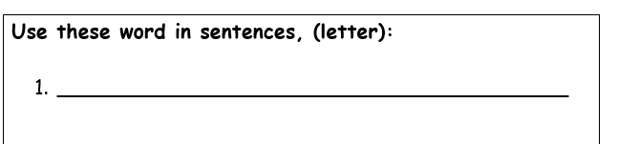
Differntiation 3

Slide 20
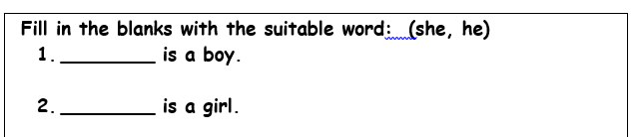
Differntiation 2

Slide 21
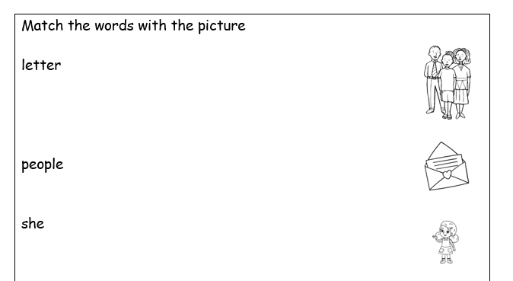
Differntiation 4

Slide 22
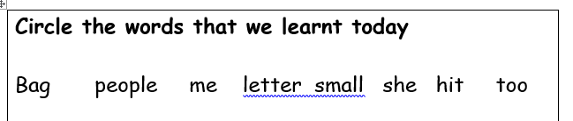
Differntiation 1

Slide 23
Summative assessment/IRS
I wrote a ……………….. To my best friend.
1. letter
2. People

Slide 24
Let’s play a game
https://create.kahoot.it/details/cccbb39a-a16d-40e2-8178-38d9bf444399

