Slide 1


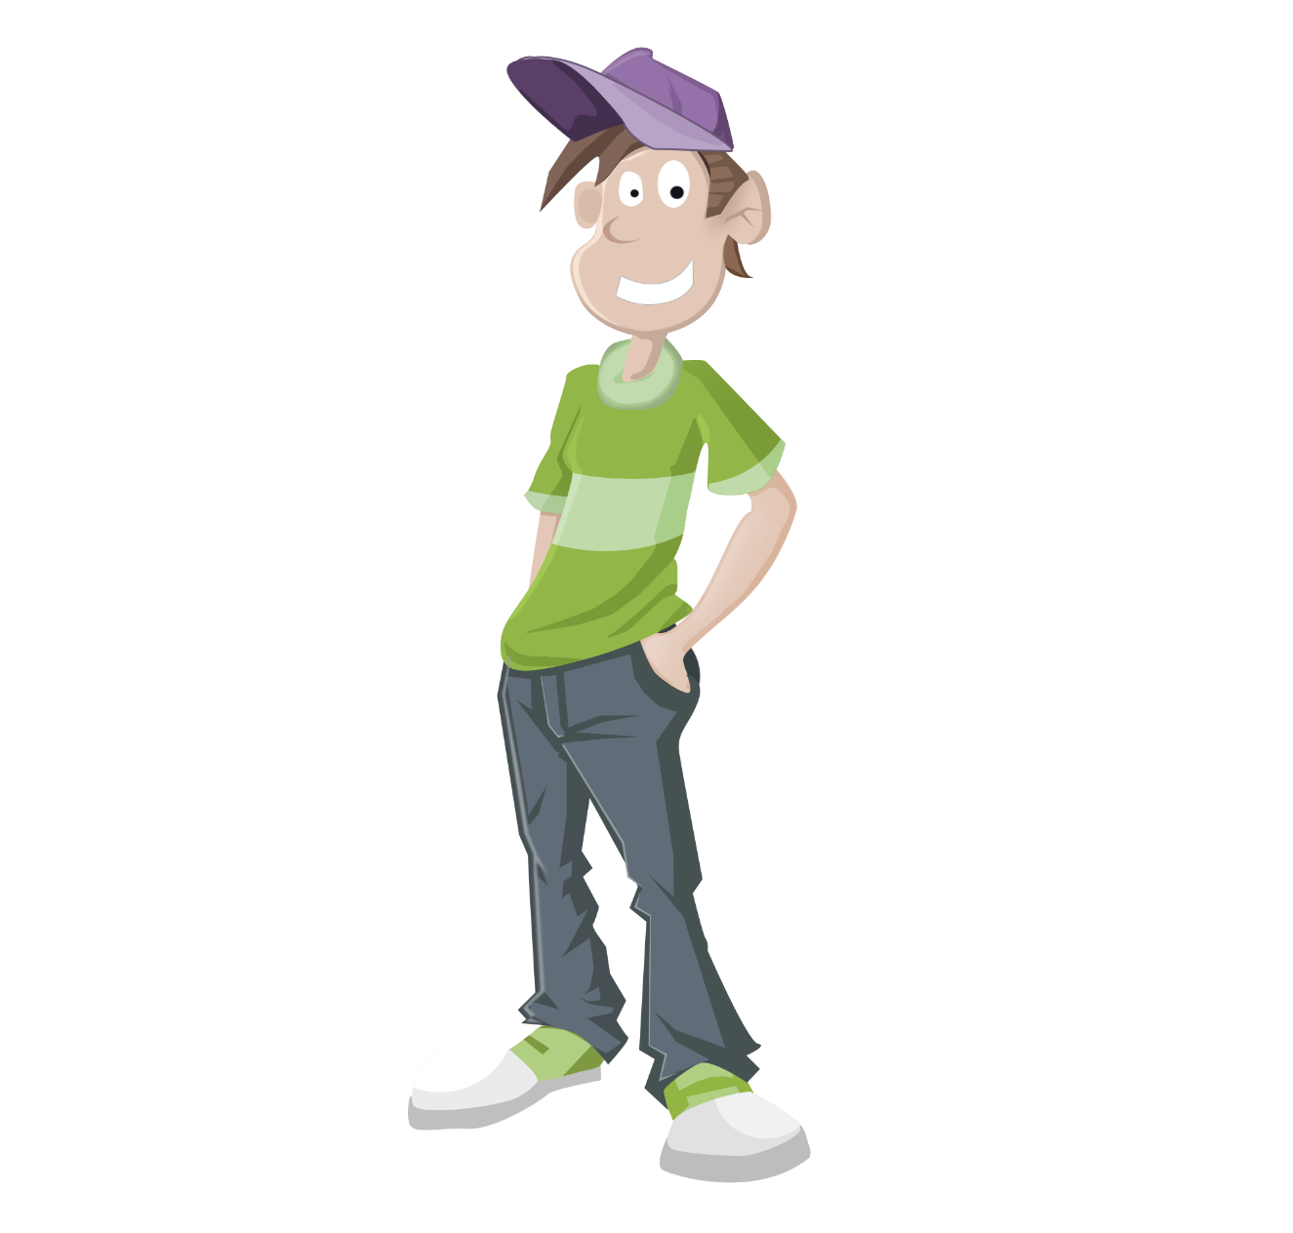

British
English
Past Tenses

Slide 2

In the lesson you’ll do the following:
revise the formation of Past Simple, Past Continuous and Past Perfect Tenses;
compare the usage of past tenses in different situations;
revise time expressions (markers);
use the past tenses in the given sentences and situations.

Slide 3


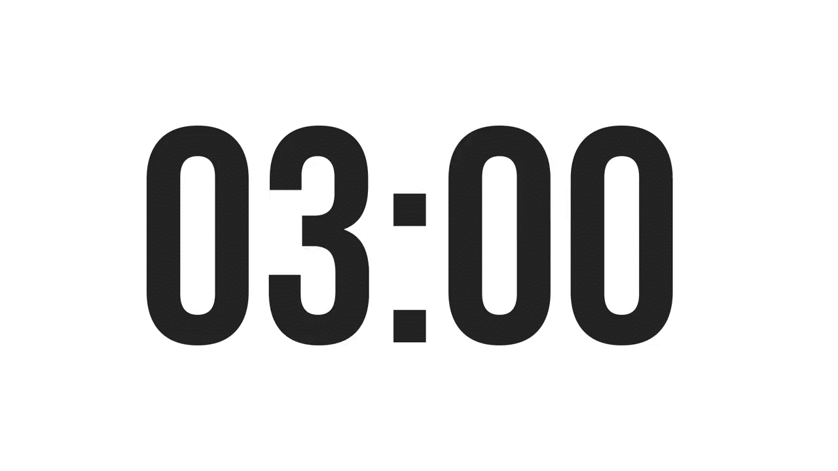
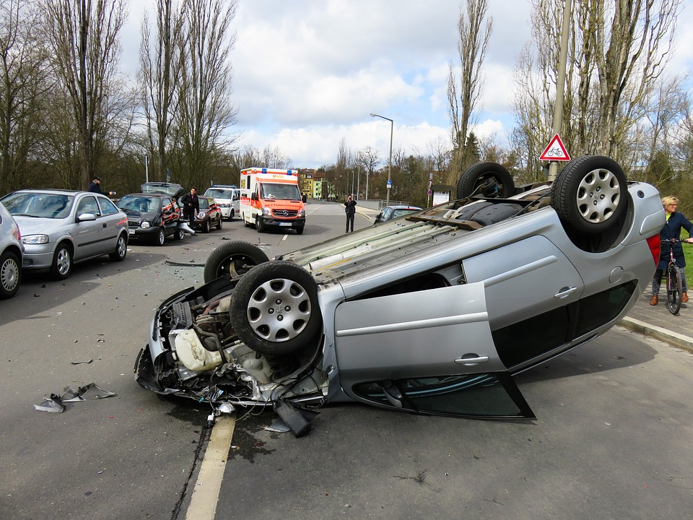
ISLAMIC EDUCATIONAL COLLEGE DATE:
SUBJECT: Past Tenses
GRADE:
UNIT:
LESSON : 3
LESSON: 1
OUTCOMES
Warm up
Based on the picture, what do you think happened next?
03:00 minutes
WARM UP
PREASSESSMENT
PRESENTATION
FORMATIVE ASSESSMENT
FEEDBACK
DIFFERENTIATION
REAL LIFE APPLICATION
CRITICAL THINKING
EXIT TICKET

Slide 4
ISLAMIC EDUCATIONAL COLLEGE DATE:
SUBJECT: Past Tenses
GRADE:
UNIT:
LESSON : 3
LESSON: 1
OUTCOMES
03:00 minutes
Pre-Assessment: Past Simple & Past Participle
Instructions: Write the Past Simple and Past Participle forms of each verb.
Begin → Past Simple: ________ / Past Participle: ________
Choose → Past Simple: ________ / Past Participle: ________
Speak → Past Simple: ________ / Past Participle: ________
Grow → Past Simple: ________ / Past Participle: ________
Break → Past Simple: ________ / Past Participle: ________
Run → Past Simple: ________ / Past Participle: ________
Fly → Past Simple: ________ / Past Participle: ________
WARM UP
PREASSESSMENT
PRESENTATION
FORMATIVE ASSESSMENT
FEEDBACK
DIFFERENTIATION
REAL LIFE APPLICATION
CRITICAL THINKING
EXIT TICKET

Slide 5
ISLAMIC EDUCATIONAL COLLEGE DATE:
SUBJECT: Past Tenses
GRADE:
UNIT:
LESSON : 3
LESSON: 1
OUTCOMES
03:00 minutes
WARM UP
Feedback Slide: Past Simple & Past Participle (Answers)
Begin → Past Simple: began / Past Participle: begun
Choose → Past Simple: chose / Past Participle: chosen
Speak → Past Simple: spoke / Past Participle: spoken
Grow → Past Simple: grew / Past Participle: grown
Break → Past Simple: broke / Past Participle: broken
Run → Past Simple: ran / Past Participle: run
Fly → Past Simple: flew / Past Participle: flown
PREASSESSMENT
PRESENTATION
FORMATIVE ASSESSMENT
FEEDBACK
DIFFERENTIATION
REAL LIFE APPLICATION
CRITICAL THINKING
EXIT TICKET

Slide 6
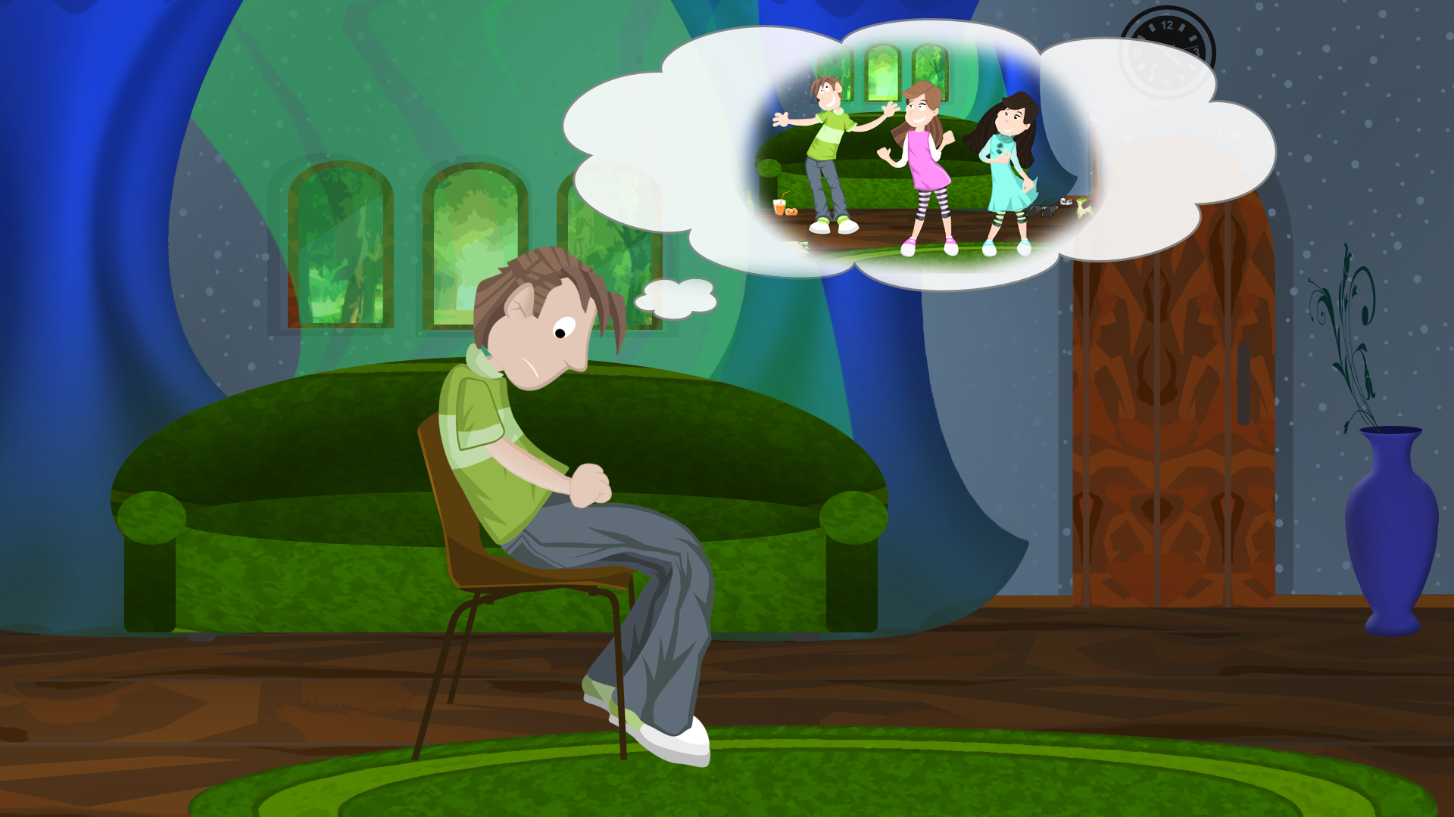
1.
Let’s consider the following situations and define the past tenses which were used in them.
James had a party yesterday evening.
Past Simple
(The party is over. The time is stated – yesterday evening.)
a complete action at a stated time in the past.

Slide 7
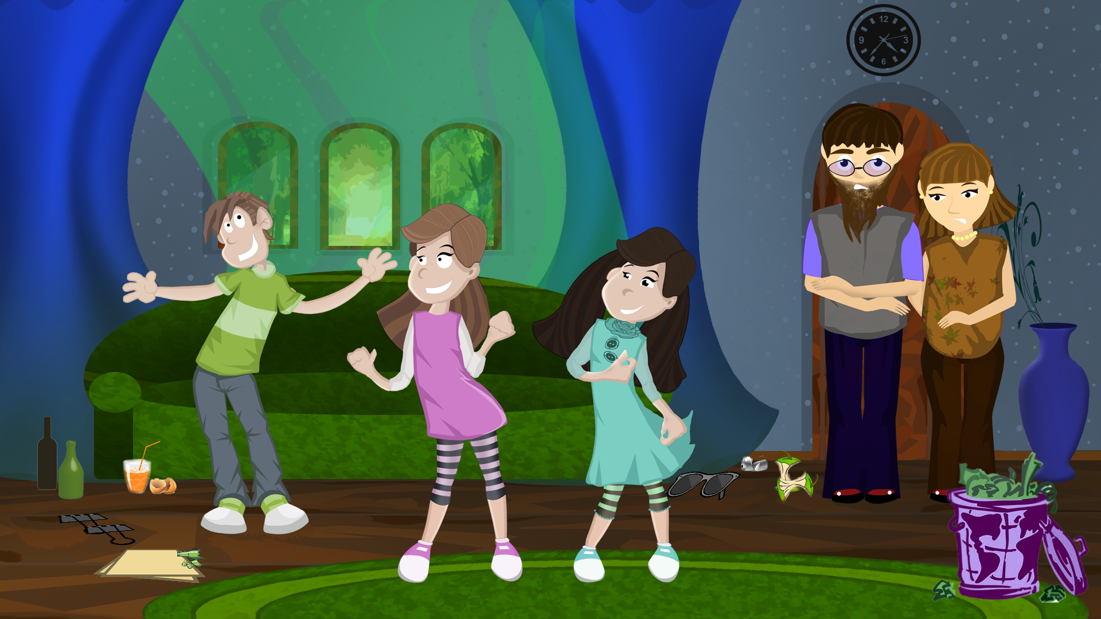
James was having a party when his parents came back home.
2.
Past Continuous
(James was still having a good time when his parents came.)
a past action which was in progress when it was interrupted by another action.

Slide 8
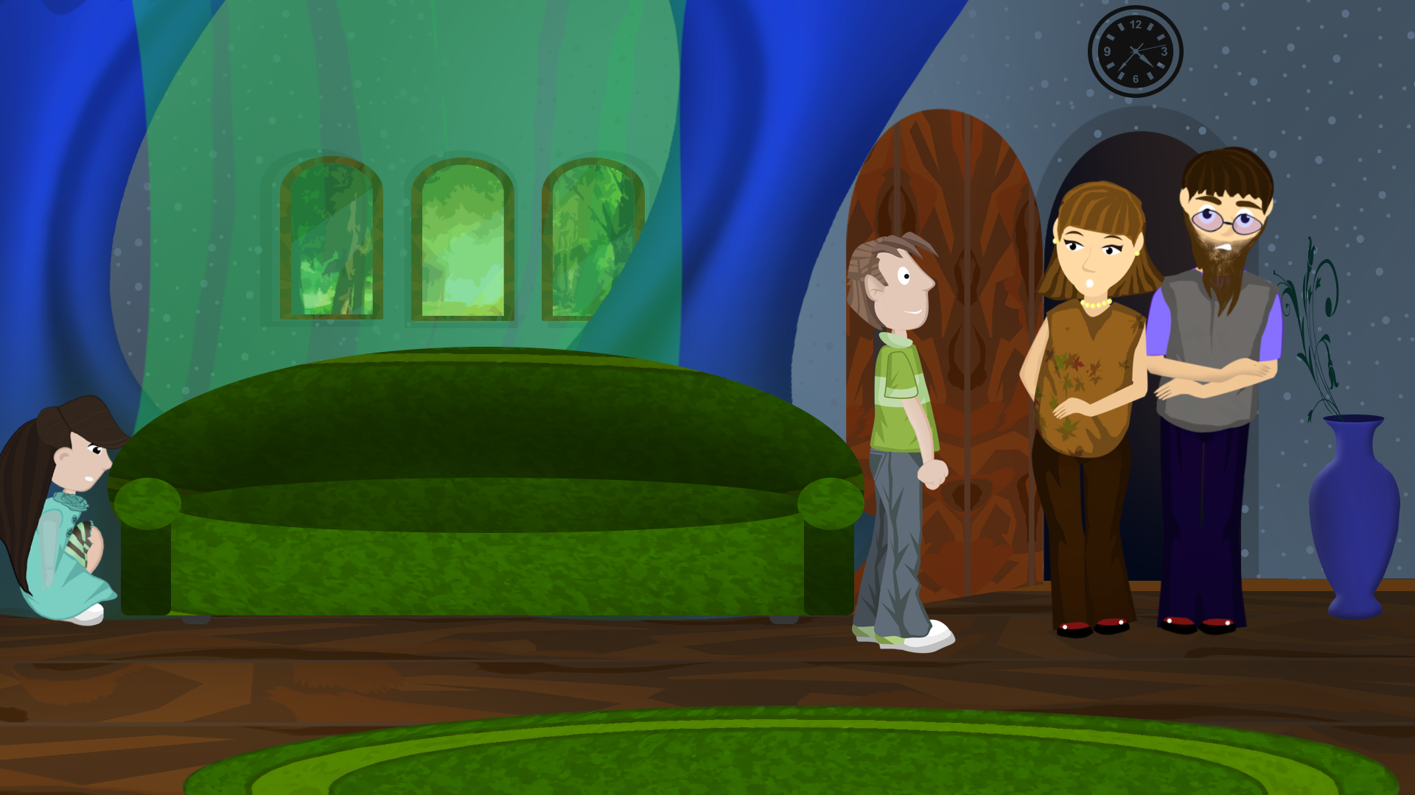
James had already seen off his guests when his parents came back home.
3.
Past Perfect
(He saw off his guests first. And his parents came afterwards.)
one past action happened before another past action in the past.

Slide 9


Past Simple
regular
irregular
V+ed
V2
arriv ed
visit ed
have - had
come - came
did
-
?
I
he/she/it
we/you/they
I
He/she/it
We/you/they
Did
?
did not
.
visit
have
ed
visit
have
ed
(didn’t)

Slide 10







Past Continuous
to be + Ving
was
were
-
I / He / She / It
You / We / They
?
Was
I/he/she/it
we/you/they
I/he/she/it
we/you/they
wasn’t
having a party?
having a party.
Were
weren’t

Slide 11
Past Perfect
regular
irregular
V+ed
had
+
V3
He had invited / seen off his guests.
-
?
I
he/she/it
we/you/they
I
he/she/it
we/you/they
Had
invited / seen off
his guests?
had not
(hadn’t)
invited / seen off his guests.

Slide 12




a complete action at a stated time in the past.
I painted my bedroom last Saturday.
Simple
stated time
past
now
an action which was in progress at a stated time in the past.
We don’t mention when it started or finished.
She was crying while watching TV.
Contin.
past
now
one past action which happened before another past action or before a stated time in the past.
I took the books back to the library when I had read them.
Perfect
Past Perfect
Past Simple
past
now

Slide 13

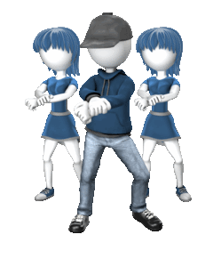

A
B
the actions which happened one after the other in the past.
He knocked her down, grabbed her purse and ran off.
C
Simple
past
A B C
now
an action which was in progress when something else happened.
We were dancing when one of the neighbors came.
Contin.
Past Continuous
past
Past Simple
now
an action which finished in the past and whose result was visible in the past.
He was tired because he had worked hard all day.
Perfect
result
past
Past Perfect
now

Slide 14




for past habits and states which are now finished. In such cases we can also use used to.
He went / used to go scuba diving.
Simple
finish
past
now
two or more simultaneous past actions.
She was doing shopping while he was reading papers.
Contin.
past
now
The Past Perfect is the past equivalent of the Present Perfect.
There were no sandwiches left. He had eaten them all.
Perfect
Past P.
Present P.
There are no sandwiches left. He has eaten them all.

Slide 15

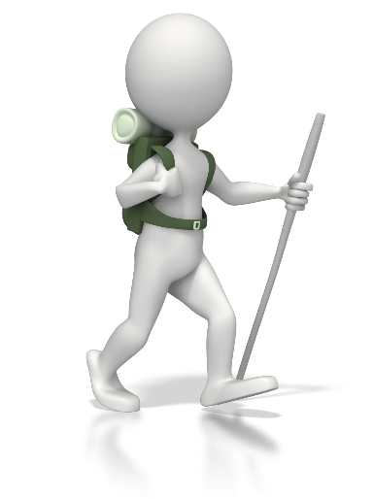

to talk about the lives of people who are no longer alive.
Simple
Edison invented the light bulb.
to describe the atmosphere, weather or place before we describe the main event.
He was walking down a quiet country road. The birds were singing, the butterflies were flying.
Contin.
P.Simple / P.Contin. / P.Perfect
think, hope, mean, expect, etc.
for things we hoped to do but didn’t.
I hoped / was hoping / had hoped her to call me, but she didn’t.

Slide 16

Time markers
Past Simple
Past Continuous
Past Perfect
yesterday
last night/week/month/year
two days/weeks/months ago
then
when
How long ago...?
in 1992/1845
while
when
as
all day/morning yesterday
at noon yesterday
the whole night yesterday
from 5 to 6 yesterday
before
after
already
till / until
by the time
never / ever
for
since
just

Slide 17
Read the sentences, identify the tenses, then match them with the correct description.
1. Mila opened a wardrobe, took out a dress and put it on.
two or more simultaneous past actions.
an action which finished in the past and whose result was visible in the past.
an action which was in progress when something else happened.
a complete action at a stated time in the past.
the actions which happened one after the other in the past.
one past action which happened before another past action or before a stated time in the past.
2. Titanic was sailing across the Atlantic when it hit an iceberg.
3. The film had finished by the time they got home.
4. He was happy because he had found a new job.
5. She went to Canada last year.
6. Sue was lying in the sun while
the children were playing in the pool.

Slide 18
1.
Choose the correct time expression.
I still/ yet/ just hadn’t done my homework when Mum came back home.
I still hadn’t done my homework when Mum came back home.
2.
He was cooking before/ while/ as soon as she was sleeping.
He was cooking while she was sleeping.
3.
How long ago/ How long/ Until did you pass your driving test?
How long ago did you pass your driving test?
4.
He continued his journey before/ after/ yet he had filled the car.
He continued his journey after he had filled the car.
Our team had scored two goals by the time we arrived at the stadium.
5.
Our team had scored two goals till/ yet/ by the time we arrived at the stadium.
6.
I haven’t been to Amsterdam for two years.
I haven’t been to Amsterdam never/ after/ for two years.

Slide 19


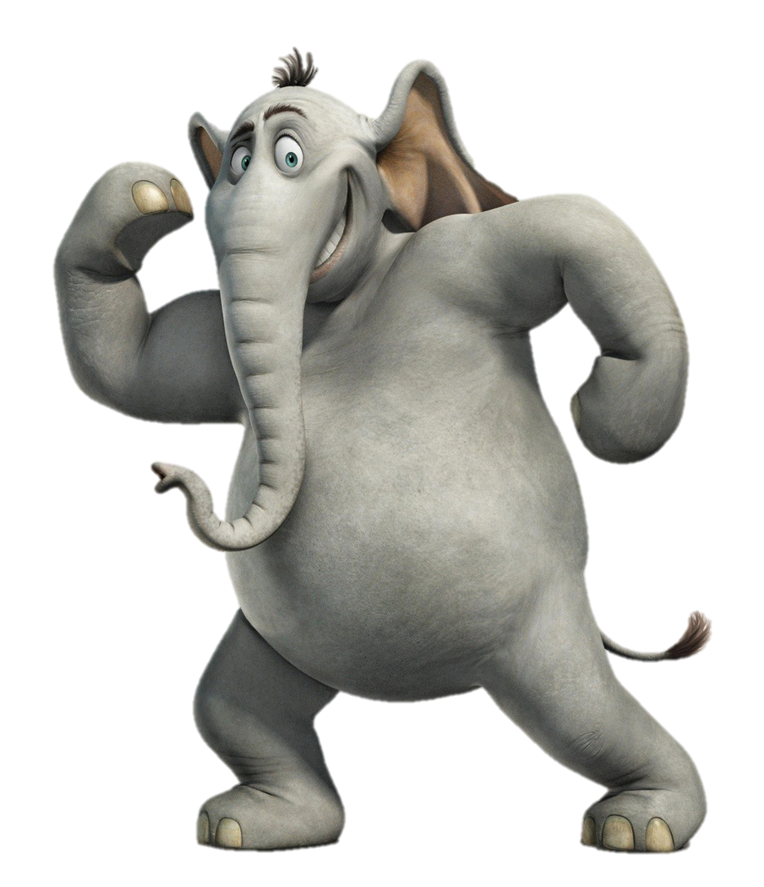

1.
Complete the sentences using Past Simple, Past Continuous or Past Perfect .
He (get) very wet because he (forget) to take an umbrella.
got
had forgotten
2.
It (snow) heavily all that day.
was snowing
3.
I (never / see) an elephant until I (go) to India.
had never seen
went

Slide 20



4.
was cleaning
While she (clean) the floors the children (wash) the windows.
were washing
5.
They (study) Maths at the university.
studied
6.
Dr. Thomas (visit) some patients yesterday.
visited
7.
cost
Computers (cost) much more a few years ago.

Slide 21


Past Simple | Past Continuous | Past Perfect
Ved / V2
to be + Ving
had + Ved / V3
a complete action at a stated time in the past.
an action which was in progress at a stated time in the past.
one past action which happened before another past action or before a stated time in the past.
Practise your grammar skills,
because practice makes PERFECT!
an action which finished in the past and whose result was visible in the past.
the actions which happened one after the other in the past.
an action which was in progress when something else happened.
for past habits and states which are now finished (used to).
two or more simultaneous past actions.
Past Perfect is the past equivalent of Present Perfect
to talk about the lives of people who are no longer alive.
to describe the atmosphere, weather or place before we describe the main event.
yesterday, last night/week/month
/year, two days/weeks ago, then, when, How long ago...?, in 1992
while, when, as, all day yesterday, at noon yesterday, the whole night yesterday, from 5 to 6 yesterday
before, after, already, till/until, by the time, never/ever, for, since, just

Slide 22
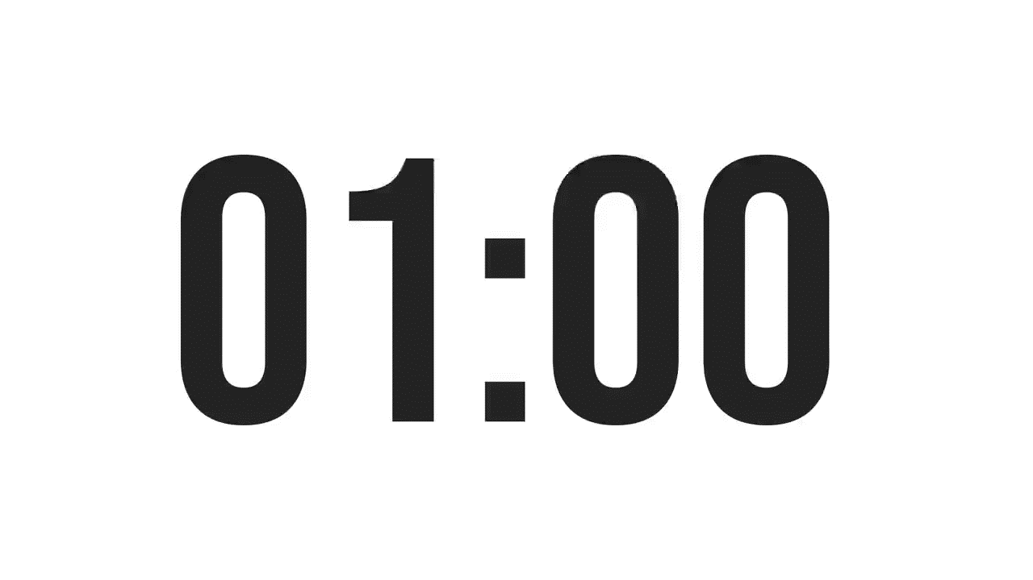
ISLAMIC EDUCATIONAL COLLEGE DATE: :
SUBJECT: Past Tenses
GRADE:
UNIT:
LESSON: 1
OUTCOMES
01:00 minute
Real Life Application :
Share a short story with your classmates about an activity you did last weekend. Use past tense verbs in your sentences.
WARM UP
PREASSESSMENT
PRESENTATION
FORMATIVE ASSESSMENT
FEEDBACK
DIFFERENTIATION
REAL LIFE APPLICATION
CRITICAL THINKING
EXIT TICKET
BUZZ IN

Slide 23

ISLAMIC EDUCATIONAL COLLEGE DATE: :
SUBJECT: Past Tenses
GRADE:
UNIT:
LESSON: 1
OUTCOMES
01:00 minute
WARM UP
Critical Thinking:
Sometimes people spend a lot of time thinking about the past and old memories. What advice would you give to someone who feels stuck in the past?
PREASSESSMENT
PRESENTATION
FORMATIVE ASSESSMENT
FEEDBACK
DIFFERENTIATION
REAL LIFE APPLICATION
CRITICAL THINKING
EXIT TICKET
BUZZ IN

Slide 24
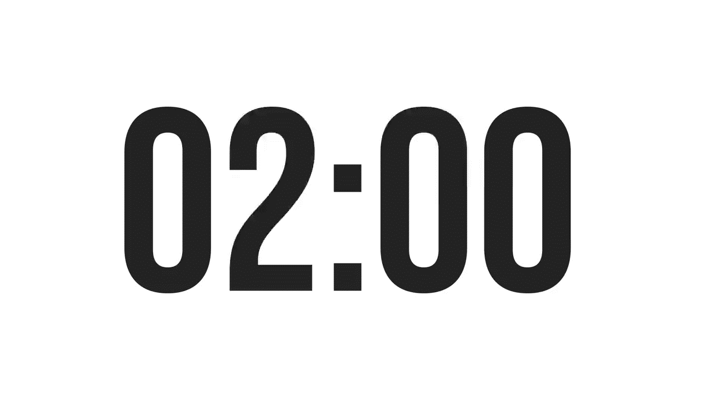
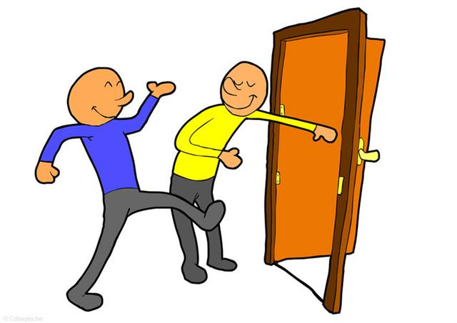
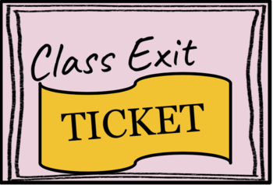
ISLAMIC EDUCATIONAL COLLEGE DATE: :
SUBJECT: Past Tenses
GRADE: 10
UNIT: 2
LESSON: 1
OUTCOMES
EXIT TICKET:
Give one sentence using the past tense correctly.
02:00 minutes
WARM UP
PREASSESSMENT
PRESENTATION
FORMATIVE ASSESSMENT
FEEDBACK
DIFFERENTIATION
REAL LIFE APPLICATION
CRITICAL THINKING
EXIT TICKET
BUZZ IN

