Slide 1

Unit Two: Learning for life
Lesson: Exams, exams
Subject: Vocabulary.
Grade: Ten

Slide 2



Subject: vocabulary
Grade: 10
Unit: 2
Lesson: 1
LESSON
OBJECTIVES
00:30 minute
WARM UP
Objectives
PREASSESSMENT
Recognize the meanings of the new words and expressions and use them correctly .
PRESENTATION
FORMATIVE ASSESSMENT
FEEDBACK
DIFFERENTIATION
REAL LIFE APPLICATION
CRITICAL THINKING
EXIT TICKET

Slide 3

Subject: vocabulary
Grade: 10
Unit: 2
Lesson: 1
OUTCOMES
WARM UP
05:00 minutes
WARM UP
🎯 Jot Thoughts – Vocabulary
Share 1 word that can be used to describe exams! Objective: Activate prior knowledge & introduce new words Time: 5 min
Setup:
Groups of 3–4, each with sticky notes + marker
Topic on board: “Exams, exams”
Jot Thoughts:
Students quickly write words/phrases (one per note) and place them in the center
Focus on speed & quantity
Vocabulary Reveal:
Teacher shows target vocab (minefield, frazzled, looming, etc.)
Groups check which words they wrote & add new ones with guessed meanings
Share & Connect:
Each group shares 2–3 useful words
Teacher confirms meanings → transitions to lesson
Real Life Application
PRESENTATION
FORMATIVE ASSESSMENT
FEEDBACK
DIFFERENTIATION
REAL LIFE APPLICATION
CRITICAL THINKING
EXIT TICKET

Slide 4
Subject: vocabulary
Grade: 10
Unit: 2
Lesson: 1
OUTCOMES
Pre assessment
03:00 minutes
Pre assessment
Mark the following words according to the attached rubric:
1- Never seen this word before
2- Seen the word, but not sure what it means
3- Used the words, but not sure if correctly
4- Used the word confidently in spelling or writing
5- Used the words confidently in both speaking and writing
Plastered .
Looming .
Flitting .
Minefield.
Frazzled/manic.
hammering.
Regurgitate.
Swimming in .
All the advice under the sun.
Real Life Application
PRESENTATION
FORMATIVE ASSESSMENT
FEEDBACK
The new words and phrases.
DIFFERENTIATION
REAL LIFE APPLICATION
Check your level below:
5 fives ⭐ = You are a Vocabulary Star – you can use words in all skills!
Mostly 4s and 5s 🌟 = You are a Confident User – keep practicing in speaking.
Mostly 3s 🙂 = You are a Growing Learner – you know the words but need practice.
Mostly 2s 🤔 = You are a Word Explorer – you recognize words, now try to use them.
Mostly 1s 🐣 = You are a Beginner – new words for you, time to learn step by step.
CRITICAL THINKING
EXIT TICKET

Slide 5
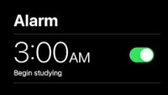
Subject: Vocabulary
Grade: 10
Unit: 2
Lesson: 1
OUTCOMES
Real Life Application
3:00
WARM UP
Watch the following video and write your comment on 1 point: https://youtu.be/ZXCQCMYpVo4?si=qhLpsYdTiWFk_Nim
Random pick: How do the ideas in the video reflect on your own life?
Real Life Application
CRITICAL THINKING
FORMATIVE ASSESSMENT
FEEDBACK
DIFFERENTIATION
REAL LIFE APPLICATION
PRESENTATION
EXIT TICKET

Slide 6
ISLAMIC EDUCATIONAL COLLEGE DATE: /2/ 2025
Subject: Vocabulary
Grade: 10
Unit: 2
Lesson: 1
OUTCOMES
CRITICAL THINKING
4:00
WARM UP
Compare and evaluate: Refer to S.B. P.16-17
Work in groups to solve the following questions.
1. The "Why": Both students feel pressure. Identify the main source of pressure for each of them.
Daniel:
Layli:
2. The "How": Compare their studying methods.
Daniel’s Method: Is it more about rote memorization or deep understanding?
Layli's Method: Is it more about rote memorization or deep understanding?
3. Choose a representative to answer: Which approach do you think is more valuable for long-term learning, and why?
4. Peer assessment .
Skill | 1 Point: Developing | 2 Points: Proficient | 3 Points: Exemplary
Analyzes Information | Identifies the main idea. | Questions claims and sources. | Challenges assumptions and biases.
Synthesizes Ideas | Summarizes information. | Connects ideas from sources. | Integrates ideas to form a new perspective.
Evaluates & Justifies | States a position. | Supports a claim with evidence. | Justifies a well-reasoned argument and considers opposing views.
Connects to Real-World | Makes personal connections. | Links topic to real-world contexts. | Applies learning to solve a problem.
REAL LIFE APPLICATION
CRITICAL THINKING
PREASSESSMENT
FEEDBACK
FORMATIVE ASSESSMENT
PRESENTATION
DIFFERENTIATION
EXIT TICKET

Slide 7
ISLAMIC EDUCATIONAL COLLEGE DATE: 19 / 2/ 2025
Subject: Vocabulary
Grade: 10
Unit: 2
Lesson: 1
OUTCOMES
1. Situation full of problems = minefield .
2 .Overwhelmed by = swimming in .
3 .Repeat=regurgitate.
4. Moving = flitting.
5 . Very busy = manic.
6 . A lot of advice = all the advice under the sun.
7. Reminding = = hammering.
8. exhausted = frazzled .
9. covered = plastered.
10. upcoming = looming
15:00
WARM UP
REAL LIFE APPLICATION
CRITICAL THINKING
PREASSESSMENT
PRESENTATION
DIFFERENTIATION
FEEDBACK
FORMATIVE ASSESSMENT
EXIT TICKET

Slide 8
1. Minefield (A situation full of problems):
1. The new project turned out to be a minefield of unexpected challenges.
2. Navigating social media can feel like a minefield, with so many opinions and risks.
Explanation: Minefield describes a situation filled with problems or risks, like walking through a field with hidden dangers.

Slide 9
2. Swimming in (Overwhelmed by)
1. She felt like she was swimming in homework and could hardly keep up."
2. He was swimming in emails after returning from vacation."
Explanation: Swimming in means having so much of something that it’s overwhelming, like being in deep water and struggling to keep up.

Slide 10
3. Regurgitate (Repeat)
1. He just regurgitated everything he read without adding his own thoughts.
2.The test requires more than just regurgitating facts; it needs understanding."
Explanation: Regurgitate means to repeat information exactly as it was, without thinking deeply about it, like a parrot saying words without understanding them.

Slide 11
Fill in the Blanks: Vocabulary Practice
Instructions: Fill in each blank with the appropriate word: minefield, swimming in, regurgitate.
After receiving feedback from multiple teams, the designer found herself ________ __suggestions on how to improve the new product design.
Deciding on a college major can feel like a __________ for students, with so many factors to consider and potential challenges along the way.
Instead of simply __________ information from the lecture, Sam tried to summarize it in his own words to ensure he truly understood the material.
swimming in
minefield
regurgitate

Slide 12
The new intern felt like he was ________ tasks and responsibilities after his first week on the job; he barely had time to catch his breath.
Preparing for the final presentation was a ________.
Every step came with unexpected issues that had to be handled carefully.
3. The professor encouraged students to think critically instead of simply ________ what they read in the textbook during discussions.
swimming in
minefield
regurgitate

Slide 13
4. Flitting (Moving quickly from place to place)
1. She kept flitting from one activity to another without finishing anything.
2. "The butterfly was flitting between flowers in the garden."
Explanation: Flitting means moving quickly and lightly between things, like a butterfly moving from flower to flower.

Slide 14
5. Manic (Very busy)
1. The office was manic as everyone rushed to meet the deadline.
2. Her schedule was so manic she barely had time to breathe.
Explanation: Manic describes a very busy and intense situation, where there’s a lot happening and it feels overwhelming.

Slide 15
6. All the Advice Under the Sun (A lot of advice)
1. When she had her first baby, she got all the advice under the sun from friends and family."
2. Before his trip, he received all the advice under the sun about what to pack."
Explanation: All the advice under the sun means getting a lot of advice, sometimes more than you need, on a topic.

Slide 16
Hammering (Reminding repeatedly)
1- The teacher kept hammering the importance of studying every day."
2- He was hammering on the rules, making sure everyone remembered them."
Explanation: Hammering means repeating something over and over to make sure people remember it, like knocking on a door until someone answers.

Slide 17
Instructions: Fill in each blank with the appropriate word or phrase: flitting, manic, all the advice under the sun, hammering.
On the day before the big event, the office was completely _____________, with everyone rushing around to finish their tasks on time.
The butterfly kept ________ from flower to flower, never staying in one place for long.
Before his first marathon, Jack’s friends gave him ____________ about hydration, stretching, and pacing himself.
The coach kept ________ on the importance of showing up to practice every day, hoping the players would remember.
manic
Flitting
All the advice under the sun
Hammering

Slide 18
Frazzled (Exhausted)
1- By the end of the day, she felt completely frazzled from all the work.
2- The busy week left him feeling frazzled and ready for a break.
Explanation: Frazzled means feeling very tired and worn out, like a piece of cloth that’s been pulled too much.

Slide 19
Plastered (Covered)
Sentence 1: "The walls were plastered with posters of her favorite bands."
Sentence 2: "After the muddy hike, her shoes were plastered with dirt."
Explanation: Plastered means something is covered thickly with something else, like a wall covered with posters or shoes covered in mud.

Slide 20
Looming (Upcoming, often causing worry)
1- The deadline for his project was looming, making him feel anxious.
2- With exams looming, the students began to study harder."
Explanation: Looming means something is coming soon, usually making people feel nervous, like seeing a large shadow getting closer.

Slide 21
Match them up
Plastered .
Looming .
Flitting .
Minefield.
Frazzled/manic.
hammering.
Regurgitate.
Swimming in .
All the advice under the sun.
Upcoming
Frazzled .
Repeat .
Covered .
Exhausted.
Moving .
Very busy.
Reminding .
A lot of advice.

Slide 22
Instructions: Fill in each blank with the appropriate word: frazzled, plastered, looming.
By the end of the long workday, Emma felt completely _____________ and couldn’t wait to relax at home.
The walls were ____________ with colorful posters, each one advertising a different school event.
With exams ___________, all the students felt the pressure to start studying more seriously.
Frazzled
Plastered
Looming

Slide 23
What is a collocation ?
A collocation is two or more words that often go together. These combinations just sound "right" to native English speakers, who use them all the time. On the other hand, other combinations may be unnatural and just sound "wrong". Look at these examples:
Natural English... | Unnatural English...
The fast train Fast food | The quick train Quick food
A quick shower A quick meal | a fast shower a fast meal

Slide 24
A. In the time before a particular event
B. To refill or increase the amount of something (usually money or energy)
C. To refill or increase the amount of something (usually money or energy
D. To encounter a challenging situation or problem.
"You're at the coffee shop and notice your phone’s battery is almost dead. You ask if you can plug it in to top up the battery while you enjoy your coffee.“
"During a football match, a player scores a goal and helps their team notch up another win in the tournament.“
You’re in a group project at school, and suddenly you’re faced with the challenge of completing it all by the end of the week because one of your group members got sick.“
"In the weeks leading up to your final exams, you feel the pressure to study more and get ready."

Slide 25
Faced with
We were _____________a difficult decision when we had to choose between two job offers.
I studied hard in the weeks _____________ the big test.
You should ____________your fuel tank before going on a long road trip.
The team was _____________a major setback when the lead designer left the company.
I need to _____________my mobile phone credit before I can make more calls.
She has _____________five promotions in her career.
There was a lot of excitement _______________to the wedding.
The company _______________its highest profits this quarter.
Leading up to
Top up
Faced with
Top up
Notched up
Leading up to
Notched up

Slide 26
You’ve taken medicine for a headache, but it takes 20 minutes before the relief kicks in and you start to feel better.“
You’ve been looking for a rare book for months, and finally, you come by a copy at a small bookstore.“
"You’ve decided to write a book. Before you begin, you set out a clear plan for each chapter and schedule time to write every day."
A. To begin a journey or a plan with a clear goal.
B. To start to have an effect or become active
C. To obtain or find something, often something that is difficult to get.

Slide 27
When the caffeine _____________, I start to feel more awake.
Jobs in this field are hard to ______________.
We ___________early in the morning to reach the summit before noon.
How did you _____________such a rare antique?
The painkiller usually ____________after 10 minutes.
He ___________to become a lawyer, working hard every day to achieve his goal.
Kicks in
Come by
Set out
Come by
Kicks in
Set out

Slide 28
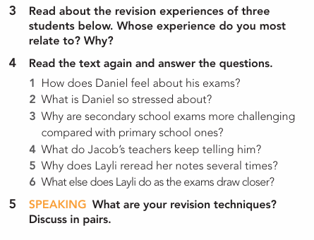
Group work
Instructions:
Work in groups
Read and respond to the questions
Buzz in

Slide 29
Feedback
Exercise 4
1 He has to cover a wide range of subjects and feels he’s only tested on facts.
2 He’s tired because his improvised timetable requires him to constantly flit from one subject to another.
3 Secondary school exams have more content that you’re expected to write about in less time.
4 His teachers keep telling him that good grades get you into university.
5 Because she finds it difficult to retain information and she hopes that by rereading her notes the information will become second nature to her.
6 Organise her thoughts and prepare to persuasively argue on a given topic.
Instructions:
Work in groups
Read and respond to the questions
Buzz in

Slide 30

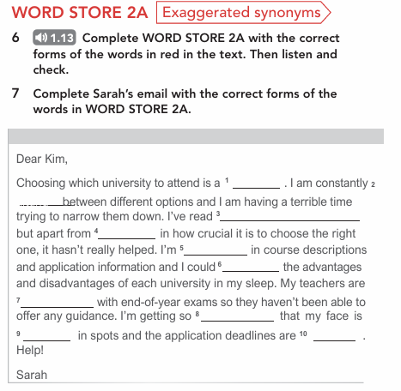
Group work
Instructions:
Work in groups
Read and respond to the questions
Buzz in

Slide 31
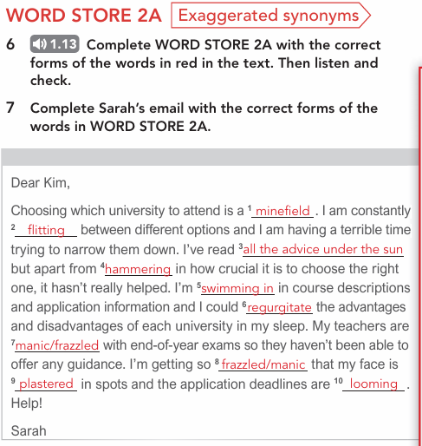
Feedback
Instructions:
Work in groups
Read and respond to the questions
Buzz in

Slide 32
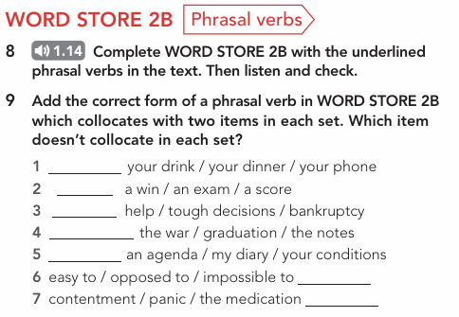
Group work
Instructions:
Work in groups
Read and respond to the questions
Buzz in

Slide 33
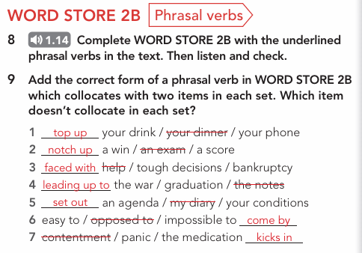
Feedback
Instructions:
Work in groups
Read and respond to the questions
Buzz in

Slide 34

ISLAMIC EDUCATIONAL COLLEGE DATE: / / 2025
Subject: Vocabulary
Grade: 10
Unit: 2
Lesson: 1
OUTCOMES
Formative assessment
3:00
WARM UP
PREASSESSMENT
A student who feels "swimming in" notes is likely feeling:
Very organized and prepared.
Overwhelmed by the large amount of material.
Excited about studying.
Confused because the notes are messy.
PRESENTATION
FORMATIVE ASSESSMENT
FEEDBACK
DIFFERENTIATION
REAL LIFE APPLICATION
CRITICAL THINKING
EXIT TICKET

Slide 35
ISLAMIC EDUCATIONAL COLLEGE DATE: / / 2025
Subject: Vocabulary
Grade: 10
Unit: 2
Lesson: 1
OUTCOMES
Feedback
WARM UP
PREASSESSMENT
A student who feels "swimming in" notes is likely feeling:
Very organized and prepared.
Overwhelmed by the large amount of material.
Excited about studying.
Confused because the notes are messy.
PRESENTATION
FORMATIVE ASSESSMENT
FEEDBACK
DIFFERENTIATION
REAL LIFE APPLICATION
CRITICAL THINKING
EXIT TICKET

Slide 36
ISLAMIC EDUCATIONAL COLLEGE DATE: / / 2025
Subject: Vocabulary
Grade: 10
Unit: 2
Lesson: 1
OUTCOMES
Formative assessment
WARM UP
PREASSESSMENT
If you 'regurgitate' information, you are:
Explaining a topic in your own words.
Repeating facts without true understanding.
Creating new ideas based on what you've learned.
Studying a topic for the first time.
PRESENTATION
FORMATIVE ASSESSMENT
FEEDBACK
DIFFERENTIATION
REAL LIFE APPLICATION
CRITICAL THINKING
EXIT TICKET

Slide 37
ISLAMIC EDUCATIONAL COLLEGE DATE: / / 2025
Subject: Vocabulary
Grade: 10
Unit: 2
Lesson: 1
OUTCOMES
Feedback
WARM UP
PREASSESSMENT
If you 'regurgitate' information, you are:
Explaining a topic in your own words.
Repeating facts without true understanding.
Creating new ideas based on what you've learned.
Studying a topic for the first time.
PRESENTATION
FORMATIVE ASSESSMENT
FEEDBACK
DIFFERENTIATION
REAL LIFE APPLICATION
CRITICAL THINKING
EXIT TICKET

Slide 38
ISLAMIC EDUCATIONAL COLLEGE DATE: / / 2025
Subject: Vocabulary
Grade: 10
Unit: 2
Lesson: 1
OUTCOMES
Formative assessment
WARM UP
The phrase "kick in" is a phrasal verb that means something is about to:
Stop.
Begin.
Get kicked.
End.
PREASSESSMENT
PRESENTATION
FORMATIVE ASSESSMENT
FEEDBACK
DIFFERENTIATION
REAL LIFE APPLICATION
CRITICAL THINKING
EXIT TICKET

Slide 39
ISLAMIC EDUCATIONAL COLLEGE DATE: / / 2025
Subject: Vocabulary
Grade: 10
Unit: 2
Lesson: 1
OUTCOMES
Feedback
WARM UP
The phrase "kick in" is a phrasal verb that means something is about to:
Stop.
Begin.
Get kicked.
End.
PREASSESSMENT
PRESENTATION
FORMATIVE ASSESSMENT
FEEDBACK
DIFFERENTIATION
REAL LIFE APPLICATION
CRITICAL THINKING
EXIT TICKET

Slide 40
ISLAMIC EDUCATIONAL COLLEGE DATE: / / 2025
Subject: Vocabulary
Grade: 10
Unit: 2
Lesson: 1
OUTCOMES
Formative assessment
WARM UP
A revision period that is described as 'manic' is one that is:
Calm and relaxed.
Well-structured and organized.
Very busy and chaotic.
Simple and straightforward.
PREASSESSMENT
PRESENTATION
FORMATIVE ASSESSMENT
FEEDBACK
DIFFERENTIATION
REAL LIFE APPLICATION
CRITICAL THINKING
EXIT TICKET

Slide 41
ISLAMIC EDUCATIONAL COLLEGE DATE: / / 2025
Subject: Vocabulary
Grade: 10
Unit: 2
Lesson: 1
OUTCOMES
Feedback
WARM UP
A revision period that is described as 'manic' is one that is:
Calm and relaxed.
Well-structured and organized.
Very busy and chaotic.
Simple and straightforward.
PREASSESSMENT
PRESENTATION
FORMATIVE ASSESSMENT
FEEDBACK
DIFFERENTIATION
REAL LIFE APPLICATION
CRITICAL THINKING
EXIT TICKET

Slide 42
ISLAMIC EDUCATIONAL COLLEGE DATE: / / 2025
Subject: Vocabulary
Grade: 10
Unit: 2
Lesson: 1
OUTCOMES
Differentiation
03:00 minutes
WARM UP
Students 1+2
Students 3+4
PREASSESSMENT
PRESENTATION
Write a short paragraph using at least five of the new words. Challenge them to incorporate both the vocabulary words and the phrasal verbs.
Write down 3 sentences using the new words
FORMATIVE ASSESSMENT
FEEDBACK
DIFFERENTIATION
REAL LIFE APPLICATION
📌 Share: Each pair presents their product to the class.
CRITICAL THINKING
Criteria | 2 pts (Strong) | 1 pt (Developing)
Engagement | Actively participates & stays on task | Limited participation or off-task
Collaboration | Shares ideas & supports partner | Minimal sharing or uneven work
Communication | Ideas are clear & connected to text | Ideas unclear or weakly linked
EXIT TICKET

Slide 43

ISLAMIC EDUCATIONAL COLLEGE DATE: / 5/ 2025
Subject: Vocabulary
Grade: 10
Unit: 2
Lesson: 1
OUTCOMES
4:00 minutes
Real-life application:
Personal Story Time:
Ask students to share a personal experience related to the words. For example, "Tell us about a time you felt swimming in homework.“
Students will have 1 minute to think.
Random pick: Speak up and share your story using the new words
WARM UP
PREASSESSMENT
PRESENTATION
FORMATIVE ASSESSMENT
FEEDBACK
DIFFERENTIATION
REAL LIFE APPLICATION
EXIT TICKET

Slide 44
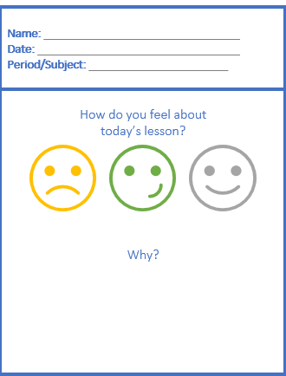
Exit Ticket

