Slide 1

Unit Two: Learning for life
Lesson: Reading
Subject: Study abroad.
Grade: Ten

Slide 2



Subject: Reading
Grade: 10
Unit: 2
Lesson: 1
LESSON
OBJECTIVES
00:30 minute
WARM UP
Objectives
PREASSESSMENT
-To understand the structure of
The text using contextual, grammatical, and lexical clues.
- To evaluate the pros and cons of studying abroad.
- To construct an opinion regarding the life abroad.
PRESENTATION
FORMATIVE ASSESSMENT
FEEDBACK
DIFFERENTIATION
REAL LIFE APPLICATION
CRITICAL THINKING
EXIT TICKET

Slide 3


Subject: Reading
Grade: 10
Unit: 2
Lesson: 1
OUTCOMES
WARM UP
03:00 minutes
WARM UP
Take off-Touch down
Instructions:
Take off if you have ever traveled abroad
For what reason have you traveled?
Random pick: For those who touched down, would you like to experience travelling abroad? Justify.
Real Life Application
PRESENTATION
FORMATIVE ASSESSMENT
FEEDBACK
DIFFERENTIATION
REAL LIFE APPLICATION
CRITICAL THINKING
EXIT TICKET

Slide 4

Subject: Reading
Grade: 10
Unit: 2
Lesson: 1
OUTCOMES
Real Life Application
3:00
WARM UP
The "Grass is Greener" Concept ⚖️
Objective: To critically evaluate the decision to study abroad by weighing the pros and cons.
Activity:
Start with the author's statement that many students weigh studying abroad as a series of pros and cons, or a "question of whether the grass will be greener on the other side".
Students will work in pairs to compare and contrast the green grass!
Random pick and speak up!
Real Life Application
CRITICAL THINKING
FORMATIVE ASSESSMENT
FEEDBACK
DIFFERENTIATION
REAL LIFE APPLICATION
PRESENTATION
EXIT TICKET

Slide 5
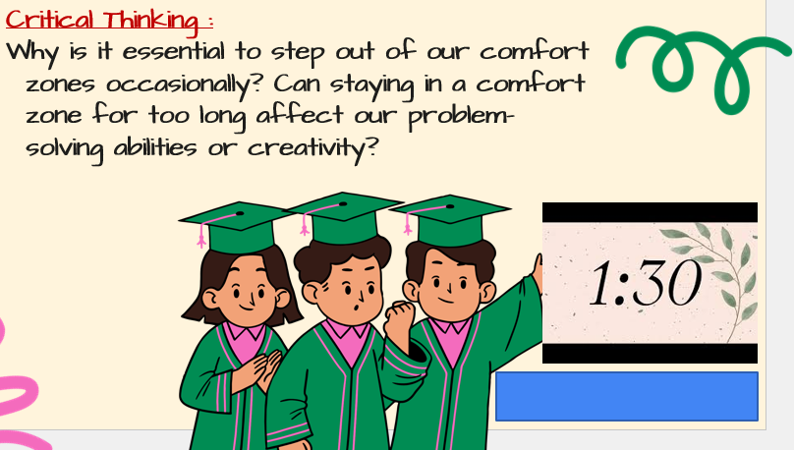
ISLAMIC EDUCATIONAL COLLEGE DATE: /2/ 2025
Subject: Reading
Grade: 10
Unit: 2
Lesson: 1
OUTCOMES
CRITICAL THINKING
2:00
WARM UP
REAL LIFE APPLICATION
CRITICAL THINKING
PREASSESSMENT
FEEDBACK
FORMATIVE ASSESSMENT
PRESENTATION
DIFFERENTIATION
EXIT TICKET

Slide 6

ISLAMIC EDUCATIONAL COLLEGE DATE: / 5/ 2025
Subject: Reading
Grade: 10
UNIT:4
Lesson: 1
OUTCOMES
Predict from a Title
Look at the title of the article: "Study Abroad: Take a Leap into the Unknown." Based on this title, what do you predict the article will be about?
2:00
WARM UP
REAL LIFE APPLICATION
CRITICAL THINKING
PREASSESSMENT
PRESENTATION
DIFFERENTIATION
FORMATIVE ASSESSMENT
FEEDBACK
EXIT TICKET

Slide 7

ISLAMIC EDUCATIONAL COLLEGE DATE: 19 / 2/ 2025
Subject: Reading
Grade: 10
Unit: 2
Lesson: 1
OUTCOMES
Groupwork skimming for the overall idea:
Students will work as groups
Each group will read a portion of the text
Students will have 1 minute to read, 1 minute to discuss, and 1 minute to share.
Random pick.
5:00
WARM UP
REAL LIFE APPLICATION
CRITICAL THINKING
PREASSESSMENT
PRESENTATION
DIFFERENTIATION
FEEDBACK
FORMATIVE ASSESSMENT
EXIT TICKET

Slide 8
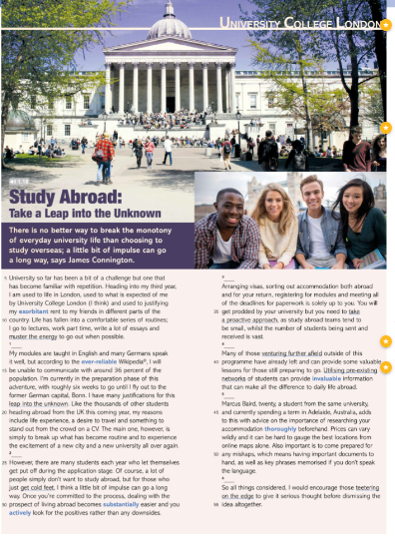
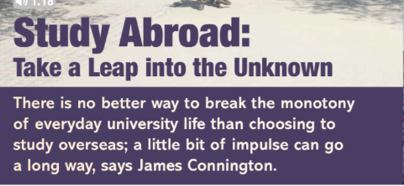
take a big risk or make a significant change without knowing exactly what will happen or what the outcome will be
feeling of dullness or boredom
Can go a long way :it is an important factor in achieving that thing.
Urge , need

Slide 9
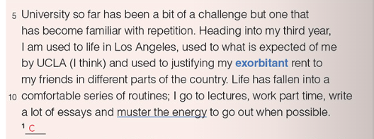
A bit of a challenge : difficult
Exorbitant : high .
Justify : give reasons for
Muster the energy : gather as much energy as you can .
"University so far has been a bit of a challenge but one that has become familiar with repetition.
Explanation: The writer is saying that university has been difficult, but over time, the challenges have become more manageable because of repetition. They have gotten used to these challenges through routine and experience.
"Heading into my third year, I am used to life in Los Angeles, used to what is expected of me by UCLA
(I think)..."
Explanation: As he starts his third year, the writer feels more comfortable with life in Los Angeles and with UCLA's academic expectations. The addition of "I think" shows a touch of humor or uncertainty, suggesting he may still feel some pressure or occasional surprises despite their familiarity.

Slide 10
"...and used to justifying my exorbitant rent to my friends in different parts of the country."
Explanation: Living in Los Angeles comes with high living expenses, particularly rent, and the writer often finds himself explaining to friends why he pays so much. This line hints at the financial realities of city life and the contrast between his experience and that of friends in less expensive areas.
"Life has fallen into a comfortable series of routines;"
Explanation: The writer’s daily life has settled into a rhythm that feels stable and familiar. The word "comfortable" suggests he finds some satisfaction or ease in this established routine.

Slide 11
I go to lectures, work part-time, write a lot of essays and muster the energy to go out when possible."
Explanation: This describes his primary activities: attending classes, working a part-time job, and handling academic assignments, especially essays. The phrase "muster the energy to go out" implies that, while socializing is important, his busy schedule means he sometimes has to make an extra effort to socialize.
Muster the energy" means to gather or summon enough energy or motivation to do something, especially when feeling tired or reluctant.

Slide 12

Made the slightly impulsive decision : made a choice quickly, without much planning or deep thought. The word "impulsive" suggests that this decision was based more on a spontaneous desire or feeling rather than careful consideration
The writer, accustomed to the routines and familiarity of his current life, has decided—somewhat spontaneously—to spend part of his final and most crucial year studying in Germany, despite not knowing any German. This choice reflects a willingness to step out of his comfort zone, embracing the unknown and potentially challenging himself in a new environment, even though it contrasts with the predictability he has grown used to.

Slide 13
Paragraph 1
What has university life been like for the writer so far?
2. How does the writer feel about life in Los Angeles as they start their third year?
3. What does the writer say he is used to about UCLA?
It has been a bit of a challenge, but one that has become familiar with repetition.
The writer feels accustomed to life in Los Angeles.
he is used to what is expected of him by UCLA..

Slide 14
4. Why does the writer mention justifying his rent to friends in other parts of the country?
Because the rent in Los Angeles is high, and he often needs to explain why he pays so much compared to friends living elsewhere.
5. What does the writer mean by saying "life has fallen into a comfortable series of routines"?
It means that his life has settled into a predictable and manageable set of daily activities.
6.List the main activities in the writer's daily routine
Attending lectures, working part-time, writing essays, and occasionally going out.

Slide 15
Find a phrase that means ‘something you have done many times so it becomes normal or less intimidating.’
Find a word that means ‘very high’ when talking about rent.
Find a phrase that means ‘gather enough energy or motivation to do something
Familiar with repetition.
Exorbitant.
Muster the energy

Slide 16
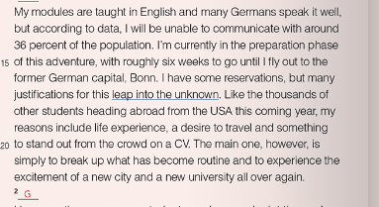
Paragraph 2

Slide 17
1. Modules: Units or courses of study in an academic program.
2. Reservations: Doubts or concerns about a particular decision or situation.
3. Justifications: Reasons or explanations that support a decision or action.
4.Leap into the unknown: A significant change or decision that involves uncertainty and risk.
5. Desire: A strong feeling of wanting to have something or wishing for something to happen.
6. Stand out from the crowd: To be noticeable or distinctive compared to others.
7. Excitement: A feeling of great enthusiasm and eagerness
8.Preparation phase: The stage of getting ready for a particular event or undertaking

Slide 18
"My modules are taught in English, and many Germans speak it well."
Explanation: The writer’s courses (modules) will be in English, which is helpful since a lot of Germans also speak English fluently. This gives him some confidence that he won’t face a language barrier in academic settings or in parts of daily life.
But according to data, I will be unable to communicate with around 36 percent of the population."
Explanation: Based on information or statistics, the writer knows that about 36 percent of people in Germany may not speak English, meaning there’s still a significant portion of the population he won’t be able to communicate with easily.

Slide 19
"I'm currently in the preparation phase of this adventure, with roughly six weeks to go until I fly out to the former German capital, Bonn."
Explanation: The writer is getting ready for this trip, which he describes as an adventure. He has about six weeks left before he leaves for Bonn, which used to be Germany’s capital
"I have some reservations, but my many justifications for this leap into the unknown, like the thousands of other students heading abroad from the USA this coming year, include life experience."
Explanation: Although he has some concerns (reservations), he also has reasons (justifications) for this decision to study abroad, which he compares to a “leap into the unknown.” Like many other U.S. students going abroad, he sees this experience as a way to gain valuable life experiences

Slide 20
"A desire to travel and something to stand out from the crowd on a CV.“
Explanation: His reasons also include wanting to explore new places (a desire to travel) and to add something unique to his CV (resume), helping him stand out when applying for jobs.
"The main one, however, is simply to break up what has become routine and to experience the excitement of a new city and a new university all over again."
Explanation: His biggest reason is wanting a break from his current routine. He looks forward to the thrill of starting fresh in a new city and university, re-experiencing the sense of novelty and excitement

Slide 21
1. What language are the writer's modules taught in?
The modules are taught in English.
2. What percentage of the German population does the writer believe he will be unable to communicate with?
The writer believes he will be unable to communicate with around 36 percent of the population.
3. What is the writer currently preparing for, and how much time does he have left until he flies out?
The writer is currently in the preparation phase for his trip and has roughly six weeks until he flies out.

Slide 22
4. What is the former capital of Germany that the writer is traveling to?
The writer is traveling to Bonn, the former capital of Germany.
5. What are some of the writer's justifications for studying abroad?
The writer's justifications include gaining life experience, a desire to travel, and wanting something that will help him stand out on his CV.
6.What is the writer's main reason for wanting to study abroad?
The main reason is to break up his routine and to experience the excitement of a new city and university.
7.How does the writer compare his experience to that of other students?
He compares his experience to that of thousands of other students heading abroad from the USA, emphasizing that they share similar reasons for studying overseas.

Slide 23
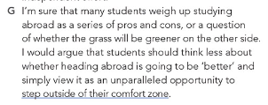
"I'm sure that many students weigh up studying abroad as a series of pros and cons..."
Explanation: The writer believes that many students consider the advantages (pros) and disadvantages (cons) of studying abroad. They analyze the situation by listing the positive and negative aspects before making a decision.
"...or a question of whether the grass will be greener on the other side."
Explanation: This phrase is a metaphor that suggests students are questioning if studying abroad will be better than their current situation. It implies a common uncertainty about whether new experiences will lead to greater satisfaction or happiness.

Slide 24
"I would argue that students should think less about whether heading abroad is going to be better..."
Explanation: The writer believes that students should not focus too much on comparing their current situation with the potential benefits of studying abroad. He suggests that this comparative thinking might hinder decision-making.

Slide 25
"...and simply view it as an unparalleled opportunity to step outside their comfort zone."
Explanation: The writer encourages students to see studying abroad as a unique chance to challenge themselves and try new experiences, which can lead to personal growth. "Stepping outside their comfort zone" means taking risks and facing unfamiliar situations that may be uncomfortable but can also be rewarding.

Slide 26
1. What do many students consider when thinking about studying abroad?
Many students weigh up studying abroad as a series of pros and cons.
2. What metaphor does the writer use to express uncertainty about studying abroad
The writer uses the metaphor "whether the grass will be greener on the other side" to express uncertainty about whether studying abroad will be better than their current situation.
3. What does the writer argue students should focus less on?
The writer argues that students should focus less on whether heading abroad is going to be better.
4. What opportunity does the writer suggest studying abroad provides?
The writer suggests that studying abroad provides an unparalleled opportunity to step outside their comfort zone.

Slide 27
5. What does "stepping outside their comfort zone" mean in this context?
In this context, "stepping outside their comfort zone" means taking risks and facing unfamiliar situations that may be uncomfortable but can lead to personal growth and new experiences.

Slide 28
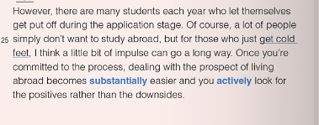
Paragraph 3
"However, there are many students each year who let themselves get put off during the application stage."
Explanation: The writer acknowledges that many students face challenges during the application process for studying abroad. The phrase "let themselves get put off" indicates that these students may become discouraged or lose motivation to apply.

Slide 29
"Of course, a lot of people simply don’t want to study abroad..."
Explanation: The writer recognizes that not everyone is interested in studying abroad. This suggests that personal preference plays a significant role in the decision-making process.
"...but for those who just get cold feet..."
Explanation: The term "cold feet" refers to a sudden loss of confidence or reluctance to proceed with a decision, often just before taking a significant step. The writer is specifically addressing students who may want to study abroad but hesitate due to fear or anxiety.

Slide 30
"...I think a little bit of impulse can go a long way."
Explanation: The writer suggests that acting on impulse or taking a leap of faith can be beneficial. This implies that sometimes making a quick decision to apply or commit can lead to positive outcomes.
"Once you are committed to the process, dealing with the prospect of living abroad becomes substantially easier...
Explanation: The writer argues that once a student decides to go through with studying abroad, the challenges and uncertainties associated with the idea of living in a foreign country become more manageable. Commitment provides clarity and reduces anxiety.

Slide 31
"...and actively look for positive rather than the downside."
Explanation: The writer emphasizes the importance of focusing on the positive aspects of studying abroad instead of dwelling on potential negatives. This proactive mindset can help students enjoy the experience and make the most of their time abroad.

Slide 32
1. Put off: to cause someone to lose interest or motivation.
2. Application stage: The phase in the process where individuals formally apply for a program or opportunity, such as studying abroad. This often involves submitting required documents and completing various forms.
3. Cold feet: A feeling of nervousness or anxiety that leads to hesitation or withdrawal from a decision or commitment, especially just before taking action.
4. Impulse: A sudden urge or instinct to act without premeditation; a spontaneous decision that can lead to action.
Committed: Dedicated to a particular course of action; having made a firm decision to pursue a goal or project.
5. Prospect: The possibility or likelihood of some future event occurring; in this context, it refers to the anticipation of living abroad.
6.Substantially: To a great extent or degree; significantly; in this context, it indicates that the ease of dealing with living abroad increases significantly after commitment.
6.Downside : The negative aspects or disadvantages of a situation; the less favorable side of something.

Slide 33
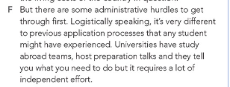
Hurdles : problems , obstacles
"But there are some administrative hurdles to get through first.
Explanation: The writer introduces the idea that before students can study abroad, they must overcome certain bureaucratic challenges or obstacles related to the administrative processes of applications and requirements.

Slide 34
"Logistically speaking, it’s very different to provide application processes than any student might have experienced."
Explanation: The phrase "logistically speaking" indicates that the writer is discussing the practical aspects of the application process. The writer suggests that the application processes for studying abroad differ significantly from what students may have encountered in their previous academic experiences.
"Universities have study abroad teams..."
Explanation: This part states that universities employ dedicated teams responsible for facilitating and managing study abroad programs. These teams provide support and guidance to students interested in going abroad.

Slide 35
"...host preparation talks and they tell you what you need to do...
"Explanation: The "preparation talks" refer to informational sessions organized by the study abroad teams. During these talks, students are informed about the requirements, procedures, and important information they need to know before embarking on their study abroad journey.
"...but it requires a lot of independent effort."
Explanation: The writer emphasizes that despite the support provided by the universities, students must take the initiative and put in considerable effort themselves. This suggests that self-motivation and responsibility are crucial for successfully navigating the application process and preparing for studying abroad.

Slide 36
1. What are students required to overcome before studying abroad?
Students are required to overcome administrative hurdles before studying abroad.
2. How does the writer describe the application processes for studying abroad?
The writer describes the application processes for studying abroad as very different from what any student might have experienced in their previous academic applications.
3. What does "logistically speaking" suggest about the writer's focus?
Logistically speaking" suggests that the writer's focus is on the practical aspects and organization of the application process rather than theoretical considerations.
4. What role do universities have in the study abroad application process?
Universities have dedicated study abroad teams that provide support, information, and guidance throughout the application process.

Slide 37
5. What does the phrase "requires a lot of independent effort" imply about the application process?
The phrase implies that, despite the support from universities, students must take initiative and be self-motivated to successfully navigate the application process for studying abroad.
6. Why might the application process for studying abroad be considered more complex than regular application processes?
The application process for studying abroad might be considered more complex due to specific requirements, procedures, and logistical challenges that are unique to studying in a foreign country.
7. What can students expect from the preparation talks hosted by study abroad teams?
Students can expect to receive important information and guidance about the application process, requirements, and what to anticipate when studying abroad.

Slide 38
1. Administrative: Relating to the management and organization of tasks, processes, or activities, particularly within an institution or organization.
2. Hurdles: Obstacles or challenges that must be overcome; difficulties that hinder progress or achievement.
3. Logistically: Pertaining to the planning and coordination of complex tasks or processes, often involving the movement and management of resources.
3. Application processes: : The series of steps or procedures required to apply for a program, opportunity, or position, which may include submitting documents, forms, and information.
4. Provide: To supply or make available; to furnish someone with something that is needed or requested.

Slide 39
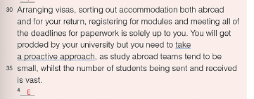
Paragraph 4
"Arranging visa, sorting out accommodation both abroad and for your return,"
Explanation: This part emphasizes two key responsibilities that students must handle themselves: obtaining a visa (the official permission to enter a foreign country) and finding suitable housing both in the host country and back home after their study abroad experience.

Slide 40
"registering for modules and meeting all of the deadlines for paperwork is solely up to you."
Explanation: The writer highlights additional responsibilities, which include enrolling in classes (modules) for the study abroad program and ensuring that all necessary documents are submitted on time. The phrase "solely up to you" indicates that these tasks fall entirely on the student, underscoring the need for personal initiative and accountability.
"You will get prodded by your university...“
Explanation: The term "prodded" suggests that the university will offer reminders or encouragement to help students complete their tasks. However, it implies that this assistance may not be extensive, and students should not rely solely on it.

Slide 41
"...but you need to take a proactive approach,"
Explanation: Here, the writer stresses the importance of being proactive—taking the initiative to act rather than waiting for reminders or help. This approach is crucial for successfully managing the study abroad process
"...as study abroad teams tend to be small,"
Explanation: This portion indicates that the teams responsible for assisting students with study abroad programs are typically limited in size. This could mean fewer resources or personnel available to support each student.

Slide 42
"...whilst the number of students being sent and received is vast."
Explanation: The writer contrasts the small size of study abroad teams with the large number of students participating in these programs. This suggests that the demand for assistance is high, which may lead to less individualized support for each student.

Slide 43
1. What are the responsibilities mentioned that students must handle when preparing for studying abroad?
Students must arrange their visa, sort out accommodation both abroad and for their return, register for modules, and meet all deadlines for paperwork.
2. What does the term "proactive approach" mean in the context of this passage?
A "proactive approach" means that students should take the initiative to manage their own preparations and responsibilities rather than waiting for assistance or reminders from the university.
3. Why is it important for students to take a proactive approach according to the text?
It is important because the study abroad teams are typically small, and the number of students being sent and received is vast, meaning there may not be enough support available for every student.

Slide 44
4. What challenges do students face in the application process for studying abroad as mentioned in the text?
Students face challenges such as managing their visa arrangements, accommodation logistics, course registration, and meeting various paperwork deadlines.
5. How does the writer compare the size of study abroad teams to the number of students involved?
The writer states that study abroad teams tend to be small while the number of students being sent and received is vast, highlighting a mismatch between available support and student demand.
6. What is implied about the role of students in the study abroad process?
It is implied that students need to be self-sufficient and take personal responsibility for their preparations to ensure a successful study abroad experience.

Slide 45
Arranging: Organizing or putting plans in place; in this context, it refers to handling the process of obtaining a visa.
Visa: An official document or stamp in a passport that allows a person to enter and stay in a foreign country for a specific purpose and time.
Accommodation: Housing or a place to stay, such as an apartment, dormitory, or other living arrangements needed both in the foreign country and for returning home.
Modules: Specific courses or classes that a student enrolls in as part of their academic program.
Deadlines: The latest dates by which something must be completed, such as paperwork or applications.
Solely: Exclusively or entirely; used to emphasize that the responsibility lies completely with the student

Slide 46

Paragraph 5
"From a financial standpoint, the ERASMUS programme in particular is a very attractive opportunity...“
Explanation: The writer is discussing the financial advantages of the ERASMUS program.
Key Terms:
-Financial standpoint: A perspective focused on costs, savings, or monetary benefits.
-ERASMUS programme: A European Union program that provides opportunities for students to study or gain work experience in different European countries.

Slide 47
"...particularly for London students used to high living costs."
Explanation: The ERASMUS program is especially appealing to students from London, where the cost of living is typically very high. Studying abroad in a country with lower living expenses can be financially beneficial for them
"In addition to the regular student loan, students get a grant..."
Explanation: Besides the usual student loans that help cover costs, students participating in ERASMUS receive an additional grant.
Key Terms:
  Grant: Money given that does not have to be repaid, which helps students manage their expenses while studying abroad.

Slide 48
"...which varies according to the living cost of the country in question."
Explanation: The amount of the grant depends on the cost of living in the destination country. Higher-cost countries provide larger grants, while lower-cost countries provide smaller ones.

Slide 49
1. Why is the ERASMUS program considered financially attractive?
It provides additional financial support, especially beneficial for students from high-cost areas like London.
2. Who might find the ERASMUS program particularly appealing, according to the passage?
Students from London, where living costs are high.
3.What financial benefit does the ERASMUS program offer to students in addition to a regular student loan?
The program offers a grant that helps cover living costs.

Slide 50
4. How is the amount of the ERASMUS grant determined?
The grant amount varies according to the cost of living in the destination country.
5. What is meant by "financial standpoint" in the context of this passage?
It refers to the financial or economic perspective, focusing on costs and savings
6.Why would the ERASMUS grant be especially helpful for London students?
Because they are used to high living costs, and the additional grant can help make studying abroad more affordable.

Slide 51
Financial standpoint: A perspective focused on money, expenses, or financial benefits.
ERASMUS programme: A European Union initiative that provides scholarships for students to study or work abroad in different European countries.
Attractive opportunity: An appealing or desirable chance or option, in this case, for financial reasons.
Particularly: Especially or specifically, highlighting a certain group or factor.
Living costs: The expenses associated with daily life, such as rent, food, and transportation.
Student loan: Money borrowed by students to help pay for their education, which must be repaid with interest after they graduate.
Grant: A financial gift or award given to students that doesn’t need to be repaid; it helps with expenses.
Varies: Changes or differs; in this context, the amount of the grant differs depending on the country.
In question: Refers to something specific that has been mentioned, in this case, the particular country the student is planning to study in.

Slide 52

Paragraph 6
"Many of those venturing further afield outside of this programme have already left...
"Explanation:
A number of students who are traveling beyond the ERASMUS program have already begun their study-abroad experience.
Key Terms:
Venturing further afield: Exploring or going beyond typical boundaries, in this case, studying outside the ERASMUS program.
Programme: Refers to the structured ERASMUS study-abroad program.

Slide 53
"...and can provide some valuable lessons for those still preparing to go.
"Explanation:
These students who have already left can share helpful insights and advice for others who are still preparing to travel.
"Utilizing a pre-existing network of students can provide invaluable information...
"Explanation: Using a network of students who have prior study-abroad experience can offer essential information.
Key Terms:
-Pre-existing network: A group of people who are already connected, such as students who have studied abroad before.
Invaluable: Extremely useful or helpful.
"...that can make all the difference to daily life abroad."
Explanation: This information could significantly improve or ease daily living while studying abroad.

Slide 54
1. What is the benefit of connecting with students who have already gone abroad
They can provide valuable lessons and insights that help others prepare for daily life abroad.
2. What does the phrase "venturing further afield" mean in this passage?
It means exploring or studying outside the usual boundaries, in this case, beyond the ERASMUS program.
3. Why might information from a "pre-existing network of students" be described as invaluable?
Because it can provide extremely useful advice that makes a big difference in adjusting to daily life abroad.

Slide 55
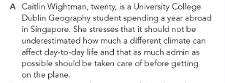
Paragraph 7
"Caitlin Wightman, twenty, is a university college Dublin Geography student spending a year abroad in Singapore.
This introduces Caitlin Wightman, a 20-year-old geography student from University College Dublin who is currently studying abroad in Singapore.
"She stresses that it should not be underestimated how much a different climate can affect day-to-day life.“
Caitlin emphasizes that a different climate can significantly impact everyday life, suggesting that adjusting to a new environment is an important consideration when studying abroad.
"And that as much admin as possible should be taken care of before getting on the plane.
She advises handling as much of the necessary administrative work as possible before departure to make the transition smoother once abroad

Slide 56
1. What aspect of studying abroad does Caitlin emphasize should not be underestimated?
Caitlin emphasizes that the impact of a different climate on daily life should not be underestimated.
2.What administrative advice does Caitlin offer to students planning to study abroad?
She advises that as much administrative work as possible should be completed before departure.

Slide 57
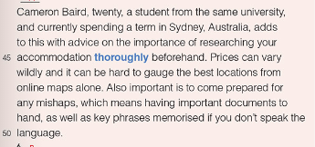
"Cameron Baird, twenty, a student from the same university, and currently spending a term in Sydney, Australia, adds to this with advice on the importance of researching your accommodation thoroughly beforehand."
Cameron Baird, a 20-year-old student also from University College Dublin, is spending a term abroad in Sydney, Australia. He advises that students thoroughly research their accommodation options before traveling.

Slide 58
"Prices can vary wildly, and it can be hard to argue the best locations from online maps alone.
: He points out that accommodation prices can differ significantly, and it can be challenging to assess the best locations based solely on online maps.
"Also, important is to come prepared for any mishaps, which means having important documents to hand, as well as key phrases memorized if you don’t speak the language.“
Cameron recommends being prepared for unexpected problems by keeping essential documents accessible and memorizing key phrases, especially if you’re unfamiliar with the language.

Slide 59
1. What advice does Cameron give about choosing accommodation when studying abroad?
Cameron advises thoroughly researching accommodation options beforehand, as prices can vary widely and online maps may not accurately show the best locations.
2. Why does Cameron recommend having important documents and memorizing key phrases?
He suggests this preparation to handle any potential mishaps, especially if students do not speak the local language.

Slide 60

Paragraph 8
"However prepared you are, studying abroad is not for everyone, and I am yet to discover whether or not it will suit me.“
This means that even with thorough preparation, studying abroad may not be a good fit for everyone. The writer acknowledges they haven’t yet determined if studying abroad will be a good experience for them personally.
"I know plenty of people who regret not applying and almost nobody who has the same reservations about their decision to go.“
The writer observes that many people regret not taking the opportunity to study abroad, while those who do go rarely regret their decision.

Slide 61
1. What does the author say about the suitability of studying abroad for everyone?
The author says that studying abroad is not for everyone, even if they are well-prepared.
2. Has the author decided if studying abroad is the right choice for them?
No, the author has not yet discovered if studying abroad will suit them.
3.What does the author notice about people who didn’t apply to study abroad compared to those who did?
The author knows many people who regret not applying, but almost no one who regrets their decision to go abroad.

Slide 62

"So all things considered, I would encourage those teetering on the edge to give it serious thought before dismissing the idea altogether."
  The writer, after weighing all the factors, advises people who are uncertain about studying abroad to think carefully about the opportunity before completely ruling it out.
This line highlights the author’s encouragement for students to carefully evaluate the potential benefits of studying abroad rather than making a quick decision against it.

Slide 63
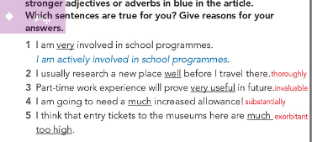

Slide 64
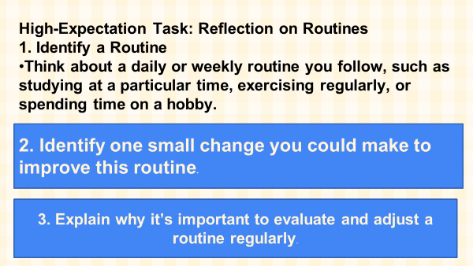

Slide 65
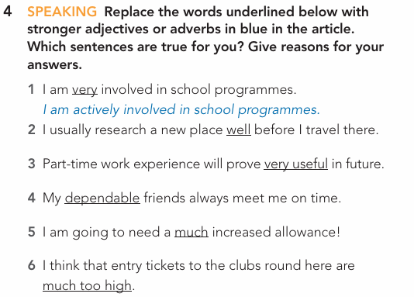
Group work
Instructions:
Work in groups
Read and answer the questions
Buzz in

Slide 66
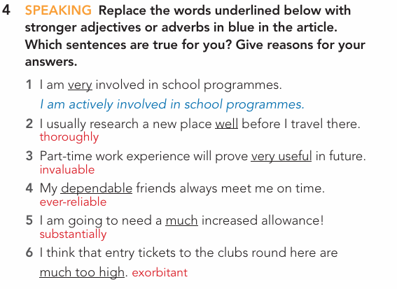
Feedback

Slide 67
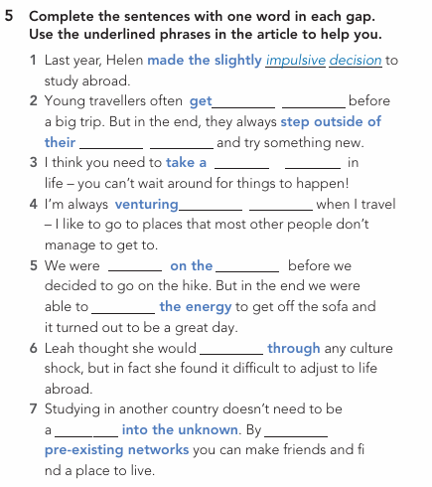
Group work
Instructions:
Work in groups
Read and respond to the questions
Buzz in

Slide 68
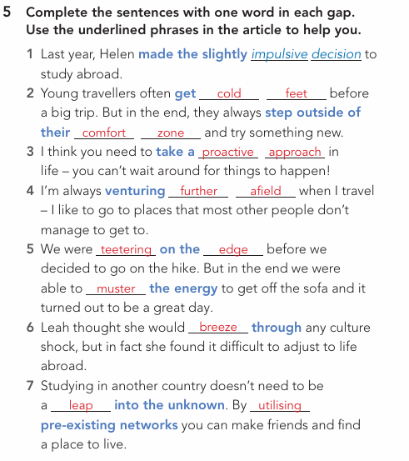
Feedback

Slide 69

ISLAMIC EDUCATIONAL COLLEGE DATE: / / 2025
Subject: Reading
Grade: 10
Unit: 2
Lesson: 1
OUTCOMES
Formative assessment
WARM UP
PREASSESSMENT
What has helped the author become more comfortable with university life?
Finding new hobbies
Repetition and routine
Exploring new places in London.
Making a lot of new friends
PRESENTATION
FORMATIVE ASSESSMENT
FEEDBACK
DIFFERENTIATION
REAL LIFE APPLICATION
CRITICAL THINKING
EXIT TICKET

Slide 70
ISLAMIC EDUCATIONAL COLLEGE DATE: / / 2025
Subject: Reading
Grade: 10
Unit: 2
Lesson: 1
OUTCOMES
Feedback
WARM UP
PREASSESSMENT
What has helped the author become more comfortable with university life?
Finding new hobbies
Repetition and routine
Exploring new places in London.
Making a lot of new friends
PRESENTATION
FORMATIVE ASSESSMENT
FEEDBACK
DIFFERENTIATION
REAL LIFE APPLICATION
CRITICAL THINKING
EXIT TICKET

Slide 71
ISLAMIC EDUCATIONAL COLLEGE DATE: / / 2025
Subject: Reading
Grade: 10
Unit: 2
Lesson: 1
OUTCOMES
Formative assessment
WARM UP
PREASSESSMENT
According to the text, what is one of the main motivations for students to study abroad?
To learn a new language
To escape their family
To stand out on a CV
To find cheaper housing
PRESENTATION
FORMATIVE ASSESSMENT
FEEDBACK
DIFFERENTIATION
REAL LIFE APPLICATION
CRITICAL THINKING
EXIT TICKET

Slide 72
ISLAMIC EDUCATIONAL COLLEGE DATE: / / 2025
Subject: Reading
Grade: 10
Unit: 2
Lesson: 1
OUTCOMES
Formative assessment
WARM UP
PREASSESSMENT
According to the text, what is one of the main motivations for students to study abroad?
To learn a new language
To escape their family
To stand out on a CV
To find cheaper housing
PRESENTATION
FORMATIVE ASSESSMENT
FEEDBACK
DIFFERENTIATION
REAL LIFE APPLICATION
CRITICAL THINKING
EXIT TICKET

Slide 73
ISLAMIC EDUCATIONAL COLLEGE DATE: / / 2025
Subject: Reading
Grade: 10
Unit: 2
Lesson: 1
OUTCOMES
Formative assessment
WARM UP
The author uses the phrase "whether the grass will be greener on the other side" to describe:
The beautiful landscapes in other countries.
Weighing the pros and cons of a decision.
The environmental benefits of travel.
How difficult it is to get a visa.
PREASSESSMENT
PRESENTATION
FORMATIVE ASSESSMENT
FEEDBACK
DIFFERENTIATION
REAL LIFE APPLICATION
CRITICAL THINKING
EXIT TICKET

Slide 74
ISLAMIC EDUCATIONAL COLLEGE DATE: / / 2025
Subject: Reading
Grade: 10
Unit: 2
Lesson: 1
OUTCOMES
Formative assessment
WARM UP
The author uses the phrase "whether the grass will be greener on the other side" to describe:
The beautiful landscapes in other countries.
Weighing the pros and cons of a decision.
The environmental benefits of travel.
How difficult it is to get a visa.
PREASSESSMENT
PRESENTATION
FORMATIVE ASSESSMENT
FEEDBACK
DIFFERENTIATION
REAL LIFE APPLICATION
CRITICAL THINKING
EXIT TICKET

Slide 75
ISLAMIC EDUCATIONAL COLLEGE DATE: / / 2025
Subject: Reading
Grade: 10
Unit: 2
Lesson: 1
OUTCOMES
Differentiation
03:00 minutes
WARM UP
Students 1+3
Students 2+4
PREASSESSMENT
PRESENTATION
Pair 1 (Students 1+3):Write 3 advice sentences for students planning to study abroad
Make a mind map with 2 benefits + 2 challenges of studying abroad.
FORMATIVE ASSESSMENT
FEEDBACK
DIFFERENTIATION
REAL LIFE APPLICATION
📌 Share: Each pair presents their product to the class.
CRITICAL THINKING
Criteria | 2 pts (Strong) | 1 pt (Developing)
Engagement | Actively participates & stays on task | Limited participation or off-task
Collaboration | Shares ideas & supports partner | Minimal sharing or uneven work
Communication | Ideas are clear & connected to text | Ideas unclear or weakly linked
EXIT TICKET

Slide 76
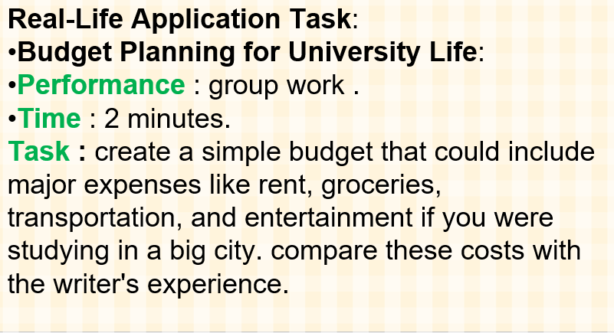
ISLAMIC EDUCATIONAL COLLEGE DATE: / 5/ 2025
Subject: Reading
Grade: 10
Unit: 2
Lesson: 1
OUTCOMES
WARM UP
PREASSESSMENT
PRESENTATION
FORMATIVE ASSESSMENT
FEEDBACK
DIFFERENTIATION
REAL LIFE APPLICATION
EXIT TICKET

Slide 77
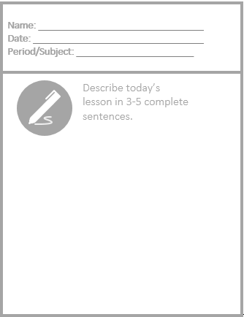
Exit Ticket

