Slide 1
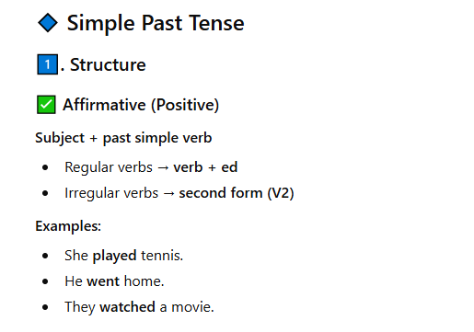

Slide 2
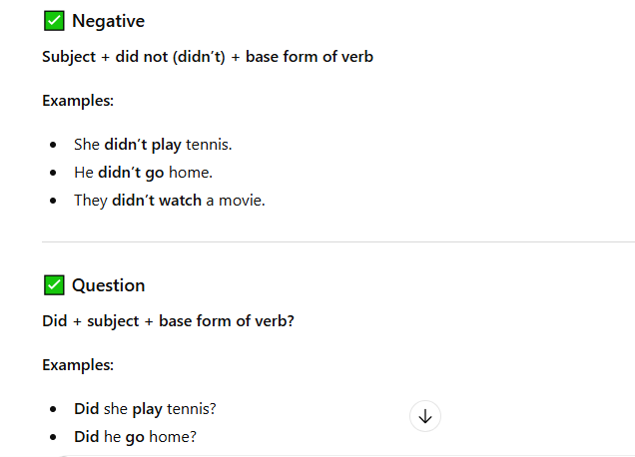

Slide 3
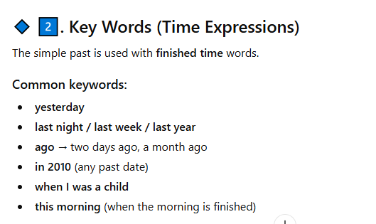

Slide 5
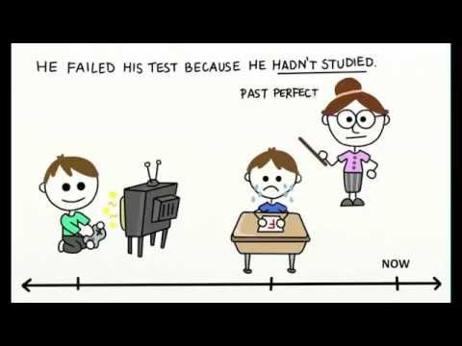
A) He didn’t study
B) He failed the test
Action 1 : Past Perfect
Action 2 : Past Simple

Slide 6
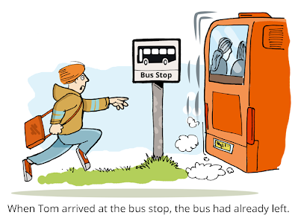
The bus left
Tom arrived

Slide 7
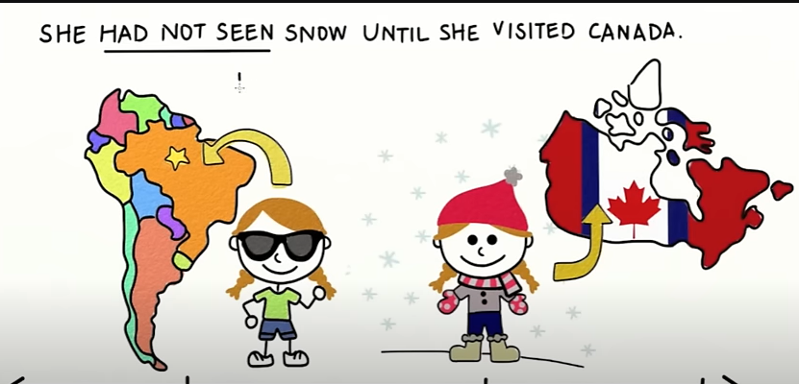
She hadn’t seen the snow
She visited Canada

Slide 8
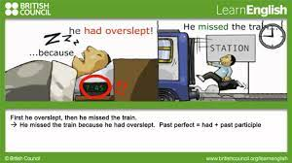
He missed the bus because he overslept .

Slide 9
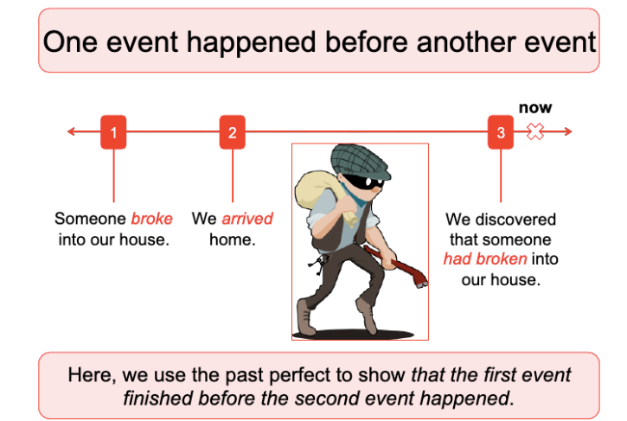

Slide 10

When do we use the past perfect ?
The past perfect tense is used to show that something happened before another action in the past.

Slide 11
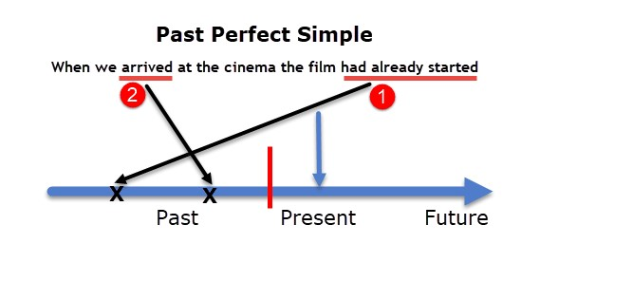

Slide 12
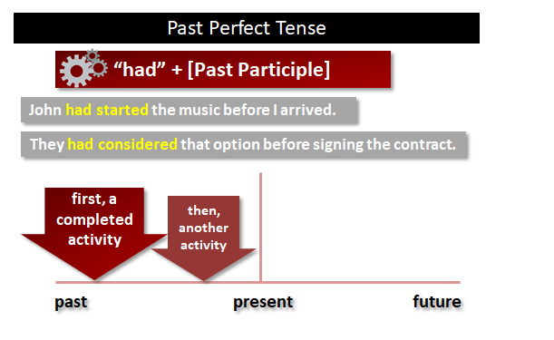

Slide 13
After + past perfect , past simple .
Before + past simple , past perfect .
As soon as + past perfect , past simple .
Past perfect + then + past simple
By + year ( past perfect )
By the time + past simple + past perfect
Because + past perfect
When + past simple

Slide 14
https://www.liveworksheets.com/w/en/english-second-language-esl/313861

Slide 15
Real Life Application
Write personal or historical narratives where the past perfect is necessary to distinguish events.
Before I moved to this city, I had lived in a small village for ten years. Life in the village was quiet, and I enjoyed the simplicity. When I arrived in the city, I immediately noticed how different everything was. I had never experienced such a fast-paced lifestyle before. By the time I met my new neighbors, I had already unpacked all my things and had explored the nearby parks.

Slide 16
She had finished her homework before she went to bed.
They had eaten dinner before the movie started.
I had studied the lesson before the quiz began.
The bus had left before we arrived at the station.
He had never tried sushi before he visited Japan.

Slide 17
After she had finished her homework, she went to bed.
After they had eaten dinner, they watched a movie.
After I had studied the lesson, I felt more confident.
After we had arrived, the meeting started.
After he had traveled to France, he learned some French words.

Slide 18
I had finished my homework by the time my mom came home.
She had left the house by the time I woke up.
They had eaten lunch by the time we arrived.
By the time they reached the station, the train had left.
By the time I called her, she had gone to bed.
By the time the rain stopped, we had become completely soaked.
By the time the bell rang, the students had completed their worksheet

Slide 19
By 7:00 a.m., I had already finished my homework.
By midnight, the storm had ended.
By the end of the lesson, the students understood the rule.
By 2030, many new technologies will appear.
By lunchtime, she had cleaned her whole room.
I had finished my homework by 7:00 a.m.
The storm had ended by midnight.
The students understood the rule by the end of the lesson.
Many new technologies will appear by 2030.
She had cleaned her whole room by lunchtime.

Slide 20
As soon as I arrived, the meeting started.
As soon as she finished her homework, she went to bed.
As soon as the bell rang, the students left the classroom.
As soon as the rain stopped, we went outside.
I called you as soon as I arrived.
She went to bed as soon as she finished her homework.
The students left the classroom as soon as the bell rang.
We went outside as soon as the rain stopped.

