Slide 1
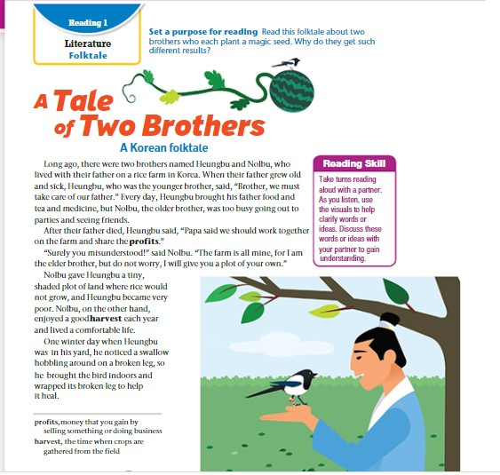
A Tale of two brothers
A Korean folktale Page :
Lesson’s Objectives :
Analyze the story to answer some questions
Summarize the story .

Slide 2
Myths usually explain how something in nature came to be. 🌞
Fables always have talking animals and a clear moral. 🐭
Legends are completely made up and have no real people or places. 🏰
Fairy tales often begin with “Once upon a time.” 👑
Folk tales are passed down orally from generation to generation. 👵
Myths and fables always end happily. 😊
A legend may be based on a real historical person or event. ⚔️
Fairy tales usually include magic or supernatural elements. ✨
Fables are meant mainly to entertain, not to teach lessons. 🙈
Folk tales and fairy tales are exactly the same. ❌

Slide 3
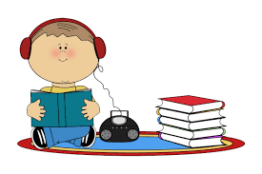



Warming up
Students 2+3
Students 1+4
Read the sentences and the options .
Listen and choose the correct answers
Look at the pictures.
Listen then put the pictures in the correct order.

Slide 4
A folktale is a story that is usually
a) Written by a famous author
b) Passed down from generation to generation by word of mouth
c) Always about real events
d) Found only in books

Slide 5
The main purpose of a folktale is to
a) To reflect and preserve the culture, traditions, and beliefs of a community
b) Give scientific facts.
c) Explain history.
d) Tell jokes.

Slide 6
Folktales are found in
a) Only one culture
b) Many different cultures around the world
c) Only in English-speaking countries
d) Modern cities only

Slide 7
Think of this questions :
Set a purpose for reading: Read this folktale about two brothers who each plant a magic seed. Why do they get such different results

Slide 8
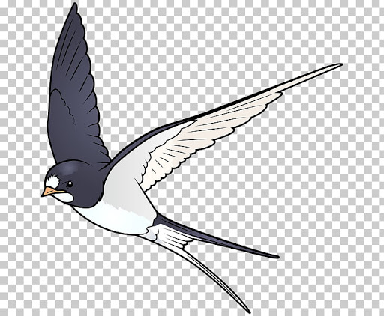
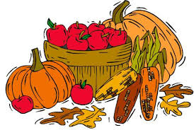

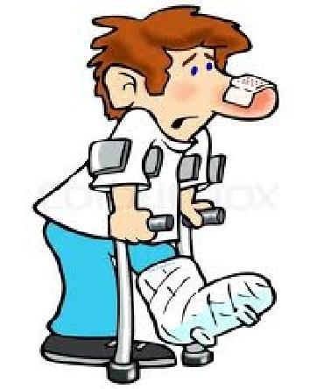
swallow
Harvest: the time when crops are gathered from the field
Profits : money that you gain by selling something or doing business
hobbling : walk in an awkward way, typically because of pain from an injury.

Slide 9
listen to the audio and then try to answer the following general questions :
What is this story about ?
* How were the two brothers different ?
* Why did the two brothers get different results although they did the same actions ?
Skimming

Slide 10
Read the questions then read the story and answer them
1- What is the setting of the story ?
2- Hungbu – unlike Nolbu -was a dutiful “ good son” .explain .
3- How did Nolbu divide the farm ? What was his justification ?
4- What was the consequence of that unfair division ?
5- How did Hungbu help the swallow ?
Scanning

Slide 11
Long ago, there were two brothers named Heungbu and Nolbu, who lived with their father on a rice farm in Korea. When their father grew old and sick, Heungbu, who was the younger brother, said, “brother, we must take care of our father.” Every day, Heungbu brought his father food and tea and medicine, but Nolbu, the older brother, was too busy going out to parties and seeing friends. After their father died, Heungbu said, “Papa said we should work together on the farm and share the profits.” “Surely you misunderstood!” said Nolbu. “the farm is all mine, for Iam the elder brother, but do not worry, I will give you a plot of your own.” Nolbu gave Neungbu a tiny, shaded plot of land where rice would not grow, and Heungbu became very poor. Nolbu, on the other hand, enjoyed a good harvest each year and lived a comfortable life.One winter day when Heungbu was in his yard, he noticed a swallow hobbling around on a broken leg, so he brought the bird indoors and wrapped its broken leg to help it heal

Slide 12
1- What is the setting of the story ?
2- Heungbu – unlike Nolbu -was a dutiful “ good son” .explain .
3- How did Nolbu divide the farm ? What was his justification ?
4- What was the consequence of that unfair division ?
5- How did Heungbu help the swallow ?
a rice farm in Korea
Every day, Heungbu brought his father food and tea and medicine
Nolbu gave Heungbu a tiny, shaded plot of land where rice would not grow, and He got the rest . He said that he is older so he deserves the biggest part .
Heungbu became very poor. Nolbu, on the other hand, enjoyed a good harvest each year and lived a comfortable life.
He brought the bird indoors and wrapped its broken leg to help it heal

Slide 13
6- Why did the bird return ?
7- What was the melon full of ?
8- What was Nolbu’s reaction when he saw what happened ?
9- What did Nolbu get at the end ?
10- Does he deserve this ending ? Explain your answer.
Scanning

Slide 14
When spring came, the swallow returned and dropped a seed at Heungbu’s feet. Heungbu understood that the seed was a thank-you gift and planted it. Soon, a flower-filled vine sprung up, and within a week, the flowers turned into huge melons. As Heungbu cut one open, he could almost taste the juicy sweet fruit but, to his surprise, the inside of the melon had no fruit at all. Instead, it was filled with gold and gemstones. He cut open the other melons and found riches in every one. He had become a wealthy man! soon, Nolbu heard about his brother’s great wealth, and he demanded to know how it happened. After hearing the story, Nolbu went out into his yard, caught a swallow, and broke its leg, ignoring the bird’s cries of pain. Nolbu then wrapped the bird’s leg in cloth the way his brother had done. the swallow came back a few days later and dropped a seed at Nolbu’s feet. “finally, I will be rich!” Nolbu thought. Nolbu planted the seed and, very soon, had his own vine of melons, but when he cut into one, muddy water came rushing out of it, destroying his rice farm and his home .

Slide 15
6- Why did the bird return to Heungbu?
7- What was the melon full of ?
8- What was Nolbu’s reaction when he saw what happened ?
9- What did Nolbu get at the end ?
10- Does Nolbu deserve this ending ?
The bird returned to give Heungbu a seed as a thank you gift.
It was full of gemstones .
He Nolbu went out into his yard, caught a swallow, and broke its leg.
When he cut the melon muddy water came rushing out of it, destroying his rice farm and his home.
Yes, because he was so cruel to his dad first , his brother and the swallow that he broke its leg .

Slide 16
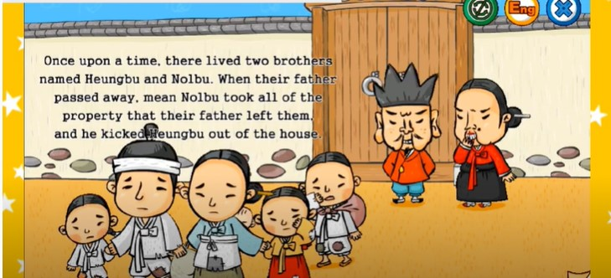

Slide 17
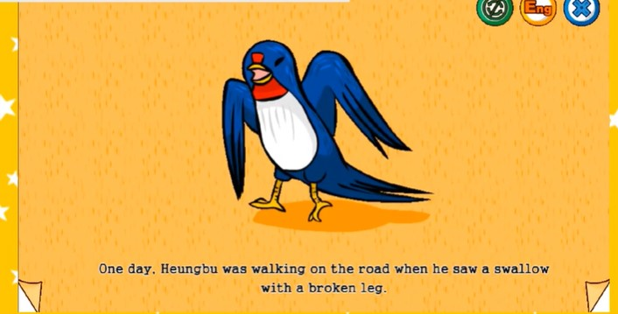

Slide 18
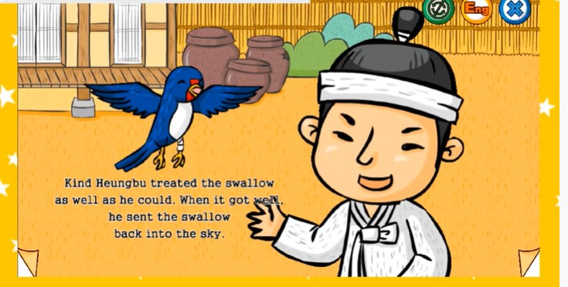

Slide 19
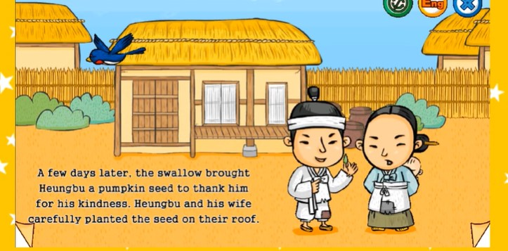

Slide 20
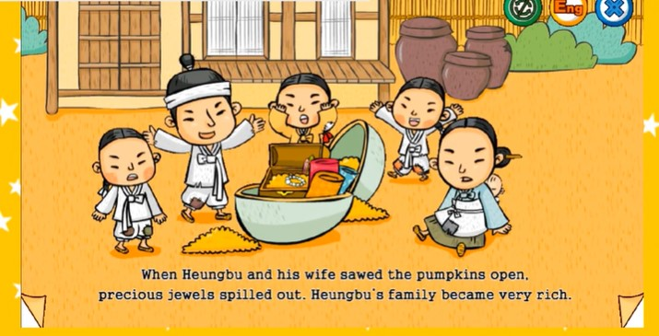

Slide 21
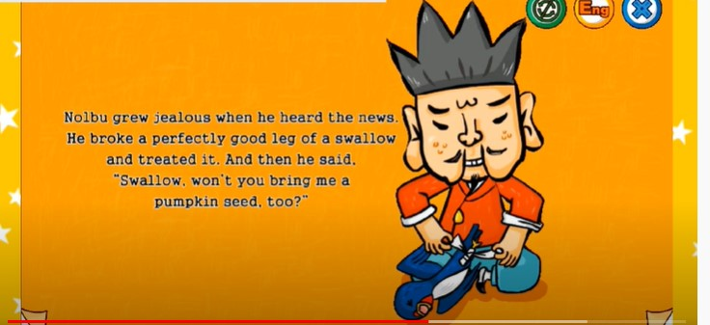

Slide 23


Slide 24
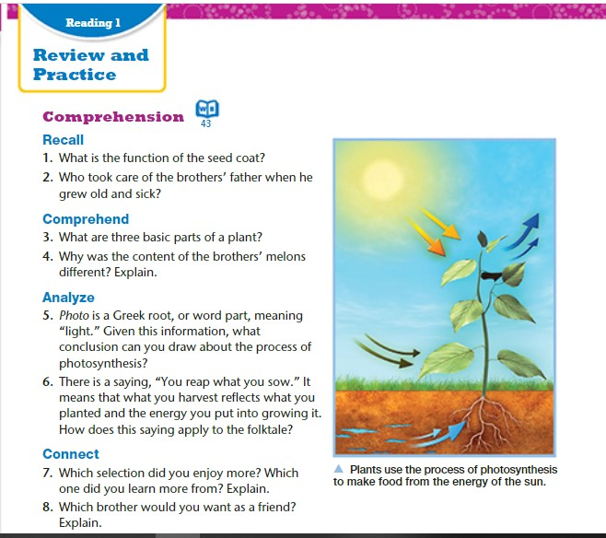

Slide 25
Write the Ending Differently ✍️

Slide 26
Recall
1. What is the function of the seed coat?
2. Who took care of the brothers’ father when he grew old and sick?
The seed coat protects the embryo
Heungbu took care of their father when he grew old and sick.

Slide 27
Comprehend
3. What are three basic parts of a plant?
4. Why was the content of the brothers’ melons different? Explain.
the three basic parts of a plant are the roots, stem, and leaves
Heungbu’s melon had gemstones in it because he was good. nolbu’s melon had muddy water in it because he had bad intentions

Slide 28
Analyze
5.Photo is a Greek root, or word part, meaning “light.” given this information, what conclusion can you draw about the process of photosynthesis?
6. There is a saying, “you reap what you sow.” it means that what you harvest reflects what you planted and the energy you put into growing it. how does this saying apply to the folktale
.
Photosynthesis, the way plants make food, has something to do with light.
Heungbu put positive energy into growing and sharing his melon, so he reaped rewards. Nolbu acted in a cruel and greedy way, so he reaped punishment.

Slide 29
The End

