Slide 2
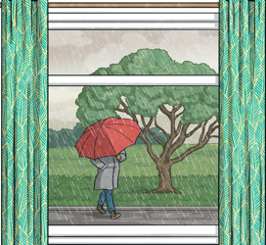
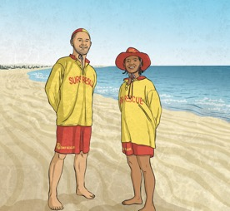
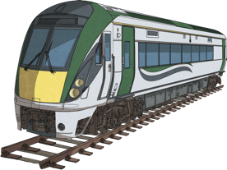
Let’s learn about the first conditional!
We use the first conditional to talk about things that can easily happen in the future, things that are possible.
Maybe it rains today
or you get a job next year
or your train is delayed
These are all things that could easily happen.

Slide 3
Let’s learn about the first conditional!
When we use the first conditional, the sentence looks like this:
If
Present simple
will
V1
For example:
Note the place of the comma between the two clauses!
If
it rains today
, she
will
use her umbrella.
If
I get a job
, I
will
work hard.
If we start with the second clause, put ‘if/when’ between the two clauses, then continue with the first clause.
They
catch the bus
will
if
their train is delayed.

Slide 4
Match the clauses to complete the first conditional
If I wake up late,
If it’s hot.
We will go swimming,
she will be sad.
If you go shopping,
if you give me your number.
if her brother leaves,
I will be late for class.
I will send you a message,
you will spend money.

Slide 5
If the seed _______ (be) dry, it __________ (not/germinate).
The plant _______ (grow) strong if the embryo _______ (be) healthy.
If the soil _______ (not/be) fertile, the plant _______ (not survive).
The leaves _______ (get) more sunlight if the stem _______ (be) straight.
If the seed coat _______ (not/be) damaged, the seed _______ (remain) protected.
The plant _______ (make) its own food if the young plant _______ (be) exposed to sunlight.
If water _______ (not/be) available, the seed _______ (not/absorb) it.
The seed wont reach the surface if it _______ (be) buried too deep.
is
Won’t germinate
will grow
is
Isn’t
Won’t
Will get
Is
Isn’t
Will remain
Will make
is
Isn’t
Wont absorb
Is

Slide 6

Be
If she is happy
I will be happy
The teacher will give us the exam
If we are ready
Not/ be
If the girl isn’t here
the manager will be angry
We will lose the competition
If we aren’t together

Slide 7
1. The plant will grow strong if the embryo _______ (be) healthy.
2. If the seed _______ (be) dry, it will not germinate.
3. If the soil _______ (not be) fertile, the plant will not survive.
4. If the stem _______ (be) straight, the leaves will get more sunlight.
5. The seed ________ (remain) protected if the seed coat isn’t damage
6. If the young plant _______ (be) exposed to sunlight, it will make its own food.
7. The seed _________ ( not/ absorb) absorb water if water _______ (not be) available.
8. If the seeds _______ (be) buried too deep, it will not reach the surface.
Is
Is
Isn’t
Is
will remain
Is
won’t
Isn’t
aren’t

Slide 8
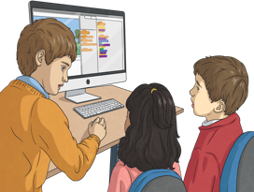

Correct the mistakes
If I got time tomorrow, I will help you.
If I get time tomorrow, I will help you.
If you feel sick, I take you to the doctor.
If you feel sick, I will take you to the doctor.

Slide 9
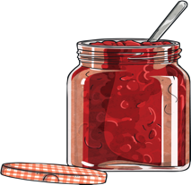
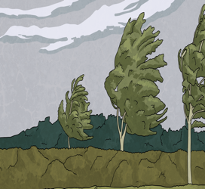
Correct the mistakes
I would make jam when I have enough strawberries.
I will make jam when I have enough strawberries.
When it was windy, I won’t go outside.
When it is windy, I won’t go outside.

Slide 10
If she eats a lot , she will gain weight .
a possible condition
probable result
The function of IF clause type 1

Slide 11
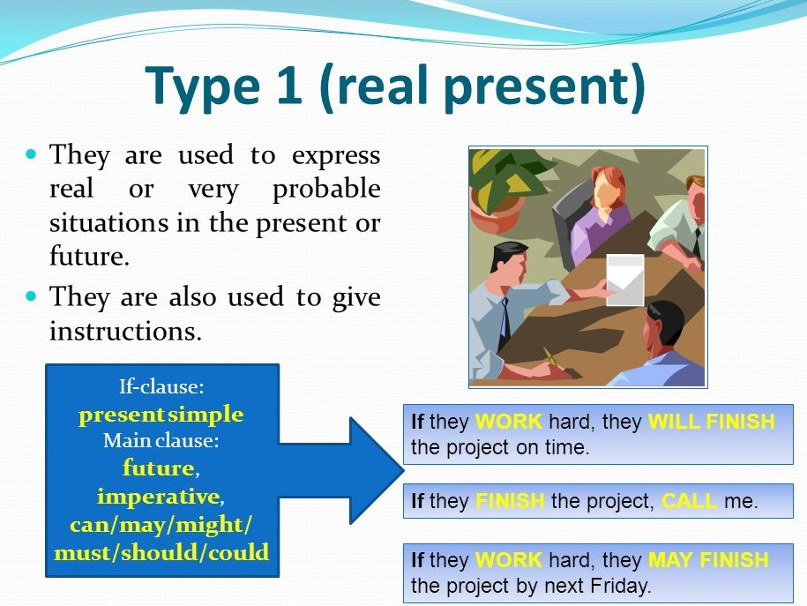

Slide 12
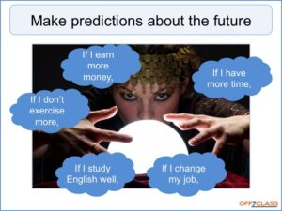
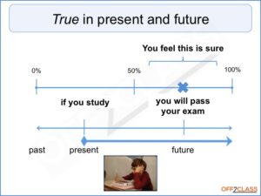

Slide 13
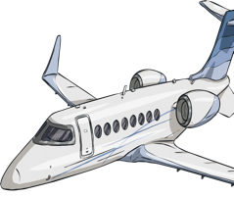


Now let’s learn about the second conditional!
We use the second conditional to talk about things that are not possible or mostly won’t happen.
If I had a private jet
or won a million dollars
or if I were a queen
These are all things that mostly will not happen.

Slide 14
Now let’s learn about the second conditional!
When we use the second conditional, the sentence looks like this:
If
past simple clause
would
infinitive
For example:
Note the place of the comma between the two clauses!
If
I owned a private jet
, I
would
fly all over the world.
If
I won a million dollars
, I
would
buy a big house.
I
would
make every Friday a holiday
if
I were queen.
If we start with the second clause, put ‘if/when’ between the two clauses, then continue with the first clause.

Slide 15
Match the clauses to complete the second conditional
If I met the president,
if he was younger.
He would choose a different job,
you would tell me.
she wouldn’t speak English.
They would stay with us longer,
I would ask her about her ideas.
If you knew the answer,
If she was a cat,
if they had more time.

Slide 16


Correct the mistakes
If I see a ghost, I would be terrified.
If I saw a ghost, I would be terrified.
If she had a superpower, she will be able to fly.
If she had a superpower, she would be able to fly.

Slide 17
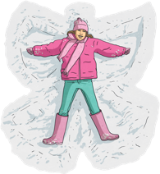
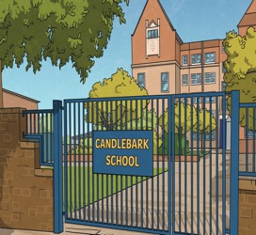

Correct the mistakes
I would make it snow everyday if I control the weather.
I would make it snow everyday if I controlled the weather.
If school is cancelled, I wouldn’t do my homework.
If school was cancelled, I wouldn’t do my homework.
Wouldn’t = Would not

Slide 18
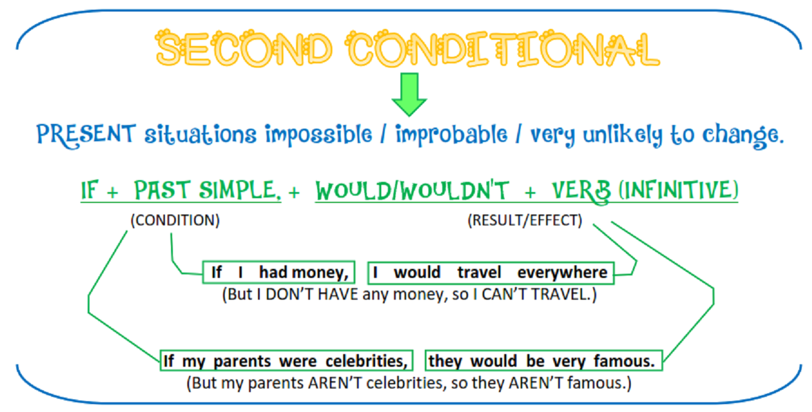

Slide 19
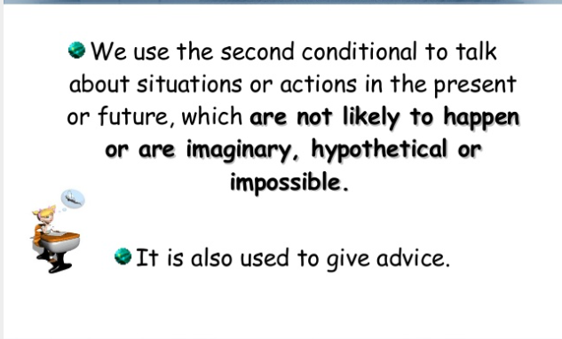

Slide 20
✅ Examples (Type 2 If-Clauses)
If I had more time, I would study French.
If she were taller, she would play basketball.
If they lived closer, we would visit them more often.
If he were rich, he would buy a new car.
If it rained, we would stay at home.
If plants did not get sunlight, they would die.
If the seed were damaged, it would not grow.
If the soil were not dry, the plant would be healthier.
If you studied, you would pass the test.
If she were not tired, she would help us.

Slide 21
Say which conditionals are 1st and which are 2nd
If we go for a picnic, I’ll pack some snacks.
1st
I would go the 1920s if I travelled to the past.
2nd
If I were you, I wouldn’t order that from the restaurant.
2nd
When she asks a rude question, I won’t answer her.
1st
If you practice harder, you will get better.
1st
If I went to space, I would take pictures of my family.
2nd

Slide 22
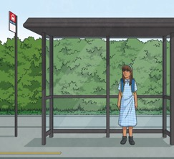

Finish the conditional sentences
We will miss the bus if…
Did you complete the sentence using the present simple?
If I chose to be one age for forever, …
Did you use the
word ‘would’?

Slide 23
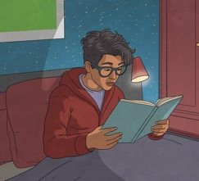
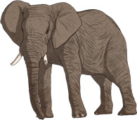
Finish the conditional sentences
When it gets dark, …
Did you use the
word ‘will’?
I would be an elephant, …
Did you use the
past tense?

Slide 24
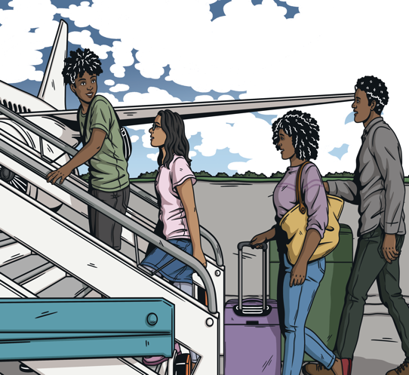
Use the picture to create a conditional sentence
first conditional
Did you use:
If/When + present simple + will clause?

Slide 25
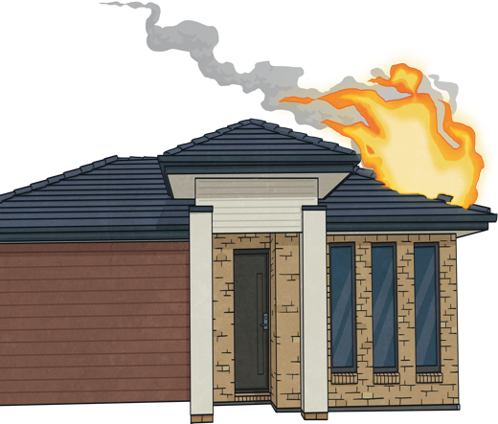
Use the picture to create a conditional sentence
second conditional
Did you use:
If + past simple + would clause?

Slide 26
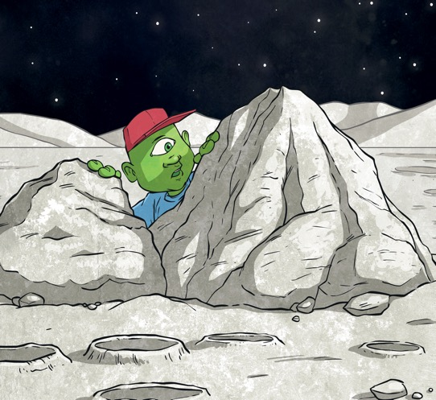
Use the picture to create a conditional sentence
second conditional
Did you use:
If + past simple + would clause?

Slide 27
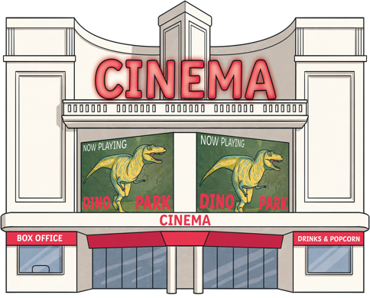
Use the picture to create a conditional sentence
first conditional
Did you use:
If/When + present simple + will clause?

Slide 28

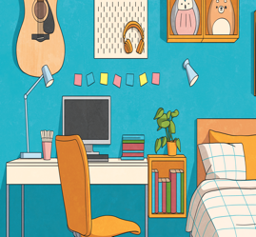
Challenge! Can you swap the first and second clauses around?
I wouldn’t hug it if a bear came into my house.
If a bear came into my house, I wouldn’t hug it.
When our room is clean, mum won’t be angry anymore.
Mum won’t be angry anymore when our room is clean.

Slide 29
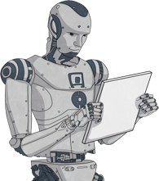
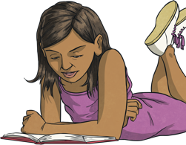
Challenge! Can you swap the first and second clauses around?
If I built an AI robot, I wouldn’t stay in school.
I wouldn’t stay in school if I built an AI robot.
If it's a good book, I will lend it to you.
I will lend it to you if it’s a good book.

Slide 30
What are your thoughts?
If you write a letter to your friend, what will you tell them?
If you travelled to the future, what would you do?
What will you eat when you go to a restaurant?
If you were a pilot, where would you go?
What would you do if you were a celebrity?
What animal will you choose if you get a pet?
If you fail an exam, what will your parents do?

