Slide 1
How Seeds and Plants grow
Lesson’s objectives :
* Recognize the meanings of the new words and Their parts of speech.
* Use the words correctly .

Slide 2
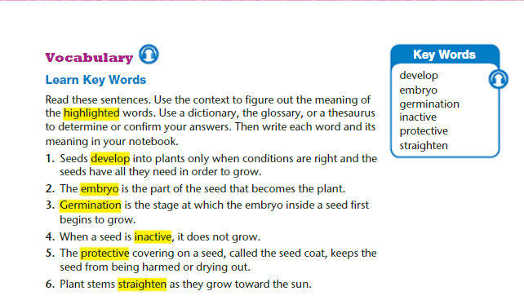

Slide 3
1. Develop (verb)
Definition: To grow, improve, or change into a more advanced form.
The students worked hard to develop their presentation skills.
Plants develop roots before they grow leaves.
She wants to develop her writing abilities this year.
The company plans to develop a new mobile app.

Slide 4
2. Embryo (noun)
Definition: A young, developing organism before it becomes fully formed (in animals, humans, or plants).
The seed contains an embryo that will grow into a new plant.
The chicken embryo grows inside the egg.
Scientists studied the fish embryo under a microscope.
Each seed protects its embryo until conditions are right for growth.

Slide 5
3. Germination (noun)
Definition: The process by which a seed begins to grow into a plant.
Model sentence:
Water and sunlight are necessary for the germination of seeds.
More examples:
The germination of the seeds started after two days.
Good soil improves the germination rate.
Farmers monitor germination carefully to ensure healthy crops.

Slide 6
4. Inactive (adjective)
Definition: Not moving, not working, or not being used.
Model sentence:
The volcano has been inactive for many years.
More examples:
Students became inactive during the long holiday.
This machine is inactive because it needs repair.
Staying inactive for too long is not healthy.

Slide 7
5. Protective (adjective)
Definition: Designed to keep someone or something safe from harm.
Model sentence:
The shell of the turtle acts as a protective covering.
More examples:
Parents can be very protective of their children.
The plant has a protective layer around the seed.
Wear protective gloves when using strong chemicals.

Slide 8
6. Straighten (verb)
Definition: To make something straight or to put it in order.
Model sentence:
Please straighten the papers on your desk.
More examples:
She stopped to straighten her hair in the mirror.
The student straightened the chairs before class.
You need to straighten your posture when you speak.

Slide 9
Fill in the blanks with the correct word from the box:
develop – embryo – germination – inactive – protective – straighten
Seeds need water and sunlight for __________ to occur.
The doctor explained that the human __________ grows rapidly in the first few weeks.
It is important to wear a helmet as a __________ measure while riding a bike.
Plants __________ roots before growing leaves.
The students were asked to __________ their desks before the teacher arrived.
The old machine has been __________ for months because it is broken.
Good soil and warmth can help improve seed __________.
She worked hard to __________ her painting skills.
He put on a jacket to provide a __________ layer against the cold wind.
Please __________ your papers so they are neat and tidy.

Slide 10
Here’s the answer key for the fill-in-the-blank exercise:
germination
embryo
protective
develop
straighten
inactive
germination
develop
protective
straighten

Slide 11
Key Words : Match the bold words in column A with their definitions in column B
Seeds develop into plants only when conditions are right and the seeds have all they need in order to grow.
Children usually develop speech in the second year of life.
The protective covering on a seed, called the seed coat, keeps the seed from being harmed or drying out.
Workers should wear full protective clothing
It's bad for your health to be physically inactive.
___ ( v) to expand by a process of growth .
________( adj) not engaging in or involving any or much physical activity.
_______ (adj) :intended to protect someone or something..

Slide 12
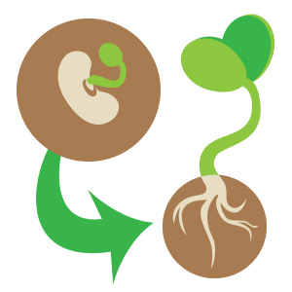
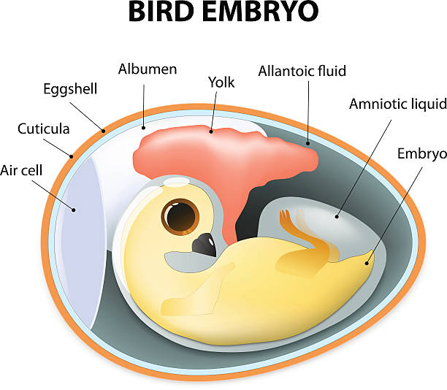
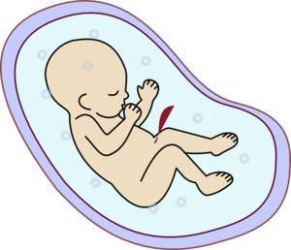
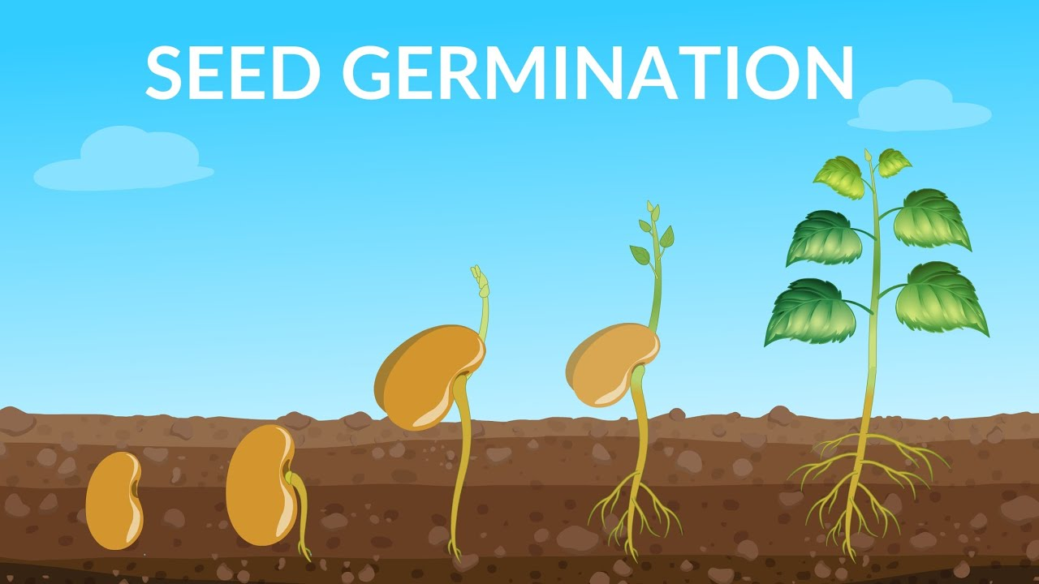
* The embryo is the part of the seed that becomes the plant .
Before I was a baby, I was an embryo.
Germination is the stage at which the embryo inside a seed first begins to grow
* Plant stems straighten as they grow toward the sun.
_____( v.) to cause to become straight .
.
_____(n.) : a human or animal at a beginning or undeveloped stage .
_______(n.) the development of a plant from a seed .

Slide 13
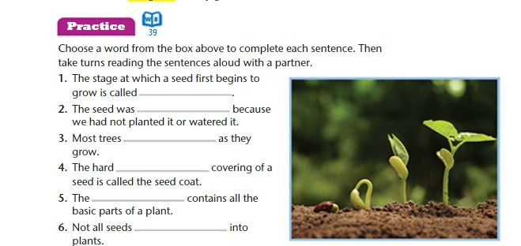

Slide 14
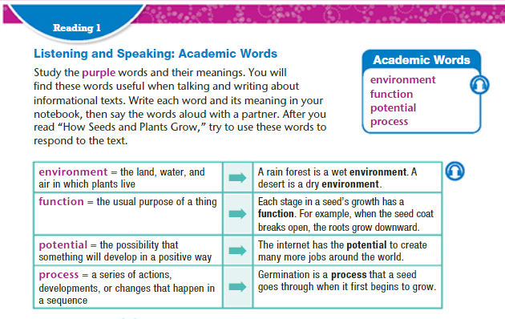

Slide 15
1. Environment (noun)
Definition: The surroundings or conditions in which a person, animal, or plant lives or operates.
Examples:
We should protect the environment by reducing pollution.
The classroom provides a positive learning environment.
Animals adapt to changes in their environment.

Slide 16
2. Potential (noun/adjective)
Definition: Noun: The ability or capacity to develop into something in the future.
Adjective: Possible but not yet realized.
Examples:
She has the potential to become a great scientist.
The new technology has potential applications in medicine.
The teacher helps students reach their full potential.

Slide 17
3. Function (noun/verb)
Definition:
Noun: The purpose or role of something; what it is used for.
The main function of the heart is to pump blood.
The machine’s function is to clean the air.

Slide 18
4. Process (noun/verb)
Definition:
Noun: A series of actions or steps taken to achieve a result.
Examples:
Photosynthesis is a natural process in plants.
Recycling is a process that helps the environment.

Slide 19
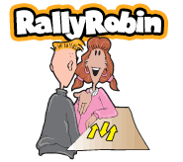
Synonyms
Environment .
Function .
Potential .
Process .
Action / course / mechanism / procedure .
Ability / capability / capacity /
Surroundings / setting .
Duty / role .

Slide 20
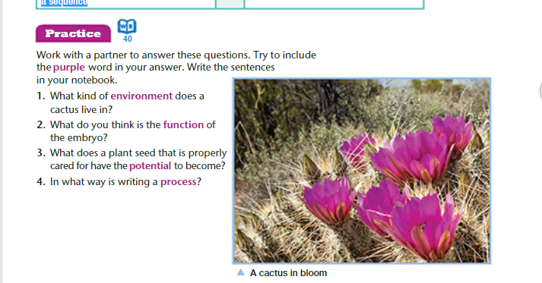

Slide 21
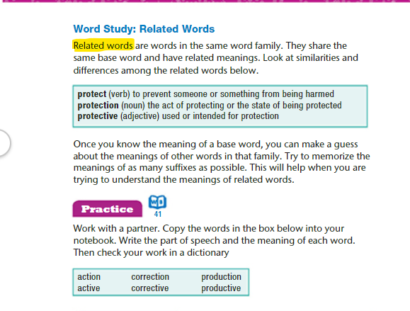

Slide 22
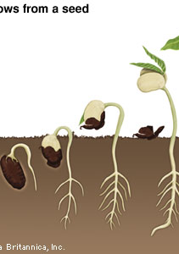
Before reading
What do you think this article will be about ?
What do plants need to grow ?
What do we need plants and trees for ?

Slide 23
1. From which part of the plant is the new plant produced ? 2. What is a seed ? 3. What are the three main parts of a seed ? ---------------------------- ---------------------------- -------------------------- 4. What does an embryo contain ? ------------------------------------------------------------------------------------------- 5. What is the function of "stored food " ? ------------------------------------------------------------------------------------------- 6. How can a plant make its food when it has leaves ? ------------------------------------------------------------------------------------------- 7. What is cotyledon ? what is the function of the cotyledon ? ------------------------------------------------------------------------------------------------------------------------------------------------------------------------------------- 8. Why do seeds need a protection ? ------------------------------------------------------------------------------------------- 9. When does the embryo become active ? -------------------------------------------------------------------------------------------

Slide 24
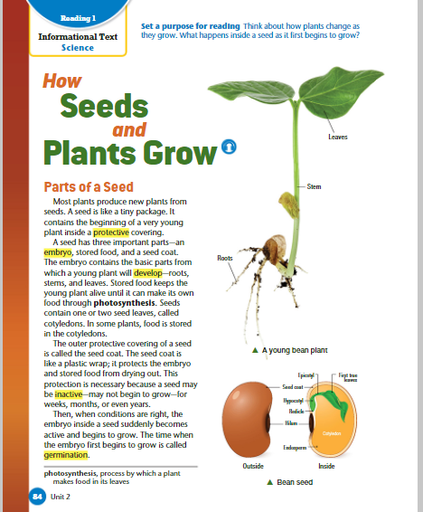
parts of a seed Most plants produce new plants from seeds. a seed is like a tiny package. it contains the beginning of a very young plant inside a protective covering. a seed has three important parts—an embryo, stored food, and a seed coat. the embryo contains the basic parts from which a young plant will develop—roots, stems, and leaves. stored food keeps the young plant alive until it can make its own food through photosynthesis. seeds contain one or two seed leaves, called cotyledons. in some plants, food is stored in the cotyledons

Slide 25
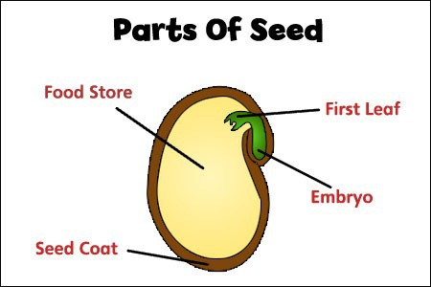
*
Fill the gaps with the suitable words :
* ___________________ contains the basic parts from which a young plant will develop—roots, stems, and leaves.
____________________keeps the young plant alive until it can make its own food through photosynthesis.
_____________ one or more of which are the first leaves to appear from a germinating seed.
The embryo
Stored food
Cotyledons

Slide 26
Explanation
Parts of a Seed
1. Seed (general idea)
Most plants grow new plants from seeds.
A seed is like a tiny package containing a young plant inside a protective covering
2. Three Important Parts of a Seed
a) Embryo
The embryo is the young plant inside the seed.
It has the basic parts from which the plant will grow: roots, stems, and leaves.
This is what develops into the new plant.
Example: The embryo in a bean seed will grow into a full bean plant.
b) Stored Food
Seeds contain stored food to keep the young plant alive.
This food is used until the plant can make its own food through photosynthesis.
Some plants store food in the cotyledons, which are the seed leaves.
Example: Corn seeds have stored food in their cotyledons to feed the young plant.
c) Seed Coat
The seed coat is the outer protective covering of the seed.
It protects the embryo and stored food from damage and drying out.
Example: The hard shell of a sunflower seed is its seed coat.

Slide 27
the outer protective covering of a seed is called the seed coat. the seed coat is like a plastic wrap; it protects the embryo and stored food from drying out. this protection is necessary because a seed may be inactive—may not begin to grow—for weeks, months, or even years. then, when conditions are right, the embryo inside a seed suddenly becomes active and begins to grow. the time when the embryo first begins to grow is called germination. * What is the function of the seed coat ? * Define germination .

Slide 28
1. “The outer protective covering of a seed is called the seed coat.”
Outer protective covering → the outside layer that protects the seed.
Seed coat → the name of this protective layer. Meaning: The seed has a protective layer on the outside called the seed coat.
2. The seed coat is like a plastic wrap because:
Protective Layer: Just like plastic wrap protects food from dust, germs, and drying out, the seed coat protects the embryo and stored food inside the seed.
Barrier: It acts as a barrier against damage from water, insects, and physical impacts.
Keeps Things Inside: The seed coat keeps the embryo and stored food secure, just like plastic wrap keeps food contained.
Example sentence:
The seed coat is like a plastic wrap that keeps the tiny plant safe until it is ready to grow.
3. “This protection is necessary because a seed may be inactive—may not begin to grow—for weeks, months, or even years.”
Inactive → not growing or developing.
May not begin to grow → the seed stays dormant.
Weeks, months, or even years → seeds can remain safe for a long time. Meaning: The seed coat’s protection is important because seeds can stay dormant for a long time before they start to grow.

Slide 29
The seed coat is like a plastic wrap because:
Protective Layer: Just like plastic wrap protects food from dust, germs, and drying out, the seed coat protects the embryo and stored food inside the seed.
Barrier: It acts as a barrier against damage from water, insects, and physical impacts.
Keeps Things Inside: The seed coat keeps the embryo and stored food secure, just like plastic wrap keeps food contained.
Example sentence:
The seed coat is like a plastic wrap that keeps the tiny plant safe until it is ready to grow.

Slide 30
4. “Then, when conditions are right, the embryo inside a seed suddenly becomes active and begins to grow.”
Conditions are right → enough water, warmth, oxygen, and light.
Embryo becomes active → starts developing into a plant. Meaning: Once the environment is suitable, the embryo starts growing.
5. “The time when the embryo first begins to grow is called germination.”
Germination → the process when the seed starts to grow into a new plant. Meaning: Germination is the beginning of the seed’s growth.

Slide 31
https://www.youtube.com/watch?v=TE6xptjgNR0

Slide 32
Germination during germination, the seed absorbs water from the environment. then the embryo uses its stored food to begin to grow. the seed coat breaks open, and the embryo’s roots grow downward. then its stem and leaves grow upward. as the stem grows longer, it breaks out of the ground. once it is above the ground, the stem straightens up toward the sunlight, and the first leaves appear on the stem. when the young plant produces its first leaves, it can begin to make its own food by photosynthesis.

Slide 33
1. “During germination, the seed absorbs water from the environment.”
During germination → the period when the seed starts to grow.
Seed absorbs water → takes in water to start activating the embryo.
From the environment → water comes from soil, rain, or surroundings. Meaning: Water is the first requirement for a seed to start growing.
2. “Then the embryo uses its stored food to begin to grow.”
Embryo → the young plant inside the seed.
Uses stored food → consumes nutrients kept in cotyledons to get energy.
Begin to grow → starts developing roots, stems, and leaves. Meaning: The embryo relies on stored nutrients to start its initial growth.
3. “The seed coat breaks open, and the embryo’s roots grow downward.”
Seed coat breaks open → the protective outer layer splits.
Roots grow downward → roots grow into the soil to absorb water and nutrients. Meaning: The first visible sign of growth is the roots emerging from the seed.

Slide 34
4. “Then its stem and leaves grow upward.”
Stem and leaves grow upward → the plant begins to reach for sunlight. Meaning: After roots, the above-ground parts of the plant develop.
5. “As the stem grows longer, it breaks out of the ground.”
Stem grows longer → elongates to reach the surface.
Breaks out of the ground → emerges above soil. Meaning: The young plant starts appearing above the soil surface.
6. “Once it is above the ground, the stem straightens up toward the sunlight, and the first leaves appear on the stem.”
Stem straightens → grows vertically toward light.
First leaves appear → initial leaves called seed leaves or cotyledons form. Meaning: The plant positions itself for photosynthesis as leaves begin to develop.
7. “When the young plant produces its first leaves, it can begin to make its own food by photosynthesis.”
First leaves → capable of producing energy.
Make its own food by photosynthesis → converts sunlight into energy for growth. Meaning: The plant becomes independent and starts creating its own food

Slide 35
