Slide 1


Unit 2
Exaggerated Synonyms

Slide 2

The Lesson’s Objectives
01
1- Recognize the meanings of the new words and expressions and use them correctly .

Slide 3
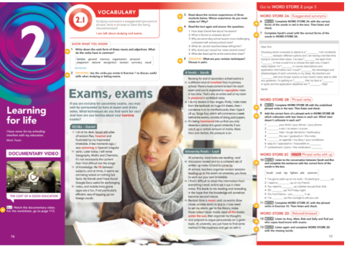
Plastered .
Looming .
Flitting .
Minefield.
Frazzled/manic.
hammering.
Regurgitate.
Swimming in .
All the advice under the sun.
The new words and phrases.

Slide 4
1. Plastered
Literal: Completely covered
The walls were plastered with wet cement.
She plastered the poster onto the classroom wall.
Figurative / Exaggerated: extremely tired or exhausted
I was plastered on the sofa after running a marathon.
He was plastered with exhaustion after studying all night

Slide 5
2. Looming
Literal: Appearing threatening
A tall tower loomed over the village.
The shadow of the mountain loomed in the distance.
Figurative / Exaggerated: about to happen
The exam was looming, and I couldn’t stop worrying.
A sense of danger was looming over the team.

Slide 6
3. Flitting : Moving quickly and lightly
Literal:
Butterflies were flitting among the flowers.
A bird was flitting from branch to branch.
Figurative / Exaggerated:
Ideas kept flitting through my mind during the test.
She was flitting between jobs without settling anywhere.

Slide 7
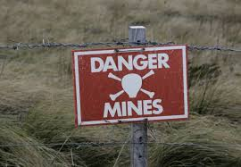
4. Minefield
Literal: Area planted with mines
The soldiers carefully crossed the minefield.
Maps were used to navigate the minefield safely.
Figurative / Exaggerated: situation full of hidden dangers
Office politics can be a minefield if you’re not careful.
Choosing the right words in that debate was like walking through a minefield.

Slide 8
5. Frazzled / Manic : Extremely stressed, tired, or busy
Literal:
Mostly figurative, not used literally in common English.
Figurative / Exaggerated:
I was frazzled after finishing all my assignments at once.
She became manic trying to organize the surprise party.

Slide 9
6. Hammering
Literal: Pounding continuously
The carpenter was hammering nails into the wood.
He kept hammering the metal into shape.
Figurative / Exaggerated:
My headache was hammering in my temples all afternoon.
Rain was hammering against the windows all night.

Slide 10
7. Regurgitate
Literal: To bring back swallowed food
The cow regurgitates its food to chew it again.
Birds sometimes regurgitate food to feed their chicks.
Figurative / Exaggerated: to repeat without understanding.
Students just regurgitate textbook answers without understanding.
He regurgitated all the facts from the lecture without thinking.

Slide 11
8. Swimming in
Literal:
She was swimming in the pool for an hour.
The kids were swimming in the lake all afternoon.
Figurative / Exaggerated:
I’m swimming in homework this weekend.
He was swimming in emails after returning from vacation.

Slide 12
9. All the advice under the sun : Every possible advice
Figurative expression only; no literal usage.
Figurative / Exaggerated:
He gave me all the advice under the sun about studying for finals.
She offered all the advice under the sun on how to raise a puppy.

Slide 13

Pre- assessment
Mark the following words according to the attached rubric:
1- Never seen this word before
2- Seen the word, but not sure what it means
3- Used the words, but not sure if correctly
4- Used the word confidently in spelling or writing
5- Used the words confidently in both speaking and writing
2 minutes

Slide 14

Differentiation .
S “2+3“= Read the text and guess the meanings of the new words from the context.
S “1+4 “ = Read the sentences and guess the meanings of the new words from the context.

Slide 15
✅ Answer Key:
Plastered → Covered everywhere, almost overwhelming
Looming → Coming soon and causing worry/panic
Flitting → Moving quickly and nervously
Minefield → Full of hidden dangers or risks
Frazzled → Extremely tired/stressed/confused
Manic → Very hyper/anxious/out of control
Hammering → Repeating something over and over
Regurgitate → Repeat facts exactly
Swimming in → Overwhelmed by a lot of something
All the advice under the sun → Every possible advice

Slide 16

Rally Coach – Fill in the Blanks
Work with a partner. One guesses, the other coaches.
Take turns for each sentence. Switch roles after each.
Use the word bank. Each word/phrase only once.
Focus on the meaning of the word in context.
Help each other by giving hints or asking questions.
1 → plastered 2 → looming 3 → flitting 4 → minefield 5 → frazzled 6 → manic 7 → hammering 8 → regurgitate 9 → swimming in 10 → all the advice under the sun

Slide 17
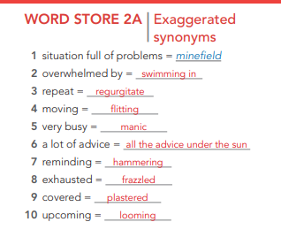
Word Store 2 A

Slide 18
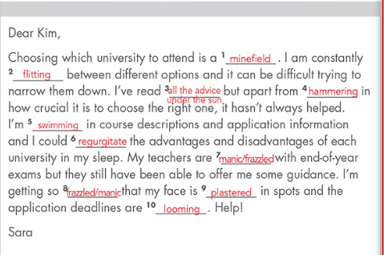

Slide 19
A. In the time before a particular event
B. To refill or increase the amount of something (usually money or energy)
C. To refill or increase the amount of something (usually money or energy
D. To encounter a challenging situation or problem.
"You're at the coffee shop and notice your phone’s battery is almost dead. You ask if you can plug it in to top up the battery while you enjoy your coffee.“
"During a football match, a player scores a goal and helps their team notch up another win in the tournament.“
You’re in a group project at school, and suddenly you’re faced with the challenge of completing it all by the end of the week because one of your group members got sick.“
"In the weeks leading up to your final exams, you feel the pressure to study more and get ready."

Slide 20
faced with
We were _____________a difficult decision when we had to choose between two job offers.
I studied hard in the weeks _____________ the big test.
You should ____________your fuel tank before going on a long road trip.
The team was _____________a major setback when the lead designer left the company.
I need to _____________my mobile phone credit before I can make more calls.
She has _____________five promotions in her career.
There was a lot of excitement _______________to the wedding.
The company _______________its highest profits this quarter.
leading up to
top up
faced with
top up
notched up
leading up to
notched up

Slide 21
You’ve taken medicine for a headache, but it takes 20 minutes before the relief kicks in and you start to feel better.“
You’ve been looking for a rare book for months, and finally, you come by a copy at a small bookstore.“
"You’ve decided to write a book. Before you begin, you set out a clear plan for each chapter and schedule time to write every day."
A. To begin a journey or a plan with a clear goal.
B. To start to have an effect or become active
C. To obtain or find something, often something that is difficult to get.

Slide 22
When the caffeine _____________, I start to feel more awake.
Jobs in this field are hard to ______________.
We ___________early in the morning to reach the summit before noon.
How did you _____________such a rare antique?
The painkiller usually ____________after 10 minutes.
He ___________to become a lawyer, working hard every day to achieve his goal.
kicks in
come by
set out
come by
kicks in
set out

Slide 23
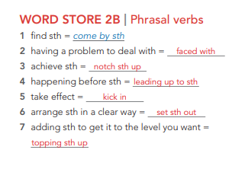

Slide 24
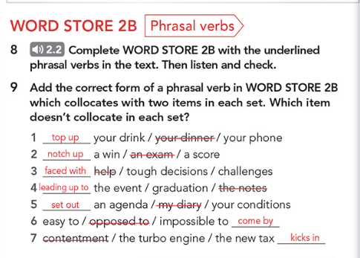

Slide 25
1. Top up
Definition: To add more of something (usually a phone credit, a drink, or fuel) so it reaches the desired level.
Correct: I need to top up my phone before the weekend.
Correct: Can you top up my drink, please?
Incorrect: I need to top up my dinner.
2. Notch up
Definition: To achieve or reach a particular success, score, or win.
Correct: The team managed to notch up a win last night.
Correct: She notched up a high score in the exam.
Incorrect: He notched up an exam.

Slide 26
3. Faced with
Definition: To have to deal with a situation, problem, or challenge.
Correct: I was faced with tough decisions about my future.
Correct: The manager was faced with many challenges.
Incorrect: She was faced with help.
4. Leading up to
Definition: The period of time before an important event.
Correct: There was a lot of preparation leading up to the graduation ceremony.
Correct: The organizers were busy leading up to the event.
Incorrect: I read my notes leading up to the event.

Slide 27
5. Set out
Definition: To explain, arrange, or present something clearly.
Correct: The committee set out an agenda for the meeting.
Correct: He set out his conditions clearly before the deal.
Incorrect: I set out my diary.
6. Easy to / opposed to / impossible to come by
Definition: Expressions describing how simple or difficult it is to obtain or experience something.
Correct: Happiness and contentment are not always easy to come by.
Correct: The new turbo engine is easy to maintain.
Incorrect: The new tax kicks in is easy to come by.

Slide 28

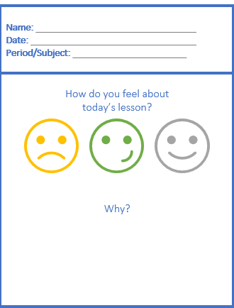
Exit Ticket

