Slide 1




Reading Comprehension
Unit 3 – Reading 2
“A Robot’s Smile” pages 156-159
5th Grade

Slide 2
Outcomes
01
02
04
03
build background knowledge about technology
relate the big question of unit 2 and how technology can make our lives easier to the story
answer comprehension questions effectively
identify literary elements and main ideas while reading

Slide 3
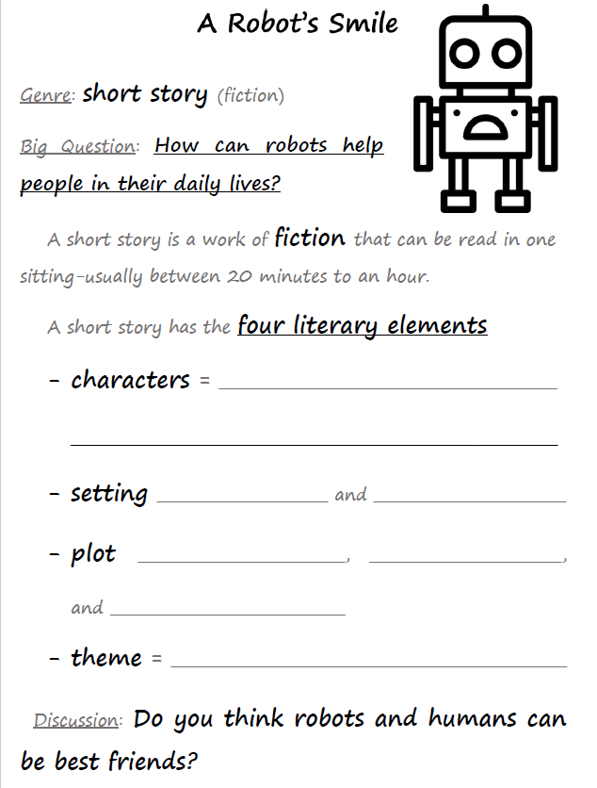
Introduction
people, animals, or things
in a story that do and say things
time place
conflict climax
resolution
the big idea

Slide 4


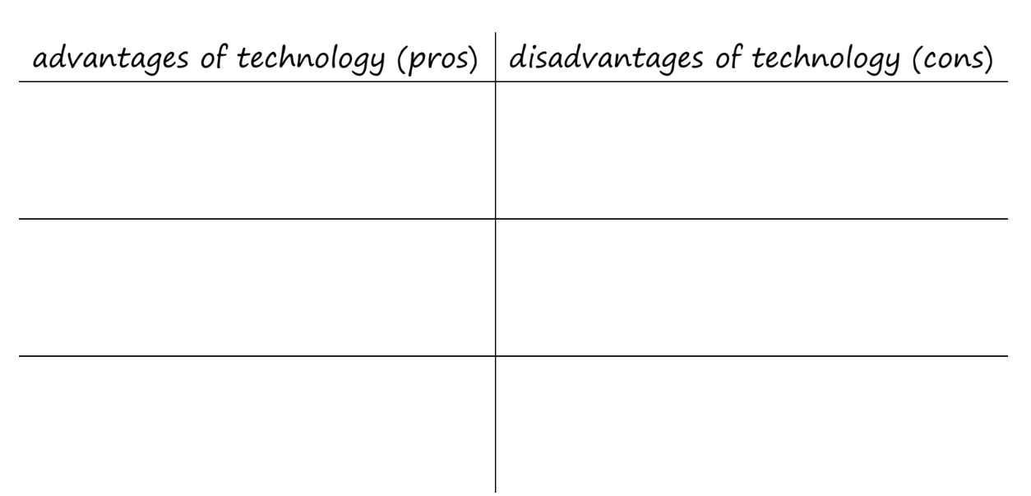

Slide 5
Advantages of Technology Pros | Disadvantages of Technology Cons
easier communication | too much screen time
robots help with tasks | less face-to-face communication
saves time and effort | expensive not everyone can afford it

Slide 6
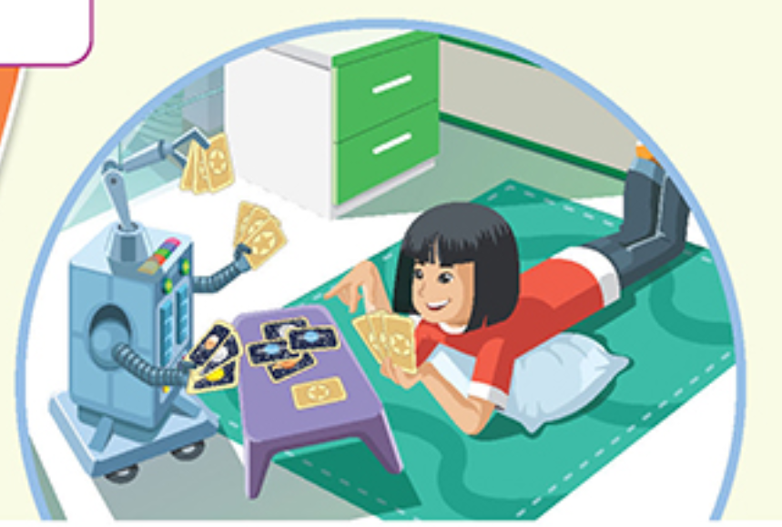
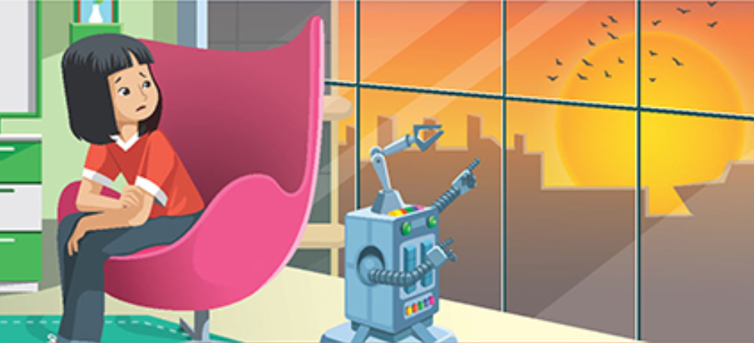
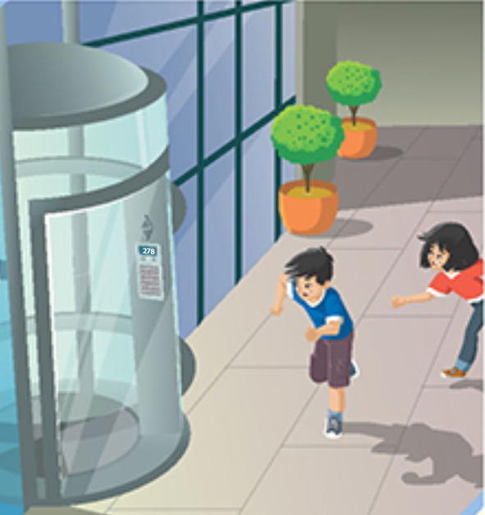
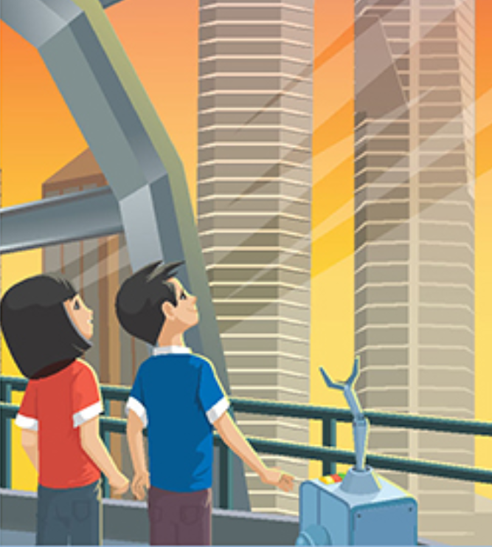
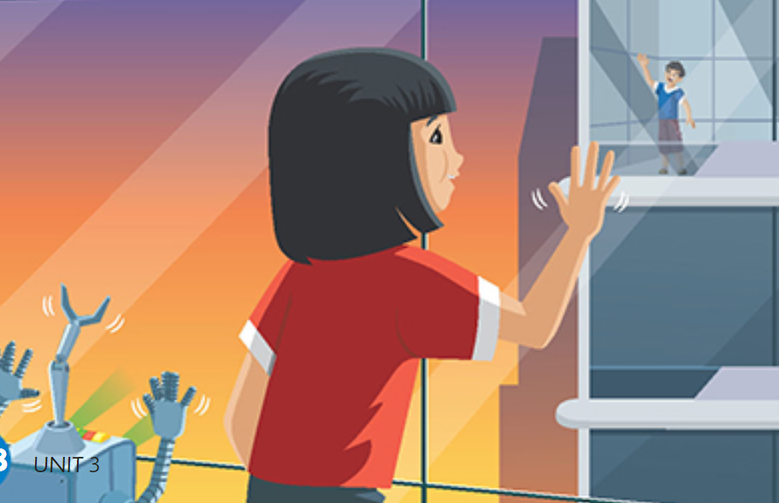

Slide 7
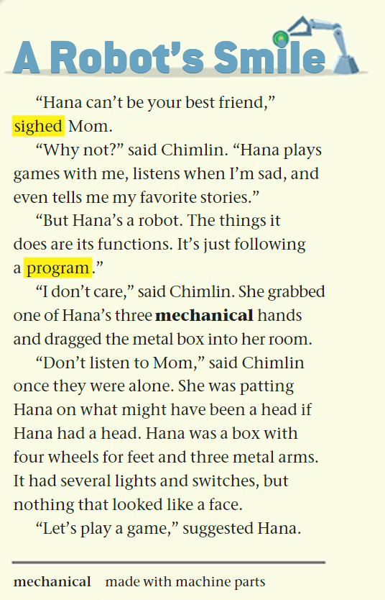


P.156

Slide 8
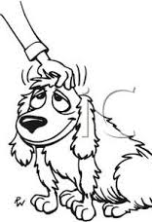
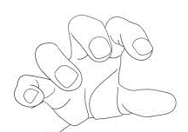

Questions on p.156
grabbed dragged patting
1. Who are the two main characters in the story?
2. Why is Hana Chimlin’s best friend?
3. Why does the mom think Hana can’t be a best friend?
4. Do you agree that robots can’t be real, best friends?
5. What does Chimlin do after talking to her mom?
6. What does Hana look like?
7. What does Hana suggest doing?

Slide 9
Feedback
the girl
the robot
grabbed dragged patting
1. Who are the two main characters in the story?
2. Why is Hana Chimlin’s best friend?
3. Why does the mom think Hana can’t be a best friend?
4. Do you agree that robots can’t be real, best friends?
5. What does Chimlin do after talking to her mom?
6. What does Hana look like?
7. What does Hana suggest doing?

Slide 10
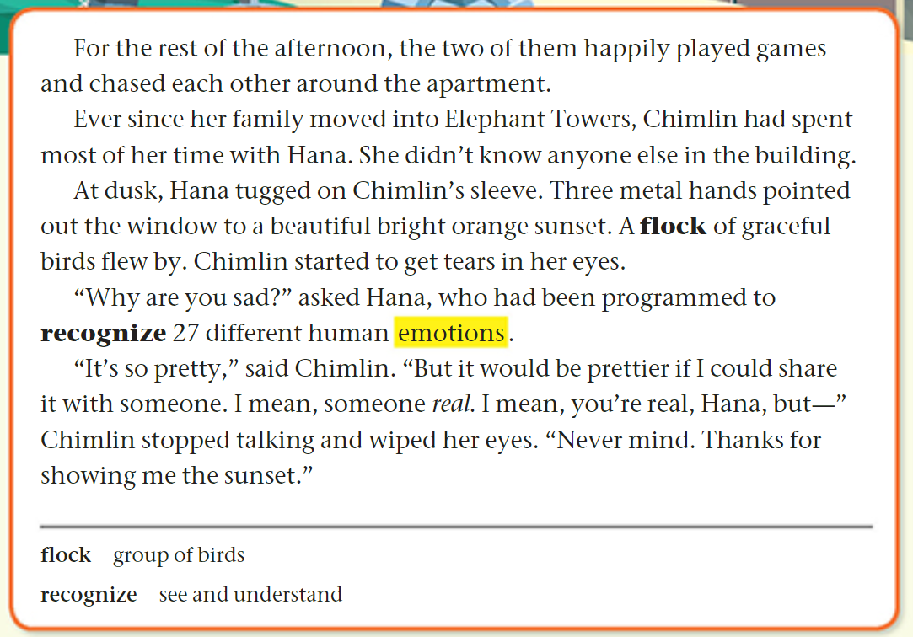
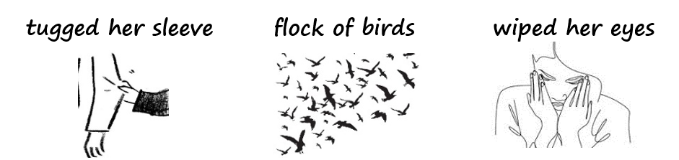
P.157

Slide 11
conflict
Feedback
1. What did Chimlin and Hana do for the rest of the afternoon?
2. What is the story’s setting? in the future
3. What flew by outside the window during the sunset?
4. Why did Chimlin start to cry?
5. What is Hana capable of?
6. What do you think Chimlin meant by "someone real"? a human
7. How can you tell that Chimlin is a good friend? (Chimlin didn’t want Hana to see her sad.)
8. What did Chimlin thank Hana for?
9. What do the following pronouns refer to?
them (line 1) Chimlin and Hana
she (line 4) Chimlin
(time)
(place)

Slide 12
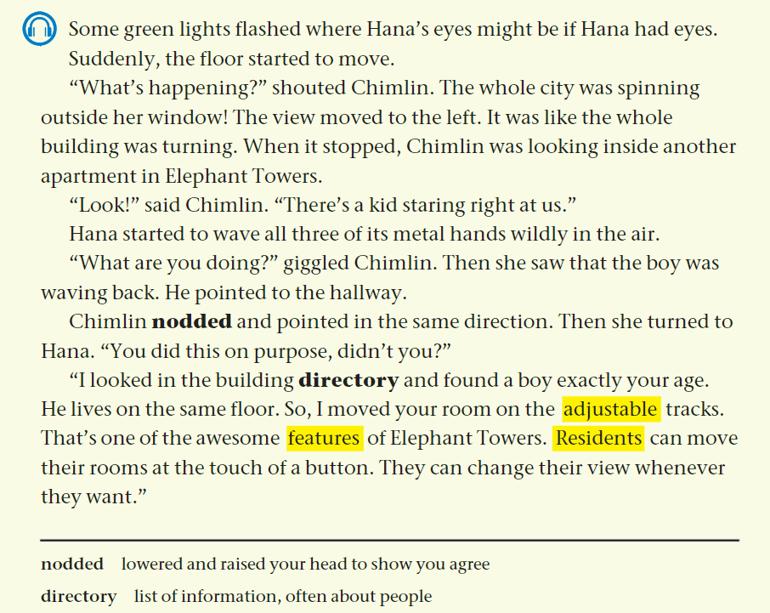
P.158

Slide 13
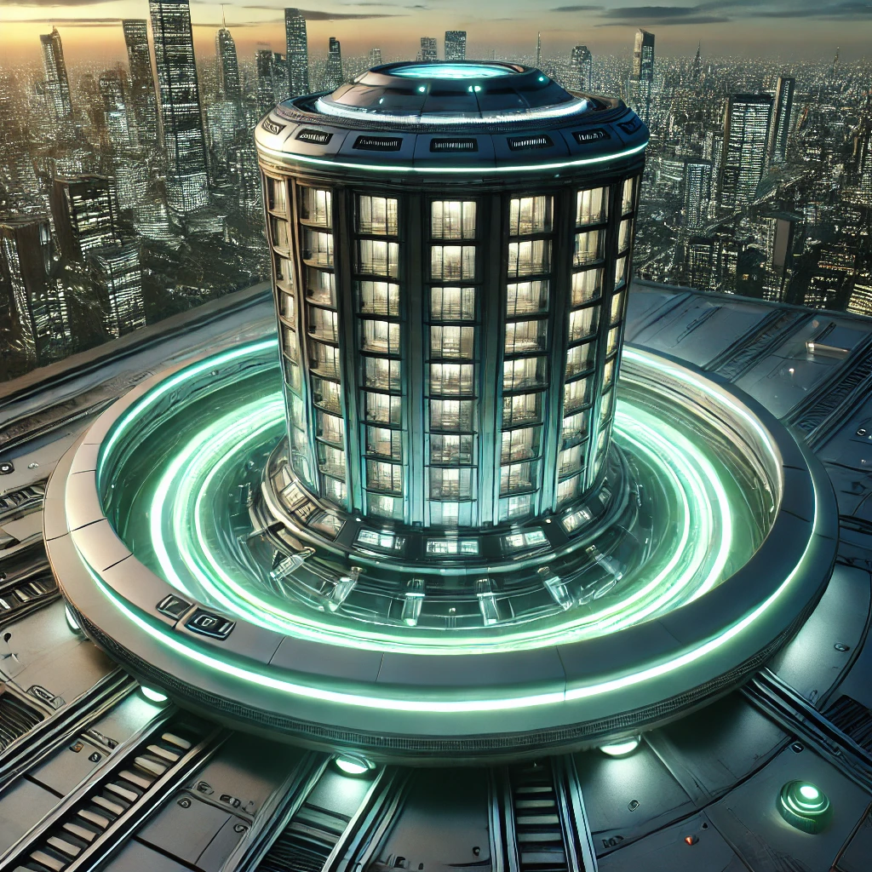
Do you think, in the future, buildings will have rooms with adjustable tracks that can spin to give people different views? Why or why not?

Slide 14


climax
Questions on p.158
1. What happened when some green lights flashed?
2. What did Chimlin shout when the floor started moving?
3. Where was Chimlin looking when the building stopped moving?
4. What did Chimlin notice in the other apartment?
5. How did Hana react when she saw the kid staring at them?
6. What did the boy do when Hana waved her metal hands?
7. Who moved Chimlin’s room? ____________________
8. How did Hana find a boy the same age as Chimlin?
9. What feature of Elephant Towers allows residents to move their rooms?
10. What can residents do to change their room’s view?

Slide 15
climax
Questions on p.158
1. What happened when some green lights flashed?
2. What did Chimlin shout when the floor started moving?
3. Where was Chimlin looking when the building stopped moving?
4. What did Chimlin notice in the other apartment?
5. How did Hana react when she saw the kid staring at them?
6. What did the boy do when Hana waved her metal hands?
7. Who moved Chimlin’s room? ____________________
8. How did Hana find a boy the same age as Chimlin?
9. What feature of Elephant Towers allows residents to move their rooms?
10. What can residents do to change their room’s view?
turning around
looking
laughed

Slide 16
climax
Questions on p.158
1. What happened when some green lights flashed?
2. What did Chimlin shout when the floor started moving?
3. Where was Chimlin looking when the building stopped moving?
4. What did Chimlin notice in the other apartment?
5. How did Hana react when she saw the kid staring at them?
6. What did the boy do when Hana waved her metal hands?
7. Who moved Chimlin’s room? ____________________
8. How did Hana find a boy the same age as Chimlin?
9. What feature of Elephant Towers allows residents to move their rooms?
10. What can residents do to change their room’s view?
turning around
looking
laughed

Slide 17
Feedback
climax
1. What happened when some green lights flashed?
2. What did Chimlin shout when the floor started moving?
3. Where was Chimlin looking when the building stopped moving?
4. What did Chimlin notice in the other apartment?
5. How did Hana react when she saw the kid staring at them?
6. What did the boy do when Hana waved her metal hands?
7. Who moved Chimlin’s room? ____________________
8. How did Hana find a boy the same age as Chimlin?
9. What feature of Elephant Towers allows residents to move their rooms?
10. What can residents do to change their room’s view?
turning around
looking
laughed
Hana

Slide 18
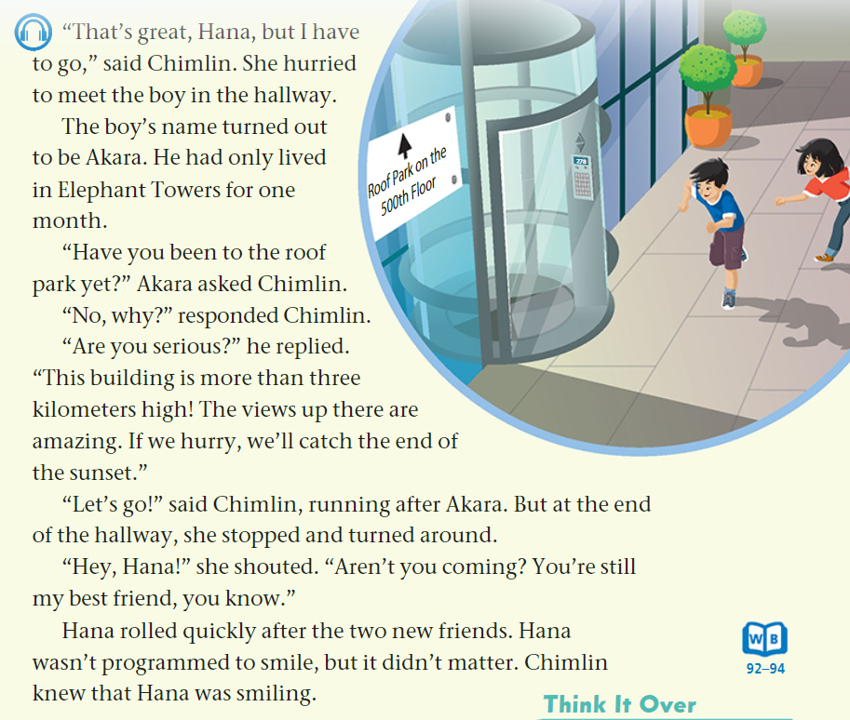
P.159

Slide 19
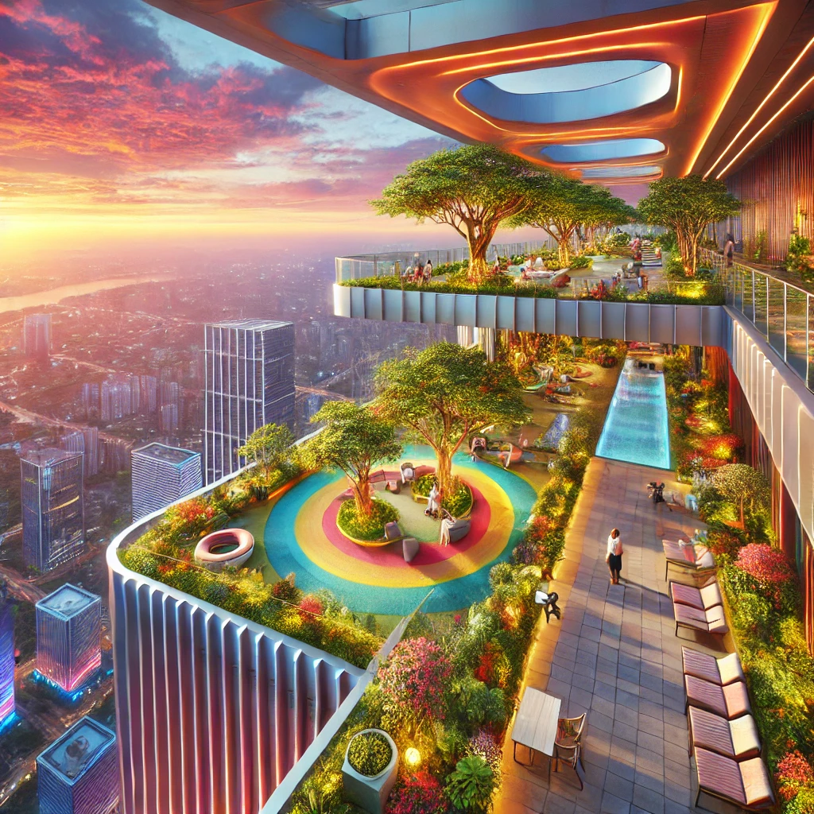
Warm up
What do you think it would feel like to stand on the roof park of Elephant Towers and look out at the sunset?

Slide 20
Questions on p.159
Resolution
1. Look at the illustration. How does Chimlin feel?
___________________________________
2. Who did Chimlin meet in the hallway?
3. How long had Akara lived in Elephant Towers?
4. What question did Akara ask Chimlin about the roof park?
5. How high is Elephant Towers?
6. What did Akara say was amazing about the roof park?
7. What was Akara excited to see?
8. What did Chimlin say to Hana before running off with Akara?
9. Is Hana capable of smiling? ______________
10. After meeting Akara, are Chimlin and Hana still best friends? _______________

Slide 21
Resolution
Feedback
1. Look at the illustration. How does Chimlin feel?
Chimlin looks happy.
2. Who did Chimlin meet in the hallway?
3. How long had Akara lived in Elephant Towers?
4. What question did Akara ask Chimlin about the roof park?
5. How high is Elephant Towers?
6. What did Akara say was amazing about the roof park?
7. What was Akara excited to see?
8. What did Chimlin say to Hana before running off with Akara?
9. Is Hana capable of smiling? No
10. After meeting Akara, are Chimlin and Hana still best friends? Yes

