Slide 1
Unit 2 Reading 1
My Litte Brother
Part (1)
pages 70 -73

Slide 2
Outcomes
1:00
min
Identify the story elements and the main events.
Read the story aloud.

Slide 3

Warm Up
2:00
mins

Slide 4

What do you want to be when you grow up?
2:00
mins
Pre assessment
Relate to Real Life

Slide 5
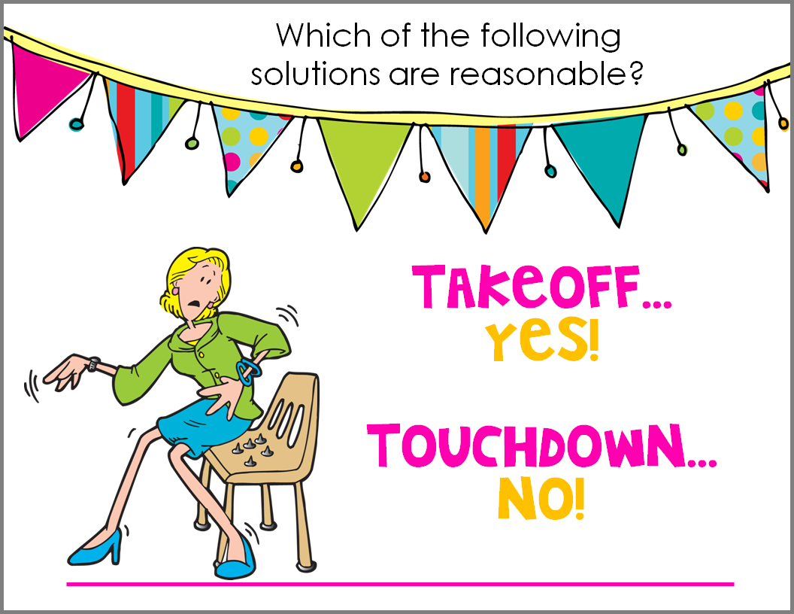
*Take off if you can do one of these activities.
*Touch down if you can’t.
1. walk to school
2. write your name
3. open a door
4. turn on the computer
5. use a stapler and scissors
Story Preview p. 70
2:00
mins

Slide 6
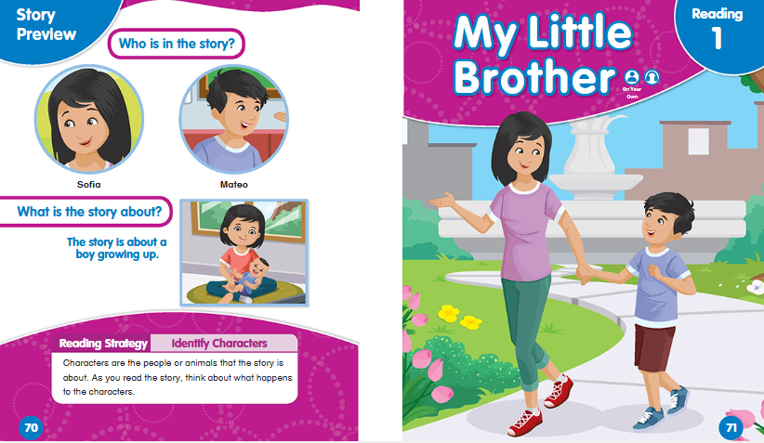

Characters
Title
The big
sister
Main Idea
The little
brother

Slide 7

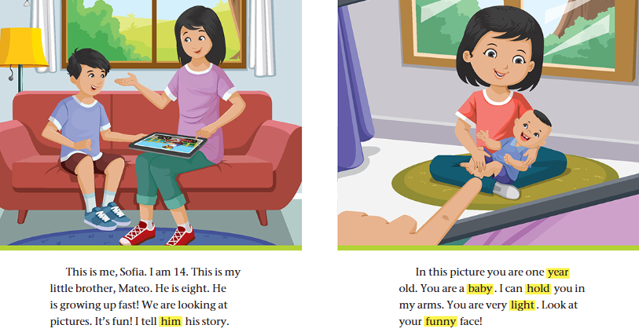
Listen to the audio ! p. 72 - 73
1. How old is Sofia and Mateo?
2. What are they doing?
3. Where are they?
Daytime
At home/ living room

Slide 8

Group work
3:00
mins
1. Find two nouns.
2. Find two verbs.
3. Find two pronouns.
4. Find a word that means (not heavy).
5. How is Mateo’s face ?

Slide 9
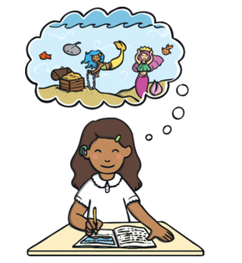
Critical Thinking
Use of Technology
2:00
mins
What does the word (fiction) mean?
Buzz In

Slide 10
Summative Assessment
2:00
mins
Choose (True) if the statement is true, and (false) if the statement is false.
Sofia is 14 years old.
1. True
2. False
IRS

Slide 11
Summative Assessment
2:00
mins
Choose (True) if the statement is true, and (false) if the statement is false.
Mateo is 8 years old.
1. True
2. False
IRS

Slide 12
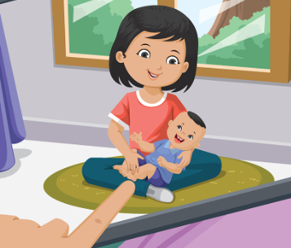
Summative Assessment
2:00
mins
Choose (True) if the statement is true, and (false) if the statement is false.
In this picture, Mateo is two years old.
1. True
2. False
IRS

Slide 13
Unit 2 Reading 1
My Litte Brother
Part (2)
pages 70 -73

Slide 14
Outcomes
1:00
min
Identify the story elements and the main events.
Read the story aloud.

Slide 15
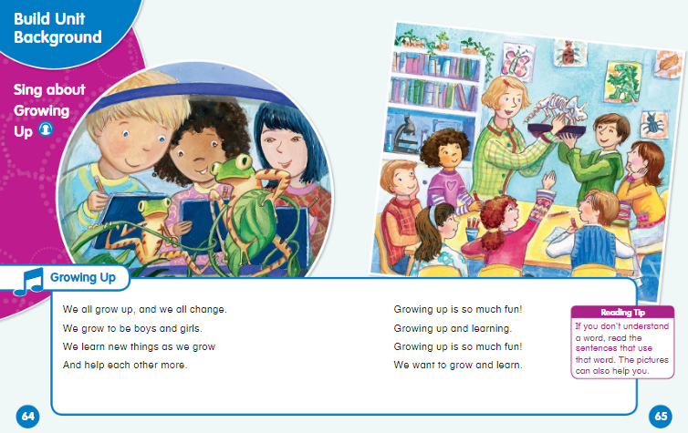
Warm Up
2:00
mins

Slide 16
Pre assessment
2:00
mins
Choose the correct answer.
What is the title of our story?
1. My Little Brother
2. Children Can Learn
IRS

Slide 17
Pre assessment
2:00
mins
Choose the correct answer.
Who are the characters in the story?
1. Dan, Jan, and Nell
2. Sofia and Mateo
IRS

Slide 18
Pre assessment
2:00
mins
Choose the correct answer.
What is the story about?
1. Children can learn.
2. A boy growing up.
IRS

Slide 19
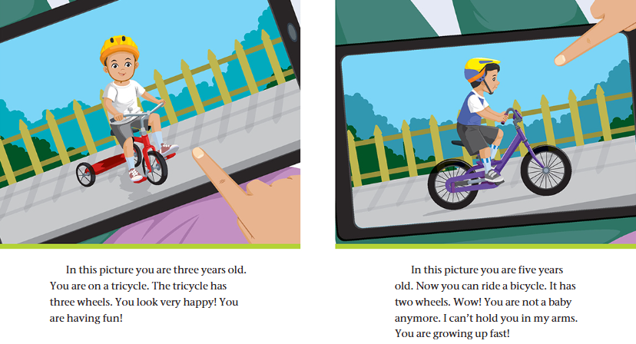
Let’s Read! pages 74, 75 & 76
1. How old is Mateo in each picture?
2. What is he riding? Is he happy?
in the street

Slide 20
Group work
3:00
mins
1. Find two nouns.
2. Find two verbs.
3. Find a word that has (wh) sound.

Slide 21
Critical Thinking
Relate to Real Life
2:00
mins
What is the difference between a (bicycle) and a (tricycle)?
Buzz In

Slide 22
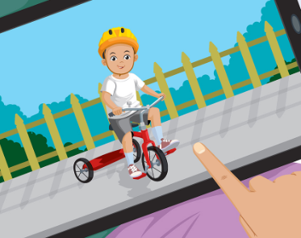

What do you think will happen next?
Critical Thinking
2:00
mins

Slide 23
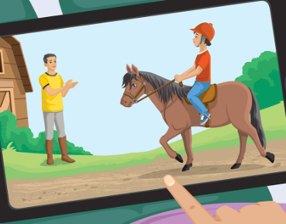
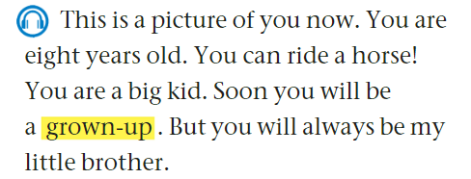
1. How old is Mateo?
A helmet
2. What is he riding?
3. What is he wearing on his head?
4. How does Mateo changed?
5. Find a word that means ( an adult)?
in the barn

Slide 24
Summative Assessment
2:00
mins
Choose (True) if the statement is true, and (false) if the statement is false.
In this picture, Mateo is riding a bicycle.
1. True
2. False
IRS

Slide 25
Summative Assessment
2:00
mins
Choose (True) if the statement is true, and (false) if the statement is false.
In this picture, Mateo is five years old.
1. True
2. False
IRS

Slide 26
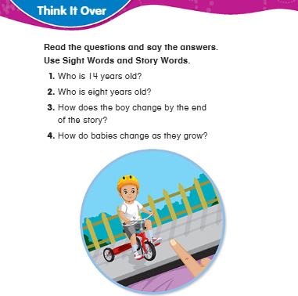
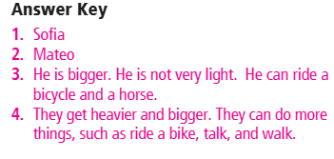
Open your book page 77

Slide 27
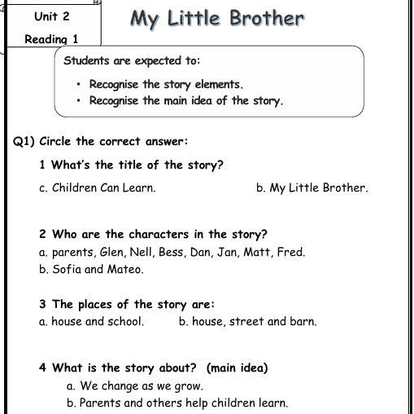
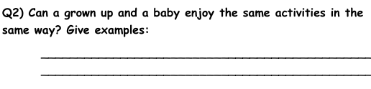
Open your English Booklet page 37
Yes, a grown-up blows bubbles, and a baby watches and tries to catch them. Both enjoy the activity in their own way.

Slide 28
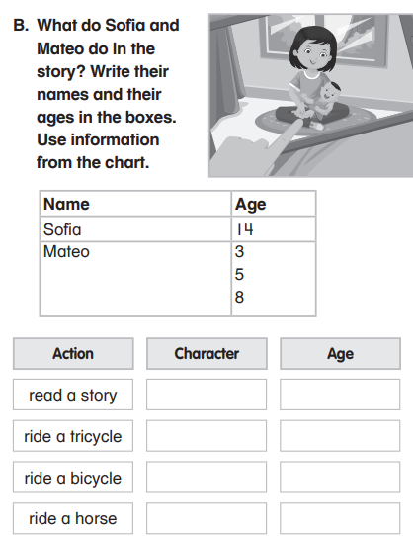
ABOUT THIS COURSE
Do you know what helps you make your point clear?
Lists like this one:
They’re simple
You can organize your ideas clearly
You’ll never forget to buy milk!
And the most important thing: the audience won’t miss the point of your presentation

Slide 29
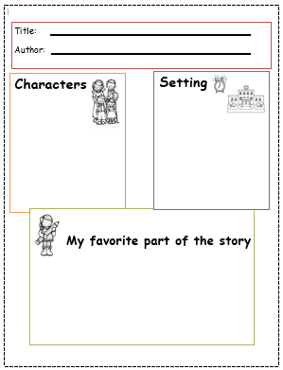

Slide 30
Thank You

