Slide 1
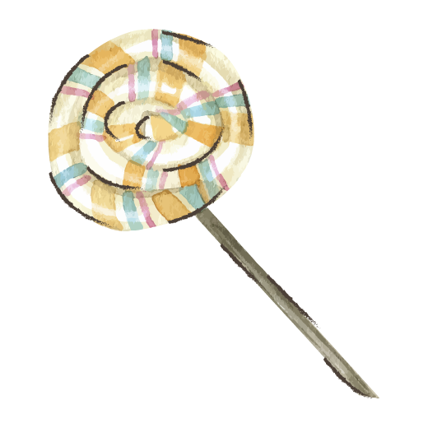
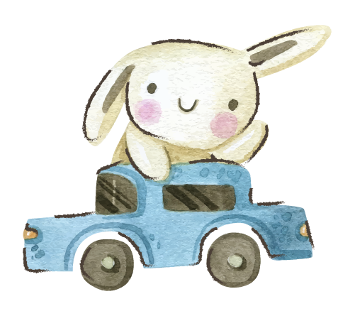






Vocabulary
Unit 2 / Reading 1

Slide 2
Specific Outcomes:
By the end of this lesson, students are expected to:
Recognize the following words:
Sight words
him
funny
Story words
year
grown-up
light
hold
baby
tricycle
wheels
bicycle

Slide 3
Warm up:
https://www.youtube.com/watch?v=YNOnFsnjYhY

Slide 4
Take off – Touch down
Take off if you know the meaning of the following words
(him, hold, light ,funny)
Touch down if you don’t

Slide 5
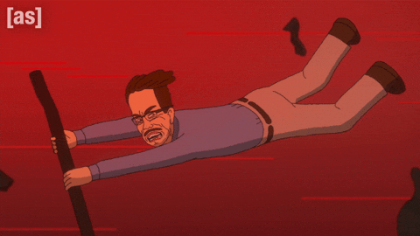
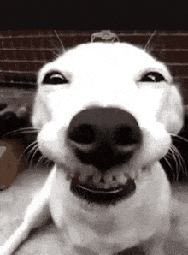
Pre assessment. IRS
1
2
Which word is a verb?
Funny
hold

Slide 6
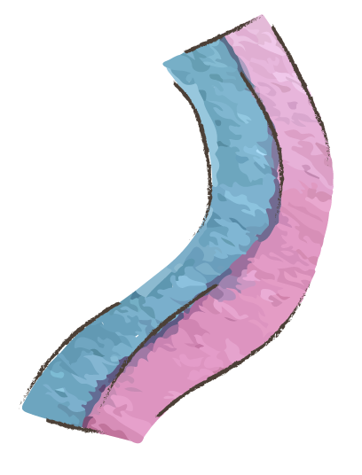
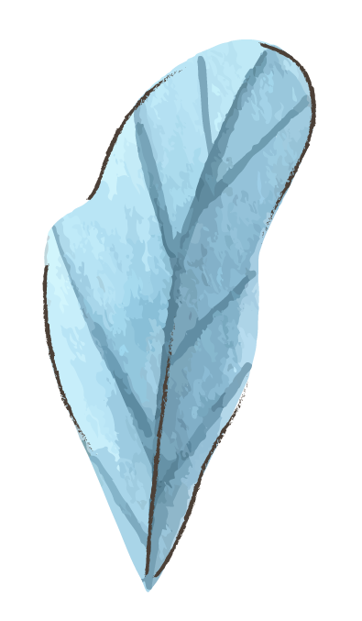
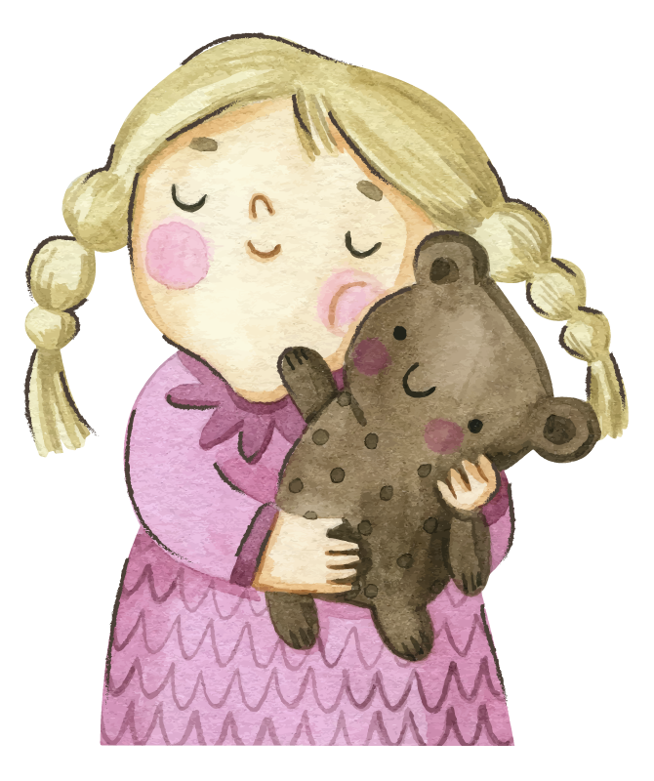
Warm-Up Game
https://wordwall.net/resource/12636940

Slide 7

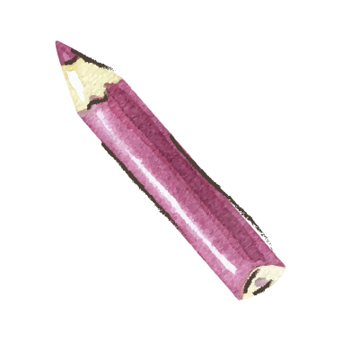
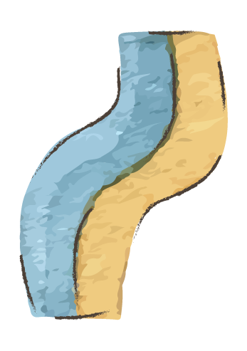
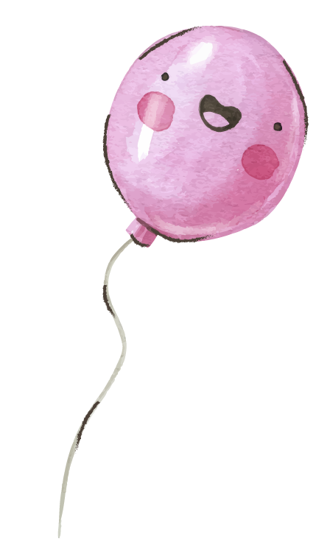



Sight Words
him
hold
light
funny

Slide 8

him
Is it a verb, a noun or a pronoun?
- Did you see Sam?
- Yes, I saw him shopping in the mall.
Use the pronoun “him” in a sentence.

Slide 9
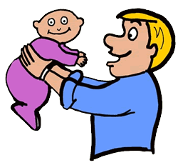
hold
Is it a verb or a noun?
1. The man is holding his baby.
2. She’s holding many books.
Use the verb “hold” in a sentence.

Slide 10
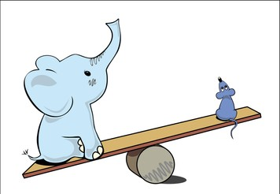
light
- The elephant is heavy, but the mouse is very light.
Use the adjective “light” in a sentence.
Is it a verb, a noun or an adjective?

Slide 11

funny
1. A funny clown came to my birthday party yesterday.
2. I love my friend Amy, she’s very funny.
Is it a verb, a noun or an adjective?
Use the adjective “funny” in a sentence.

Slide 12
Round Table

Slide 13
Critical thinking. Buzz in
What is the noun of funny?

Slide 14
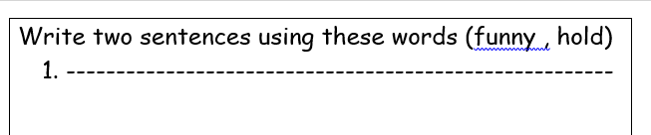
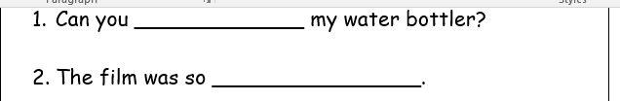
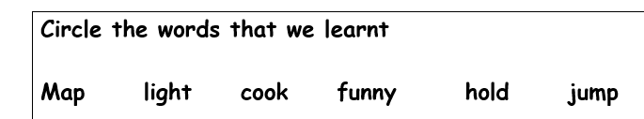
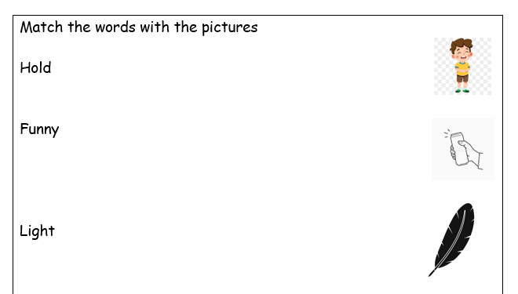
Differentiation
4
3
2
1

Slide 15
Real life application, Buzz in
What was a funny situation that you had recently?

Slide 16
Story Words
year
baby
Grown-up
bicycle
tricycle
wheel

Slide 17

year
I’m 7 years old.
Use the noun “year” in a sentence.

Slide 18
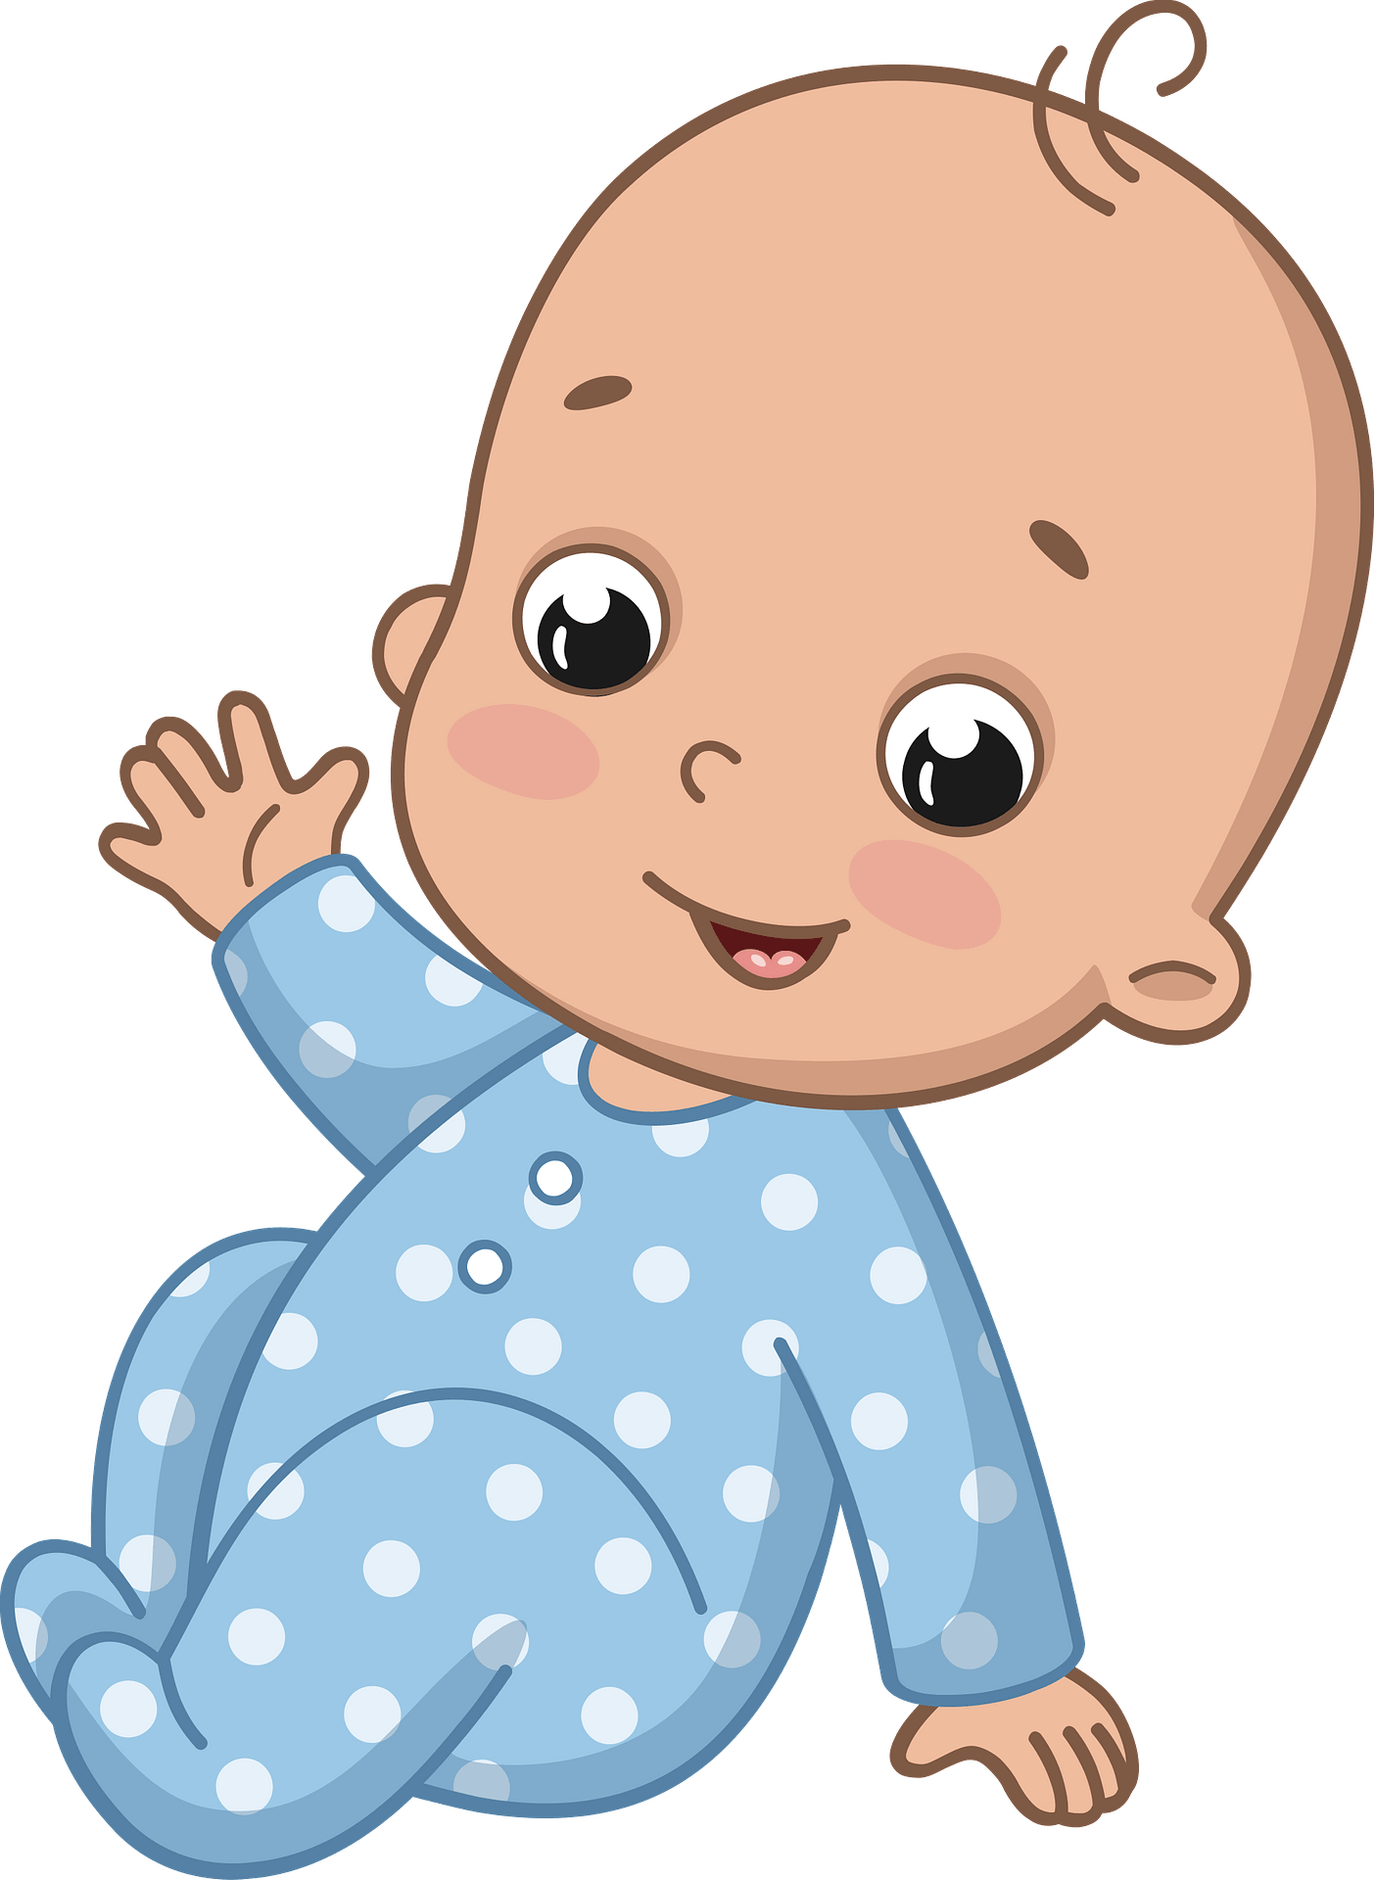
baby
The baby is crawling quickly.
Use the noun “baby” in a sentence.

Slide 19
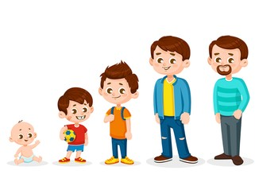
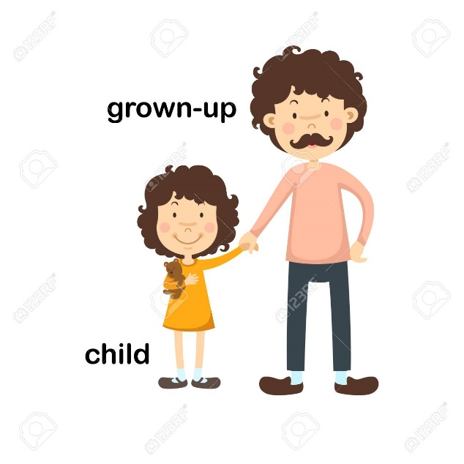
Grown-up
My brother isn’t young. He’s a grown-up.
Use the adjective “grown-up” in a sentence.

Slide 20
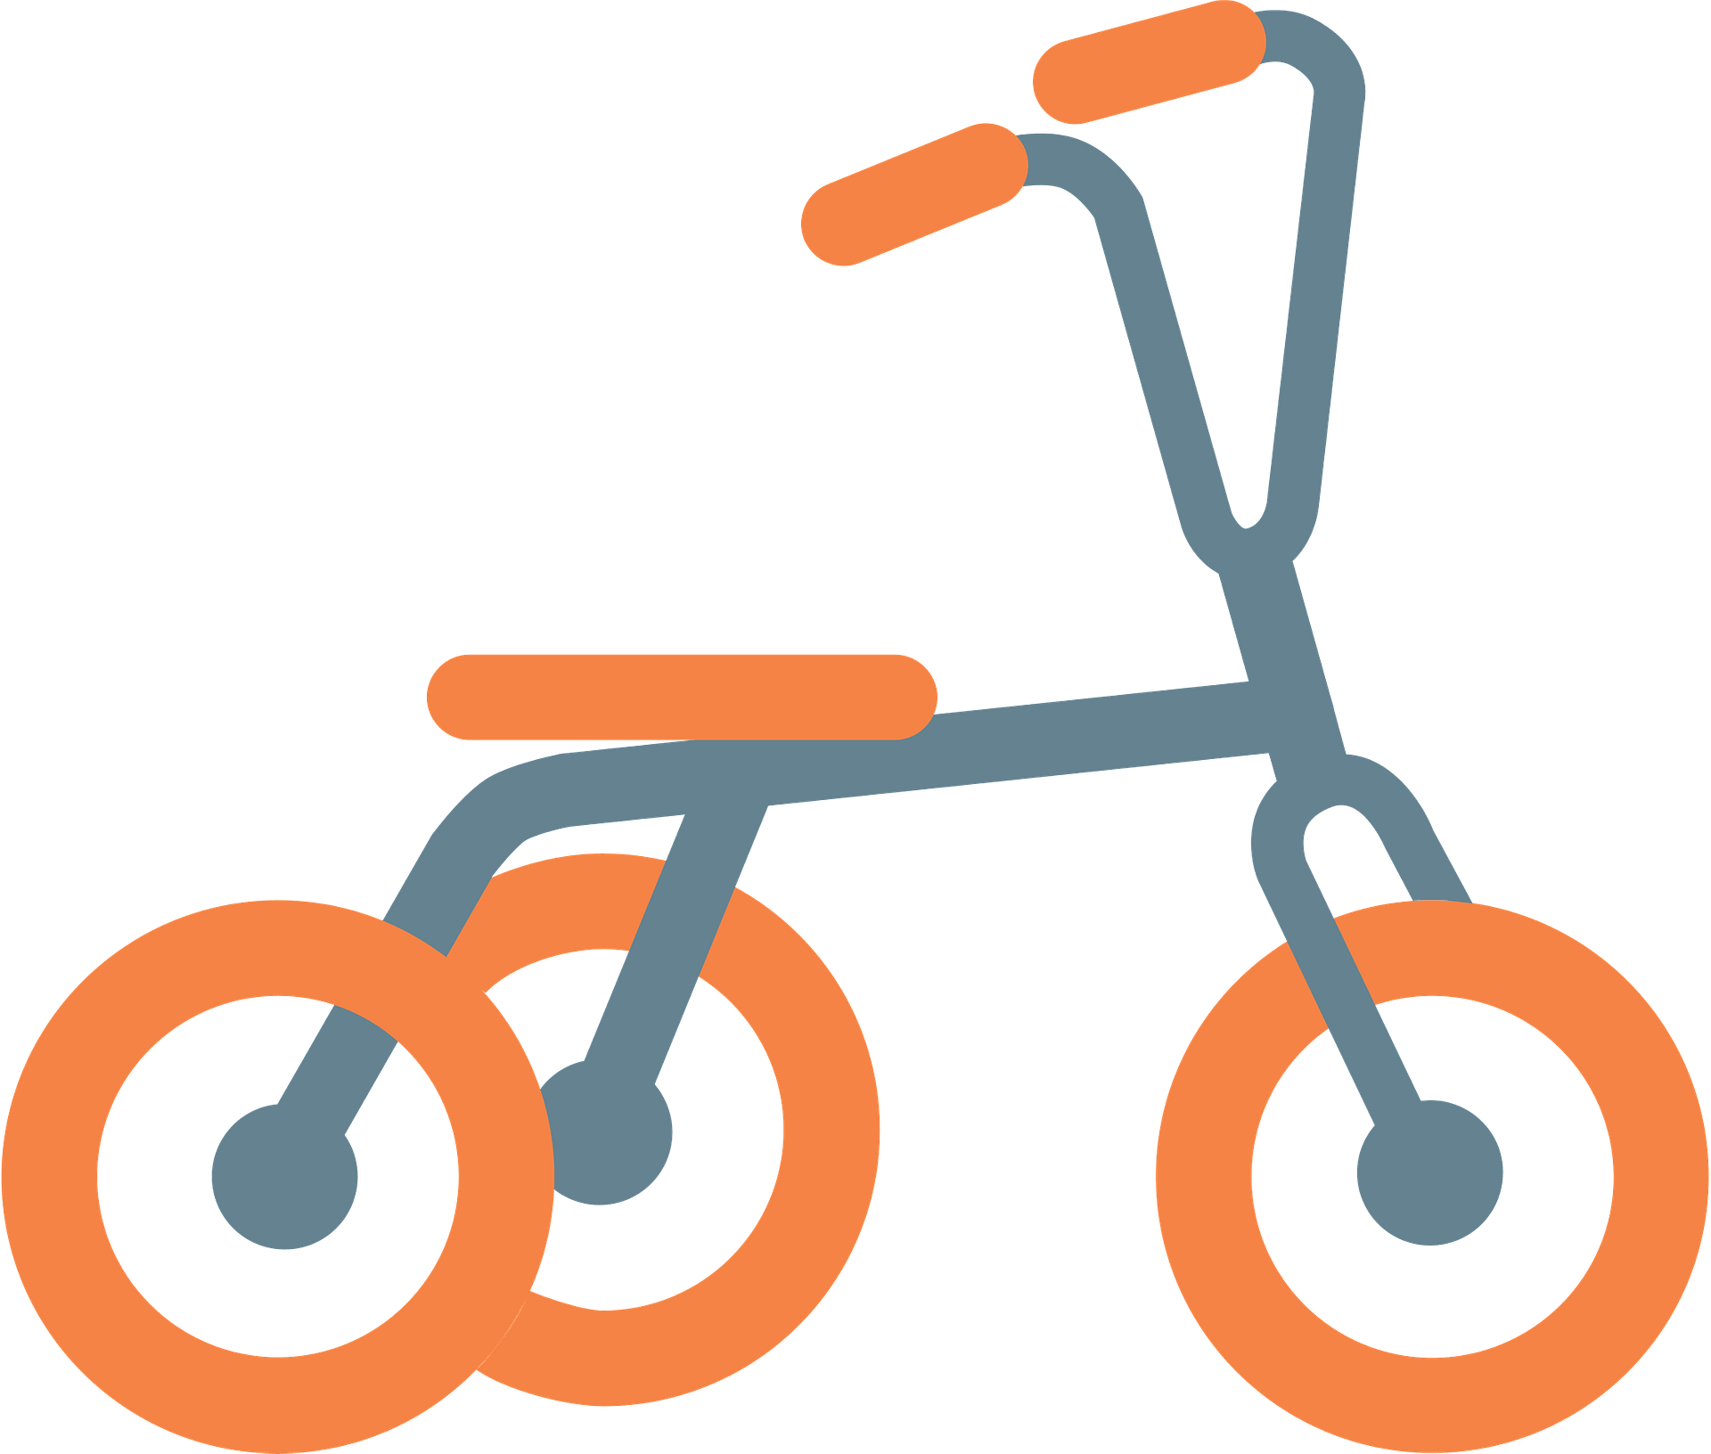
tricycle
My 3 year old sister rides a tricycle.
Use the noun “tricycle” in a sentence.

Slide 21
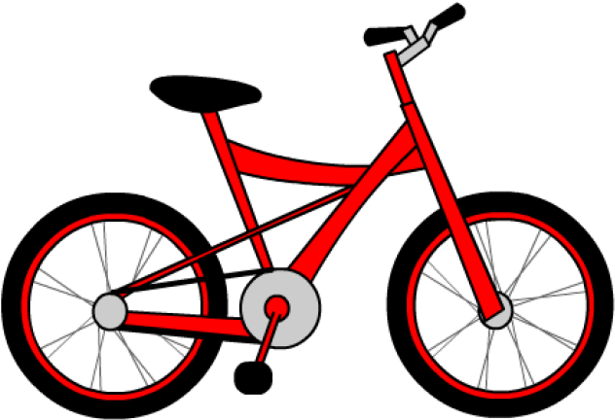
bicycle
I’m parking my bicycle in the garage.
Use the noun “bicycle” in a sentence.

Slide 22

wheel
The tricycle has 3 wheels.
Use the noun “wheel” in a sentence.

Slide 23

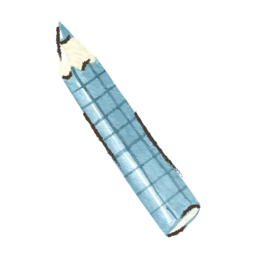
Let’s write on the boards:

Slide 24
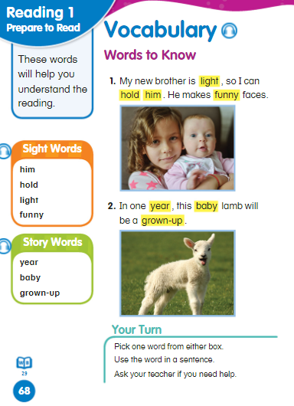
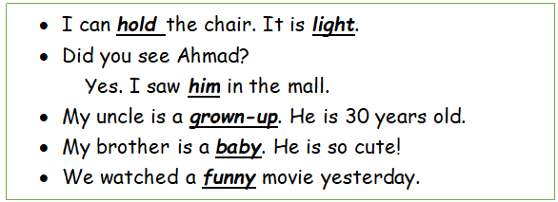
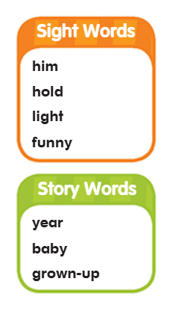

Slide 25
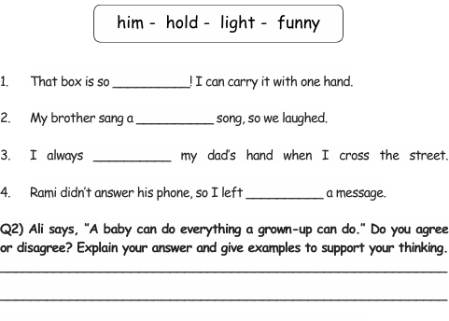
Open you English Booklet p. 34
light
funny
hold
him
I disagree. Babies cannot walk, read, or drive a car.
Grown-ups can do more things because they are bigger and older.

Slide 26
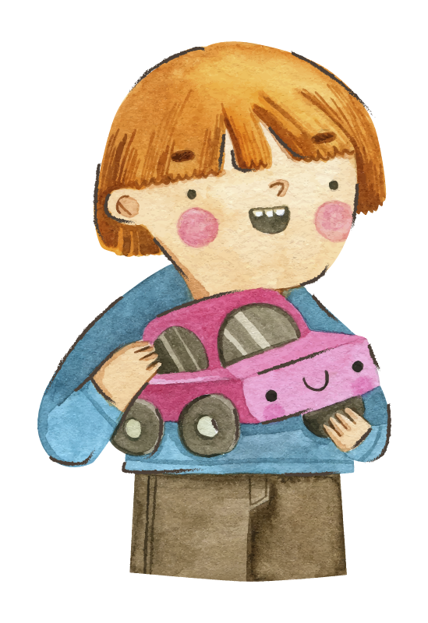
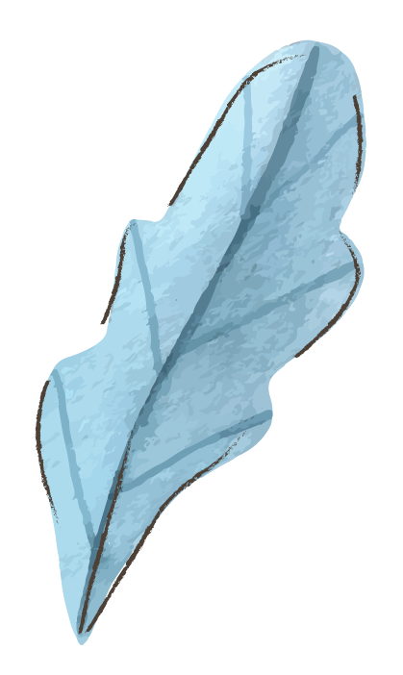
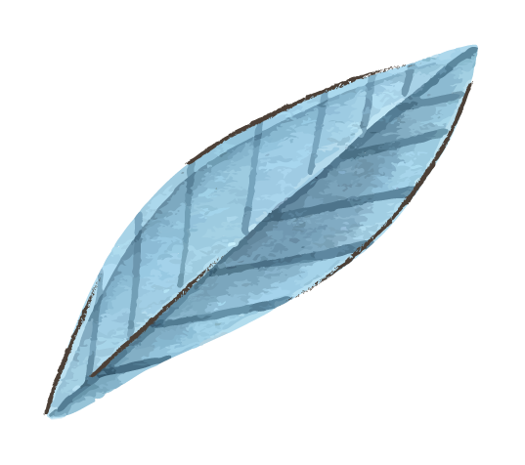
Wrap-Up Game
https://wordwall.net/resource/25348771

