Slide 1

Short o ; wh
Unit 2 / Reading 1 / Phonics 1 p. 69 / Part 1

Slide 2
Outcomes
1:00
min
1. Identify and read words containing short o and wh sounds.
2. Use words containing short o and wh sounds in sentences.

Slide 3

Warm Up
2:00
mins

Slide 4

Pre- assessment
2:00
mins
Look at the picture and choose the correct answer.
1. box
2. dog
3. pot
IRS

Slide 5

Pre- assessment
2:00
mins
Look at the picture and choose the correct answer.
1. hot
2. fox
3. pop
IRS

Slide 6

Pre- assessment
2:00
mins
Look at the picture and choose the correct answer.
1. week
2. water
3. wash
IRS

Slide 7
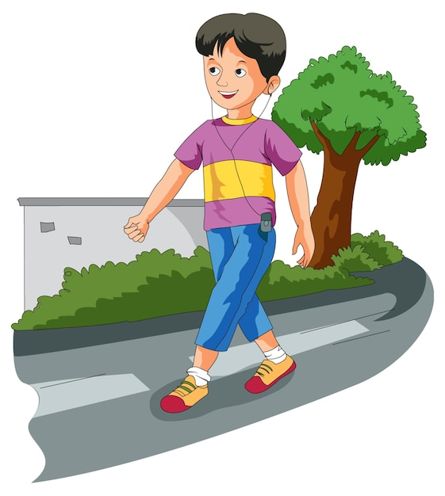
Pre- assessment
2:00
mins
Look at the picture and choose the correct answer.
1. wash
2. wake
3. walk
IRS

Slide 8


Presentation
1. What is the name of this letter?
2. What is the sound of this letter?
Random Pick

Slide 9








dog
box
pop
hot
mop
fox
dot
pot

Slide 10

Presentation
1. What letters can you see?
2. What sound do these letters make together?
Random Pick

Slide 11




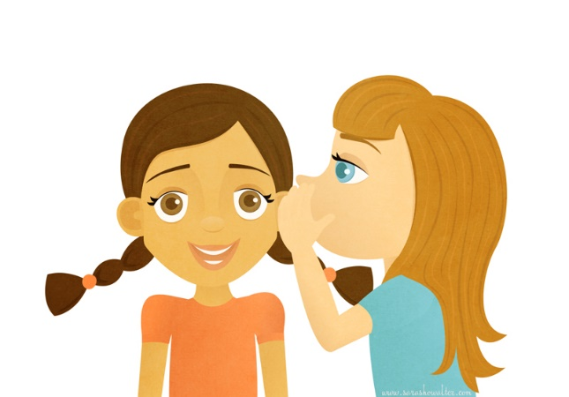
whale
wheel
whip
whisper
white

Slide 12
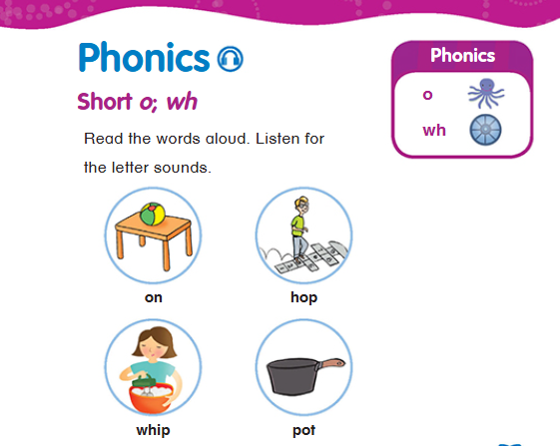

Open your book p. 69
Octopus
Wheel
Random Pick

Slide 13
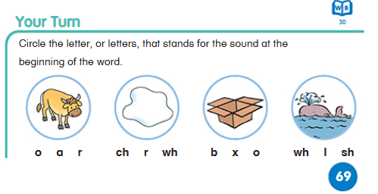
Open your book p. 69
ox
white
box
whale

Slide 14
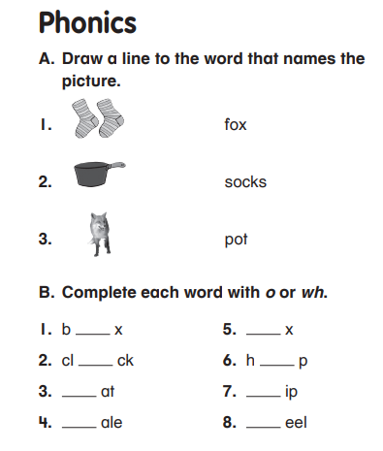
Group work
3:00
mins
Random Pick

Slide 15
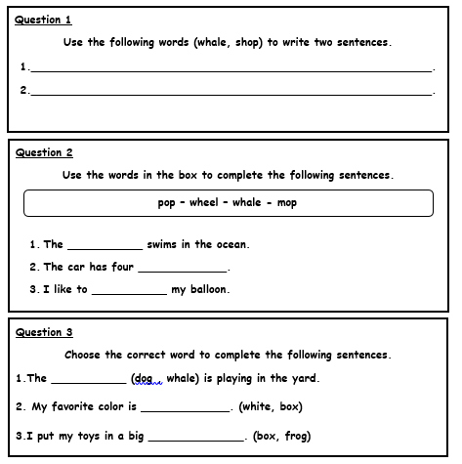
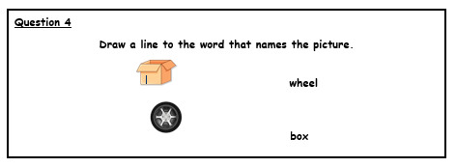
Differentiation
3:00
mins
Student 1
Student 2
Student 3
Student 4
Random Pick

Slide 16
Feedback
3:00
mins
Student 1
Student 2
whale
wheels
pop
Student 3
dog
white
box
Student 4
Random Pick

Slide 17


Relate to Real Life
2:00
mins
Use the
wh- question words to ask questions.
Random Pick

Slide 18

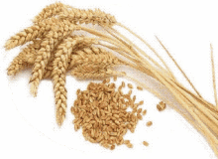
Critical Thinking
1:00
min
I grow in fields, golden and tall. Farmers harvest me in the fall. I’m used for making bread and treats, What am I?
Buzz In

Slide 19

Summative Assessment
2:00
mins
Look at the picture and choose the correct answer.
1. mop
2. jog
3. cot
IRS

Slide 20

Summative Assessment
2:00
mins
Look at the picture and choose the correct answer.
1. whale
2. whisper
3. whistle
IRS

Slide 21
Closure
1:00
min
Give / write a sentence using a word you have learnt using a word containing short o or wh sound.
https://www.tinytap.com/activities/g9rl/play/short-o-sound
https://wordwall.net/resource/37637670/reading/short-o-cvc-wds
Round Robin / Mini Boards

Slide 22
Open your Workbook p.30

Slide 23
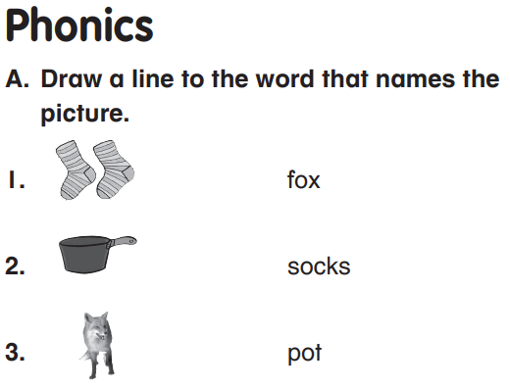

Slide 24
