Slide 1







Will + Verb
Unit 2 Reading 3 Grammar 1 SB pages 106-107
Part 1

Slide 2




Outcomes
Identify Future Simple with (will + verb).
Use Future Simple using (Will + verb) in sentences.
Perceive the importance of positive attitude by sharing experiences.

Slide 3

Warm Up
Sometimes a mistake turns into a bright idea!

Slide 4


Slide 5
2:00
mins
1.book
2. pink
Pre - assessment
Which word of the following is a ‘verb’ ?
3. run
4. she
IRS

Slide 6

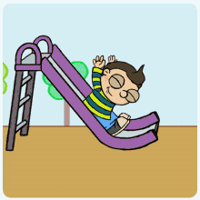
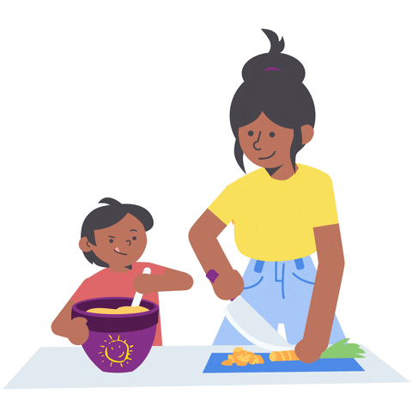
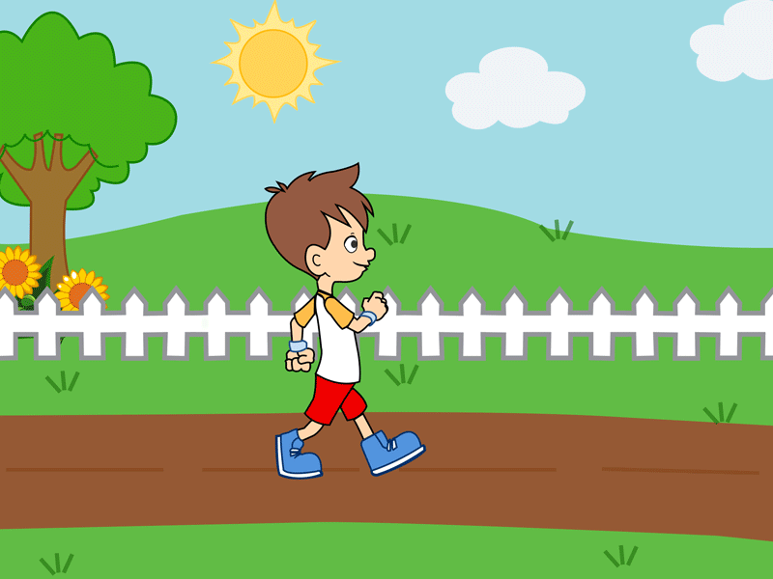
What is a verb?
A verb is a word that shows an action.
play
cook
walk

Slide 7

This is Tala !
She is a smart and kind girl. She is on vacation, and sometimes she feels bored. So, she decided to make a to-do list. Every day, she has a task to do.

Slide 8
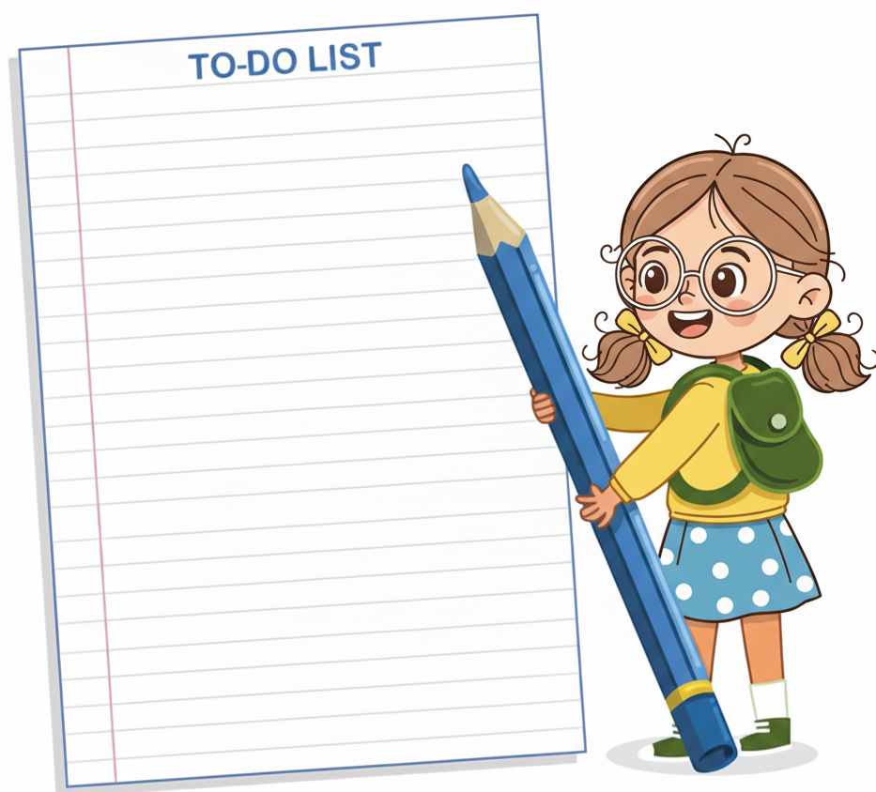
Read Tala’s to do list and answer the following questions.
1. What did Tala do yesterday?
I helped my mom in the garden. (Yesterday)
2. What does Tala do everyday?
I make a to do list. (present)
3. What do you think Tala will do tomorrow?
(tomorrow) ?

Slide 9
Future Simple
We use (subject + will + verb ) to talk about predictions and future promises.
Example:
Tala will visit her friend tomorrow.

Slide 10

Contractions!
I will | I’ll
He will | He’ll
She will | She’ll
It will | It’ll
You will | You’ll
We will | We’ll
They will | They’ll
You can also use contractions of
(will).
Change the subject add (will) to the subject. Then, add an apostrophe and (ll).

Slide 11


Examples
1. He will start a new job next week.
2. They will travel to Dubai next year.
3. I’ll visit my grandparents tomorrow.
4. She will buy a new car soon.
Random Pick

Slide 12
Negative Form
We use (subject + will + not + verb ) to talk about things that won’t happen in the future.
Example:
Tala won’t visit her friend tomorrow.

Slide 13
Contractions!
You can also change ( will + not ) into (won’t)
I will not | I won’t
He will not | He won’t
She will not | She won’t
It will not | It won’t
You will not | You won’t
We will not | We won’t
They will not | They won’t

Slide 14
Examples
1. I won’t forget my homework.
2. They will not run in the house.
3. We won’t go to bed early tonight.
4. She will not wear her rain coat today.
Random Pick

Slide 15
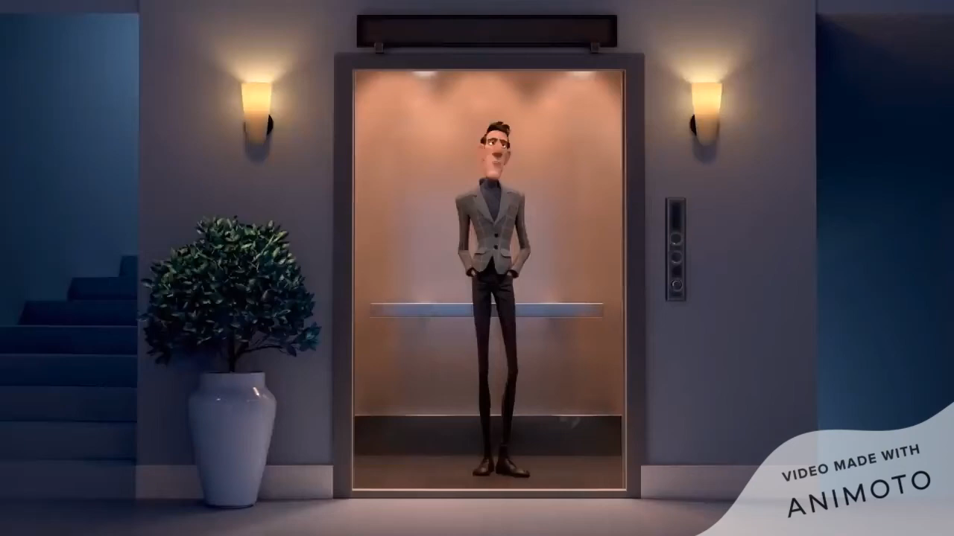
Future Simple
What will happen in the future?
Random Pick

Slide 16
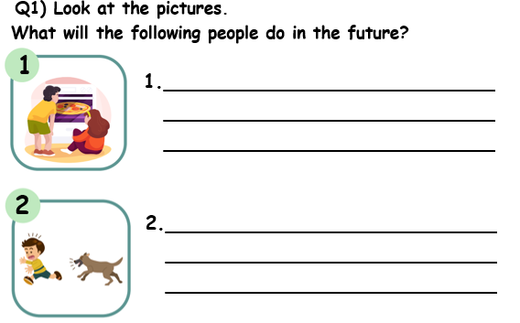

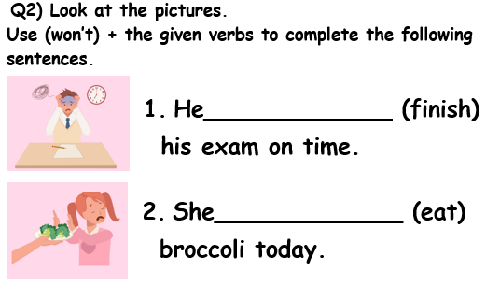
4:00
mins
Group work

Slide 17
4:00
mins
Feedback
They will eat pizza.
The dog will bite the boy.
won’t finish
won’t eat

Slide 18
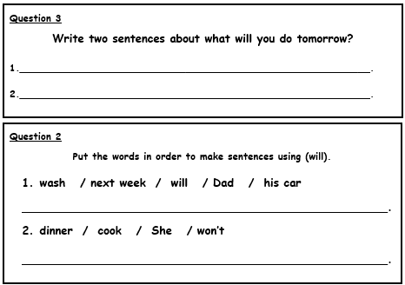
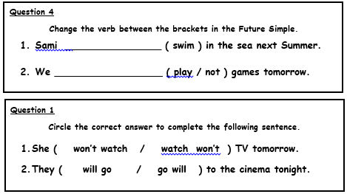
3:00
mins
Differentiation

Slide 19
3:00
mins
Feedback
will swim
Dad will wash his car next week.
won’t play
She won’t cook dinner.

Slide 20



2:00
mins
Relate to Real Life
What will you do after school?
I will ………

Slide 21
2:00
mins
Critical Thinking
What is the difference between
"I will eat"
and
"I am eating"?
Buzz In

Slide 22
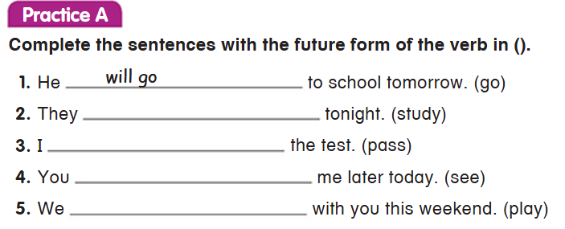

2:00
mins
Summative Assessment
Open our book p. 106

Slide 23
2:00
mins
Feedback
Open your book p. 106
will study
will pass
will see
will play

Slide 24
Wrap Up
Spin the wheels and make a funny sentence!

Slide 25
Will + Verb
Unit 2 Reading 3 Grammar 1 SB pages 106-107
Part 2

Slide 26
Outcomes
Identify Future Simple with (will + verb).
Use Future Simple using (Will + verb) in sentences.
Perceive the importance of positive attitude by sharing experiences.

Slide 27
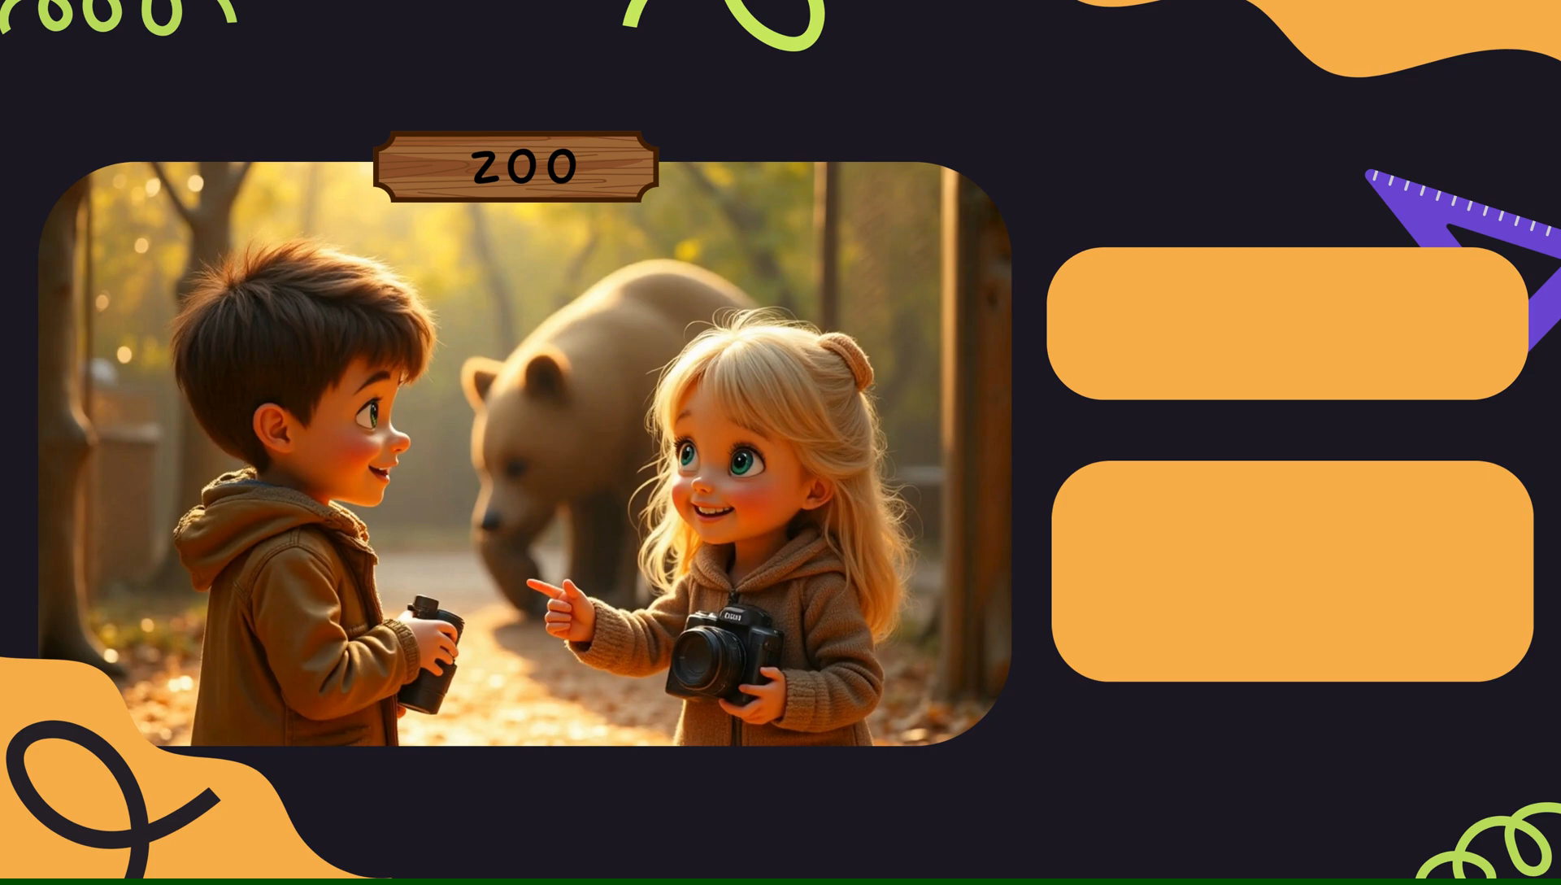
Warm Up

Slide 28
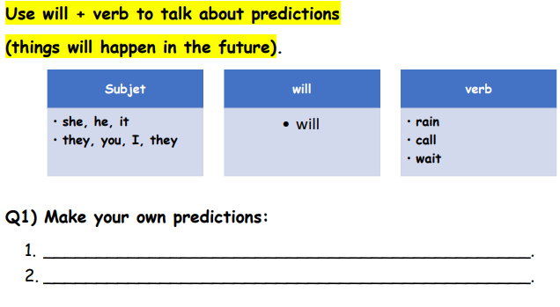
Pre- assessment
Open your English Booklet p. 47

Slide 29
Future Simple
We use (subject + will + verb ) to talk about predictions and future promises.
Example:
Tala will visit her friend tomorrow.

Slide 30
Negative Form
We use (subject + will + not + verb ) to talk about things that won’t happen in the future.
Example:
Tala won’t visit her friend tomorrow.

Slide 31
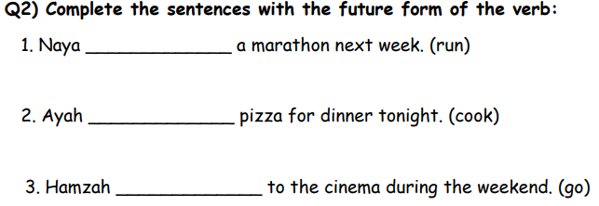
Formative Assessment
Open your English Booklet p. 48

Slide 32
Feedback
Open your English Booklet p. 48
will run
will cook
will go

Slide 33
Contractions!
I will | I’ll
He will | He’ll
She will | She’ll
It will | It’ll
You will | You’ll
We will | We’ll
They will | They’ll
You can also use contractions of
(will).
Change the subject add (will) to the subject. Then, add an apostrophe and (ll).

Slide 34
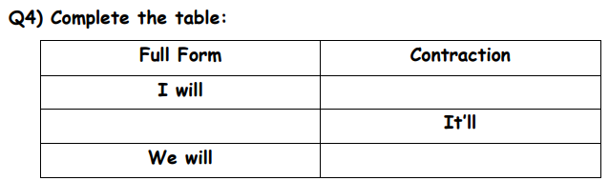
Formative Assessment
Open your English Booklet p. 49

Slide 35
Feedback
Open your English Booklet p. 49
I’ll
It will
We’ll

Slide 36


Question form
Examples
1. Will you go to the park tomorrow?
2. Will they play outside?
3. Will he eat applies?
4. Will you help me with my homework?
We use
Will + subject + verb
to ask questions.
Don’t forget to put the question mark at the end.

Slide 37
2:00
mins
Relate to Real Life
Yes, I will.
No, I won’t.
Will you come to school tomorrow?

Slide 38
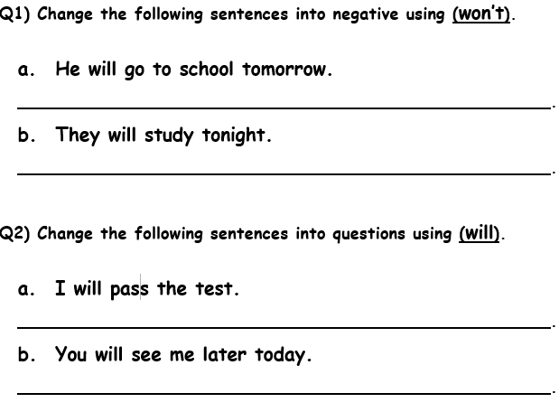
3:00
mins
Group work

Slide 39
3:00
mins
Feedback
He won’t go to school tomorrow.
They won’t study tonight.
Will I pass the test?
Will you see me later today?

Slide 40
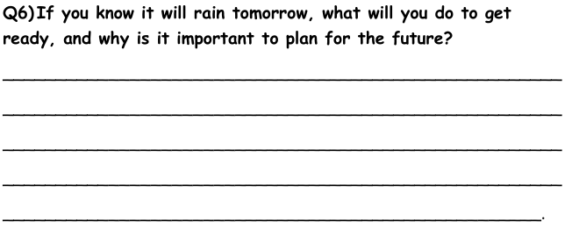
Critical Thinking
Open you English Booklet P. 50
2:00
mins
I will bring my umbrella and wear my raincoat. I won't forget my rainboots, so I will be ready and stay dry.
Buzz In

Slide 41

Summative Assessment
Choose the correct answer.
___________ he be a doctor when he grows up?
1. will
2. won’t
IRS

Slide 42
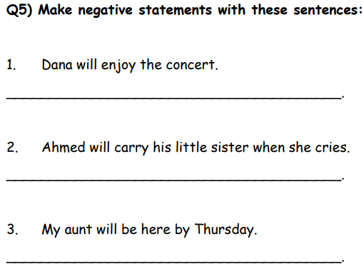
Summative Assessment
Open your English Booklet p. 49

Slide 43
Feedback
Open your English Booklet p. 49
Dana won’t enjoy the concert.
Ahmed won’t carry his little sister when she cries.
My aunt won’t be here by Thursday.

Slide 44
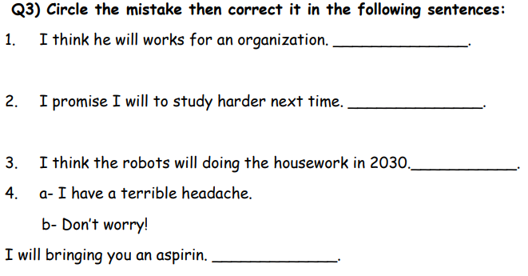
Homework
Open your English Booklet p. 48

Slide 45
Will + Verb
Unit 2 Reading 3 Grammar 1 SB pages 106-107
Part 3

Slide 46
Outcomes
Identify Future Simple with (will + verb).
Use Future Simple using (Will + verb) in sentences.
Perceive the importance of positive attitude by sharing experiences.

Slide 47
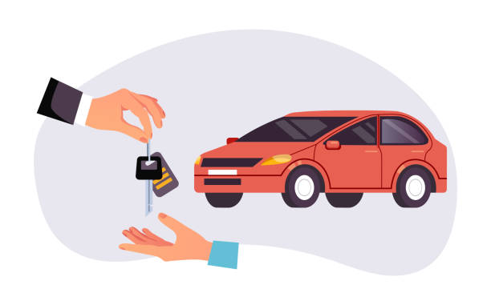
2:00
mins
Pre - assessment
1.will buy
Choose the correct answer
He ________ a new car next year.
2.buys
IRS

Slide 48
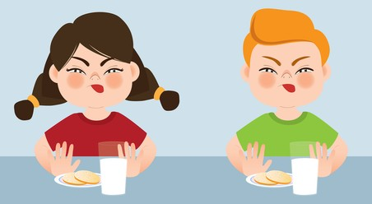
2:00
mins
Pre - assessment
1.drink not
Choose the correct answer
They ________ milk tomorrow.
2.won’t drink
IRS

Slide 49
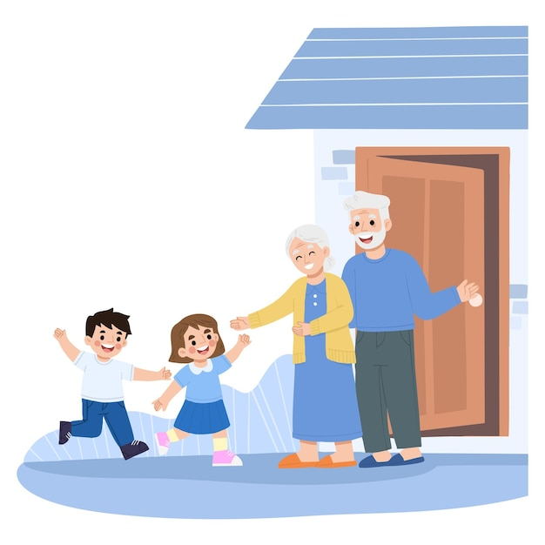
2:00
mins
Pre - assessment
1.Will
Choose the correct answer
_______ you visit your grandparents?
2.Won’t
IRS

Slide 50
Future Simple
We use (subject + will + verb ) to talk about predictions and future promises.
Example:
Tala will visit her friend tomorrow.

Slide 51
Contractions!
I will | I’ll
He will | He’ll
She will | She’ll
It will | It’ll
You will | You’ll
We will | We’ll
They will | They’ll
You can also use contractions of
(will).
Change the subject add (will) to the subject. Then, add an apostrophe and (ll).

Slide 52
Negative Form
We use (subject + will + not + verb ) to talk about things that won’t happen in the future.
Example:
Tala won’t visit her friend tomorrow.

Slide 53
Contractions!
You can also change ( will + not ) into (won’t)
I will not | I won’t
He will not | He won’t
She will not | She won’t
It will not | It won’t
You will not | You won’t
We will not | We won’t
They will not | They won’t

Slide 54
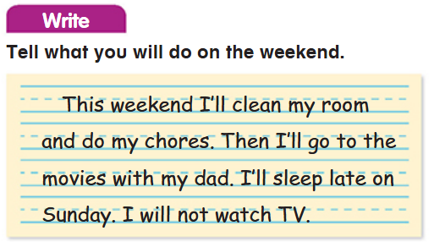
English Book p. 107

Slide 55

A Day Out
This is what a paragraph look like;
Title in the middle
The first letter in each word in the title is capitalized
Indentation
Laila and Ahmad are going to the park. They are running to the swings. Laila is swinging high in the air. Ahmad is climbing the jungle gym. They are laughing and having fun. A bird is flying above them. The sun is shining, and the sky is blue. They are playing together. Now, they are sitting on the grass, eating ice cream. It is a happy day at the park!
Capitalization and Punctuation Marks

Slide 56
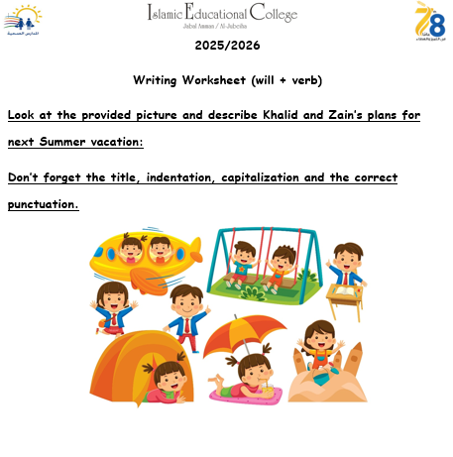
Summer Vacation
Khalid and Zain will go to the beach next Summer. They will swim in the sea and play in the sand. They will also eat ice cream. They will have a lot of fun together!

Slide 57
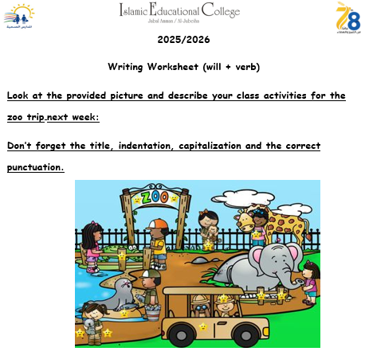
The Zoo Trip
Next week, we will go to the zoo. We will see the elephants. We will watch the monkeys. We will also see the lions and take many photos. We will have fun and enjoy the zoo!

Slide 58
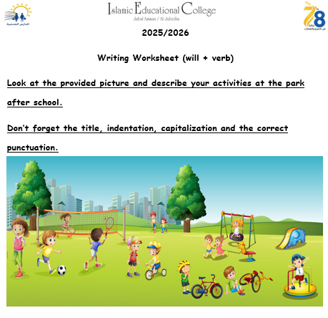
At The Park
After school, I will go to the park. I will play on the swings. I will run and jump. I will kick the ball. Some children will ride bikes. Others will play on the slide. I will have fun!

Slide 59
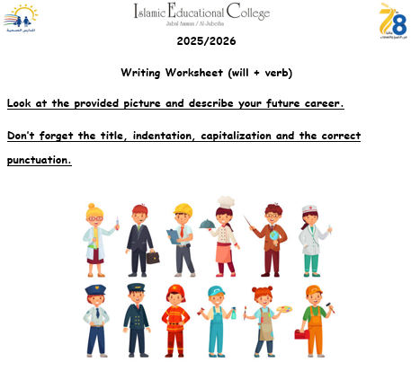

Slide 60

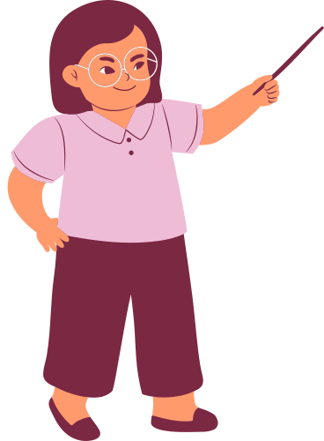


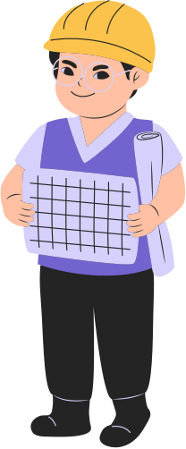

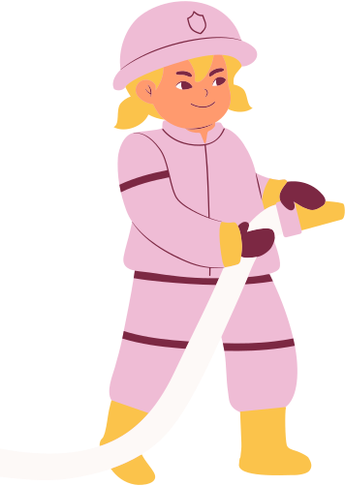

Jobs in our community
NURSE
TEACHER
OFFICER
DANCER
ENGINEER
DOCTOR
FIREFIGHTER

Slide 61
Pre- assessment
Choose the correct sentence.
She _______a firefighter when she grows up.
1.will be
2. be will
IRS

Slide 62
Pre- assessment
Choose the correct sentence.
He _______a doctor when he grows up.
1. will be
2. won’t be
IRS

Slide 63

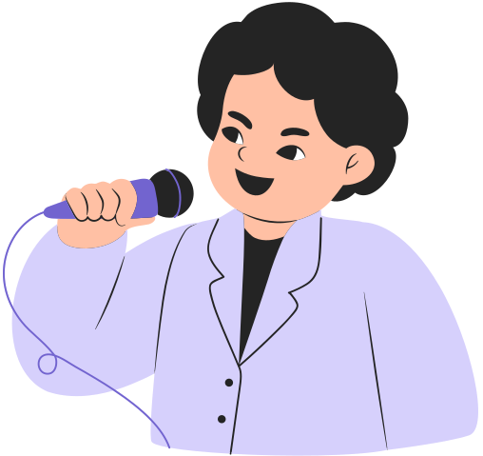

SHOW AND TELL
DREAM JOBS
Talk about your dream job

Slide 64

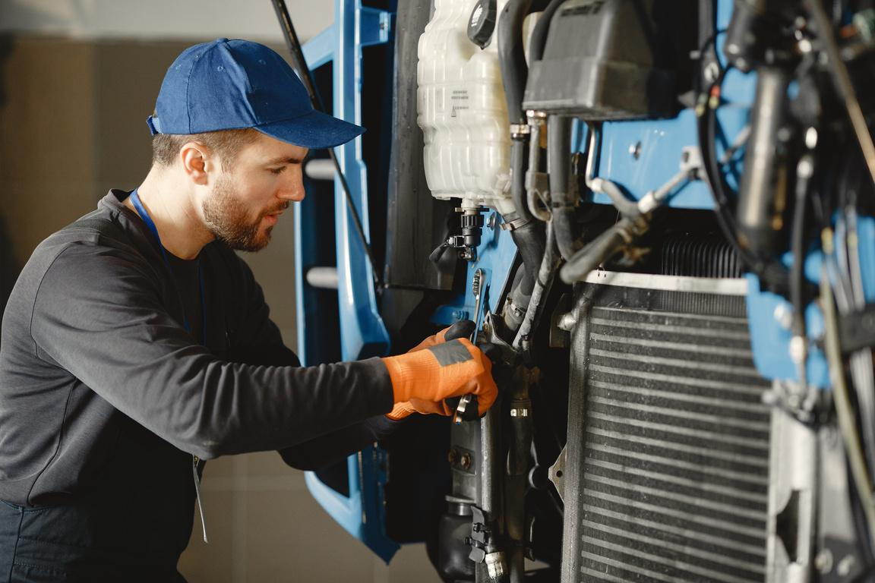
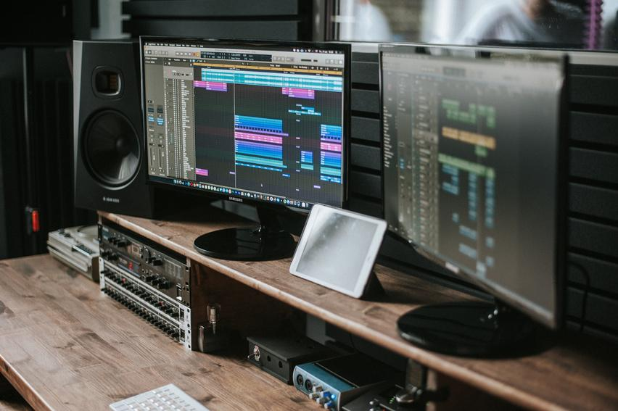
Hello, I’m [Name]
WHAT I DO
TOOLS I USE

Slide 65

Resource Page
Use these in your presentation. Delete or hide this page before presenting.
Fonts
Design Elements / Icons
This presentation template
uses the following free fonts:
TITLES:
LUCKIEST GUY
BODY TEXT:
DM Sans Regular
You can find these fonts online too.
Colors
#426BB2
#C0DB79
#D6D0FC
#EFBCD5
#FFE565

Slide 66

Credits
This presentation template is free for everyone to use, thanks to the following:
Pexels, Pixabay, Sketchify
for this presentation template
for the photos, graphics, and elements

