Slide 1
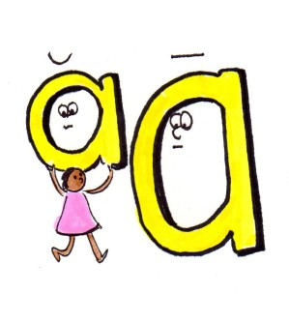
Long
Unit 2 Reading 3 Phonics 1 Page 97

Slide 2
1. Identify long ‘a’ sound.
2. Use words with long ‘a’ sound in sentences.
Outcomes
1:00
min

Slide 3
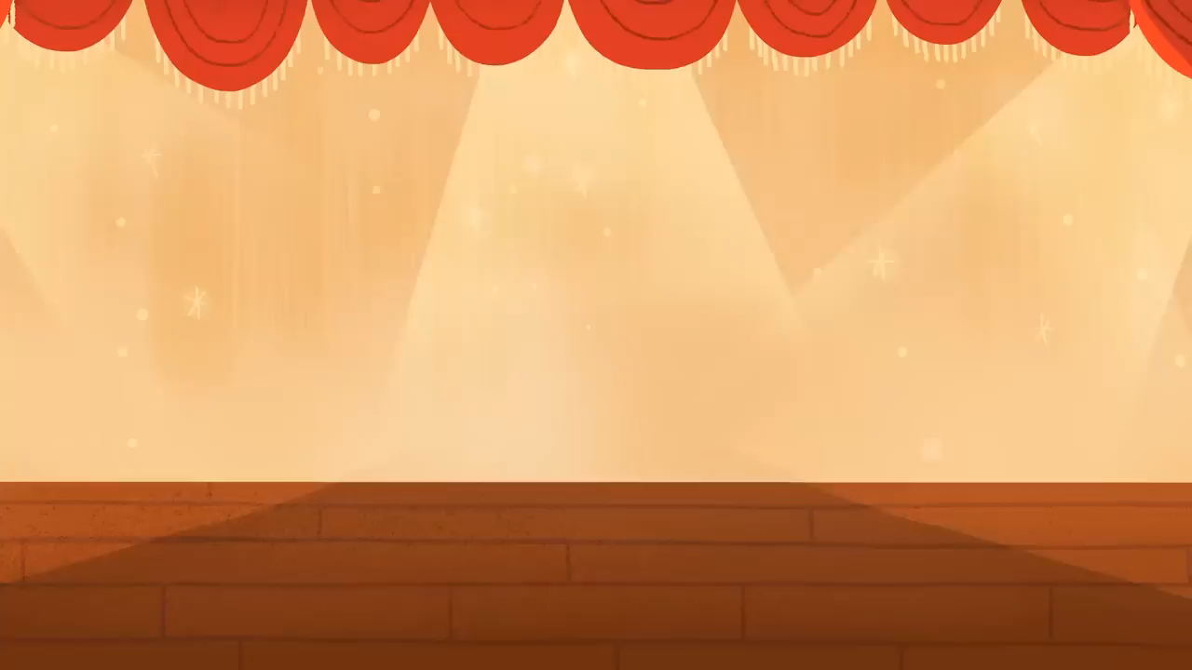
Warm Up
2:00
mins

Slide 4

Pre Assessment
2:00
mins
Look at the picture, and choose the correct answer.
1. pig
2. cat
3.dog
IRS

Slide 5

Pre Assessment
2:00
mins
Look at the picture, and choose the correct answer.
1. bed
2. net
3. egg
IRS

Slide 6
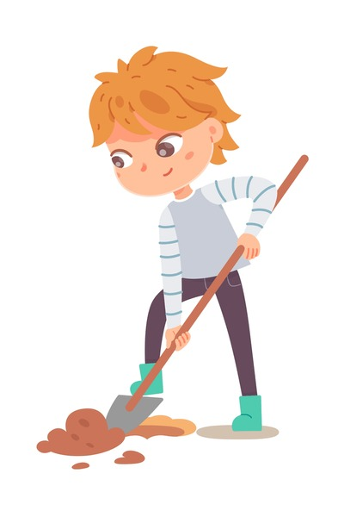
Pre Assessment
2:00
mins
Look at the picture, and choose the correct answer.
1. dig
2. igloo
3. lip
IRS

Slide 7

Pre Assessment
2:00
mins
Look at the picture, and choose the correct answer.
1. box
2. orange
3. octopus
IRS

Slide 8

Pre Assessment
2:00
mins
Look at the picture, and choose the correct answer.
1. umbrella
2. sun
3. bug
IRS

Slide 9
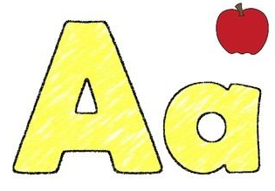
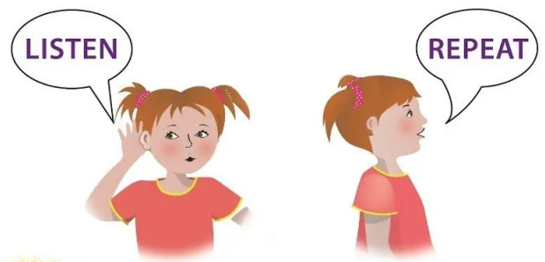
Presentation
What is the name of this letter?
What is the sound of this letter?
Random Pick

Slide 10
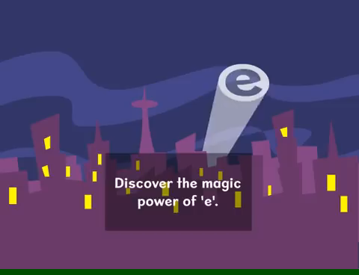
Magic “e" is a special letter that can change the sound of a vowel (like a, e, i, o, u) when it is placed at the end of a word.
Random Pick

Slide 11
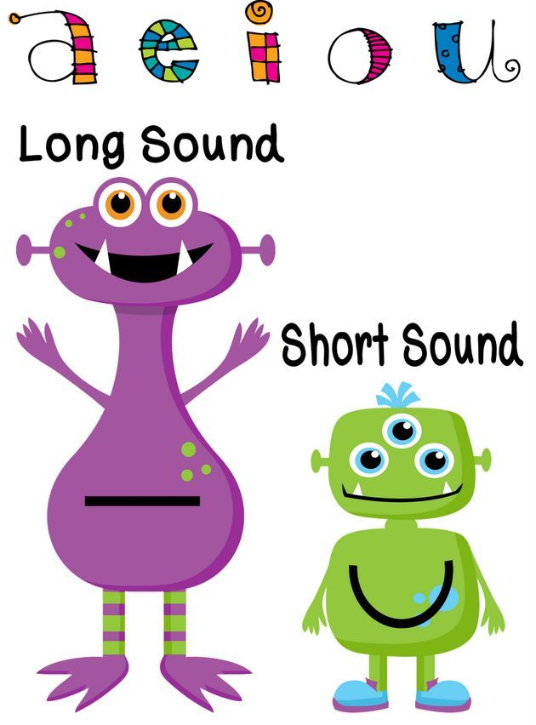

Magic “e” changes vowels sound from short sound into long sound.
Random Pick

Slide 12
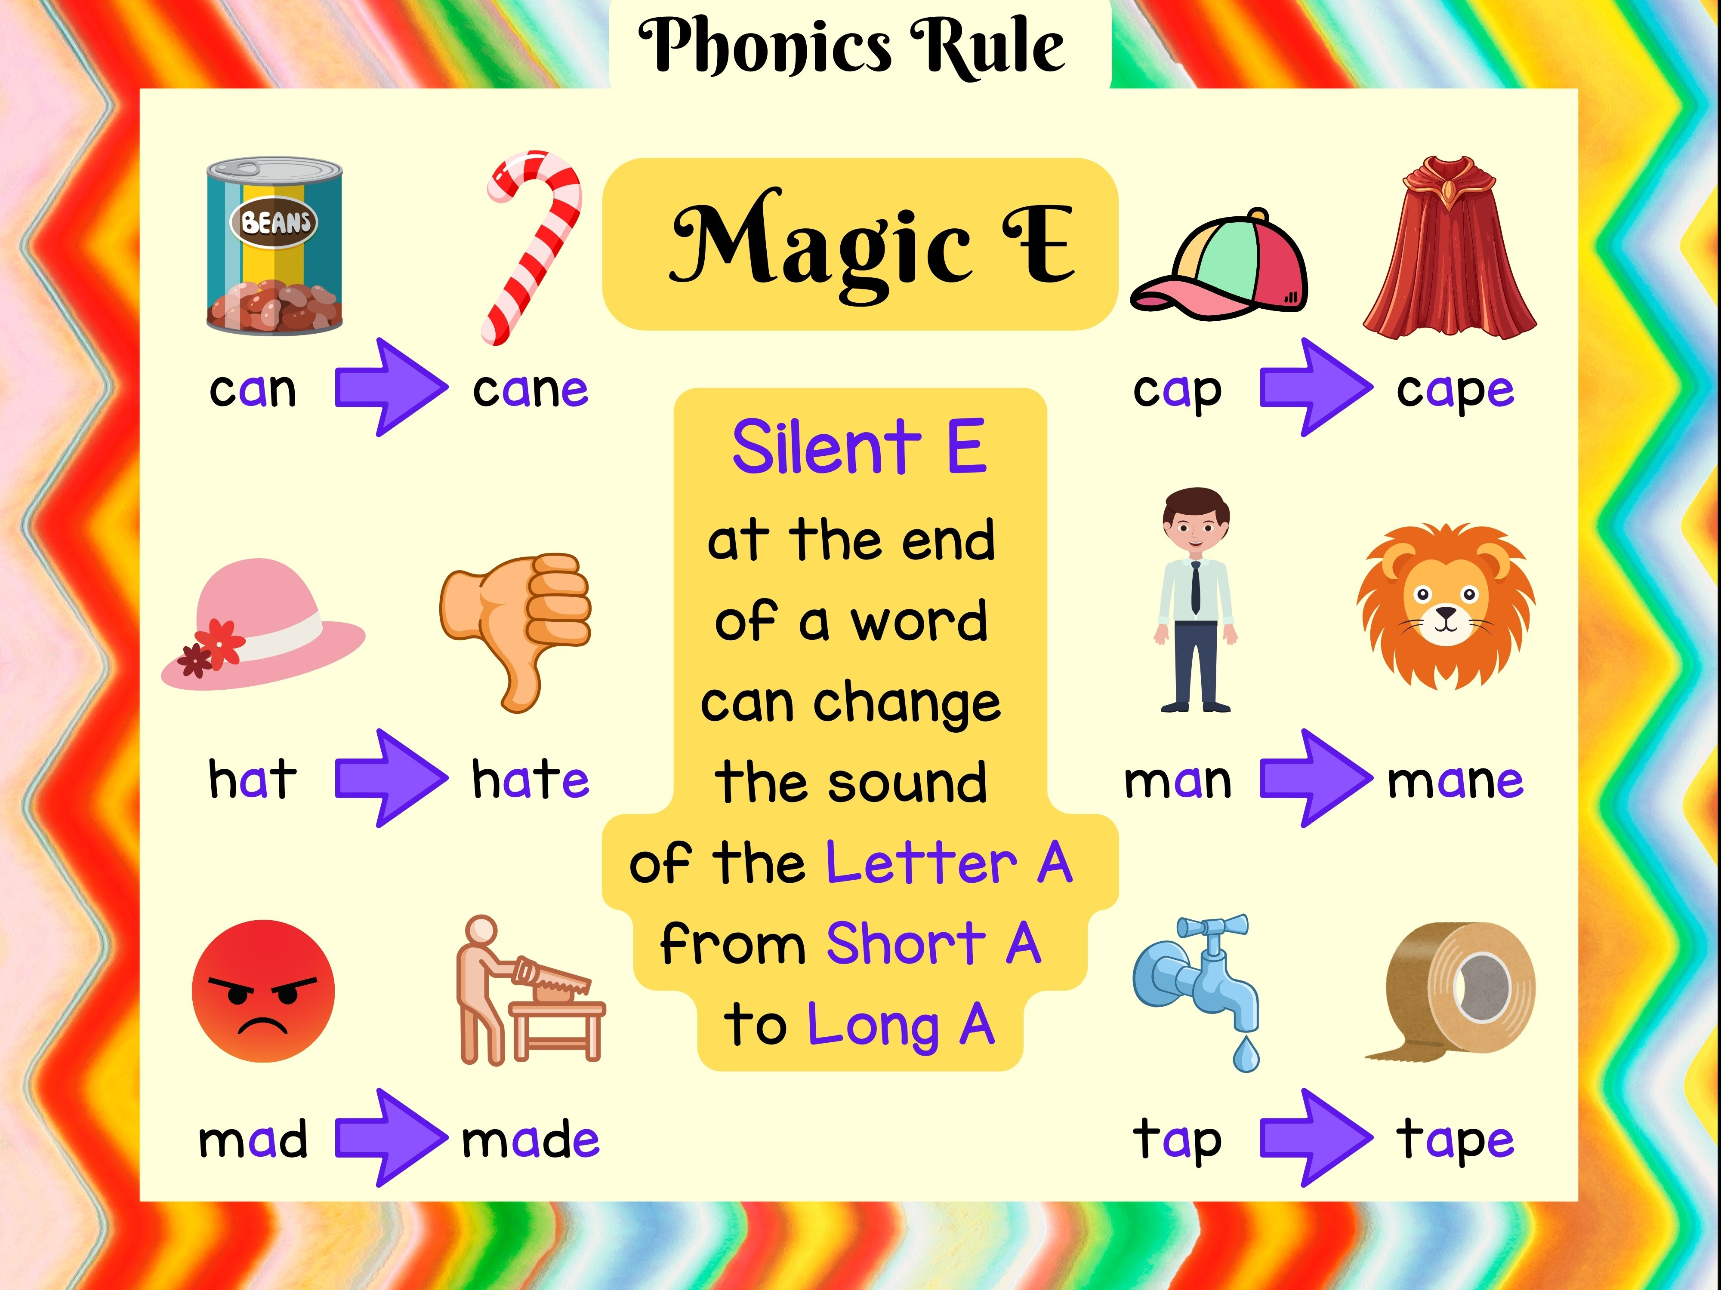
The long "a" sound sounds like the letter name "A“
Examples:
Random Pick

Slide 13



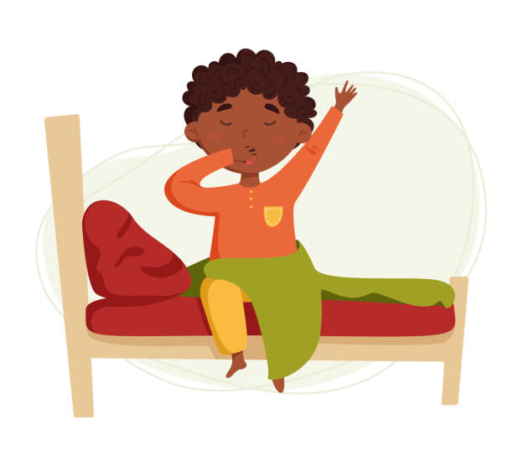

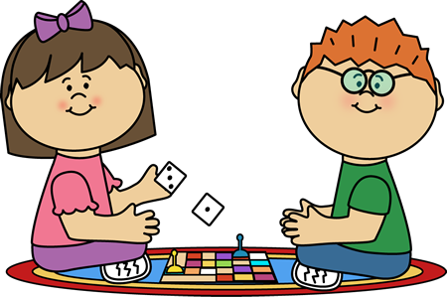
cake
wave
gate
game
wake
lake

Slide 14
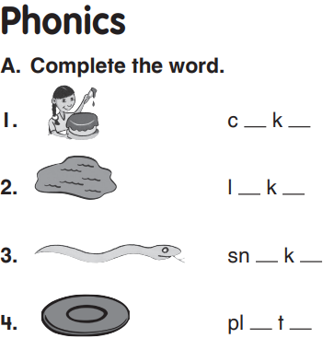
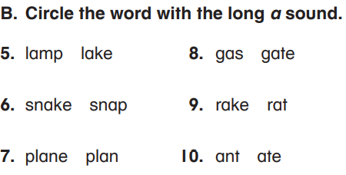

Group Work
3:00
mins

Slide 15
Feedback
3:00
mins
a e
a e
a e
a e

Slide 16
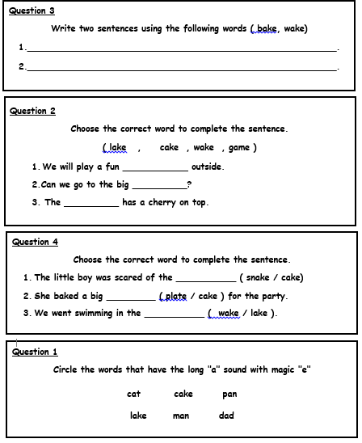
Differentiation
3:00
mins
Student 3
Student 2
Student 4
Student 1
Random Pick

Slide 17
Feedback
3:00
mins
Student 3
game
lake
Student 2
cake
Student 4
Student 1
Random Pick

Slide 18


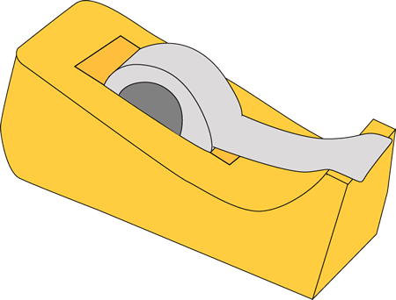
Relate to Real Life
2:00
mins
Look around the class, and give examples of long ‘a’ sound.
Random Pick

Slide 19

Critical Thinking
2:00
mins
I help tell stories in a book,
You turn me forward and backward to take a look.
I can be blank or filled with lines,
What am I?
Buzz In

Slide 20
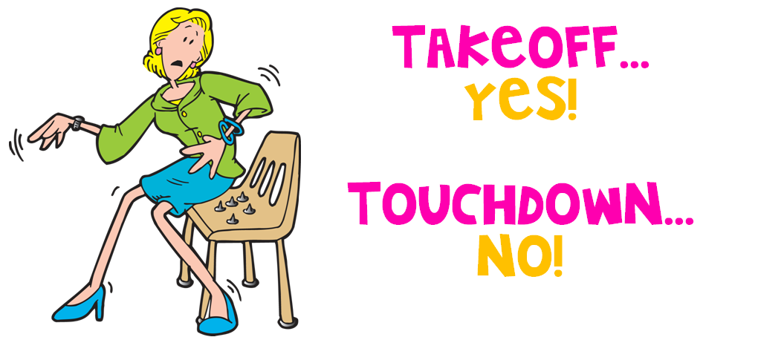
Take off if you hear a word that has the long (a) sound.
Touch down if you hear a word that doesn’t have the long (a) sound.
2:00
mins

Slide 21
Summative Assessment
2:00
mins
Look at the picture, and choose the correct answer.
1. snake
2. whale
3. lake
IRS

Slide 22
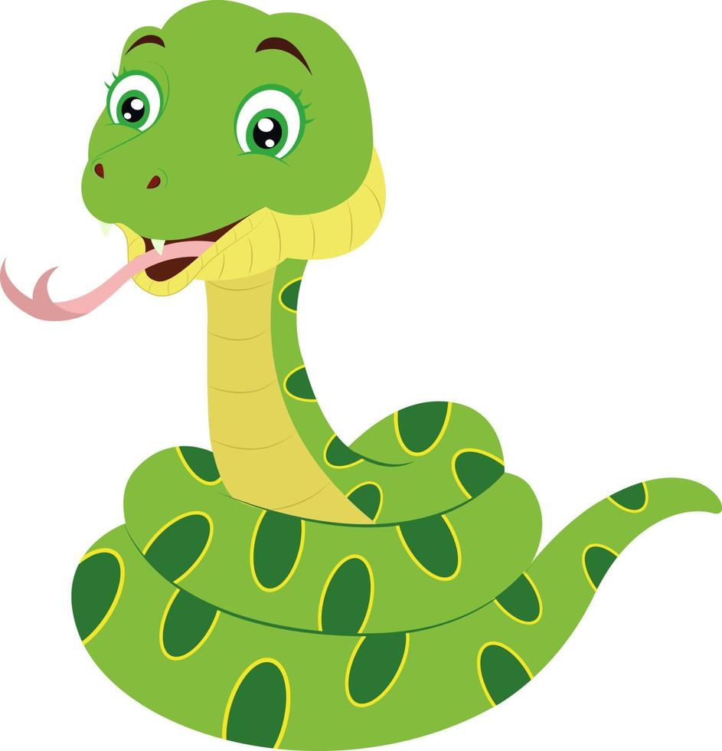
Summative Assessment
2:00
mins
Look at the picture, and choose the correct answer.
1. snake
2. whale
3. lake
IRS

Slide 23
Summative Assessment
2:00
mins
Read the sentence and choose the words that have long “a” sound.
I am late to the game.
1. am, late
2. late, game
IRS

Slide 24
Summative Assessment
2:00
mins
Read the sentence and choose the words that have long “a” sound.
The ape sat in the cage
1. ape, cage
2. sat, cage
IRS

Slide 25
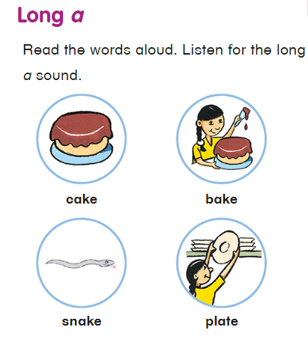
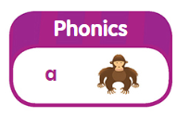
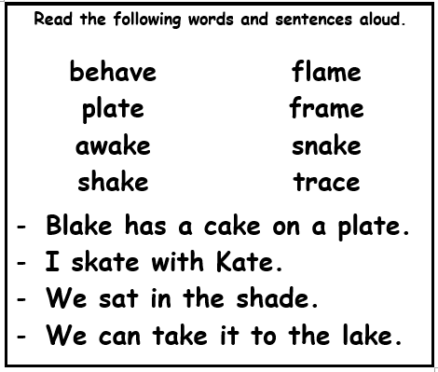
Open your book p. 97
ape
Random Pick

Slide 26
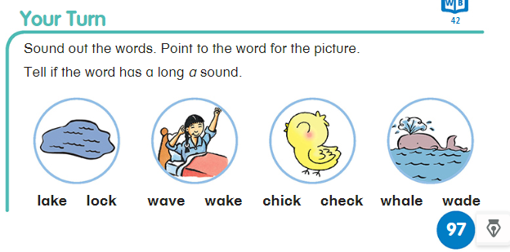
Random Pick

Slide 27
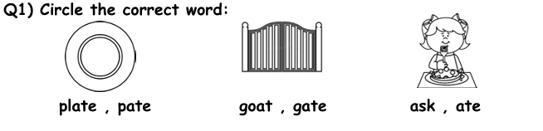

Summative Assessment
Open your English Booklet p. 45
2:00
mins
Random Pick

Slide 28
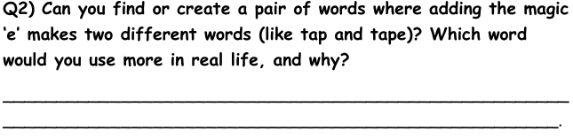
Relate to Real Life
Open your English Booklet p. 45
2:00
mins
cut → cute
We use the word (cute) more in real life because it describes things or people that are lovely and sweet.
Random Pick

Slide 29
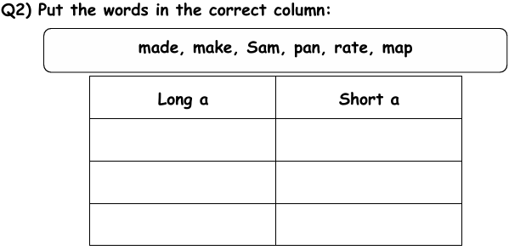
Summative Assessment
Open your English Booklet p. 45
2:00
mins
made
Sam
make
pan
rate
map
Random Pick

Slide 30

Wrap up
2:00
mins
https://wordwall.net/resource/2473950/reading/magic-e
https://wordwall.net/resource/1438298/english/magic-e
Random Pick

