Slide 1

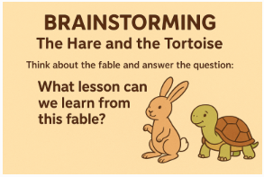

SUBJECT: Reading
GRADE: 6
UNIT: 4
LESSON: 4
OUTCOMES
Warm Up
4:00 Mines
WARM UP
Kagan Strategy: Rally Robin
PREASSESSMENT
PRESENTATION
FORMATIVE ASSESSMENT
FEEDBACK
DIFFERENTIATION
REAL LIFE APPLICATION
CRITICAL THINKING
EXIT TICKET

Slide 2

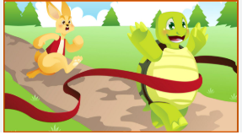
SUBJECT: Reading
GRADE: 6
UNIT: 4
LESSON: 4
OUTCOMES
Warm Up
Feedback
WARM UP
Answer: Overconfidence and laziness can lead to failure, while patience, persistence, and steady effort lead to success.
PREASSESSMENT
PRESENTATION
FORMATIVE ASSESSMENT
FEEDBACK
DIFFERENTIATION
REAL LIFE APPLICATION
CRITICAL THINKING
EXIT TICKET

Slide 3


SUBJECT: ThReading
GRADE: 6
UNIT: 4
LESSON: 4
OUTCOMES
Presentation
5:00 Mines
WARM UP
Listen to the fable “The Hare and the Tortoise”​ page: 217, then after listening answer the following questions:​
PREASSESSMENT
PRESENTATION
1. Mention the characters in the story.
2. What human traits do they have?
3. What conflict, problem, or challenge, does the character face?
4. What moral/ lesson does the story teach?
5. Where and when the events takes place? Mention the time and the place.
FORMATIVE ASSESSMENT
FEEDBACK
DIFFERENTIATION
REAL LIFE APPLICATION
CRITICAL THINKING
EXIT TICKET

Slide 4
SUBJECT: Reading
GRADE: 6
UNIT: 4
LESSON : 3
LESSON: 4
OUTCOMES
Presentation
Feedback
WARM UP
Characters Traits: Hare: Overconfident, boastful, careless, and competitive. Tortoise: Determined, patient, humble, and persistent. | Conflict: The Hare’s problem is his overconfidence, which leads him to underestimate the Tortoise. The Tortoise’s challenge is his slow pace, but he overcomes this through perseverance. | Moral Lessons: Slow and steady wins the race. Overconfidence and underestimating others can lead to failure. Consistency and determination lead to success. | Setting: Place: A forest or countryside with a path suitable for a race. Time: On a hot sunny day.
PREASSESSMENT
PRESENTATION
FORMATIVE ASSESSMENT
FEEDBACK
DIFFERENTIATION
REAL LIFE APPLICATION
CRITICAL THINKING
EXIT TICKET

