Slide 1


Unit : 1
Lesson: What do you see in the daytime?
Major: Science
Grade: 2

Slide 2


Islamic Educational College Date : / To /
Major:
Grade:
Unit:
Lesson:
Outcomes
01:00 minutes
Warm-Up
Recognize what to see during the daytime.
Pre-assessment
Presentation
Formative assessment
Feedback
Differentiation
Linking to life
Critical Thinking
Closure

Slide 3

Islamic Educational College Date : / To /
Major:
Grade:
Unit:
Lesson:
Outcomes
03:00 minutes
Warm-Up
https://www.youtube.com/watch?v=Wr-CRKsTYGs
Pre-assessment
Presentation
Formative assessment
Feedback
Differentiation
Linking to life
Critical Thinking
Closure

Slide 4
Islamic Educational College Date : / To /
Major:
Grade:
Unit:
Lesson:
Outcomes
02:00 minutes
Warm-Up
Pre-assessment
Presentation
Formative assessment
Feedback
Differentiation
Linking to life
Critical Thinking
Closure
IRS
Magic Boards

Slide 5

Islamic Educational College Date : / To /
Major:
Grade:
Unit:
Lesson:
Outcomes
05:00 minutes
What do we see during the daytime?
Warm-Up
Pre-assessment
Presentation
Formative assessment
1. We can see the sun and feel its heat.
Feedback
Differentiation
Linking to life
Critical Thinking
Closure

Slide 6

Islamic Educational College Date : / To /
Major:
Grade:
Unit:
Lesson:
Outcomes
05:00 minutes
What do we see during the daytime?
Warm-Up
Pre-assessment
Presentation
Formative assessment
2. We can see the bright blue sky and the white clouds.
Feedback
Differentiation
Linking to life
Critical Thinking
Closure

Slide 7
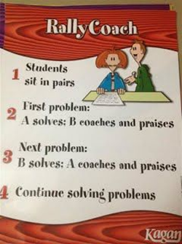
Islamic Educational College Date : / To /
Major:
Grade:
Unit:
Lesson:
Outcomes
03:00 minutes
Warm-Up
What activities do you do during the day?
Pre-assessment
Presentation
Formative assessment
Feedback
Differentiation
Linking to life
Critical Thinking
Closure
IRS

Slide 8
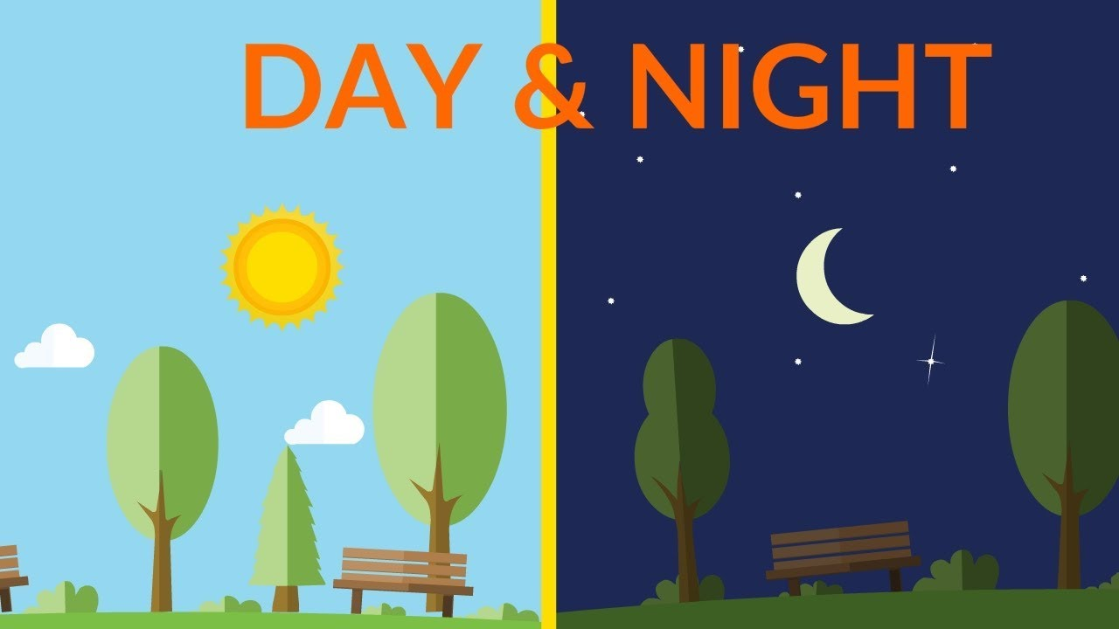
Islamic Educational College Date : / To /
Major:
Grade:
Unit:
Lesson:
Outcomes
What is the difference between day and night?
02:00 minutes
Warm-Up
Pre-assessment
Presentation
Formative assessment
Feedback
Differentiation
Linking to life
Critical Thinking
Closure
Random Pick

Slide 9
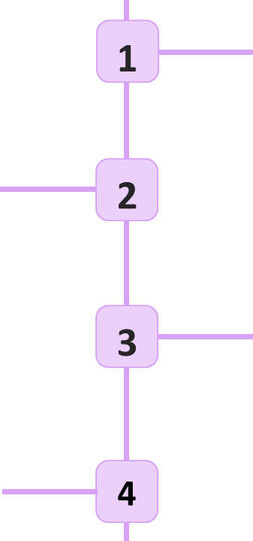
Islamic Educational College Date : / To /
Major:
Grade:
Unit:
Lesson:
Outcomes
How do you know when it is day?
01:00 minutes
Warm-Up
Pre-assessment
How do you know when it is night?
Presentation
Formative assessment
Feedback
What are the activities you do during the day?
Differentiation
Linking to life
Critical Thinking
What are the activities you do during the night?
Closure
Random Pick

Slide 10



Islamic Educational College Date : / To /
Major:
Grade:
Unit:
Lesson:
Outcomes
01:00 minutes
Warm-Up
When do you play outside?
Pre-assessment
Presentation
Formative assessment
Feedback
Differentiation
Linking to life
Critical Thinking
Closure

Slide 11

Islamic Educational College Date : / To /
Major:
Grade:
Unit:
Lesson:
Outcomes
01:00 minutes
Warm-Up
When do you watch fireworks?
Pre-assessment
Presentation
Formative assessment
Feedback
Differentiation
Linking to life
Critical Thinking
Closure
BUZZ IN

Slide 12

Islamic Educational College Date : / To /
Major:
Grade:
Unit:
Lesson:
Outcomes
Page: 50
02:00 minutes
Warm-Up
Pre-assessment
Presentation
Formative assessment
Feedback
Differentiation
Linking to life
Critical Thinking
Closure

Slide 13

Islamic Educational College Date : / To /
Major:
Grade:
Unit:
Lesson:
Outcomes
02:00 minutes
Warm-Up
Pre-assessment
Presentation
Formative assessment
Feedback
Differentiation
Linking to life
Critical Thinking
Closure

Slide 14
Unit : 1
Lesson: What do you see in the night time?
Major: Science
Grade: 2

Slide 15
Islamic Educational College Date : / To /
Major:
Grade:
Unit:
Lesson:
Outcomes
01:00 minutes
Warm-Up
Recognize what to see during the night time.
Pre-assessment
Presentation
Formative assessment
Feedback
Differentiation
Linking to life
Critical Thinking
Closure

Slide 16

Islamic Educational College Date : / To /
Major:
Grade:
Unit:
Lesson:
Outcomes
03:00 minutes
Warm-Up
https://www.youtube.com/watch?v=Wr-CRKsTYGs
Pre-assessment
Presentation
Formative assessment
Feedback
Differentiation
Linking to life
Critical Thinking
Closure

Slide 17
Islamic Educational College Date : / To /
Major:
Grade:
Unit:
Lesson:
Outcomes
02:00 minutes
Warm-Up
Pre-assessment
Presentation
Formative assessment
Feedback
Differentiation
Linking to life
Critical Thinking
Closure
IRS
Magic Boards

Slide 18

Islamic Educational College Date : / To /
Major:
Grade:
Unit:
Lesson:
Outcomes
05:00 minutes
What do we see during the night time?
Warm-Up
Pre-assessment
Presentation
Formative assessment
1. We can see the moon and its light.
Feedback
Differentiation
Linking to life
Critical Thinking
Closure

Slide 19

Islamic Educational College Date : / To /
Major:
Grade:
Unit:
Lesson:
Outcomes
05:00 minutes
What do we see during the night time?
Warm-Up
Pre-assessment
Presentation
Formative assessment
2. We can see the shining stars.
Feedback
Differentiation
Linking to life
Critical Thinking
Closure

Slide 20
Islamic Educational College Date : / To /
Major:
Grade:
Unit:
Lesson:
Outcomes
03:00 minutes
Warm-Up
What activities do you do during the night?
Pre-assessment
Presentation
Formative assessment
Feedback
Differentiation
Linking to life
Critical Thinking
Closure
IRS

Slide 21
Islamic Educational College Date : / To /
Major:
Grade:
Unit:
Lesson:
Outcomes
What is the difference between day and night?
02:00 minutes
Warm-Up
Pre-assessment
Presentation
Formative assessment
Feedback
Differentiation
Linking to life
Critical Thinking
Closure
Random Pick

Slide 22
Islamic Educational College Date : / To /
Major:
Grade:
Unit:
Lesson:
Outcomes
How do you know when it is day?
01:00 minutes
Warm-Up
Pre-assessment
How do you know when it is night?
Presentation
Formative assessment
Feedback
What are the activities you do during the day?
Differentiation
Linking to life
Critical Thinking
What are the activities you do during the night?
Closure
Random Pick

Slide 23
Islamic Educational College Date : / To /
Major:
Grade:
Unit:
Lesson:
Outcomes
01:00 minutes
Warm-Up
When do you play outside?
Pre-assessment
Presentation
Formative assessment
Feedback
Differentiation
Linking to life
Critical Thinking
Closure

Slide 24
Islamic Educational College Date : / To /
Major:
Grade:
Unit:
Lesson:
Outcomes
01:00 minutes
Warm-Up
When do you watch fireworks?
Pre-assessment
Presentation
Formative assessment
Feedback
Differentiation
Linking to life
Critical Thinking
Closure
BUZZ IN

Slide 25
Islamic Educational College Date : / To /
Major:
Grade:
Unit:
Lesson:
Outcomes
Page: 54
02:00 minutes
Warm-Up
Pre-assessment
Presentation
Formative assessment
Feedback
Differentiation
Linking to life
Critical Thinking
Closure

Slide 26
Islamic Educational College Date : / To /
Major:
Grade:
Unit:
Lesson:
Outcomes
02:00 minutes
Warm-Up
Pre-assessment
Presentation
Formative assessment
Feedback
Differentiation
Linking to life
Critical Thinking
Closure

