Slide 1
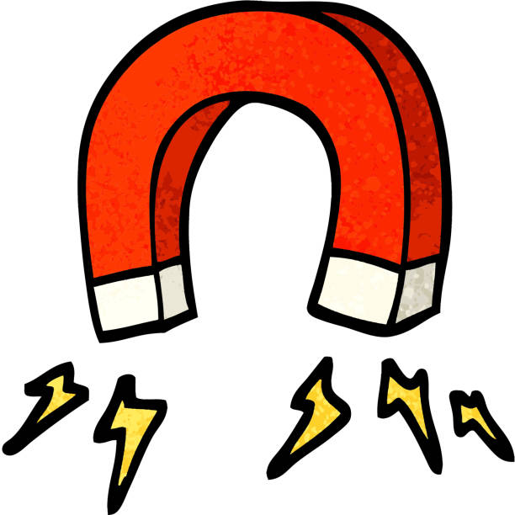
What will a magnet attract?
Chapter 3 Lesson 3 Part 1 p. 36

Slide 2
Outcomes
1:00
min
Identify objects that are attracted to magnets.
Use magnets to attract and repel objects.

Slide 3

Warm up
2:00
mins

Slide 4

Pre Assessment
2:00
mins
1. What is this picture?
2. Does it attract objects?
3. Does it attract all kind of objects?

Slide 5
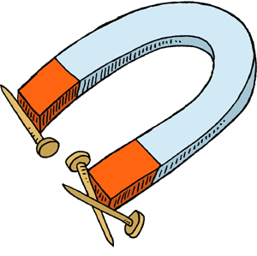
What is a magnet?
5:00
mins
Magnets are pieces of metal that are able to attract other kinds of metal.
RANDDOM PICK

Slide 6
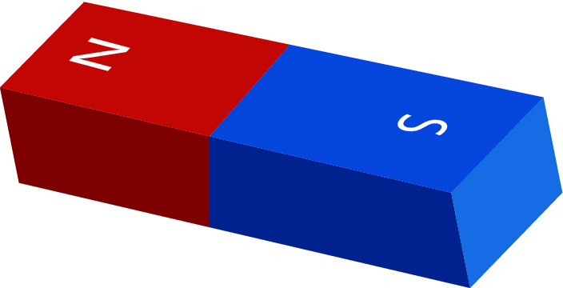
What is a magnet?
5:00
mins
There are two ends on each magnet one is called the North Pole and the other is called the South Pole.
RANDDOM PICK

Slide 7

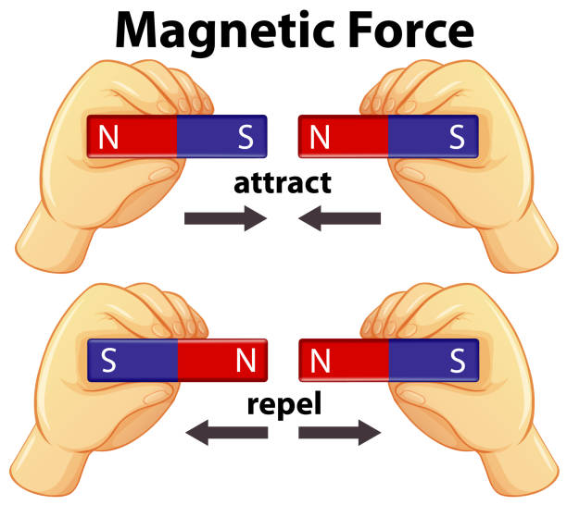
The North and South Poles of magnets are attracted to each other and will always be pulled towards each other.

Slide 8
But the same poles of two different magnets will push apart or repel the other.

Slide 9
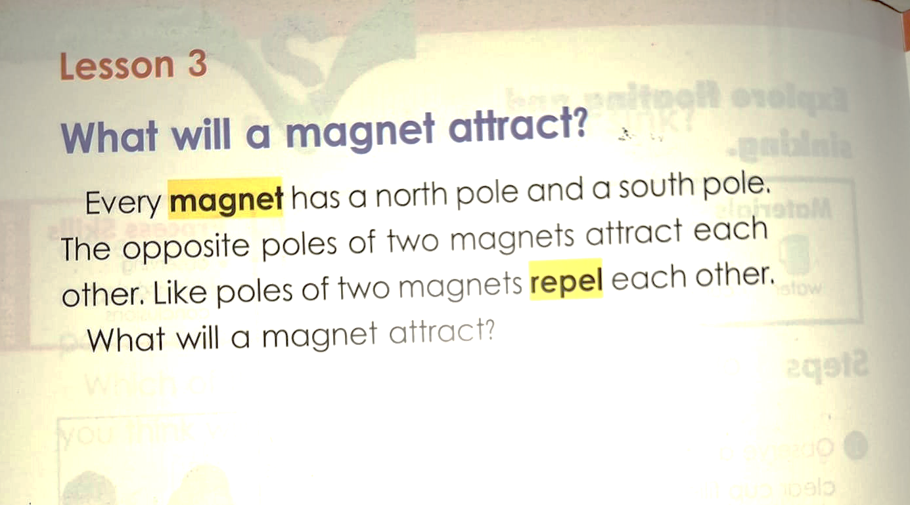
Open your book p.36

Slide 10

What will a magnet attract?
https://wordwall.net/resource/11360898/science/y3-which-items-are-magnetic-or-non-magnetic

Slide 11
Group work
3:00
mins
https://www.liveworksheets.com/w/en/science/356411
RANDDOM PICK

Slide 12
Relate to real life
2:00
mins
Name some objects at home that are attracted to magnets?
RANDDOM PICK

Slide 13
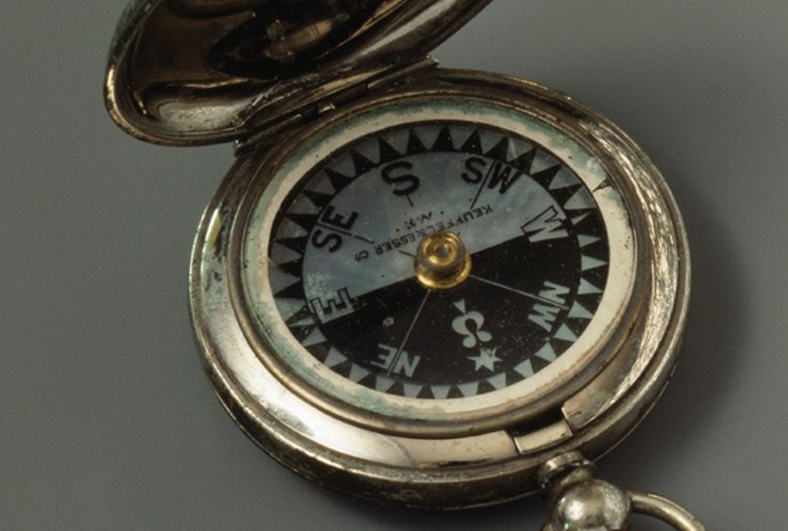
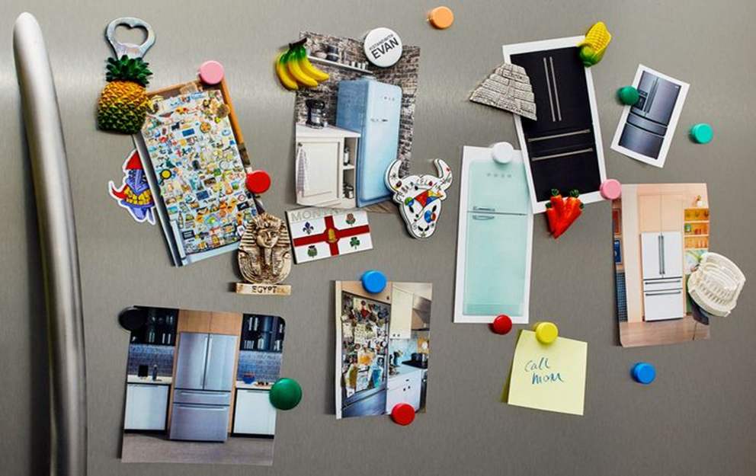
Critical thinking
1:00
mins
Where do we use magnets?
BUZZ IN

Slide 14
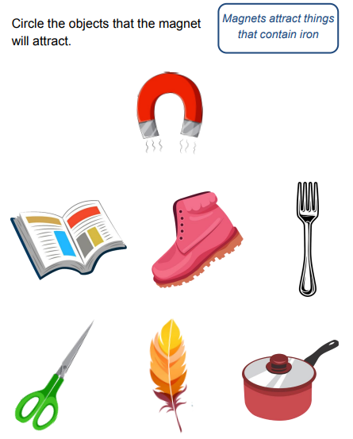

Summative Assessment
2:00
mins
RANDDOM PICK

Slide 15
Let’s play!
RANDDOM PICK
https://www.liveworksheets.com/w/en/science/953382

Slide 16
What will a magnet attract?
Chapter 3 Lesson 3 Part 2 p. 36

Slide 17

Warm up
2:00
mins

Slide 18
Pre Assessment
2:00
mins
IRS
Magnets attract object that are made of wood.
1. True
2. False

Slide 19
Pre Assessment
2:00
mins
IRS
Magnets attract objects that are made of metal.
1. True
2. False

Slide 20
Pre Assessment
2:00
mins
IRS
Every magnet has a north pole and a south pole.
1. True
2. False

Slide 21
Pre Assessment
2:00
mins
IRS
The opposite poles of two magnets repel each other.
1. True
2. False

Slide 22
Pre Assessment
2:00
mins
IRS
Like poles of two magnets repel each other.
1. True
2. False

Slide 23
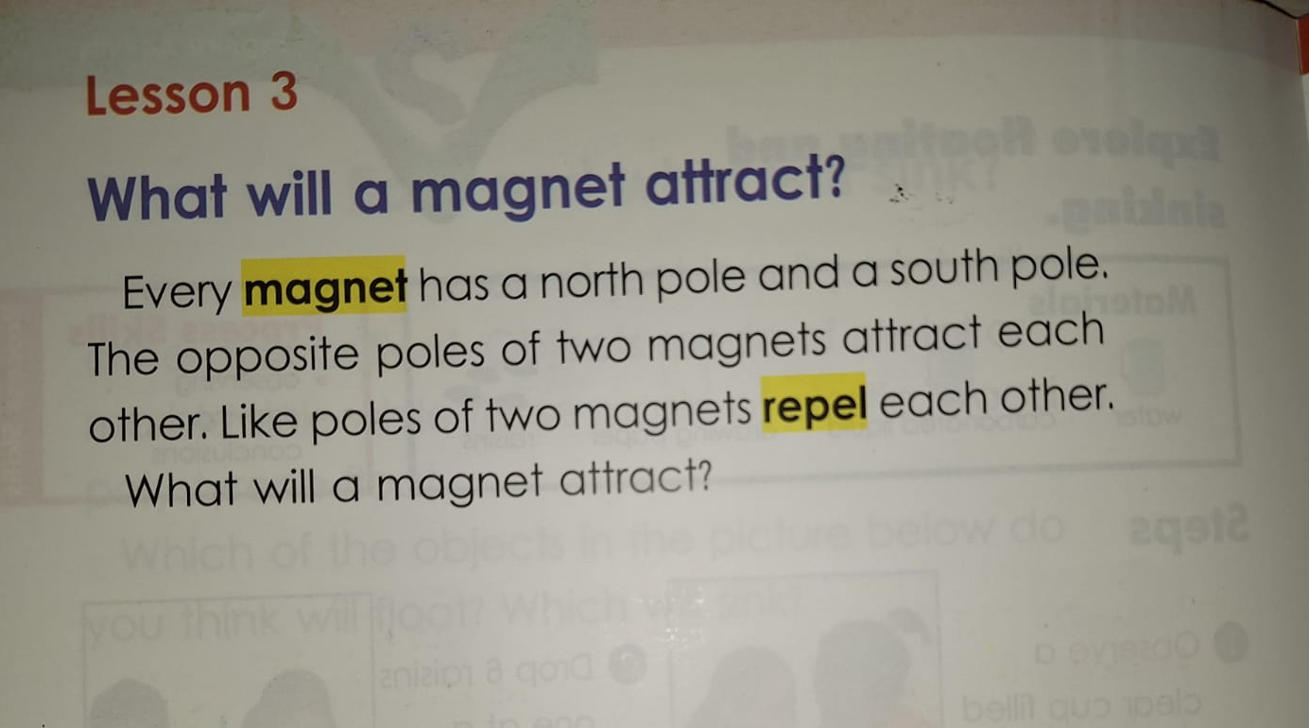
Open your book p.36

Slide 24
Group work
3:00
mins
RANDDOM PICK

Slide 25
Relate to real life
2:00
mins
Name some objects at home that are attracted to magnets?
RANDDOM PICK

Slide 26
Critical thinking
1:00
mins
Where do we use magnets?
BUZZ IN

Slide 27
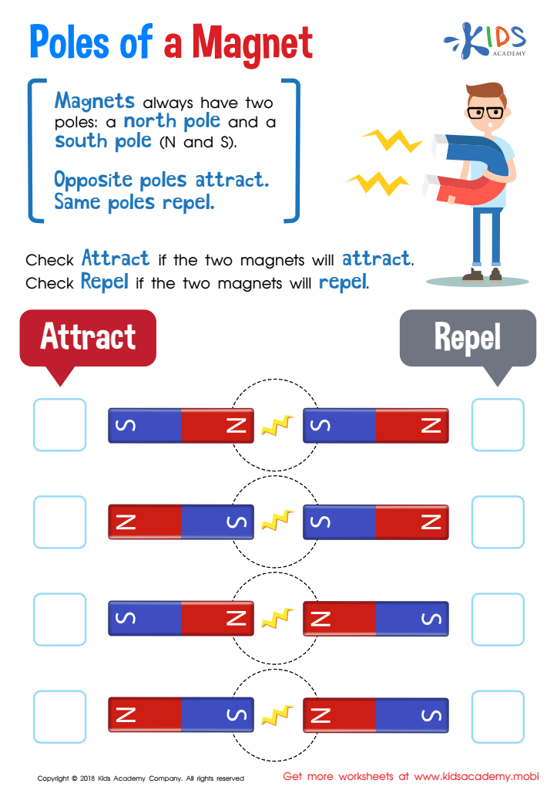
2:00
mins
Summative Assessment
RANDDOM PICK

Slide 28


Slide 29


