Slide 1

What will float and what will sink?
Chapter 3 / Lesson 2 / pages 34 & 35

Slide 2
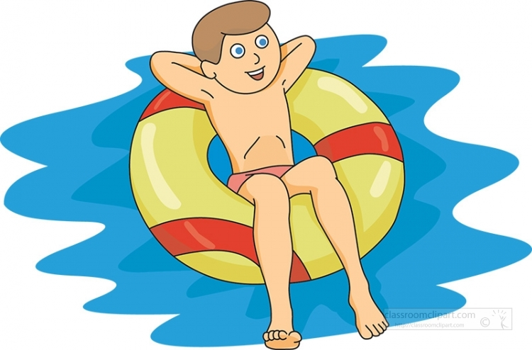
Outcomes
1:00
min
Identify objects that will float and sink.
Sort objects that float and sink.

Slide 3


Pre Assessment
2:00
mins
What do you bring with you when you go swimming at the pool?
1.
2.
3.
IRS

Slide 4
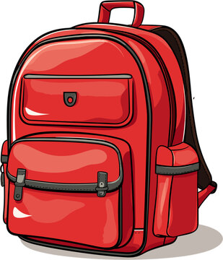


Pre Assessment
2:00
mins
What do you bring with you when you go swimming at the pool?
1.
2.
3.
IRS

Slide 5


Slide 6
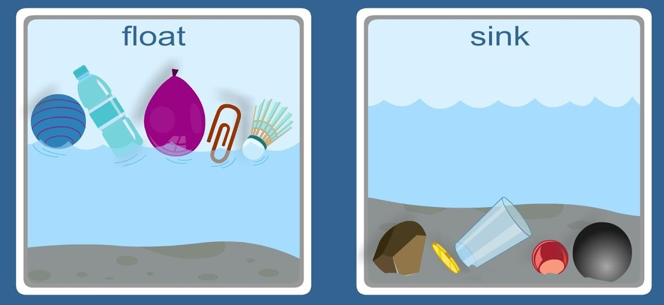
What makes something float or sink?
Generally, if something is light it will float.
And if something is heavy it will sink.
Random Pick

Slide 7
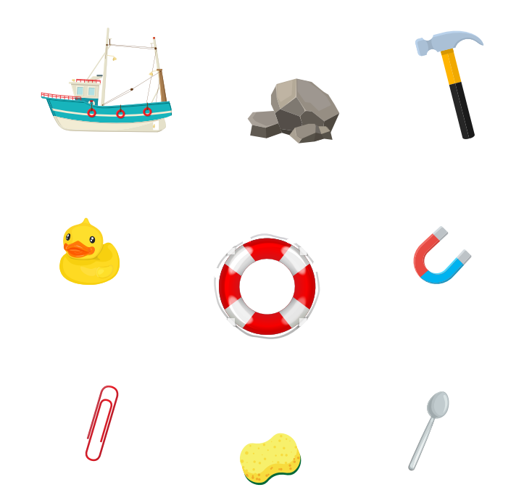
Circle the objects that would float.
Random Pick

Slide 8
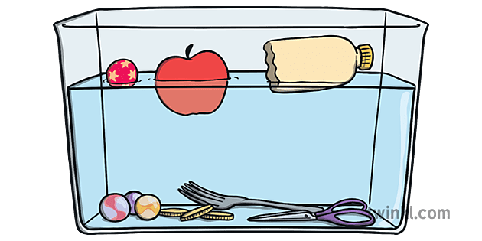
Why do some objects float and others sink?
Objects made of metal or marble sink, because water can’t lift them.
Objects made of plastic, wood or polystyrene float, because water can lift them.
Random Pick

Slide 9
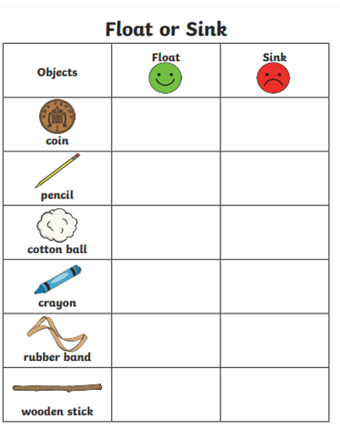
Float
or
Sink
Formative Assessment
3:00
mins
Random Pick

Slide 10

Summative Assessment
2:00
mins
Will it float or sink?
1. float
2. sink
IRS

Slide 11
Summative Assessment
2:00
mins
Will it float or sink?
1. float
2. sink
IRS

Slide 12
Summative Assessment
2:00
mins
Will it float or sink?
1. float
2. sink
IRS

Slide 13
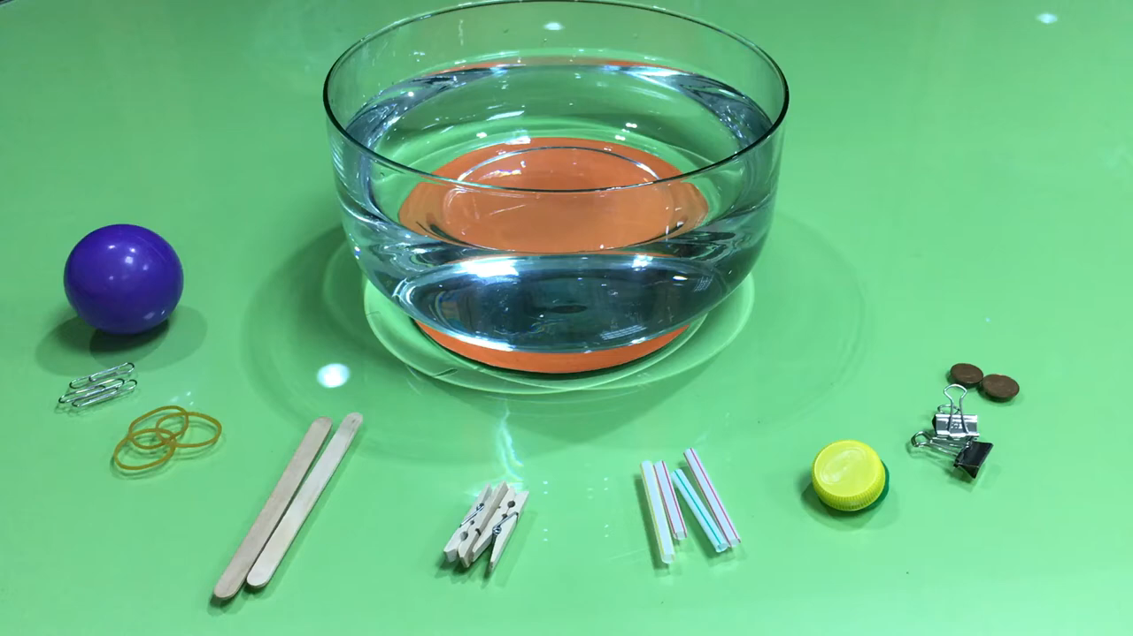

Slide 14
Wrap up
2:00
mins
https://wordwall.net/resource/8588055/science/r-float-or-sink
https://wordwall.net/resource/7276220/science/y1-float-or-sink

