Slide 1
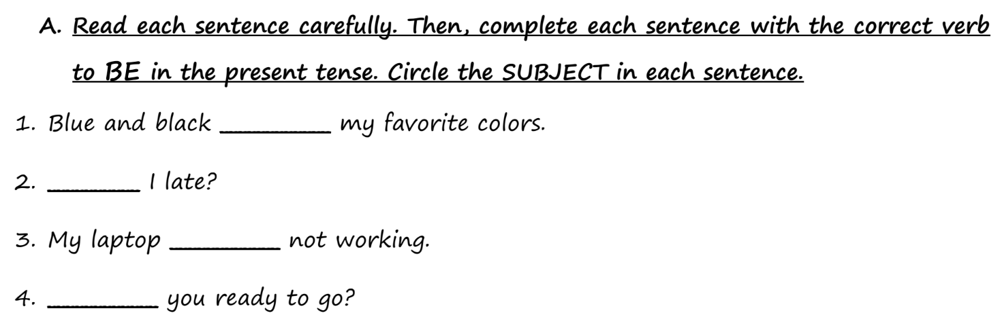
Worksheet – Page 2 – Practice A
Be
am is are
I he, she, it they, you, we

Slide 2
Worksheet – Page 2 – Practice A
are
Am
Be
is
am is are
I he, she, it they, you, we
Are

Slide 3
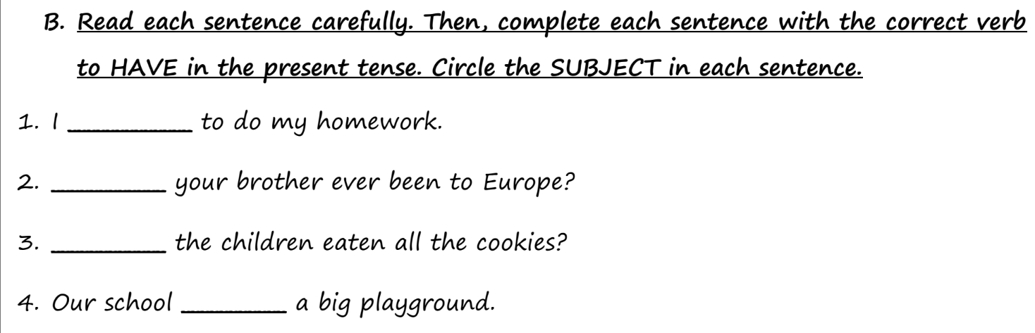
Worksheet – Page 2 – Practice B
Have
have has
I, they, you, we he, she, it

Slide 4
Worksheet – Page 2 – Practice B
have
Have
Has
Have
have has
I, they, you, we he, she, it
has

Slide 5
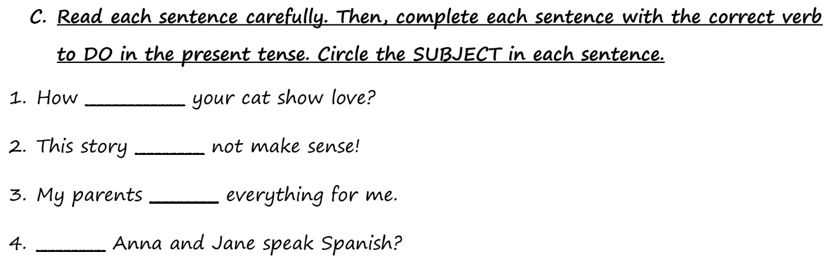
Worksheet – Page 2 – Practice C
Do
do does
I, they, you, we he, she, it

Slide 6
Worksheet – Page 2 – Practice C
does
Do
does
do
do does
I, they, you, we he, she, it
Do

Slide 7
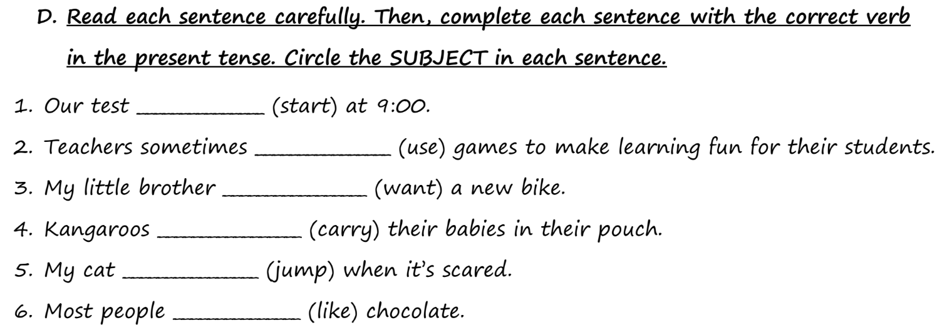
Worksheet – Page 2 – Practice D
action verb
base form +s
I, they, you, we he, she, it

Slide 8
Worksheet – Page 2 – Practice D
starts
use
wants
action verb
carry
jumps
base form +s
I, they, you, we he, she, it
like

