Slide 1


Problem Solving with Simultaneous Linear Equations
10th garade Unit 5

Slide 2


Learning Objectives
The Islamic Scientific College
problem solving using simultaneous linear equations
Unit : 5
Grade: 10
Subject: Math
Solve real-world problems using simultaneous linear equations

Slide 3
Warm Up
The Islamic Scientific College
problem solving using simultaneous linear equations
Unit : 5
Grade: 10
Subject: Math
A taxi company charges a base fee of $3 plus $2 per km. Another company charges no base fee but $3 per km. After how many kilometers will both cost the same?

Slide 4

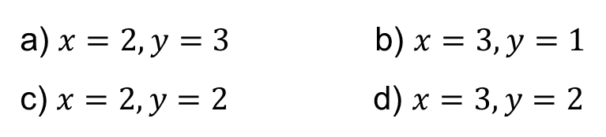

Pre-learning
The Islamic Scientific College
problem solving using simultaneous linear equations
Unit : 5
Grade: 10
Subject: Math
Solve the system: $2x+y=7$
$x−y=1$
a) $x=2,y=3$b) $x=3,y=1$ c) $x=2,y=2$d) $x=3,y=2$

Slide 5

The Islamic Scientific College
problem solving using simultaneous linear equations
Unit : 5
Grade: 10
Subject: Math
What are Simultaneous Linear Equations?
Two or more equations that must be solved together
Each equation represents a relationship between variables
Solution must satisfy ALL equations at once Example: $x+y=20$
$x−y=2$

Slide 6
The Islamic Scientific College
problem solving using simultaneous linear equations
Unit : 5
Grade: 10
Subject: Math
Key Components
Unknown quantities (variables)
At least two pieces of information
Two equations needed for two unknowns
Real-world context and applications

Slide 7
The Islamic Scientific College
problem solving using simultaneous linear equations
Unit : 5
Grade: 10
Subject: Math
Solution Methods
Elimination Method
Substitution Method
Graphical Method

Slide 8
The Islamic Scientific College
problem solving using simultaneous linear equations
Unit : 5
Grade: 10
Subject: Math
Solving problems steps:
Identify variables
Form equations
Solve step-by-step
Check solution

Slide 9
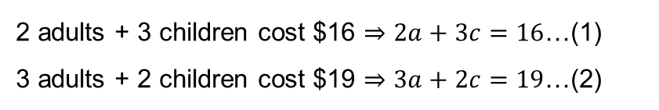
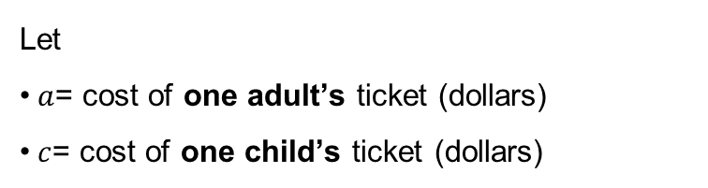
The Islamic Scientific College
problem solving using simultaneous linear equations
Unit : 5
Grade: 10
Subject: Math
The total cost of the tickets to a show for 2 adults and 3 children is $16, while the cost for 3 adults and 2 children is $19. Find the cost of an adult’s ticket and that of a child’s ticket.
Identify variables
Form equations
Let
$a$= cost of one adult’s ticket (dollars)
$c$= cost of one child’s ticket (dollars)
2 adults + 3 children cost $16 $⇒2a+3c=16$…(1)
3 adults + 2 children cost $19 $⇒3a+2c=19$…(2)

Slide 10


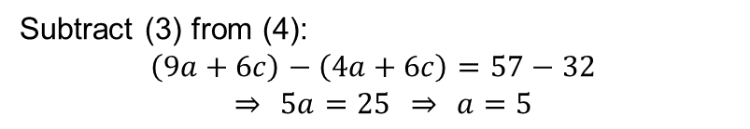
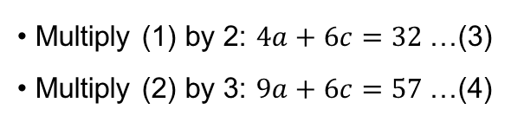
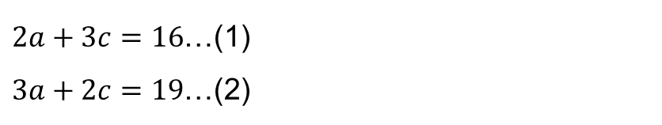
The Islamic Scientific College
problem solving using simultaneous linear equations
Unit : 5
Grade: 10
Subject: Math
$2a+3c=16$…(1)
$3a+2c=19$…(2)
Solve step-by-step (elimination)
Multiply (1) by 2: $4a+6c=32$…(3)
Multiply (2) by 3: $9a+6c=57$…(4)
Check solution
In (1): $2\left(5\right)+3\left(2\right)=10+6=16$✓
In (2): $3\left(5\right)+2\left(2\right)=15+4=19$✓
Therefore: an adult’s ticket costs $5 and a child’s ticket costs $2.
Subtract (3) from (4):
$$\left(9a+6c\right)−\left(4a+6c\right)=57−32$$
$$⇒ 5a=25 ⇒ a=5$$
Substitute $a=5$into (1):
$$2\left(5\right)+3c=16 ⇒ 10+3c=16$$
$$⇒ 3c=6 ⇒ c=2$$

Slide 11
The Islamic Scientific College
problem solving using simultaneous linear equations
Unit : 5
Grade: 10
Subject: Math
The sum of two numbers is 7. The difference between two times the larger number and the smaller one is 5. Find the two numbers.
Rally Coach
Student A: identify the variables and form the equations, while student B coaches.
Student B: solve the equations and check the answers while student A coaches.

Slide 12



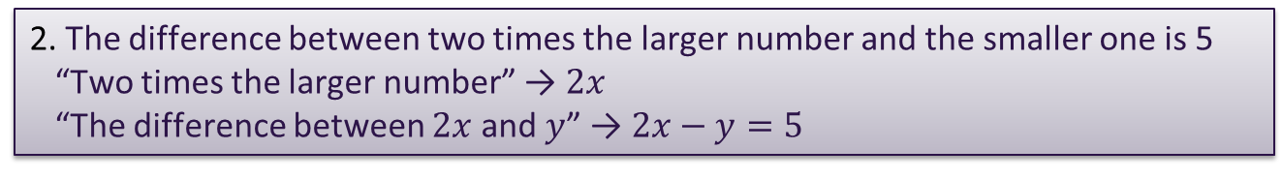


The Islamic Scientific College
problem solving using simultaneous linear equations
Unit : 5
Grade: 10
Subject: Math
The sum of two numbers is 7. The difference between two times the larger number and the smaller one is 5. Find the two numbers.
Feedback
Solution:
The sum of two numbers is 7 → $x+y=7$
The difference between two times the larger number and the smaller one is 5 “Two times the larger number” → $2x$ “The difference between $2x$ and $y$” → $2x−y=5$
3. We now have:
$$x+y=7 \text{(}\text{1}\text{)}$$
$$2x−y=5 \text{(}\text{2}\text{)}$$
The two numbers are: $\boxed{4 \text{and} 3}$

Slide 13
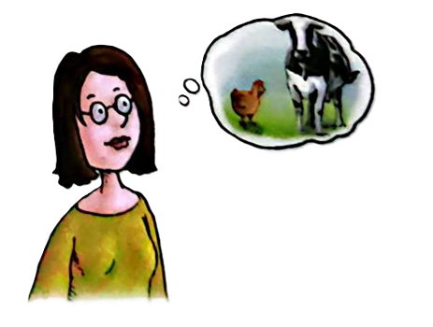
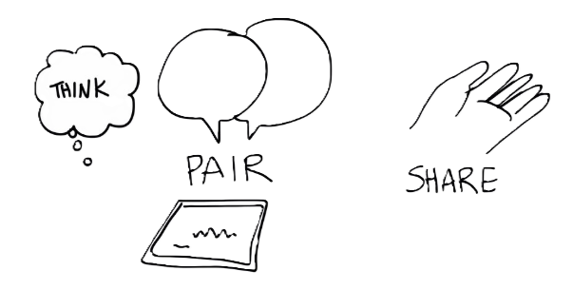
The Islamic Scientific College
problem solving using simultaneous linear equations
Unit : 5
Grade: 10
Subject: Math
In a farm, there are some cows and some chickens. If the animals have a total of 35 heads and 96 legs, how many cows and chickens are there respectively?

Slide 14

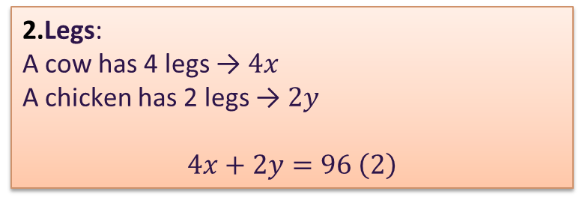
The Islamic Scientific College
problem solving using simultaneous linear equations
Unit : 5
Grade: 10
Subject: Math
In a farm, there are some cows and some chickens. If the animals have a total of 35 heads and 96 legs, how many cows and chickens are there respectively?
Solution:
Heads: Each animal has 1 head. → $x+y=35 \left(1\right)$
Legs:
A cow has 4 legs → $4x$
A chicken has 2 legs → $2y$
$$4x+2y=96 \left(2\right)$$
✅ Final Answer:
Number of cows = 13
Number of chickens = 22
3. We now have:
$$x+y=35 \text{(}\text{1}\text{)}$$
$$4x+2y=96 \text{(}\text{2}\text{)}$$

Slide 15
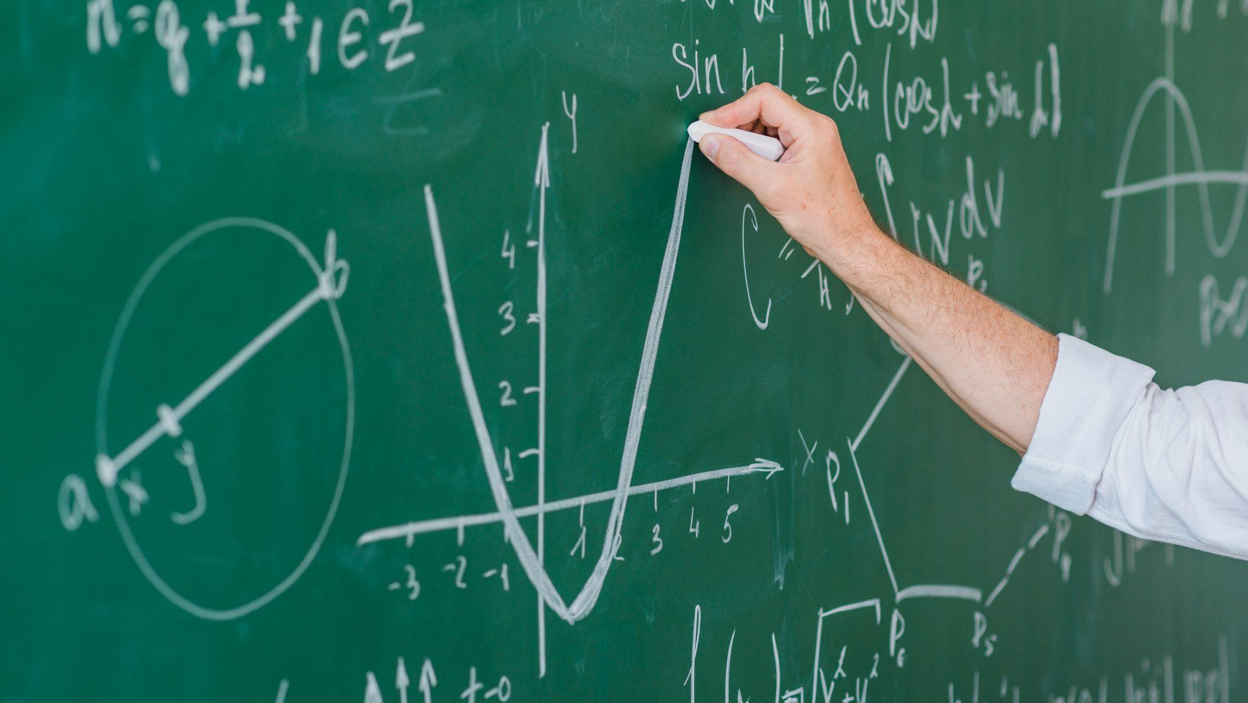
Open your book page 167

Slide 16


The Islamic Scientific College
problem solving using simultaneous linear equations
Unit : 5
Grade: 10
Subject: Math
$$Question 7 page 167.$$
2
3
𝑄𝑢𝑒𝑠𝑡𝑖𝑜𝑛 3 𝑝𝑎𝑔𝑒 167.
1
4

Slide 17

The Islamic Scientific College
problem solving using simultaneous linear equations
Unit : 5
Grade: 10
Subject: Math
👉 Critical Thinking Question
Two friends argue:
Ali says substitution is always better.
Mariam says elimination is always faster. Who do you agree with? Justify your reasoning using an example

Slide 18

The Islamic Scientific College
problem solving using simultaneous linear equations
Unit : 5
Grade: 10
Subject: Math
The sum of two numbers is 72. One number is 6 more than twice the other. What are the numbers?
a) 20 and 52 b) 22 and 50 c) 24 and 48 d) 26 and 46
✅
IRS

Slide 19

Exit Ticket
Summarize: steps for solving real-world problems with simultaneous equations.
“Give a real-life situation where simultaneous equations are necessary. Write two equations for it, but don’t solve them.”

Slide 20
Problems and equations
Directions: For each problem, set up the appropriate equation(s) and solve for the unknown. Show all your work and provide the final answer with proper units or labels if necessary
A total of 300 tickets were sold for a school play. Adult tickets cost $8 each, while student tickets cost $5 each. If the total revenue from ticket sales was $2,100, how many adult and student tickets were sold?
A
Write your answer here…
A carpenter is cutting a wooden board into two pieces. One wooden piece is 6 inches longer than the other. If the total length of the board is 42 inches, what are the lengths of the two wooden pieces?
B
Write your answer here…

