Slide 1
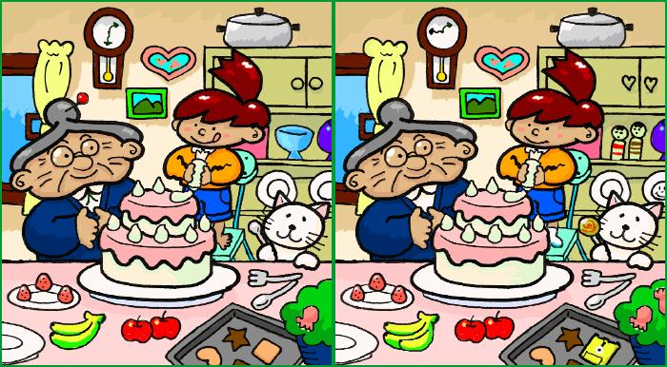
Figure out the differences :

Slide 2

Guess the topic of the lesson..

Slide 3

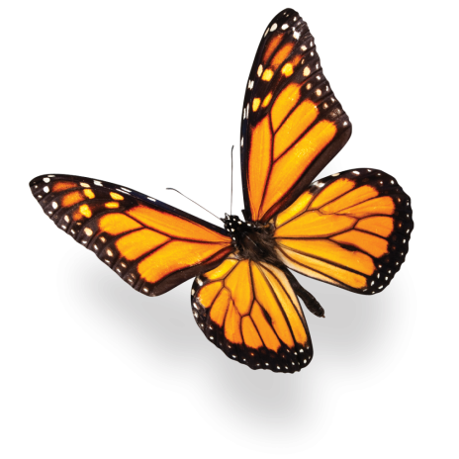
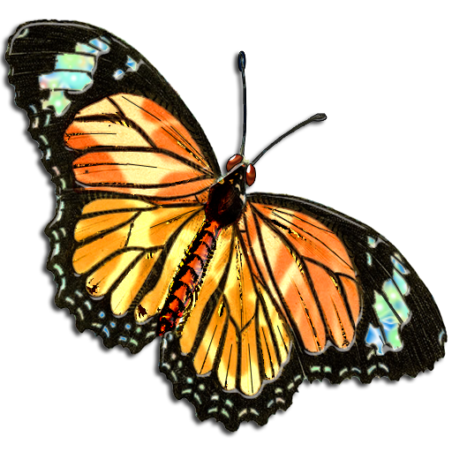
Compare and Contrast Essay
First semester
8th grade
Unit (2)
Writing

Slide 4
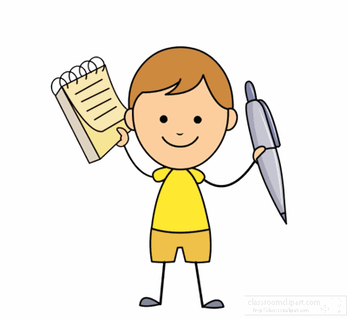
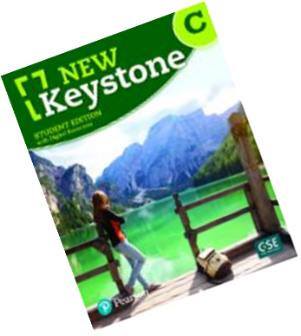

We are going to :
Recognize the structure of an essay
Use the linking words to form a short paragraph

Slide 5


Slide 6
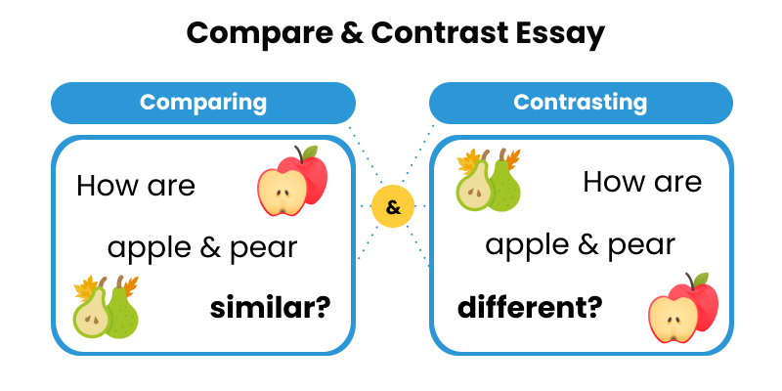
Compare and Contrast essay
Definition: It is a type of essays that highlights the similarities and differences between two things.

Slide 7
Real Life Application
Why might it be helpful to compare and contrast in everyday life? Can you give an example of a situation where this skill would be useful?

Slide 8
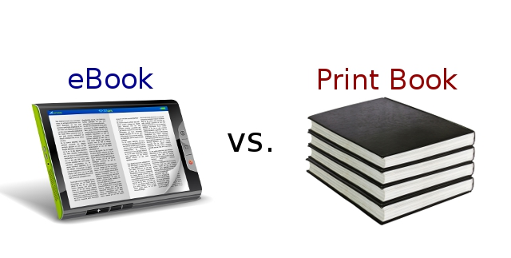
Compare and Contrast essay
How are e-books and paper books different?
How are e-books and paper books the same?

Slide 9
In pairs 1 and 2:
Write the similarities and the differences

Slide 10
Discuss your diagram with 3 and 4

Slide 11
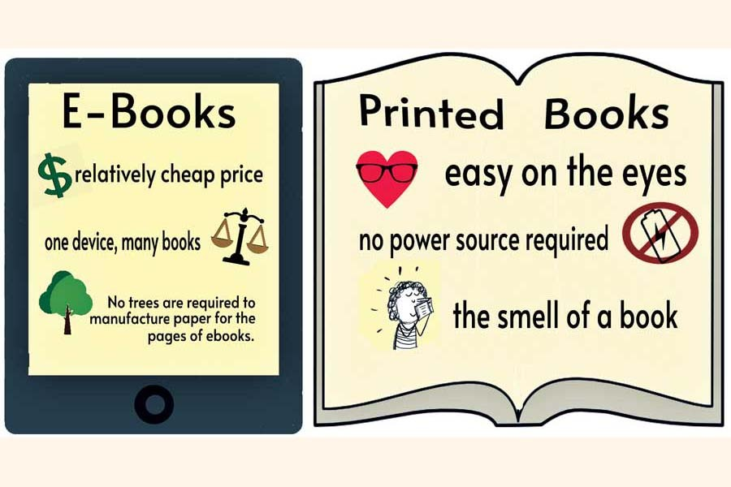
Feedback :
1-
2-
3-

Slide 12
The Great Wall of China and The Pyramids of Giza.
People have built many amazing things throughout history. Two of the most famous world wonders are the Great Wall of China and the Pyramids of Giza in Egypt. Even though they are both incredible, they were made for different reasons, built in different ways, and have different meanings. At the same time, they also have some things in common.
The main difference between the two is why they were built. The Great Wall of China was made to protect the country from enemies. It was used like a big fence to keep invaders out. On the other hand, the Pyramids of Giza were built to bury Egyptian kings called pharaohs. They believed the pyramids helped the pharaohs reach the afterlife.
The way they were built is also very different. The Great Wall is very long—over 13,000 miles—and was built using stone, bricks, and earth. It took hundreds of years and many workers to build it. The Pyramids were made of large stone blocks, some weighing many tons. They were built with great care and skill, and they have stood for thousands of years.
Even though they are different, they also have things in common. Both were built a long time ago by powerful civilizations. They show how smart and strong people were in the past. Today, millions of people visit them every year, and they are important symbols for their countries.
In conclusion, the Great Wall of China and the Pyramids of Giza are both amazing world wonders. They were made for different reasons and in different ways, but they both show the hard work and creativity of ancient people. These wonders continue to impress and teach us about history.

Slide 13
Tasks :
Draw Venn diagram to compare and contrast between mobiles and laptops .
2. Choose three different scenarios where either a mobile or a laptop would be used (e.g., working from home, traveling, attending a virtual meeting) and write 2 lines .
3. Compare and contrast between mobiles and laptops: according to :
Screen Size:
Battery Life:
Weight :
4. Answer each question with a full sentence :
• How easy is it to type on a mobile versus a laptop?
____________________________________________________
• Which device do you find more comfortable for watching videos for a long time?
_____________________________________________________
• Which one do you use more often and why?
______________________________________________________

Slide 14
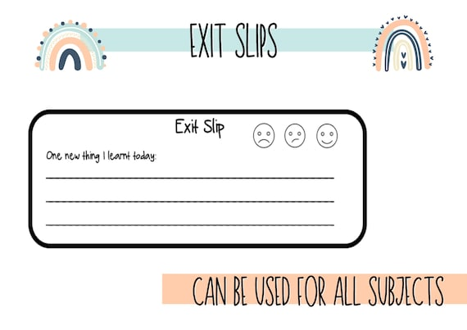

Slide 15
We are going to :
Read a given essay and analyze the layout.
Write a well-structured compare and contrast essay .

Slide 16
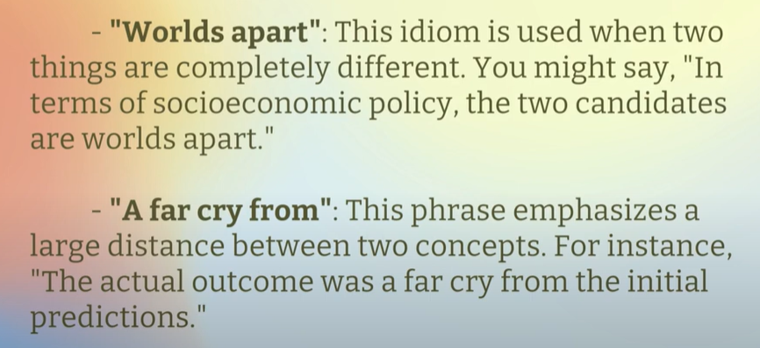
Discuss these two idioms that can help you emphasize differences :

Slide 17
Real Life Application
Can you think of a real-world situation where comparing and contrasting would be harmful?

Slide 18

What are the signal words?
To talk about the differences
To talk about similarities
different from
in contrast
although
more than
less than
whereas
however
on the other hand
on the contrary
as opposed to
but not
while
unless
same as
alike
not only…but also
either…or
likewise
similarly
similar to
compared with
as well as
resemble

Slide 19
What are the signal words in the following passage?
Chimpanzees and humans are alike in many ways. A baby chimp laughs when its mother tickles it. After chimpanzees fight, they kiss and make up. When one chimpanzee comforts another, it gives it a hug or pat on the back. There are, of course, many ways that chimpanzees and humans are different. Chimpanzees are smaller and stronger than humans. An adult male chimpanzee stands three or four feet tall and weighs about 100 pounds. But a chimpanzee can lift more weight than a man who is six feet tall.
Chimps have a smaller stature than humans.
Even though they are smaller, chimps can lift more.
People are taller than chimpanzees.
A male human is able to lift less weight than chimps.
Both human and chimp babies laugh at being tickled.
People and chimpanzees try to resolve disagreements.
The kiss each other.

Slide 20
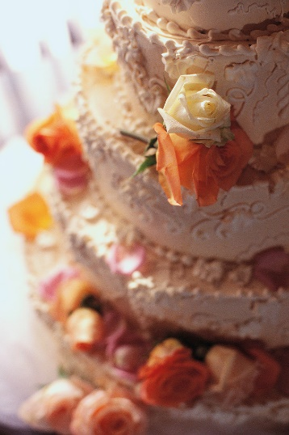
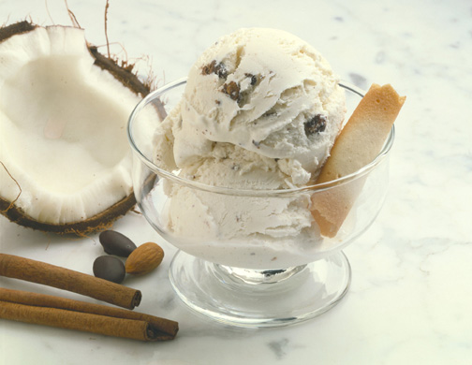
Compare and Contrast between cakes and ice-cream
Both change from their initial liquid form in order to be consumed.
Cake and ice cream are both served at certain special occasions.
There are many different varieties and flavors of these desserts.
Cake is baked in an oven.
People spend hundreds of dollars for the perfect cake for a wedding.
Ice cream melts easily when left at room temperature.
Ice or a freezer must to be used for ice cream to be prepared to eat.

Slide 21
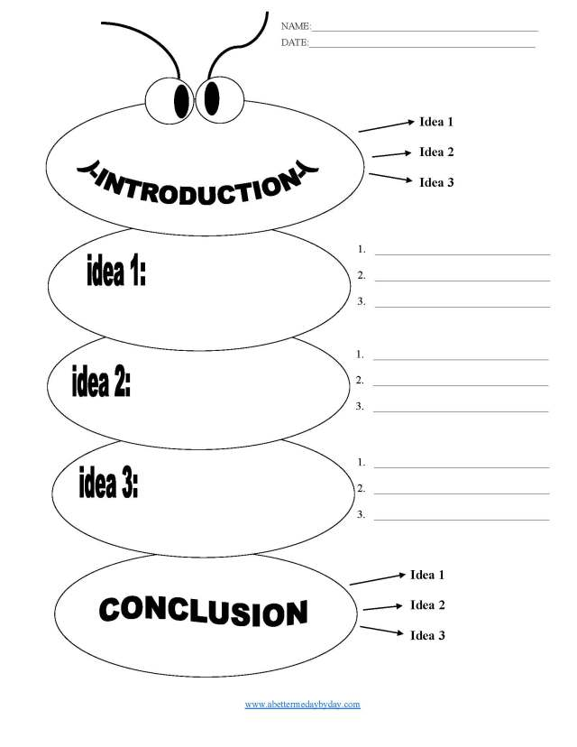
4-paragraph essay outline :
Similarities
differences

Slide 22
Baked Cakes vs. Ice Cream
Baked cakes and ice cream are both delicious desserts, but they are quite different in how they are made and enjoyed. Cakes are baked in the oven and have a soft texture. They are made from ingredients like flour, sugar, eggs, and butter, and can be flavored with chocolate, fruit, or other ingredients. Ice cream, on the other hand, is made by freezing a mix of cream, sugar, and flavorings. It is churned to make it creamy and smooth, and it melts in your mouth.
The textures of cakes and ice cream are very different. Cakes are dense and can be moist or dry, depending on the recipe. They can also be layered with frosting or filled with fruit and nuts. Ice cream is soft and creamy, and it melts quickly because it is cold. This makes it a refreshing treat, especially on a hot day, while cakes are often enjoyed in cooler weather or at celebrations.
Despite these differences, both cakes and ice cream can be flavored in many ways. Cakes can be made in various flavors like vanilla, chocolate, or strawberry, and ice cream can have flavors like cookies and cream, mint chocolate chip, or fruit. Both desserts are popular for special occasions, like birthdays and parties, because they are sweet and enjoyable.
In conclusion, baked cakes and ice cream are different in their preparation and texture, but they are both loved by many people. Cakes are baked and have a crumbly texture, while ice cream is frozen and has a creamy texture. Their different textures and flavors make them special treats for any occasion.

Slide 23
Write an essay about one of the following:
Playing Team Sports vs. Individual Sports:
Online Learning vs. In-Person Learning
Books vs. Movies:

Slide 25
The End

