Slide 1







Unit 2
Study Abroad

Slide 2


WELCOME
STUDENTS!
Discuss reasons for studying abroad .
Answer some questions after analayzing a text.

Slide 3
Warming up
Students 1+3 :
Read the questions.
Listen and answer the questions that follow.
Students 2+4 :
Read the questions.
Listen and choose the correct answers

Slide 4


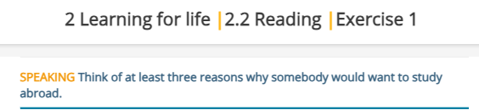
Speaking
Round Table
2 minutes

Slide 5
Real-Life Application Task:
Performance : Individual .
Task : Research a country you would like to visit or study in, outline how you would prepare for language barriers and cultural differences.
1:30
Share
1 minute

Slide 6

Critical Thinking :
Why is it essential to step out of our comfort zones occasionally? Can staying in a comfort zone for too long affect our problem-solving abilities or creativity?

Slide 7
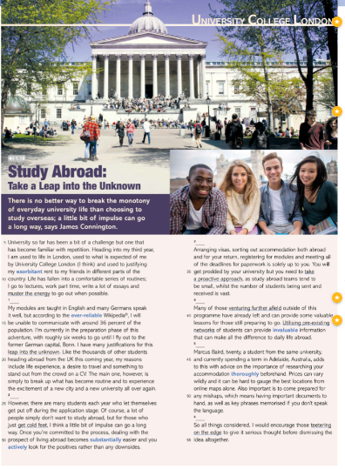
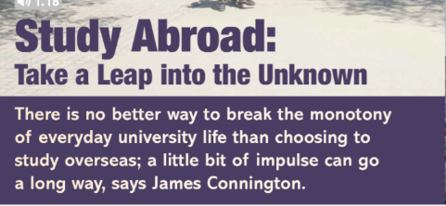
take a big risk or make a significant change without knowing exactly what will happen or what the outcome will be
Can go a long way :it is an important factor in achieving that thing.
feeling of dullness or boredom
Urge , need

Slide 8
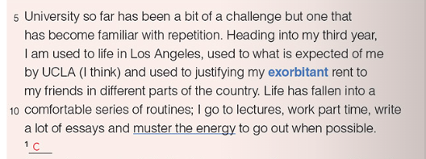
A bit of a challenge : difficult
Exorbitant : high .
Justify : give reasons for
Muster the energy : gather as much energy as you can .
"University so far has been a bit of a challenge but one that has become familiar with repetition.
Explanation: The writer is saying that university has been difficult, but over time, the challenges have become more manageable because of repetition. They have gotten used to these challenges through routine and experience.
"Heading into my third year, I am used to life in Los Angeles, used to what is expected of me by UCLA
(I think)..."
Explanation: As he starts his third year, the writer feels more comfortable with life in Los Angeles and with UCLA's academic expectations. The addition of "I think" shows a touch of humor or uncertainty, suggesting he may still feel some pressure or occasional surprises despite their familiarity.

Slide 9
"...and used to justifying my exorbitant rent to my friends in different parts of the country."
Explanation: Living in Los Angeles comes with high living expenses, particularly rent, and the writer often finds himself explaining to friends why he pays so much. This line hints at the financial realities of city life and the contrast between his experience and that of friends in less expensive areas.
"Life has fallen into a comfortable series of routines;"
Explanation: The writer’s daily life has settled into a rhythm that feels stable and familiar. The word "comfortable" suggests he finds some satisfaction or ease in this established routine.

Slide 10
I go to lectures, work part-time, write a lot of essays and muster the energy to go out when possible."
Explanation: This describes his primary activities: attending classes, working a part-time job, and handling academic assignments, especially essays. The phrase "muster the energy to go out" implies that, while socializing is important, his busy schedule means he sometimes has to make an extra effort to socialize.
Muster the energy" means to gather or summon enough energy or motivation to do something, especially when feeling tired or reluctant.

Slide 11

Made the slightly impulsive decision : made a choice quickly, without much planning or deep thought. The word "impulsive" suggests that this decision was based more on a spontaneous desire or feeling rather than careful consideration
The writer, accustomed to the routines and familiarity of his current life, has decided—somewhat spontaneously—to spend part of his final and most crucial year studying in Germany, despite not knowing any German. This choice reflects a willingness to step out of his comfort zone, embracing the unknown and potentially challenging himself in a new environment, even though it contrasts with the predictability he has grown used to.

Slide 12
Paragraph 1
What has university life been like for the writer so far?
2. How does the writer feel about life in Los Angeles as they start their third year?
3. What does the writer say he is used to about UCLA?
It has been a bit of a challenge, but one that has become familiar with repetition.
The writer feels accustomed to life in Los Angeles.
he is used to what is expected of him by UCLA..

Slide 13
4. Why does the writer mention justifying his rent to friends in other parts of the country?
Because the rent in Los Angeles is high, and he often needs to explain why he pays so much compared to friends living elsewhere.
5. What does the writer mean by saying "life has fallen into a comfortable series of routines"?
It means that his life has settled into a predictable and manageable set of daily activities.
6.List the main activities in the writer's daily routine
Attending lectures, working part-time, writing essays, and occasionally going out.

Slide 14
Find a phrase that means ‘something you have done many times so it becomes normal or less intimidating.’
Find a word that means ‘very high’ when talking about rent.
Find a phrase that means ‘gather enough energy or motivation to do something
Familiar with repetition.
Exorbitant.
Muster the energy

Slide 15
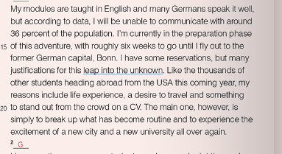
Paragraph 2

Slide 16
1. Modules: Units or courses of study in an academic program.
2. Reservations: Doubts or concerns about a particular decision or situation.
3. Justifications: Reasons or explanations that support a decision or action.
4.Leap into the unknown: A significant change or decision that involves uncertainty and risk.
5. Desire: A strong feeling of wanting to have something or wishing for something to happen.
6. Stand out from the crowd: To be noticeable or distinctive compared to others.
7. Excitement: A feeling of great enthusiasm and eagerness
8.Preparation phase: The stage of getting ready for a particular event or undertaking

Slide 17
"My modules are taught in English, and many Germans speak it well."
Explanation: The writer’s courses (modules) will be in English, which is helpful since a lot of Germans also speak English fluently. This gives him some confidence that he won’t face a language barrier in academic settings or in parts of daily life.
But according to data, I will be unable to communicate with around 36 percent of the population."
Explanation: Based on information or statistics, the writer knows that about 36 percent of people in Germany may not speak English, meaning there’s still a significant portion of the population he won’t be able to communicate with easily.

Slide 18
"I'm currently in the preparation phase of this adventure, with roughly six weeks to go until I fly out to the former German capital, Bonn."
Explanation: The writer is getting ready for this trip, which he describes as an adventure. He has about six weeks left before he leaves for Bonn, which used to be Germany’s capital
"I have some reservations, but my many justifications for this leap into the unknown, like the thousands of other students heading abroad from the USA this coming year, include life experience."
Explanation: Although he has some concerns (reservations), he also has reasons (justifications) for this decision to study abroad, which he compares to a “leap into the unknown.” Like many other U.S. students going abroad, he sees this experience as a way to gain valuable life experiences

Slide 19
"A desire to travel and something to stand out from the crowd on a CV.“
Explanation: His reasons also include wanting to explore new places (a desire to travel) and to add something unique to his CV (resume), helping him stand out when applying for jobs.
"The main one, however, is simply to break up what has become routine and to experience the excitement of a new city and a new university all over again."
Explanation: His biggest reason is wanting a break from his current routine. He looks forward to the thrill of starting fresh in a new city and university, re-experiencing the sense of novelty and excitement

Slide 20
1. What language are the writer's modules taught in?
The modules are taught in English.
2. What percentage of the German population does the writer believe he will be unable to communicate with?
The writer believes he will be unable to communicate with around 36 percent of the population.
3. What is the writer currently preparing for, and how much time does he have left until he flies out?
The writer is currently in the preparation phase for his trip and has roughly six weeks until he flies out.

Slide 21
4. What is the former capital of Germany that the writer is traveling to?
The writer is traveling to Bonn, the former capital of Germany.
5. What are some of the writer's justifications for studying abroad?
The writer's justifications include gaining life experience, a desire to travel, and wanting something that will help him stand out on his CV.
6.What is the writer's main reason for wanting to study abroad?
The main reason is to break up his routine and to experience the excitement of a new city and university.
7.How does the writer compare his experience to that of other students?
He compares his experience to that of thousands of other students heading abroad from the USA, emphasizing that they share similar reasons for studying overseas.

Slide 22
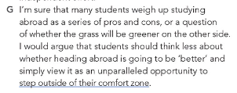
"I'm sure that many students weigh up studying abroad as a series of pros and cons..."
Explanation: The writer believes that many students consider the advantages (pros) and disadvantages (cons) of studying abroad. They analyze the situation by listing the positive and negative aspects before making a decision.
"...or a question of whether the grass will be greener on the other side."
Explanation: This phrase is a metaphor that suggests students are questioning if studying abroad will be better than their current situation. It implies a common uncertainty about whether new experiences will lead to greater satisfaction or happiness.

Slide 23
"I would argue that students should think less about whether heading abroad is going to be better..."
Explanation: The writer believes that students should not focus too much on comparing their current situation with the potential benefits of studying abroad. He suggests that this comparative thinking might hinder decision-making.

Slide 24
"...and simply view it as an unparalleled opportunity to step outside their comfort zone."
Explanation: The writer encourages students to see studying abroad as a unique chance to challenge themselves and try new experiences, which can lead to personal growth. "Stepping outside their comfort zone" means taking risks and facing unfamiliar situations that may be uncomfortable but can also be rewarding.

Slide 25
1. What do many students consider when thinking about studying abroad?
Many students weigh up studying abroad as a series of pros and cons.
2. What metaphor does the writer use to express uncertainty about studying abroad
The writer uses the metaphor "whether the grass will be greener on the other side" to express uncertainty about whether studying abroad will be better than their current situation.
3. What does the writer argue students should focus less on?
The writer argues that students should focus less on whether heading abroad is going to be better.
4. What opportunity does the writer suggest studying abroad provides?
The writer suggests that studying abroad provides an unparalleled opportunity to step outside their comfort zone.

Slide 26
5. What does "stepping outside their comfort zone" mean in this context?
In this context, "stepping outside their comfort zone" means taking risks and facing unfamiliar situations that may be uncomfortable but can lead to personal growth and new experiences.

Slide 27
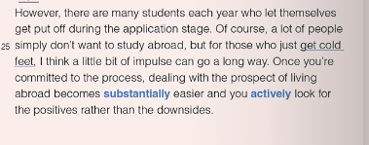
"However, there are many students each year who let themselves get put off during the application stage."
Explanation: The writer acknowledges that many students face challenges during the application process for studying abroad. The phrase "let themselves get put off" indicates that these students may become discouraged or lose motivation to apply.

Slide 28
"Of course, a lot of people simply don’t want to study abroad..."
Explanation: The writer recognizes that not everyone is interested in studying abroad. This suggests that personal preference plays a significant role in the decision-making process.
"...but for those who just get cold feet..."
Explanation: The term "cold feet" refers to a sudden loss of confidence or reluctance to proceed with a decision, often just before taking a significant step. The writer is specifically addressing students who may want to study abroad but hesitate due to fear or anxiety.

Slide 29
"...I think a little bit of impulse can go a long way."
Explanation: The writer suggests that acting on impulse or taking a leap of faith can be beneficial. This implies that sometimes making a quick decision to apply or commit can lead to positive outcomes.
"Once you are committed to the process, dealing with the prospect of living abroad becomes substantially easier...
Explanation: The writer argues that once a student decides to go through with studying abroad, the challenges and uncertainties associated with the idea of living in a foreign country become more manageable. Commitment provides clarity and reduces anxiety.

Slide 30
"...and actively look for positive rather than the downside."
Explanation: The writer emphasizes the importance of focusing on the positive aspects of studying abroad instead of dwelling on potential negatives. This proactive mindset can help students enjoy the experience and make the most of their time abroad.

Slide 31
1. Put off: to cause someone to lose interest or motivation.
2. Application stage: The phase in the process where individuals formally apply for a program or opportunity, such as studying abroad. This often involves submitting required documents and completing various forms.
3. Cold feet: A feeling of nervousness or anxiety that leads to hesitation or withdrawal from a decision or commitment, especially just before taking action.
4. Impulse: A sudden urge or instinct to act without premeditation; a spontaneous decision that can lead to action.
Committed: Dedicated to a particular course of action; having made a firm decision to pursue a goal or project.
5. Prospect: The possibility or likelihood of some future event occurring; in this context, it refers to the anticipation of living abroad.
6.Substantially: To a great extent or degree; significantly; in this context, it indicates that the ease of dealing with living abroad increases significantly after commitment.
6.Downside : The negative aspects or disadvantages of a situation; the less favorable side of something.

Slide 32
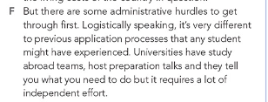
Hurdles : problems , obstacles
"But there are some administrative hurdles to get through first.
Explanation: The writer introduces the idea that before students can study abroad, they must overcome certain bureaucratic challenges or obstacles related to the administrative processes of applications and requirements.

Slide 33
"Logistically speaking, it’s very different to provide application processes than any student might have experienced."
Explanation: The phrase "logistically speaking" indicates that the writer is discussing the practical aspects of the application process. The writer suggests that the application processes for studying abroad differ significantly from what students may have encountered in their previous academic experiences.
"Universities have study abroad teams..."
Explanation: This part states that universities employ dedicated teams responsible for facilitating and managing study abroad programs. These teams provide support and guidance to students interested in going abroad.

Slide 34
"...host preparation talks and they tell you what you need to do...
"Explanation: The "preparation talks" refer to informational sessions organized by the study abroad teams. During these talks, students are informed about the requirements, procedures, and important information they need to know before embarking on their study abroad journey.
"...but it requires a lot of independent effort."
Explanation: The writer emphasizes that despite the support provided by the universities, students must take the initiative and put in considerable effort themselves. This suggests that self-motivation and responsibility are crucial for successfully navigating the application process and preparing for studying abroad.

Slide 35
1. What are students required to overcome before studying abroad?
Students are required to overcome administrative hurdles before studying abroad.
2. How does the writer describe the application processes for studying abroad?
The writer describes the application processes for studying abroad as very different from what any student might have experienced in their previous academic applications.
3. What does "logistically speaking" suggest about the writer's focus?
Logistically speaking" suggests that the writer's focus is on the practical aspects and organization of the application process rather than theoretical considerations.
4. What role do universities have in the study abroad application process?
Universities have dedicated study abroad teams that provide support, information, and guidance throughout the application process.

Slide 36
5. What does the phrase "requires a lot of independent effort" imply about the application process?
The phrase implies that, despite the support from universities, students must take initiative and be self-motivated to successfully navigate the application process for studying abroad.
6. Why might the application process for studying abroad be considered more complex than regular application processes?
The application process for studying abroad might be considered more complex due to specific requirements, procedures, and logistical challenges that are unique to studying in a foreign country.
7. What can students expect from the preparation talks hosted by study abroad teams?
Students can expect to receive important information and guidance about the application process, requirements, and what to anticipate when studying abroad.

Slide 37
1. Administrative: Relating to the management and organization of tasks, processes, or activities, particularly within an institution or organization.
2. Hurdles: Obstacles or challenges that must be overcome; difficulties that hinder progress or achievement.
3. Logistically: Pertaining to the planning and coordination of complex tasks or processes, often involving the movement and management of resources.
3. Application processes: : The series of steps or procedures required to apply for a program, opportunity, or position, which may include submitting documents, forms, and information.
4. Provide: To supply or make available; to furnish someone with something that is needed or requested.

Slide 38
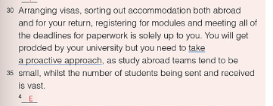
"Arranging visa, sorting out accommodation both abroad and for your return,"
Explanation: This part emphasizes two key responsibilities that students must handle themselves: obtaining a visa (the official permission to enter a foreign country) and finding suitable housing both in the host country and back home after their study abroad experience.

Slide 39
"registering for modules and meeting all of the deadlines for paperwork is solely up to you."
Explanation: The writer highlights additional responsibilities, which include enrolling in classes (modules) for the study abroad program and ensuring that all necessary documents are submitted on time. The phrase "solely up to you" indicates that these tasks fall entirely on the student, underscoring the need for personal initiative and accountability.
"You will get prodded by your university...“
Explanation: The term "prodded" suggests that the university will offer reminders or encouragement to help students complete their tasks. However, it implies that this assistance may not be extensive, and students should not rely solely on it.

Slide 40
"...but you need to take a proactive approach,"
Explanation: Here, the writer stresses the importance of being proactive—taking the initiative to act rather than waiting for reminders or help. This approach is crucial for successfully managing the study abroad process
"...as study abroad teams tend to be small,"
Explanation: This portion indicates that the teams responsible for assisting students with study abroad programs are typically limited in size. This could mean fewer resources or personnel available to support each student.

Slide 41
"...whilst the number of students being sent and received is vast."
Explanation: The writer contrasts the small size of study abroad teams with the large number of students participating in these programs. This suggests that the demand for assistance is high, which may lead to less individualized support for each student.

Slide 42
1. What are the responsibilities mentioned that students must handle when preparing for studying abroad?
Students must arrange their visa, sort out accommodation both abroad and for their return, register for modules, and meet all deadlines for paperwork.
2. What does the term "proactive approach" mean in the context of this passage?
A "proactive approach" means that students should take the initiative to manage their own preparations and responsibilities rather than waiting for assistance or reminders from the university.
3. Why is it important for students to take a proactive approach according to the text?
It is important because the study abroad teams are typically small, and the number of students being sent and received is vast, meaning there may not be enough support available for every student.

Slide 43
4. What challenges do students face in the application process for studying abroad as mentioned in the text?
Students face challenges such as managing their visa arrangements, accommodation logistics, course registration, and meeting various paperwork deadlines.
5. How does the writer compare the size of study abroad teams to the number of students involved?
The writer states that study abroad teams tend to be small while the number of students being sent and received is vast, highlighting a mismatch between available support and student demand.
6. What is implied about the role of students in the study abroad process?
It is implied that students need to be self-sufficient and take personal responsibility for their preparations to ensure a successful study abroad experience.

Slide 44
Arranging: Organizing or putting plans in place; in this context, it refers to handling the process of obtaining a visa.
Visa: An official document or stamp in a passport that allows a person to enter and stay in a foreign country for a specific purpose and time.
Accommodation: Housing or a place to stay, such as an apartment, dormitory, or other living arrangements needed both in the foreign country and for returning home.
Modules: Specific courses or classes that a student enrolls in as part of their academic program.
Deadlines: The latest dates by which something must be completed, such as paperwork or applications.
Solely: Exclusively or entirely; used to emphasize that the responsibility lies completely with the student

Slide 45

"From a financial standpoint, the ERASMUS programme in particular is a very attractive opportunity...“
Explanation: The writer is discussing the financial advantages of the ERASMUS program.
Key Terms:
-Financial standpoint: A perspective focused on costs, savings, or monetary benefits.
-ERASMUS programme: A European Union program that provides opportunities for students to study or gain work experience in different European countries.

Slide 46
"...particularly for London students used to high living costs."
Explanation: The ERASMUS program is especially appealing to students from London, where the cost of living is typically very high. Studying abroad in a country with lower living expenses can be financially beneficial for them
"In addition to the regular student loan, students get a grant..."
Explanation: Besides the usual student loans that help cover costs, students participating in ERASMUS receive an additional grant.
Key Terms:
Grant: Money given that does not have to be repaid, which helps students manage their expenses while studying abroad.

Slide 47
"...which varies according to the living cost of the country in question."
Explanation: The amount of the grant depends on the cost of living in the destination country. Higher-cost countries provide larger grants, while lower-cost countries provide smaller ones.

Slide 48
1. Why is the ERASMUS program considered financially attractive?
It provides additional financial support, especially beneficial for students from high-cost areas like London.
2. Who might find the ERASMUS program particularly appealing, according to the passage?
Students from London, where living costs are high.
3.What financial benefit does the ERASMUS program offer to students in addition to a regular student loan?
The program offers a grant that helps cover living costs.

Slide 49
4. How is the amount of the ERASMUS grant determined?
The grant amount varies according to the cost of living in the destination country.
5. What is meant by "financial standpoint" in the context of this passage?
It refers to the financial or economic perspective, focusing on costs and savings
6.Why would the ERASMUS grant be especially helpful for London students?
Because they are used to high living costs, and the additional grant can help make studying abroad more affordable.

Slide 50
Financial standpoint: A perspective focused on money, expenses, or financial benefits.
ERASMUS programme: A European Union initiative that provides scholarships for students to study or work abroad in different European countries.
Attractive opportunity: An appealing or desirable chance or option, in this case, for financial reasons.
Particularly: Especially or specifically, highlighting a certain group or factor.
Living costs: The expenses associated with daily life, such as rent, food, and transportation.
Student loan: Money borrowed by students to help pay for their education, which must be repaid with interest after they graduate.
Grant: A financial gift or award given to students that doesn’t need to be repaid; it helps with expenses.
Varies: Changes or differs; in this context, the amount of the grant differs depending on the country.
In question: Refers to something specific that has been mentioned, in this case, the particular country the student is planning to study in.

Slide 51

"Many of those venturing further afield outside of this programme have already left...
"Explanation:
A number of students who are traveling beyond the ERASMUS program have already begun their study-abroad experience.
Key Terms:
Venturing further afield: Exploring or going beyond typical boundaries, in this case, studying outside the ERASMUS program.
Programme: Refers to the structured ERASMUS study-abroad program.

Slide 52
"...and can provide some valuable lessons for those still preparing to go.
"Explanation:
These students who have already left can share helpful insights and advice for others who are still preparing to travel.
"Utilizing a pre-existing network of students can provide invaluable information...
"Explanation: Using a network of students who have prior study-abroad experience can offer essential information.
Key Terms:
-Pre-existing network: A group of people who are already connected, such as students who have studied abroad before.
Invaluable: Extremely useful or helpful.
"...that can make all the difference to daily life abroad."
Explanation: This information could significantly improve or ease daily living while studying abroad.

Slide 53
1. What is the benefit of connecting with students who have already gone abroad
They can provide valuable lessons and insights that help others prepare for daily life abroad.
2. What does the phrase "venturing further afield" mean in this passage?
It means exploring or studying outside the usual boundaries, in this case, beyond the ERASMUS program.
3. Why might information from a "pre-existing network of students" be described as invaluable?
Because it can provide extremely useful advice that makes a big difference in adjusting to daily life abroad.

Slide 54
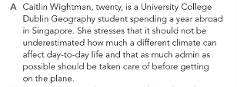
"Caitlin Wightman, twenty, is a university college Dublin Geography student spending a year abroad in Singapore.
This introduces Caitlin Wightman, a 20-year-old geography student from University College Dublin who is currently studying abroad in Singapore.
"She stresses that it should not be underestimated how much a different climate can affect day-to-day life.“
Caitlin emphasizes that a different climate can significantly impact everyday life, suggesting that adjusting to a new environment is an important consideration when studying abroad.
"And that as much admin as possible should be taken care of before getting on the plane.
She advises handling as much of the necessary administrative work as possible before departure to make the transition smoother once abroad

Slide 55
1. What aspect of studying abroad does Caitlin emphasize should not be underestimated?
Caitlin emphasizes that the impact of a different climate on daily life should not be underestimated.
2.What administrative advice does Caitlin offer to students planning to study abroad?
She advises that as much administrative work as possible should be completed before departure.

Slide 56
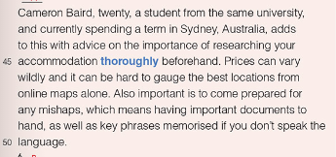
"Cameron Baird, twenty, a student from the same university, and currently spending a term in Sydney, Australia, adds to this with advice on the importance of researching your accommodation thoroughly beforehand."
Cameron Baird, a 20-year-old student also from University College Dublin, is spending a term abroad in Sydney, Australia. He advises that students thoroughly research their accommodation options before traveling.

Slide 57
"Prices can vary wildly, and it can be hard to argue the best locations from online maps alone.
: He points out that accommodation prices can differ significantly, and it can be challenging to assess the best locations based solely on online maps.
"Also, important is to come prepared for any mishaps, which means having important documents to hand, as well as key phrases memorized if you don’t speak the language.“
Cameron recommends being prepared for unexpected problems by keeping essential documents accessible and memorizing key phrases, especially if you’re unfamiliar with the language.

Slide 58
1. What advice does Cameron give about choosing accommodation when studying abroad?
Cameron advises thoroughly researching accommodation options beforehand, as prices can vary widely and online maps may not accurately show the best locations.
2. Why does Cameron recommend having important documents and memorizing key phrases?
He suggests this preparation to handle any potential mishaps, especially if students do not speak the local language.

Slide 59

"However prepared you are, studying abroad is not for everyone, and I am yet to discover whether or not it will suit me.“
This means that even with thorough preparation, studying abroad may not be a good fit for everyone. The writer acknowledges they haven’t yet determined if studying abroad will be a good experience for them personally.
"I know plenty of people who regret not applying and almost nobody who has the same reservations about their decision to go.“
The writer observes that many people regret not taking the opportunity to study abroad, while those who do go rarely regret their decision.

Slide 60
1. What does the author say about the suitability of studying abroad for everyone?
The author says that studying abroad is not for everyone, even if they are well-prepared.
2. Has the author decided if studying abroad is the right choice for them?
No, the author has not yet discovered if studying abroad will suit them.
3.What does the author notice about people who didn’t apply to study abroad compared to those who did?
The author knows many people who regret not applying, but almost no one who regrets their decision to go abroad.

Slide 61

"So all things considered, I would encourage those teetering on the edge to give it serious thought before dismissing the idea altogether."
The writer, after weighing all the factors, advises people who are uncertain about studying abroad to think carefully about the opportunity before completely ruling it out.
This line highlights the author’s encouragement for students to carefully evaluate the potential benefits of studying abroad rather than making a quick decision against it.

Slide 62
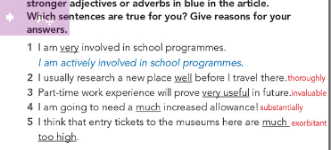

Slide 63
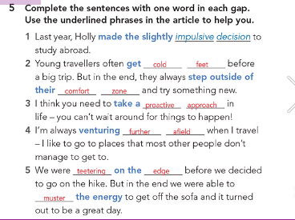

Slide 64
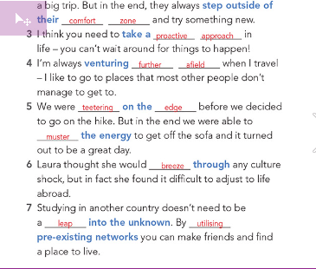

Slide 65

Going through the roof : To increase rapidly or reach a very high level, often referring to prices, emotions, or reactions.
Worth their while : Something that is beneficial or rewarding enough to justify the time and effort put into it.
The world’s your oyster : A phrase meaning that one has many opportunities or possibilities available to them, often used to encourage someone to explore what life has to offer.
Massive character building : Experiences or activities that greatly contribute to the development of personal qualities like resilience, integrity, and confidence.
Weighing up other options : Considering or evaluating different choices before making a decision.
Value work experience over a degree : To prioritize practical, hands-on experience in a job or field over academic qualifications.
Stand out from the crowd : To be noticeably different or unique in a way that makes one more appealing or memorable than others.

Slide 66
Topic: Is spending a year studying abroad a valuable experience for university students?
Type: Argumentative article (pros and cons, with a personal opinion)
Audience: Students (tone should be engaging and accessible)

Slide 67
Structure:
Introduction: Introduce the topic and mention why it's a relevant choice for university students.
Arguments For Studying Abroad:
Cultural Exposure: Emphasize how studying abroad exposes students to different cultures, languages, and ways of life.
Personal Growth: Discuss how adapting to a new environment fosters independence, resilience, and confidence.
Networking Opportunities: Mention the chance to meet international friends, professors, and potential employers, which could benefit their future career.
Educational Benefits: Some countries may offer unique courses, teaching methods, or resources that students don’t have at home.

Slide 68
Arguments Against Studying Abroad:
Cost: Studying abroad can be expensive, including tuition, accommodation, and travel.
Homesickness and Cultural Adjustment: Some students may find it hard to adapt to a new culture or miss family and friends.
Academic Disruption: The experience may disrupt their academic flow, especially if there are differences in academic standards or if credits aren’t transferable.
Uncertain Benefits: The experience may not always be directly beneficial to a student's career or field of study.

Slide 69
Your Opinion (Conclusion):
Summarize: Briefly restate key pros and cons.
Personal View: Encourage students to clearly state their stance on whether they believe studying abroad is worthwhile, with a reason based on the points they made.
Closing Thought: Suggest that studying abroad can be a personal decision based on one’s goals, finances, and adaptability.

Slide 70
Key Points Checklist:
Introduction: Define “studying abroad” and why it's appealing to students.
Arguments For: Cultural exposure, personal growth, networking, educational benefits.
Arguments Against: Cost, homesickness, academic disruption, uncertain benefits.
Conclusion: Reaffirm your view with a balanced summary.

Slide 71
https://www.liveworksheets.com/w/en/english-second-language-esl/130897c e * AZ

Slide 72




(Cross-Group Collaboration):

Slide 73
Real-Life Application Task:
Budget Planning for University Life:
Performance : group work .
Time : 2 minutes.
Task : create a simple budget that could include major expenses like rent, groceries, transportation, and entertainment if you were studying in a big city. compare these costs with the writer's experience.

Slide 74
High-Expectation Task: Reflection on Routines
1. Identify a Routine
Think about a daily or weekly routine you follow, such as studying at a particular time, exercising regularly, or spending time on a hobby.
2. Identify one small change you could make to improve this routine.
3. Explain why it’s important to evaluate and adjust a routine regularly.

Slide 75
"Life has fallen into a comfortable series of routines; I go to lectures, work part time, write a lot of essays and muster the energy to go out when possible."
Explanation: The writer describes their life as predictable and routine. They list the key activities that make up their daily life:
Going to lectures: Attending university classes regularly.
Working part-time: Balancing studies with a job, which might also help with their living expenses.
Writing essays: A common task in university, especially in humanities or social science programs, indicating that the workload involves a lot of writing.
Muster the energy to go out: This suggests that while the writer enjoys social activities, they often feel tired or drained from their routine and have to gather enough energy to go out and have fun.

Slide 76
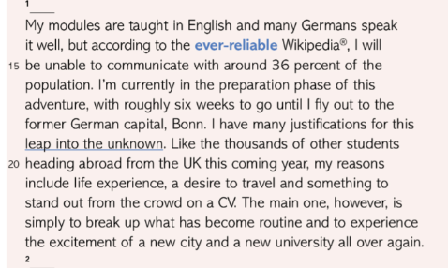
Differentiation
Paragraph 2:

