Slide 1
How Seeds and Plants grow
Lesson’s objectives :
* Recognize the meanings of the new words and Their parts of speech.
* Use the words correctly .

Slide 2
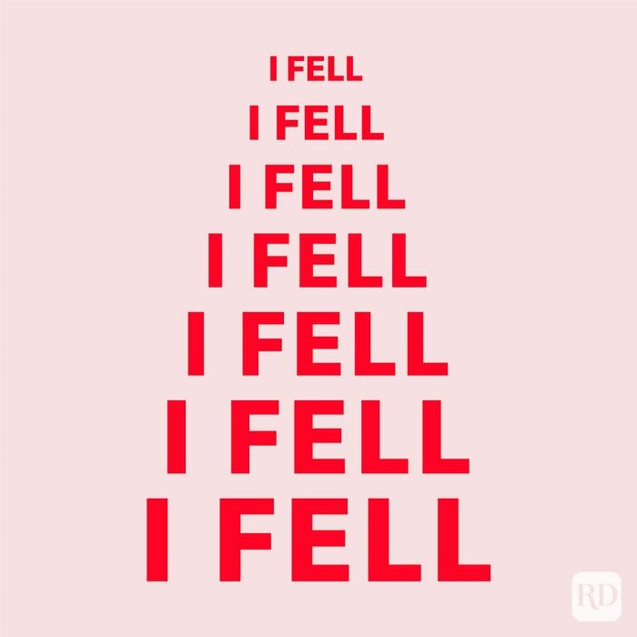

Slide 3


Slide 4


Slide 5
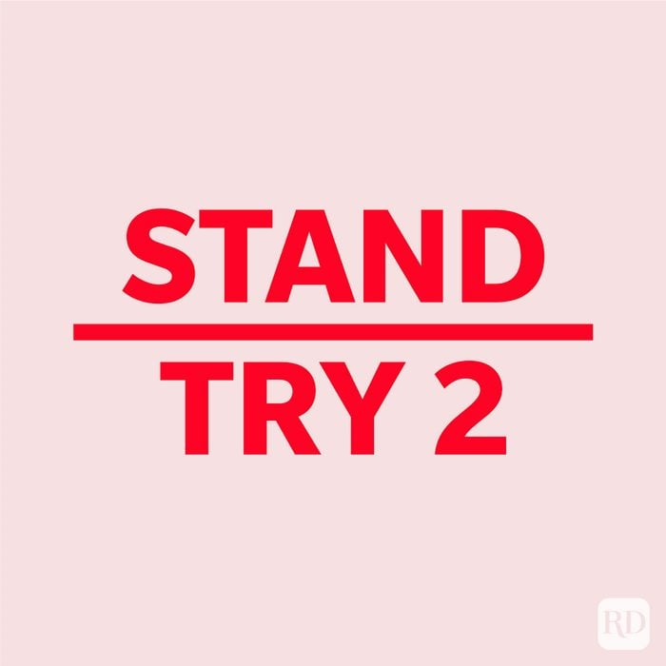

Slide 6
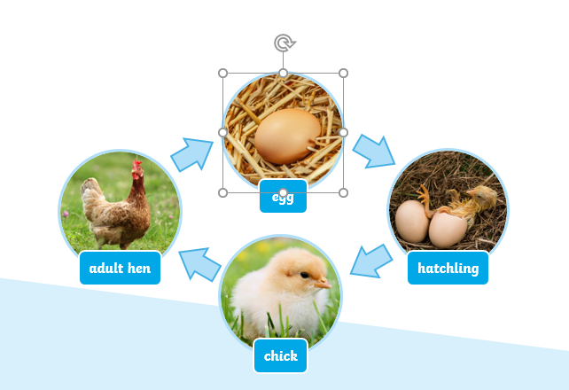
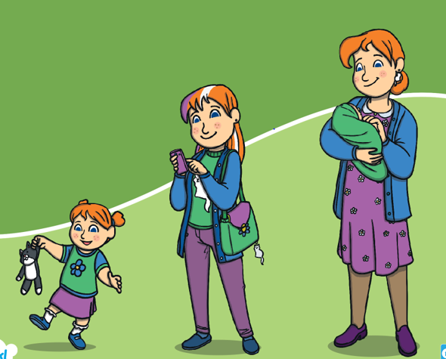
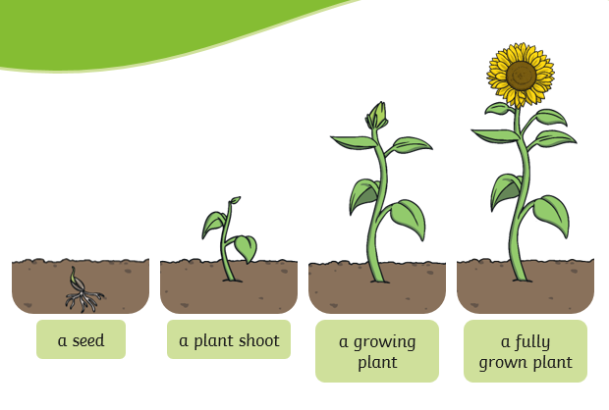
Critical Thinking
🌿 Warming-up Instructions
“Look at these pictures of people, plants, and animals at different stages of life.”
“Work in groups of four.”
“We’ll use Round Robin — take turns sharing your ideas, one by one.”
“Everyone must share at least one thought.”

Slide 7
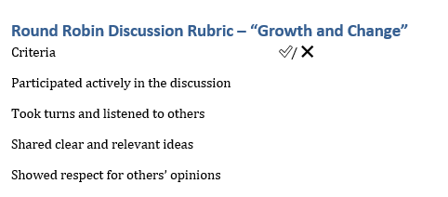
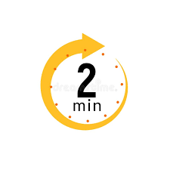

Slide 8
🌱 Overall Idea
Growth and change are closely connected.
Everything that grows must go through changes.
Changes allow living things — people, plants, and animals — to develop and reach maturity.
Growth cannot happen without change, and change leads to growth.

Slide 9
Listening
Listen to five people talking about recent life changes.
Answers:
A ✅
B ✅
B ✅
C ✅
A ✅

Slide 10
Real Life Application.
Personal Reflection Questions
1. Think about a skill or hobby you have learned. How have you changed since you started?
2. Describe a personal challenge that helped you grow. What changed in you as a result?
3. How do you think you’ve grown physically, mentally, or emotionally over the past year?

Slide 11

Take off if you know the parts of a plant .
Touch down if you know the right conditions for planting .

Slide 12
Pre assessment
https://www.liveworksheets.com/pe957765qz

Slide 13
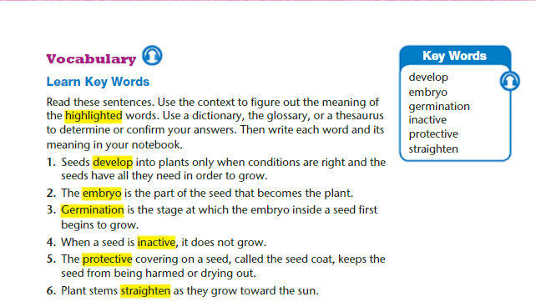

Slide 14
Formative Assessment
https://www.educaplay.com/learning-resources/26348826-how_seeds_and_plants_grow.html

Slide 15
Students 2+ 3 :
read the text , try to guess the meanings of the new words from the text .
Match the words with their definitions
Students 1+ 4 :
read the text , try to guess the meanings of the new words from the text .
Match the words with their definitions

Slide 16
Key Words : Match the bold words in column A with their definitions in column B
Seeds develop into plants only when conditions are right and the seeds have all they need in order to grow.
Children usually develop speech in the second year of life.
The protective covering on a seed, called the seed coat, keeps the seed from being harmed or drying out.
Workers should wear full protective clothing
It's bad for your health to be physically inactive.
___ ( v) to expand by a process of growth .
________( adj) not engaging in or involving any or much physical activity.
_______ (adj) :intended to protect someone or something..

Slide 17
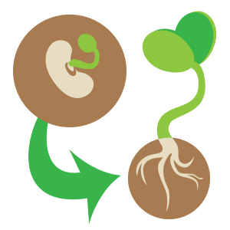
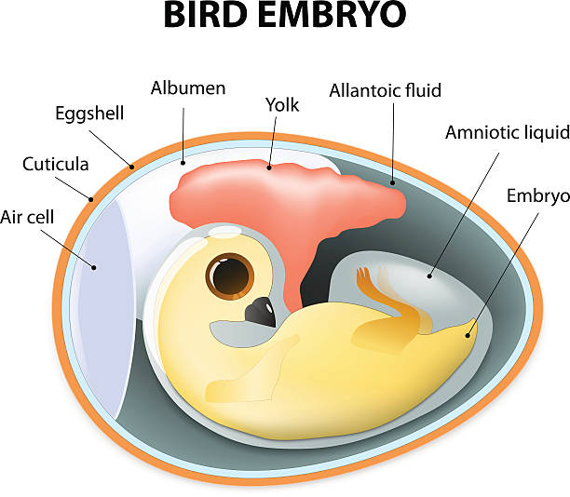
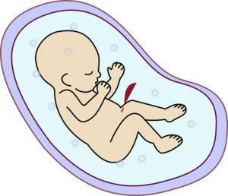
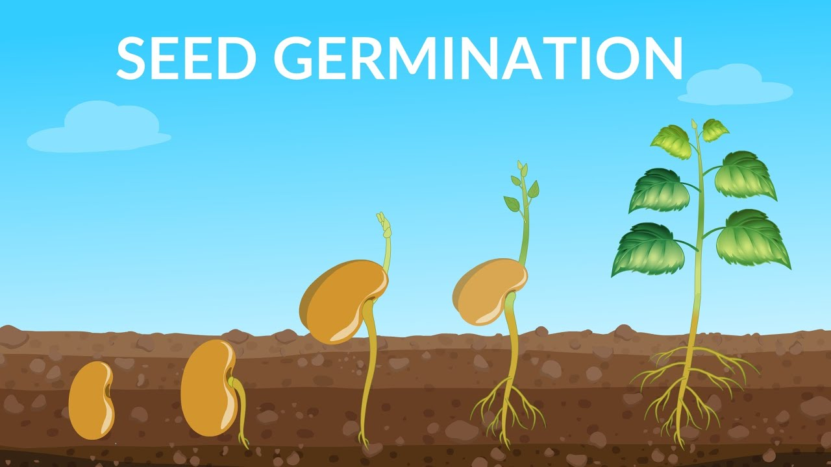
* The embryo is the part of the seed that becomes the plant .
Before I was a baby, I was an embryo.
Germination is the stage at which the embryo inside a seed first begins to grow
* Plant stems straighten as they grow toward the sun.
_____( v.) to cause to become straight .
.
_____(n.) : a human or animal at a beginning or undeveloped stage .
_______(n.) the development of a plant from a seed .

Slide 18

https://www.liveworksheets.com/1-cq1262100lx

Slide 19
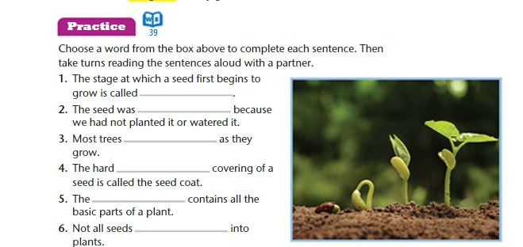

Slide 20
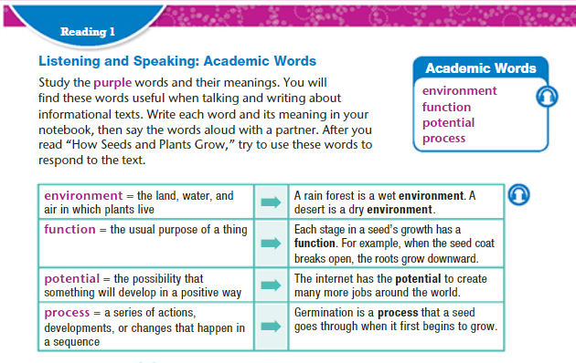

Slide 21
Students 2+ 3 :
read the text , try to guess the meanings of the new words from the text .
Match the words with their definitions
Students 1+ 4 :
read the text , try to guess the meanings of the new words from the text .
Match the words with their definitions

Slide 22
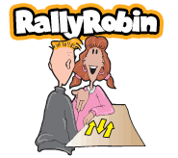
Synonyms
Environment .
Function .
Potential .
Process .
Action / course / mechanism / procedure .
Ability / capability / capacity /
Surroundings / setting .
Duty / role .

Slide 23
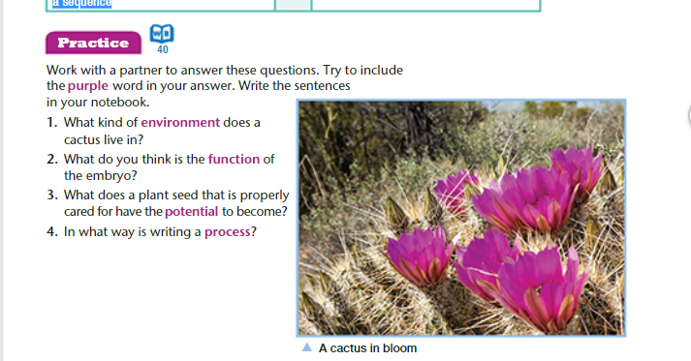

Slide 24
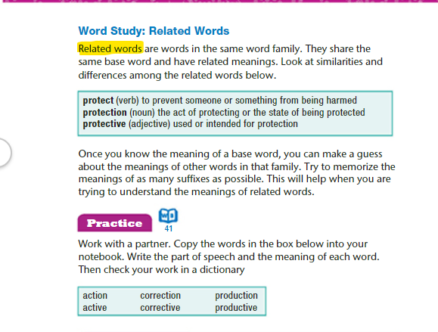

Slide 25
Lesson’s objectives : * Analyze the text to answer some questions . * match the parts of the seed with their names . * Answer some questions based on a video students will listen to .

Slide 26
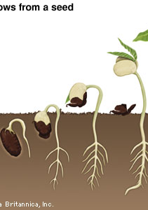
Before reading
What do you think this article will be about ?
What do plants need to grow ?
What do we need plants and trees for ?

Slide 27
1. From which part of the plant is the new plant produced ? 2. What is a seed ? 3. What are the three main parts of a seed ? ---------------------------- ---------------------------- -------------------------- 4. What does an embryo contain ? ------------------------------------------------------------------------------------------- 5. What is the function of "stored food " ? ------------------------------------------------------------------------------------------- 6. How can a plant make its food when it has leaves ? ------------------------------------------------------------------------------------------- 7. What is cotyledon ? what is the function of the cotyledon ? ------------------------------------------------------------------------------------------------------------------------------------------------------------------------------------- 8. Why do seeds need a protection ? ------------------------------------------------------------------------------------------- 9. When does the embryo become active ? -------------------------------------------------------------------------------------------

Slide 28
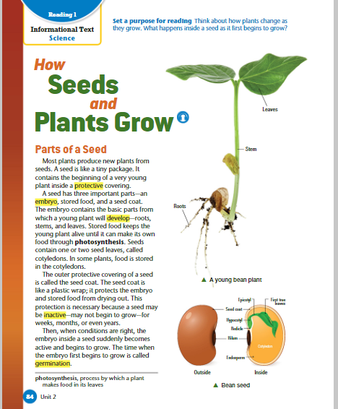
parts of a seed Most plants produce new plants from seeds. a seed is like a tiny package. it contains the beginning of a very young plant inside a protective covering. a seed has three important parts—an embryo, stored food, and a seed coat. the embryo contains the basic parts from which a young plant will develop—roots, stems, and leaves. stored food keeps the young plant alive until it can make its own food through photosynthesis. seeds contain one or two seed leaves, called cotyledons. in some plants, food is stored in the cotyledons

Slide 29
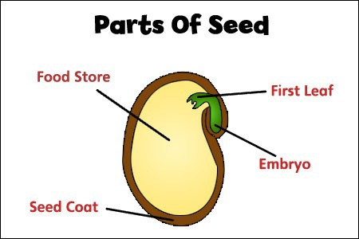
*
Fill the gaps with the suitable words :
* ___________________ contains the basic parts from which a young plant will develop—roots, stems, and leaves.
____________________keeps the young plant alive until it can make its own food through photosynthesis.
_____________ one or more of which are the first leaves to appear from a germinating seed.
The embryo
Stored food
Cotyledons

Slide 30
the outer protective covering of a seed is called the seed coat. the seed coat is like a plastic wrap; it protects the embryo and stored food from drying out. this protection is necessary because a seed may be inactive—may not begin to grow—for weeks, months, or even years. then, when conditions are right, the embryo inside a seed suddenly becomes active and begins to grow. the time when the embryo first begins to grow is called germination. * What is the function of the seed coat ? * Define germination .

Slide 31
https://www.liveworksheets.com/jj410137lf

Slide 32
https://www.youtube.com/watch?v=TE6xptjgNR0

Slide 33
Germination during germination, the seed absorbs water from the environment. then the embryo uses its stored food to begin to grow. the seed coat breaks open, and the embryo’s roots grow downward. then its stem and leaves grow upward. as the stem grows longer, it breaks out of the ground. once it is above the ground, the stem straightens up toward the sunlight, and the first leaves appear on the stem. when the young plant produces its first leaves, it can begin to make its own food by photosynthesis.

Slide 34
https://www.liveworksheets.com/pd1161354vg

Slide 35
Revision
https://www.liveworksheets.com/rt990342cx

