Slide 1

Writing a Main Idea and Details Paragraph

Slide 2
Imagine that in the future, robots will play a big role in everyday life.
Write a paragraph on how these robots will change the way people live, work, or have fun.
Explain what robots will do and how they will make life different.
Use the future tense and words like 'will,' 'might,‘ and 'could' to describe these changes. Make sure to include a clear main idea and provide at least three supporting details.

Slide 3
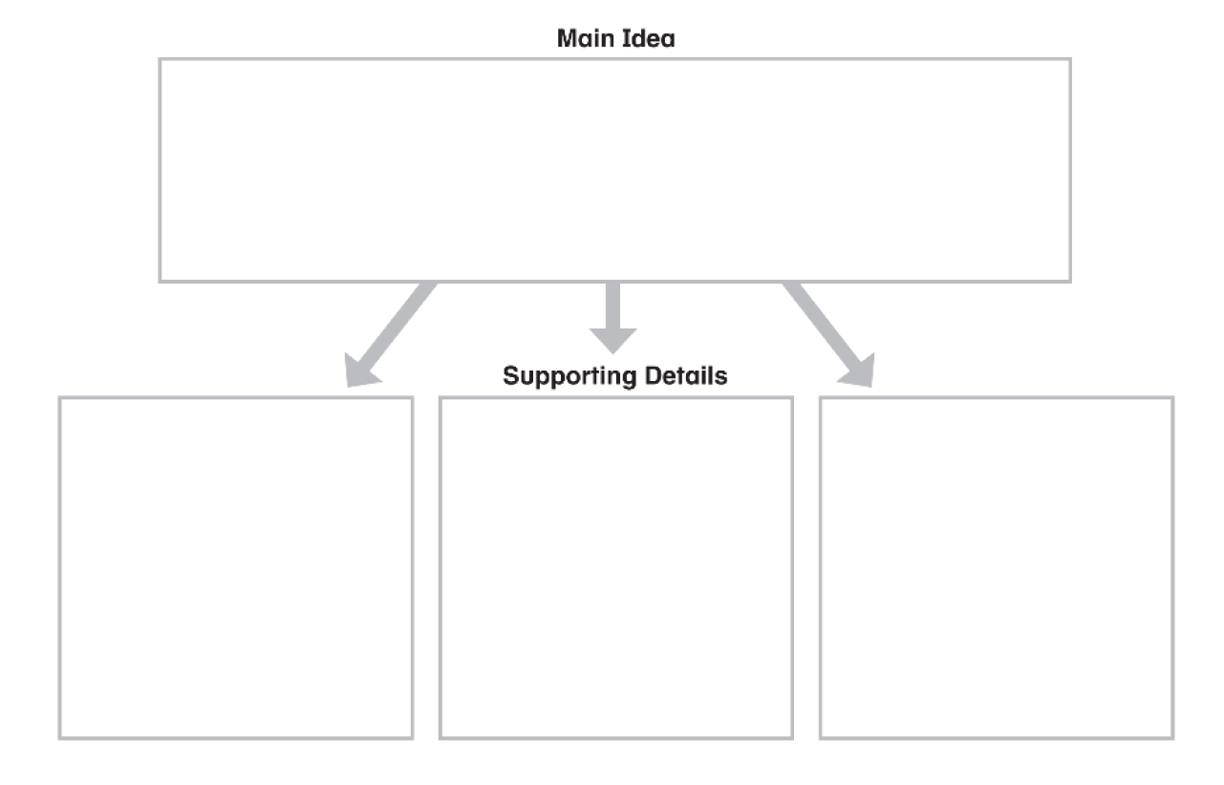
Robots will change people’s lives in the future in many different ways.
Robots will help with house chores.
Robots might take over some jobs.
Robots could entertain people and play games with kids.

Slide 4
(first detail)
(second detail)
(third detail)
(concluding sentence)
First,
First of all,
To begin with,
Firstly,
In addition,
Also,
Furthermore,
Moreover,
Finally,
Last but not least,
In the end,
Lastly,
In conclusion,
To sum up,
All in all,
In summary,
Overall,

Slide 5
Robots will change people’s lives in the future in many different ways. First, robots will help with house chores. For example, they will clean, cook, and take care of babies. In addition, robots might take over jobs. They might become teachers, doctors, engineers, and cashiers. Finally, robots could entertain people and play games with kids. In conclusion, robots will change how people live, work, and have fun.

Slide 6
Technology will make homes smarter in the future and change the way families live.

Slide 7
Technology will make homes smarter in the future and change the way families live.
Smart kitchens will help with cooking. For example, smart kitchens will have ovens that set the right temperature and fridges that remind you when food is running out.
Smart homes might have voice-controlled lights, so families can turn lights on and off just by speaking.
Smart homes will have cleaning robots, so floors and rooms can stay tidy without much effort.
Smart doors and alarms will make homes safer. They will warn families if there is danger or if someone enters the house.
Smart homes could save energy. They could turn off lights and devices automatically when no one is using them.
Smart bathrooms will save water, with showers that turn off when the water has been running too long.

Slide 8
Technology will make homes smarter in the future and change the way families live. First of all, smart kitchens will help with cooking. For example, smart kitchens will have ovens that set the right temperature and fridges that remind you when food is running out. Furthermore, smart bathrooms might save water, with showers that turn off when the water has been running too long. Last but not least, smart homes could save energy. They could turn off lights and devices automatically when no one is using them. To sum up, technology will make homes easier to live in for all families.

Slide 9
Practice writing a Main Idea and Details paragraph about the following topic.
Technology will change transportation in the future and make travel easier for everyone.

Slide 10
