Slide 1

OBJECTIVES
WARM UP
Unit: 1 >> If Poem
Subject: Problem-Solving Essay
Grade: SEVEN
PREASSESSMENT
PRESENTATION
FORMATIVE ASSESSMENT
FEEDBACK
DIFFERENTIATION
REAL LIFE APPLICATION
CRITICAL THINKING
EXIT TICKET

Slide 2

UNIT 3
Week 4
Problem-Solving Essay

Slide 3


SUBJECT
GRADE
UNIT
LESSON
01:00 minutes
Objectives
students should be able to discuss a problem they face at school and find out some solutions
to organize ideas in a clear problem-solution essay structure
- to collaborate effectively using Kagan structures

Slide 4
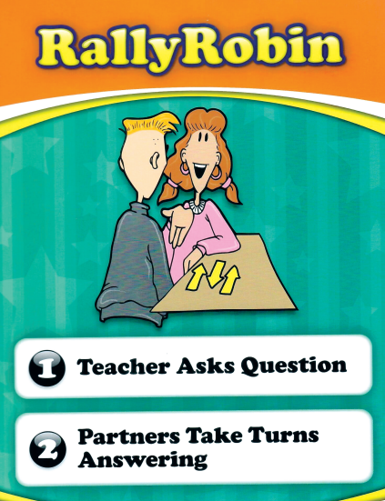

WARM UP
You are a detective in school! Your mission: Find 3 common problems that students face every day.
“Which of these problems can we actually solve if we work together?”

Slide 5

SUBJECT
GRADE
UNIT
LESSON
05:00 minutes
PREASSESSMENT
*What is the main purpose of a problem-solution essay?
1- to explain a problem and suggest ways to fix it
2- to describe an event
*Which of the following is a good topic for a problem-solution essay?
1- My summer vacation
2- Too much homework!

Slide 6
SUBJECT
GRADE
UNIT
LESSON
10:00 minutes
PRESENTATION
What Is a Problem–Solution Essay?
A Problem-Solving Essay = Identify the problem
+
Offer clear solutions

Slide 7
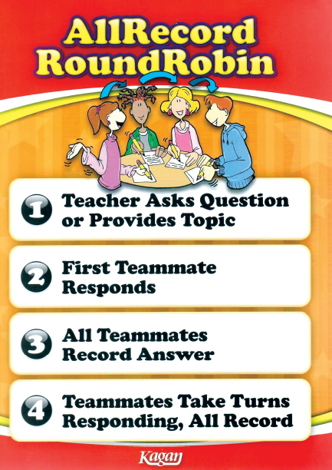
SUBJECT
GRADE
UNIT
LESSON
10:00 minutes
PRESENTATION
Basic Structure
Introduction: Presents the problem.
Body Paragraphs: Explain causes and effects.
Solution Paragraph: Gives logical, realistic solutions.
Conclusion: Summarizes and restates what was mentioned
Problem in general → causes and results → possible solutions → summary

Slide 8
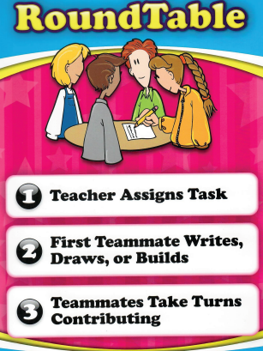

SUBJECT
GRADE
UNIT
LESSON
10:00 minutes
Critical Thinking
REAL LIFE APPLICATION
If you could change one rule or system at your school to solve a common students’ problems, what would it be and why do you think your solution would work better than the current system?

Slide 9

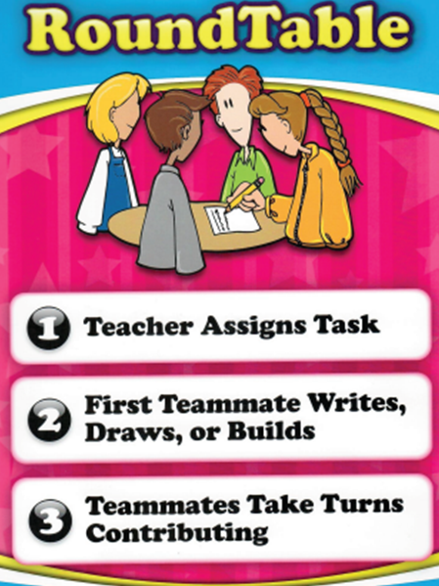
SUBJECT
GRADE
UNIT
LESSON
10:00 minutes
FORMATIVE ASSESSMENT
Identify a problem in your school/community.
Write one clear sentence explaining the problem.
Write one sentence suggesting a possible solution.

Slide 10
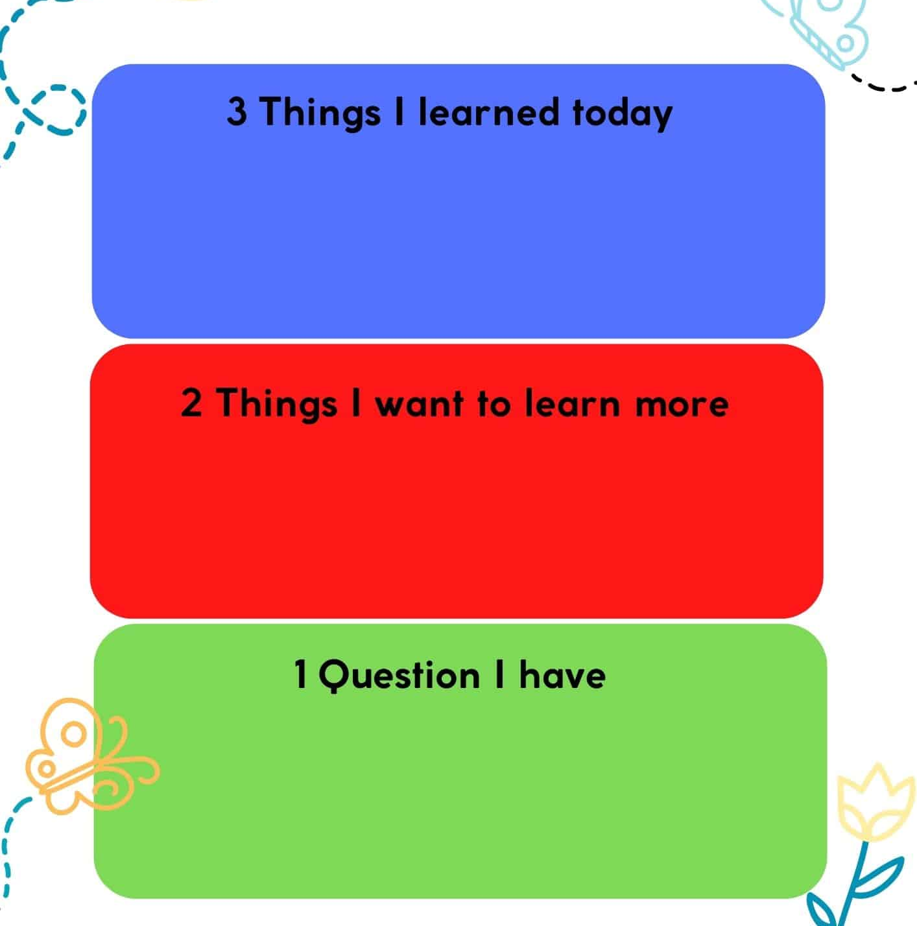

SUBJECT
GR ADE
UNIT
LESSON
OUTCOMES
03:00 minutes
WARM UP
PREASSESSMENT
PRESENTATION
FORMATIVE ASSESSMENT
FEEDBACK
DIFFERENTIATION
REAL LIFE APPLICATION
CRITICAL THINKING
EXIT TICKET

Slide 11
SUBJECT
GRADE
UNIT
LESSON
10:00 minutes
Suggested Topics
Bullying
Lack of sleep
Too much homework
Phone addiction
Cafeteria food problems
Exam stress

Slide 12
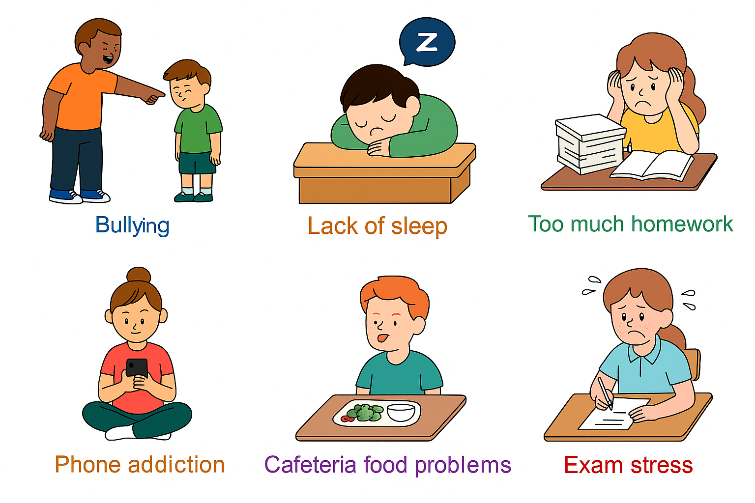
SUBJECT
GRADE
UNIT
LESSON
10:00 minutes
Suggested Topics

Slide 13
