Slide 1

COMPARATIVES
&
SUPERLATIVES

Slide 2
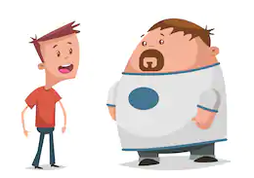
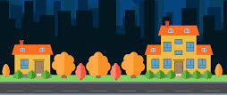
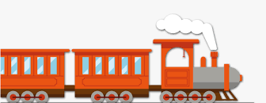
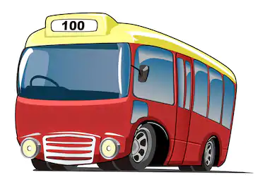
COMPARATIVES
(We use to compare two things, people...)
John
Bob
John is thinner than Bob.
My friend’s house
My
house
My house is smaller than my friend's house.
It's more expensive to travel by train than by bus.

Slide 3
COMPARATIVE
RULES

Slide 4
ONE SYLLABLE ADJECTIVES –ADD ER
CHEAP – CHEAPER
FAST – FASTER
LIGHT - LIGHTER
ONE SYLLABLE ADJECTIVES ENDING IN E –ADD R
NICE – NICER
FINE - FINER
WIDE - WIDER

Slide 5
ONE SYLLABLE ADJECTIVES ENDING IN CVC – DOUBLE THE LAST CONSONANT + ER
HOT - HOTTER
BIG - BIGGER
FAT - FATTER
TWO SYLLABLES ADJECTIVES ENDING IN Y PRECEDED BY A CONSONANT – REPLACE Y WITH IER
HAPPY - HAPPIER
EASY - EASIER
LONELY - LONELIER

Slide 6
TWO OR MORE SYLLABLES ADJECTIVES –ADD MORE/LESS
BEAUTIFUL – MORE BEAUTIFUL / LESS BEAUTIFUL
INTERESTING – MORE INTERESTING / LESS INTERESTING
IRREGULAR ADJECTIVES:
GOOD – BETTER
BAD – WORSE
FAR – FURTHER / FARTHER

Slide 7
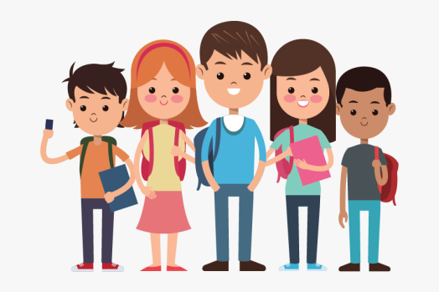
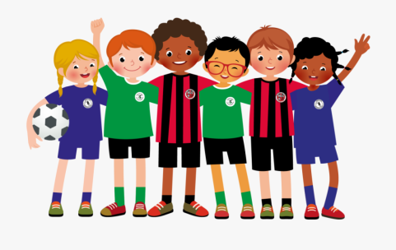
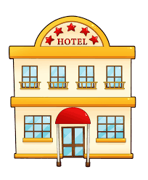
SUPERLATIVES
(We use to compare one thing, person... With the rest of the group)
John
John is the tallest in the class.
The best
He's the best football player in the team.
This is the most expensive hotel I've ever stayed in.

Slide 8
SUPERLATIVE
RULES

Slide 9
ONE SYLLABLE ADJECTIVES –ADD EST
CHEAP – CHEAPEST
FAST – FASTEST
LIGHT - LIGHTEST
ONE SYLLABLE ADJECTIVES ENDING IN E –ADD ST
NICE – NICEST
FINE - FINEST
WIDE - WIDEST

Slide 10
ONE SYLLABLE ADJECTIVES ENDING IN CVC – DOUBLE THE LAST CONSONANT + EST
HOT - HOTTEST
BIG - BIGGEST
FAT - FATTEST
TWO SYLLABLES ADJECTIVES ENDING IN Y PRECEDED BY A CONSONANT – REPLACE Y WITH IEST
HAPPY - HAPPIEST
EASY - EASIEST
LONELY - LONELIEST

Slide 11
TWO OR MORE SYLLABLES ADJECTIVES –ADD THE MOST/THE LEAST
BEAUTIFUL – THE MOST BEAUTIFUL / THE LEAST BEAUTIFUL
INTERESTING – THE MOST INTERESTING / THE LEAST INTERESTING
IRREGULAR ADJECTIVES:
GOOD – THE BEST
BAD – THE WORST
FAR – THE FURTHEST / THE FARTHEST

Slide 12
SOME ADJECTIVES CAN BE USED THE BOTH FORMS:
ADJECTIVE | COMPARATIVE | SUPERLATIVE
CLEVER | CLEVERER / MORE CLEVER | THE CLEVEREST / THE MOST CLEVER
FRIENDLY | FRIENDLIER / MORE FRIENDLY | THE FRIENDLIEST / THE MOST FRIENDLY
QUIET | QUIETER / MORE QUIET | THE QUIETEST / THE MOST QUIET

Slide 13
Comparative/Superlative Form
We use the comparative form + than to compare two people, things, places, etc.
Rob is stronger than Tim.
We use the + superlative form + of/in to compare a person, thing or place with the whole group they belong to. We use in when we talk about places.
Sue is the shortest of her friends.

Slide 14
Form
We add -(e)r/-(e)st to one syllable and two-syllable adjectives to form their comparative and superlative forms.
tall – taller (than) - the tallest (of/in)
Adjectives of three or more syllables take more and most
beautiful - more beautiful - the most beautiful
Note: The comparative and superlative forms of clever, common, cruel, friendly, gentle, narrow, pleasant, polite, shallow, simple, stupid, quiet are formed with –er/-est or more/most.
gentle-gentler-the gentlest Also: gentle-more gentle-the most gentle

Slide 15
Spelling
One-syllable adjectives ending in –e take –r in the comparative form and -st in the superlative form.
nice – nicer – nicest
Two syllable adjectives ending in –y turn the –y into i and then take -er/est .
funny – funnier –funniest
Adjectives ending in a stressed vowel between two consonants double the final consonant and take –er/-est.
big – bigger – biggest
but: strong – stronger – strongest

Slide 16
IRREGULAR FORMS
Adjective | Comparative | Superlative
good bad much/many/ a lot of little far | better worse more less further/ farther | the best the worst the most the least the furthest/ farthest

Slide 17
Adjectives
1. One-syllable adjectives
long
strong
slow
2. Two-syllable adjectives
hap
py
mo
dern
dir
ty
3. Three-syllable adjectives
beau
ti
ful
won
der
ful
Back

Slide 18
Comparative form
long
er
one syllable adjectives
funn
ier
two syllable adjectives
ending in -y
y

more
modern
other two and three syllable adjectives
modern
good
irregular adjectives
better
worse
bad
Back

Slide 19
Superlative form (the)
one syllable adjectives
long
est
funn
y
two syllable adjectives
ending in -y
iest

most
modern
other two and three syllable adjectives
modern
best
good
irregular adjectives
bad
worst
Back

Slide 20
Complete the table
hot | hotter | the hottest
nice | nicer | the nicest
short | shorter | the shortest
good | better | the best
exciting | more exciting | the most exciting
happy | happier | the happiest
big | bigger | the biggest
expensive | more expensive | the most expensive
thin | thinner | the thinnest
bad | worse | the worst
Back

Slide 21
Comparison of adjectives in sentences
This is a nice cat. It's much nicer than my friend's cat.
Emily is six years old. Her brother is nine, so he is older .
He has an interesting hobby, but my sister has the most interesting hobby in the world.
Her mum is a good cook, but my mum is better .
This magazine is expensive, but that one is more expensive .
We live in a small house, but my grandparents' house is even smaller than ours.
It’s hot today, but it was hotter yesterday.
I got a bad mark for Maths, but Laura’s mark was the worst
in the class.

Slide 22
Spelling of the adjectives using the endings -er/-est
Change -y to -i (consonant before -y)
dirty dirtier dirtiest
Leave out the silent -e
large larger largest
Double the consonant after short vowel
big bigger biggest
Back

Slide 23


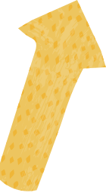






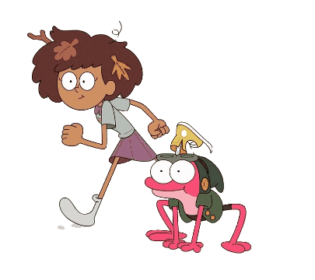




Comparatives & Superlatives

Slide 24
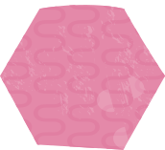

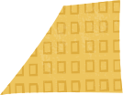

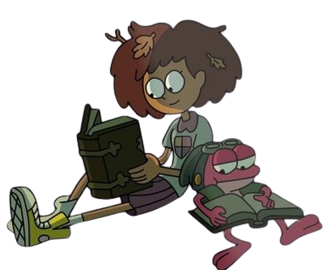
Comparative and superlatives
Comparatives
Superlatives
Comparatives are normally use to compare two nouns*.
Superlatives are commonly used to compare more than two nouns.

Slide 25
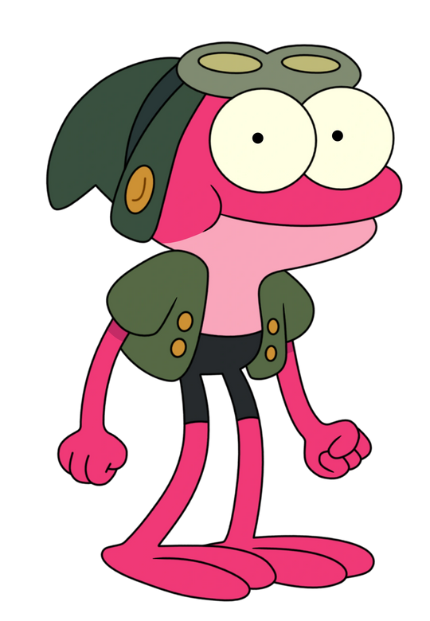
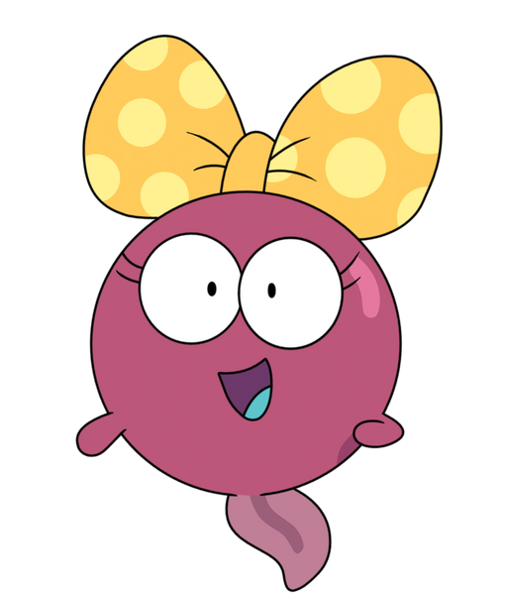
Tips
Whenever we form comparative we usually add “er” to the adjective.
For example: Taller – Shorter – faster - older
Sprig is older than Polly

Slide 26
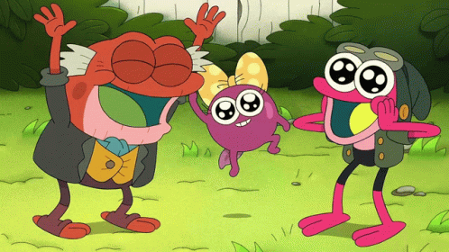
Tips
In order to turn an adjective into a superlative we just simple add“est” to adjective.
For example: Tallest – Shortest – fastest- oldest
Hop is the oldest

Slide 27
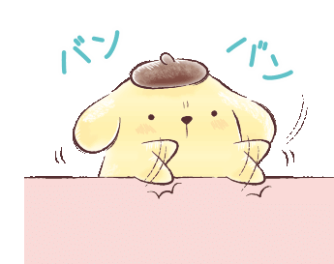
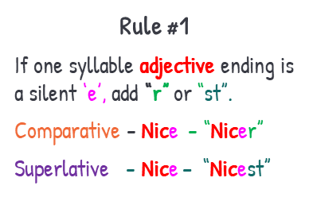
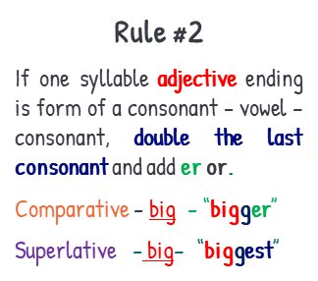
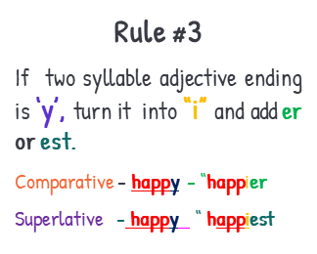
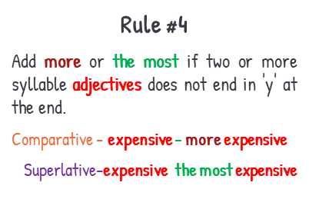
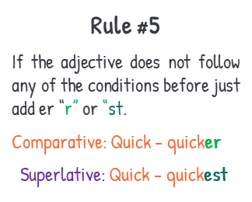
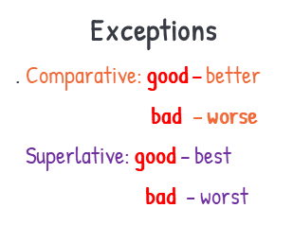
Rules to form
Comparatives and Superlatives

Slide 28
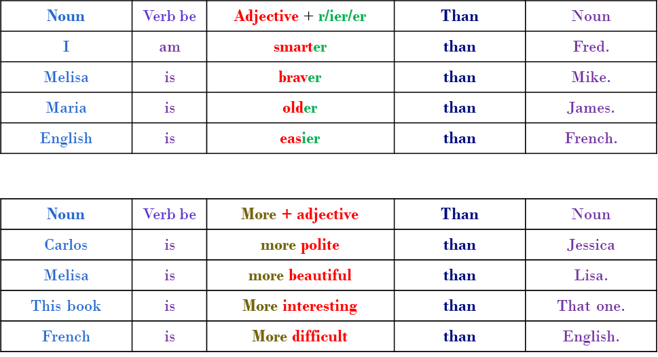

Structure for comparatives

Slide 29
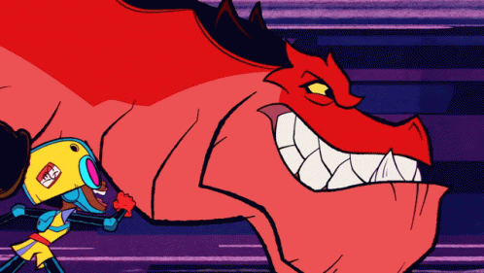

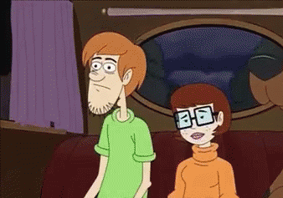
Examples
Moon girl is Faster than Devil the dinosaur
Wilma is more intelligent than Shaggy.
Coca Cola is worse than Pepsi.

Slide 30
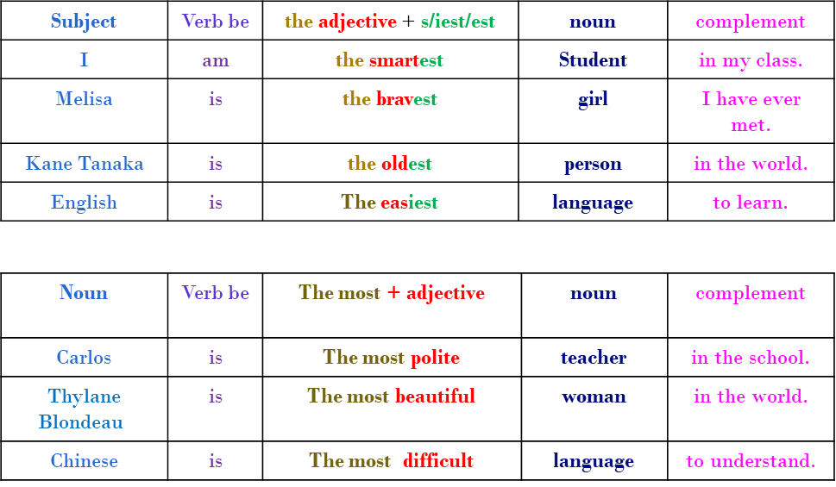

Structure for Superlatives

Slide 31
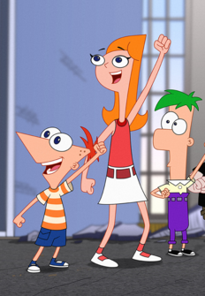
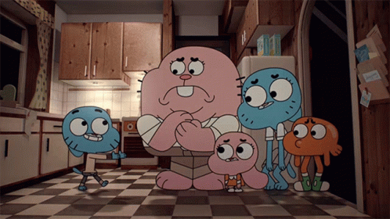
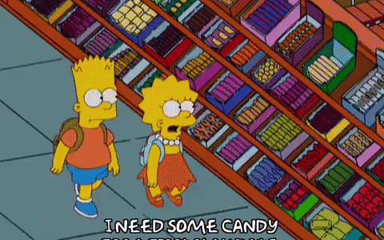
Examples
Richard is the dumbest member of the Waterson family.
Candace is the tallest sibling
Lisa is the most intelligent member of the Simpson family

Slide 32
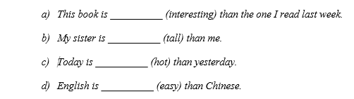

I. Complete the sentences with the comparative form of the given adjective.

Slide 33
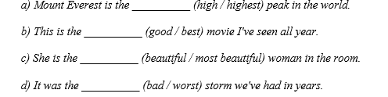
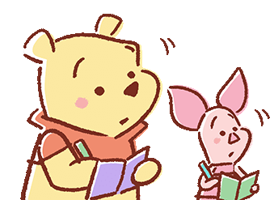
II. Select the correct Superlative adjective

Slide 34
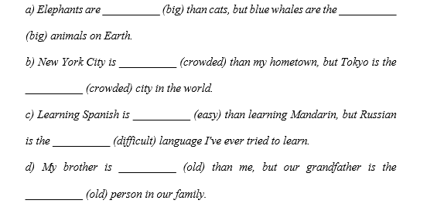

III. Complete the sentences using superlatives and comparatives adjectives

Slide 35

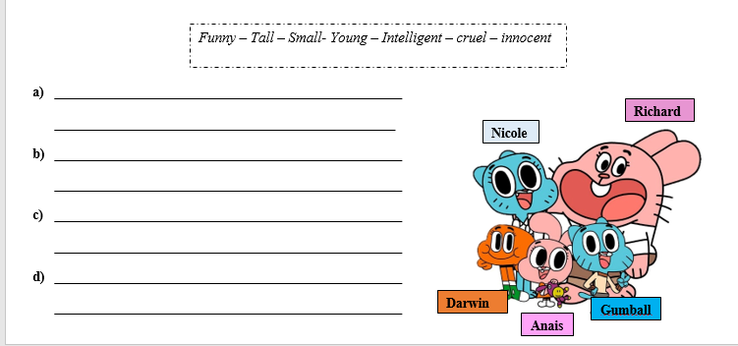
IV. Write 4 sentences using superlatives and comparatives adjectives

Slide 36
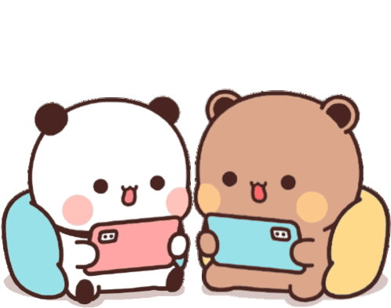
Let’s play

