Slide 1
The poem “IF”

Slide 2
Check You Understanding - IRS
What is a metaphor?
A comparison using "like" or "as“
A direct comparison between two unlike things without using "like" or "as“
C) A rhyme scheme

Slide 3
Check You Understanding - IRS
What is a stanza in a poem?
A) The main theme of the poem B) A group of lines forming a unit in a poem C) The rhyme scheme used in a poem D) A type of metaphor

Slide 4
Check You Understanding - IRS
Why do poets use repetition?
A) To confuse the reader B) To emphasize an idea or theme C) To make the poem longer D) To create random patterns

Slide 5
stanza, repetition , metaphor
Her smile is sunshine on a cloudy day. __________.
In the second group of lines, the poet describes the setting sun. ____________.
The song’s chorus is repeated to make the words
stick in your head. _____________.

Slide 6
stanza, repetition , metaphor
Her smile is sunshine on a cloudy day. __________.
In the second group of lines, the poet describes the setting sun. ____________.
The song’s chorus is repeated to make the words
stick in your head. _____________.
metaphor
stanza
repetition

Slide 7
The poem “IF” Academic Words P.140

Slide 8
1. Her voice is very distinctive and easy to recognize.
2. He tried to interpret the meaning of the old painting.
3. The doctor gave precise instructions for taking the medicine.
4. She decided to pursue her dream of becoming an artist.

Slide 9
Check You Understanding - IRS
Which of the following best describes something that is "distinctive"?
a) Common and ordinary b) Unique and easily recognizable c) Difficult to notice d) Confusing and unclear

Slide 10
Check You Understanding - IRS
2. To "interpret" something means to:
a) Create something new b) explain the meaning of something c) Ignore details

Slide 11
Check You Understanding - IRS
3. When someone decides to "pursue" a goal, they:
a) Ignore it b) Try to achieve it c) Avoid it d) Postpone it

Slide 12
The poem “IF” Explanation

Slide 13
In today's lesson, we will....
1- Read the stanza and discuss it.
2- Answer questions related to it.

Slide 14
Google Search
Warming Up
Who is the poet of the poem if? I want one piece of information related to him.

Slide 15
Stanza (1)
If you can keep your head when all about you Are losing theirs and blaming it on you, If you can trust yourself when all men doubt you, But make allowance for their doubting too; If you can wait and not be tired by waiting, Or being lied about, don’t deal in lies, Or being hated, don’t give way to hating, And yet don’t look too good, nor talk too wise:

Slide 16
Stanza (1)-Explanation
1. "If you can keep your head when all about you / Are losing theirs and blaming it on you,"
Stay calm and clear-headed when everyone else is panicking or blaming you unfairly.
2. "If you can trust yourself when all men doubt you, / But make allowance for their doubting too;"
Have confidence in yourself even when others doubt you, but also understand why they might have doubts.
3. "If you can wait and not be tired by waiting,"
Be patient and don’t get frustrated while waiting for things to happen.
4. "Or being lied about, don't deal in lies,"
When others lie about you, don’t respond by lying yourself.
5. "Or being hated, don't give way to hating,"
Even if others hate you, resist the urge to hate them back.
6. "And yet don't look too good, nor talk too wise:"
Don’t act overly proud or try to seem smarter than everyone else.

Slide 17
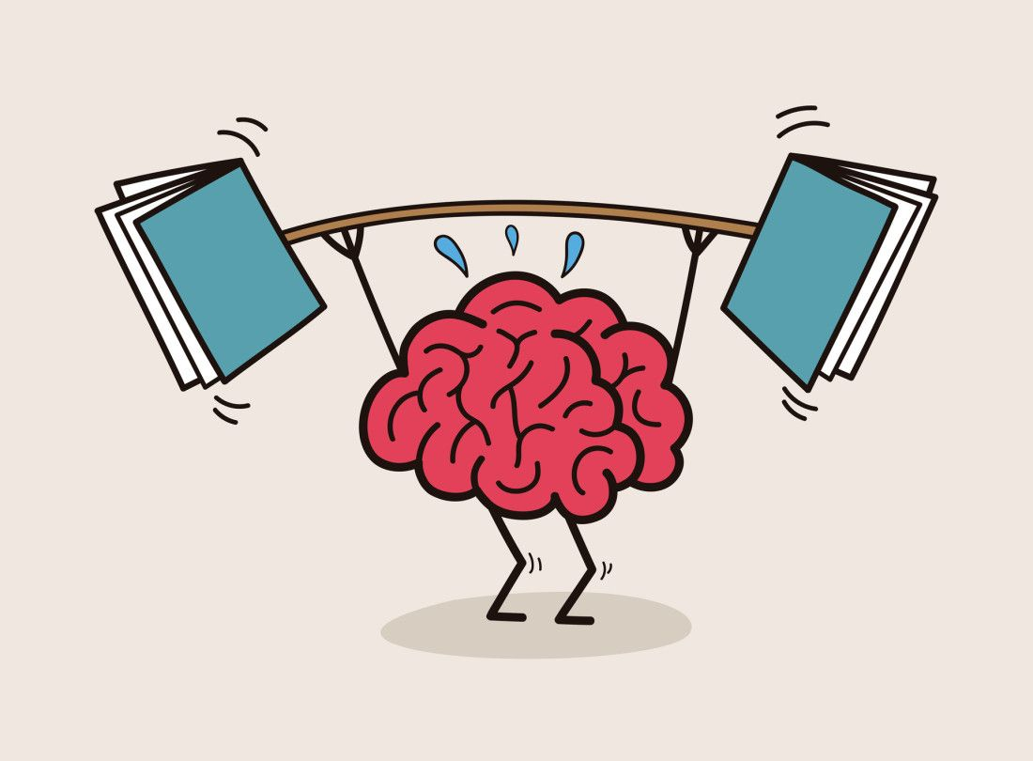

Kipling says we should stay calm and patient even when others lose control or treat us badly. Do you think this is still a good way to live in today’s world? Why or why not?
Challenge Yourself- Buzz IN
Yes, I think Kipling’s advice is still a good way to live today. Staying calm and patient helps people make better decisions instead of reacting with anger or fear. In a world where social media and news can spread emotions quickly, keeping your “head” allows you to think clearly and stay true to yourself. However, it can be hard to do this all the time—sometimes speaking up strongly is also important. Still, being calm, honest, and humble usually leads to more respect and peace in the long run.

Slide 18
Think of a time when you faced a difficult situation—maybe at school, home, or with friends. How could the advice in this stanza (staying calm, patient, and kind even when others aren’t) help you handle that situation better?
Challenge Yourself- Buzz IN
One time, I was working on a group project at school, and some of my teammates weren’t doing their part. I got really frustrated and wanted to argue with them. But if I followed Kipling’s advice, I would have stayed calm and tried to handle it more patiently. Instead of blaming or getting angry, I could have talked to them respectfully and focused on finishing the work together. By keeping my “head” and not giving in to anger, the situation could have been less stressful and more productive.

Slide 19
Check You Understanding - IRS
Formative Assessment
What does the poet suggest you should do when others lose control and blame you?
A. Argue back and defend yourself B. Keep calm and stay in control C. Ignore everyone completely D. Leave the situation immediately

Slide 20
Check You Understanding - IRS
Formative Assessment
2. In the stanza, what quality is emphasized when it says, “If you can wait and not be tired by waiting”?
A. Anger B. Impatience C. Patience D. Pride

Slide 21
Check You Understanding - IRS
Formative Assessment
3. What does the line “Or being hated, don’t give way to hating” teach us?
A. Hate people who hate you B. Don’t let hate control your actions C. Avoid people who dislike you D. Pretend to like everyone

Slide 22


✅ True or ❌ False
According to the stanza, you should stay calm and trust yourself even when others doubt or criticize you.

Slide 23




POSTASSESSMENT
https://create.kahoot.it/share/stanza-1-the-poem-if/6ce3aa7f-d6aa-469e-a1c2-0f4185c13ed5

Slide 24
Stanza (2)
If you can dream—and not make dreams your master; If you can think—and not make thoughts your aim; If you can meet with Triumph and Disaster And treat those two impostors just the same; If you can bear to hear the truth you’ve spoken Twisted by knaves to make a trap for fools, Or watch the things you gave your life to, broken, And stoop and build ’em up with worn-out tools:

Slide 25
Stanza (2)-Explanation
1. "If you can dream—and not make dreams your master;"
It’s great to have dreams, but don’t let them control your life.
2. "If you can think—and not make thoughts your aim;"
Think carefully, but don’t just sit around thinking—take action too.
3. "If you can meet with Triumph and Disaster / And treat those two impostors just the same;"
Accept both success and failure calmly because neither lasts forever.
4. "If you can bear to hear the truth you’ve spoken": This means enduring the pain of hearing something you know to be true being misrepresented or distorted by others. You've spoken the truth, but others have manipulated it.
5. "Twisted by knaves to make a trap for fools,": Knaves are deceitful people. They take your truth and twist it for their own dishonest purposes, misleading others (the "fools"). The image here is of people manipulating your words to deceive others or create problems.
6. "Or watch the things you gave your life to, broken,": This refers to witnessing the collapse or destruction of something you have dedicated yourself to, whether it's a project, a relationship, or a goal you've worked hard for.
7. "And stoop and build ’em up with worn-out tools:": Despite the difficulty and exhaustion, you must humble yourself ("stoop") and start rebuilding what was destroyed, even if you're working with "worn-out tools"—limited resources, physical or emotional fatigue, or less-than-ideal circumstances.

Slide 26
Kipling says we should treat success and failure as “impostors.” What do you think he means by that, and how could this idea help people deal with winning and losing in life today?
Challenge Yourself- Buzz IN
Kipling calls success and failure “impostors” because they can be misleading—they don’t define who we are or guarantee the future. Success might make us overconfident, and failure might make us feel defeated, even though neither is permanent. By treating them as impostors, we learn to stay balanced, keep working hard, and focus on our effort rather than the outcome. This can help people handle both winning and losing calmly, without letting either control their emotions or decisions.

Slide 27
Kipling emphasizes staying calm and steady no matter what happens. How can this idea be applied in everyday life when dealing with stress, challenges, or unexpected changes?
Challenge Yourself- Buzz IN
Kipling’s idea of staying calm and steady can help in everyday life by encouraging us not to overreact to stress or unexpected challenges. Instead of panicking when things go wrong or becoming overly proud when things go well, we can focus on taking practical steps to solve problems and keep moving forward. For example, if a project at work fails, staying calm allows us to analyze what went wrong, learn from it, and try again. In personal life, it can help us handle conflicts or sudden changes without letting emotions take over. Overall, treating challenges and successes with balance helps us make better decisions and stay resilient.

Slide 28
Check You Understanding - IRS
Formative Assessment
1. According to Kipling, how should one view “Triumph and Disaster”? A) As the ultimate goals in life B) As impostors that shouldn’t control you C) As punishments for mistakes D) As rewards for hard work

Slide 29
Check You Understanding - IRS
Formative Assessment
2. What does Kipling suggest doing when things you worked for are broken? A) Give up and move on B) Blame others for the failure C) Rebuild them patiently, even with worn-out tools D) Wait for someone else to fix them

Slide 30
Check You Understanding - IRS
Formative Assessment
3. What is the main lesson of this stanza? A) Dreams and thoughts should always guide your life B) Life is easy if you work hard C) Stay balanced and resilient, no matter success or failure D) Triumph is more important than disaster

Slide 31
According to the stanza, you should stay calm and trust yourself even when others doubt or criticize you.
✅ True or ❌ False
According to Kipling, one should let their dreams completely control their actions.

Slide 32
POSTASSESSMENT
https://create.kahoot.it/share/stanza-2-the-poem-if/0c22e4c9-1231-4f17-b13a-2a1c104e630e

Slide 33
Stanza (3)
If you can make one heap of all your winnings And risk it on one turn of pitch-and-toss, And lose, and start again at your beginnings And never breathe a word about your loss; If you can force your heart and nerve and sinew To serve your turn long after they are gone, And so hold on when there is nothing in you Except the Will which says to them: ‘Hold on!’

Slide 34
Stanza (3)-Explanation
1. "If you can make one heap of all your winnings / And risk it on one turn of pitch-and-toss,"
Be brave enough to risk everything you’ve achieved on a single chance.
2. "And lose, and start again at your beginnings / And never breathe a word about your loss;"
If you lose everything, start over without complaining.
3. "If you can force your heart and nerve and sinew / To serve your turn long after they are gone,"
Keep going even when you’re exhausted and feel like you can’t continue.
4. "And so hold on when there is nothing in you / Except the Will which says to them: 'Hold on!'"
Persevere through willpower when you have nothing else left.

Slide 35
Kipling talks about risking everything and continuing even when exhausted. What do you think he means by relying on “the Will” when all else is gone? How might this idea apply to challenges people face in real life today?
Challenge Yourself- Buzz IN
Kipling means that even when we feel physically or emotionally exhausted, our determination—our “Will”—can push us to keep going. In real life, this could apply to studying for a hard exam, training for a sports event, or working on a difficult project. By focusing on willpower instead of giving up, people can overcome setbacks and keep moving toward their goals, even when it seems impossible.

Slide 36
Think of a situation where you had to start over after losing something important. How could Kipling’s idea of risking everything and starting again without complaint help you handle the situation better?
Challenge Yourself- Buzz IN
If a student fails a test, instead of giving up, they can study harder and try again. By relying on their determination and not complaining, they increase their chances of eventually succeeding. The lesson applies to jobs, sports, or personal challenges too—persistence often leads to progress even after failure.

Slide 37
Check You Understanding - IRS
Formative Assessment
1. What does Kipling mean by risking “all your winnings on one turn”? A) Gambling is the most important part of life B) Taking bold risks even when the outcome is uncertain C) Never take risks and stay safe D) Only risk small amounts to avoid loss

Slide 38
Check You Understanding - IRS
Formative Assessment
According to the stanza, what should you rely on when you feel physically or emotionally exhausted? A) Luck B) Other people C) Your Will D) Complaining about your difficulties

Slide 39
Check You Understanding - IRS
Formative Assessment
3. What is the main idea of this stanza? A) Only take small risks in life B) Keep going and rebuild after failure, relying on determination C) Life is easy if you don’t take risks D) Winning is more important than trying again

Slide 40
According to the stanza, you should stay calm and trust yourself even when others doubt or criticize you.
✅ True or ❌ False
Kipling suggests complaining about losses is part of building a character.

Slide 41
POSTASSESSMENT
https://create.kahoot.it/share/stanza-3-the-poem-if/ab9f863e-539a-49cc-9a44-ad77703d6a94

Slide 42
Stanza (4)
If you can talk with crowds and keep your virtue, Or walk with Kings—nor lose the common touch, If neither foes nor loving friends can hurt you, If all men count with you, but none too much; If you can fill the unforgiving minute With sixty seconds' worth of distance run, Yours is the Earth and everything that’s in it, And—which is more—you’ll be a Man, my son!

Slide 43
Stanza (4)-Explanation
1. If you can talk with crowds and keep your virtue, / Or walk with Kings—nor lose the common touch,"
Stay true to your values whether you’re with ordinary people or powerful leaders. Don’t let anyone change who you are.
2. "If neither foes nor loving friends can hurt you,"
Don’t let enemies or even close friends hurt or manipulate your emotions.
3. "If all men count with you, but none too much;"
Value everyone equally, but don’t rely too heavily on anyone.
4. "If you can fill the unforgiving minute / With sixty seconds' worth of distance run,"
Make the most of every moment by using your time productively.
5. "Yours is the Earth and everything that's in it, / And—which is more—you'll be a Man, my son!"
If you can do all of this, you’ll achieve success in life, and more importantly, you’ll become a mature, responsible adult.

Slide 44
Kipling says you should treat everyone fairly but not let anyone control you. How could this idea help in your daily life?
Challenge Yourself- Buzz IN
Kipling is saying that to succeed, you need to interact with all kinds of people—whether ordinary crowds or powerful leaders—without losing your principles. In real life, this means staying humble, respecting everyone, and making fair decisions without letting friends, enemies, or authority figures influence you too much. This approach helps build trust, maintain integrity, and make sound choices in school, work, or personal relationships.

Slide 45
How can maintaining humility and treating everyone equally help you handle leadership roles, friendships, or teamwork in real life?
Challenge Yourself- Buzz IN
In a team project at school or work, treating all members with respect while making fair decisions ensures everyone feels valued. This can lead to better collaboration and results, while also showing your integrity. Similarly, staying grounded around people with more power helps you make wise decisions without being swayed by pressure or flattery.

Slide 46
Check You Understanding - IRS
Formative Assessment
1. What does Kipling mean by walking “with Kings—nor lose the common touch”? A) Only hang out with powerful people B) Stay humble and treat everyone equally, no matter who they are C) Avoid ordinary people entirely D) Act differently around important people

Slide 47
Check You Understanding - IRS
Formative Assessment
2. What is the significance of “filling the unforgiving minute with sixty seconds’ worth of distance run”? A) Always measure time carefully B) Make the most of every moment and work diligently C) Focus only on physical exercise D) Relax and take life slowly

Slide 48
✅ True or ❌ False
According to Kipling, you should let friends or enemies control your decisions.

Slide 49






Slide 50
POSTASSESSMENT
https://create.kahoot.it/share/stanza-4-the-poem-if/496aac88-2001-40eb-b085-39ef5f777baa

Slide 51
Check You Understanding - IRS
What does Kipling mean by "keep your head" in the first line?
A) Stay angry B) Stay calm C) Stay confused

Slide 52
Check You Understanding - IRS
2. What does the author suggest is important when facing doubt from others? A) Ignoring their opinions B) Trusting yourself C) Trying to please everyone D) Arguing with them

Slide 53
Check You Understanding - IRS
What is the main idea of the first stanza? A) Following others is important B) Staying calm and believing in yourself during tough times C) Rebelling against authority D) The importance of friendship

Slide 54
Check You Understanding - IRS
Stanza (2)
How should you react to both winning and losing, according to the poem?
a) Celebrate wins and avoid losses. b) Stay calm with both. c) Run from winning and face losses with fear. d) Enjoy wins and ignore losses.

Slide 55
Check You Understanding - IRS
Stanza (2)
What is the main idea of this part of the poem "If—" by Rudyard Kipling? a) You should always avoid failure. b) It’s important to stay calm and strong in both good and bad times. c) Success is the most important thing in life. d) You should always win and never make mistakes.

Slide 56
Check You Understanding - IRS
Stanza (3)
1. What is the author suggesting when he says, "And lose, and start again at your beginnings"?
A) Never take risks
B) Give up after failure
C) Start over without complaining after a loss
D) Blame others for your failures

Slide 57
Check You Understanding - IRS
Stanza (3)
2. What does the phrase "hold on when there is nothing in you" suggest?
A) You should never quit even when exhausted
B) You should ask for help when you're tired
C) Physical strength is more important than mental strength
D) Success comes easily

Slide 58
Check You Understanding - IRS
Stanza (3)
3. What is the main idea of this stanza?
A) Taking risks in life is unnecessary
B) One should persevere through challenges and failures without complaining
C) Winning is the most important thing in life
D) It’s better to avoid difficult situations

Slide 59
What does the repetition in the phrase "If you can..." indicate?
Challenge Yourself- Buzz IN
It highlights the various qualities and challenges one must face to succeed.

Slide 60

1. In the first stanza, what should you do when others doubt you? a) Get upset and stop trying b) Trust yourself but understand their doubts 2. According to the first stanza, what should you avoid doing when people lie about you? a) Be truthful and not lower yourself to lying b) Run away from the situation 3. What should you do when people hate you, according to the first stanza? a) Pretend to be their friend b) Stay calm and not return the hate

