Slide 1
Literature Poetry
If
Rudyard Kipling
S. B. p. 139-143

Slide 2
If
Outcomes:
Students should be able to:
Recognize the meanings of the new words.
Use the new words correctly in meaningful sentences.

Slide 3
Page: 139 Literary Words
Listen and repeat
Extended Metaphor
repetition
stanza

Slide 4
- Tina is a shining star. - Ali has a heart of a lion.
Metaphor: comparison between two things that aren’t alike, but do have something in common.

Slide 5
All the world’s a stage
And all the men and women merely players
They have their exits and their entrances
-William Shakespeare
The entire poem here is a metaphor. In this poem, the metaphor compares life to theater and people to actors.
This is called extended metaphor because it continues the comparison for several lines or for an entire poem.

Slide 6
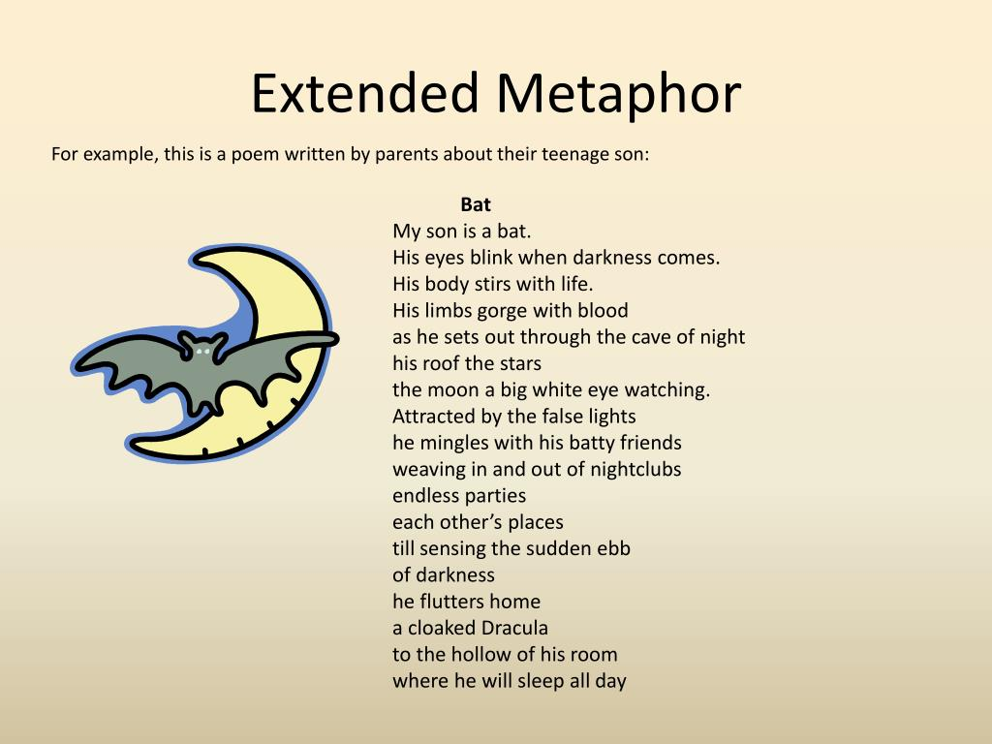

Slide 7
“ I am your father!” cried he. “ Young Rip Van Winkle once; old Rip Van Winkle now! Does anybody know poor Rip Van Winkle”?
- Washington Irving
Repetition: saying something again and again. Writers use repetition of words , phrases, or sentences to emphasize their ideas .

Slide 8
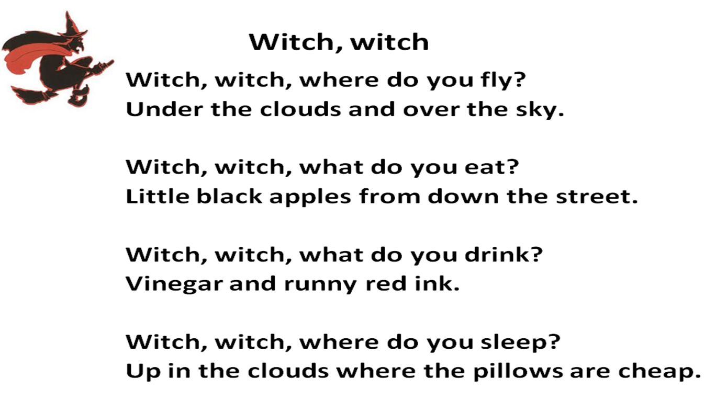

Slide 9
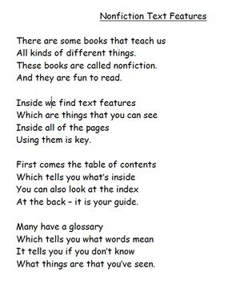
Stanza: a group of lines in a poem. A stanza may have only a few lines, or it may have many lines. The stanzas in a poem may all be the same length or may be different length. This poem has 4 stanzas.

Slide 10
Page: 139 If
Practice Literary Words
Read the following poem .
How many stanzas does it have?
Where does the author use repetition?
What is the extended metaphor?

Slide 11
My mother is the sun.
She gives light to the world.
She gives life to all.
In the early morning, my
mother is warm and welcoming.
She breathes life into the day.
In the evening, my mother
tires. A hard day’s work is done.
She slips down behind the mountains and sleeps.

Slide 12
Possible answer:
The poem has three stanzas. The author uses repetition, he repeats the phrases My mother and She gives.
The extended metaphor compares the speaker’s mother to the sun. Examples include that she gives light and life: She is warm and welcoming in the morning; at night she is tired and she sleeps.

Slide 13
Page: 140 If/ Academic Words
Listen and repeat
distinctive
interpret
precise
pursue

Slide 14
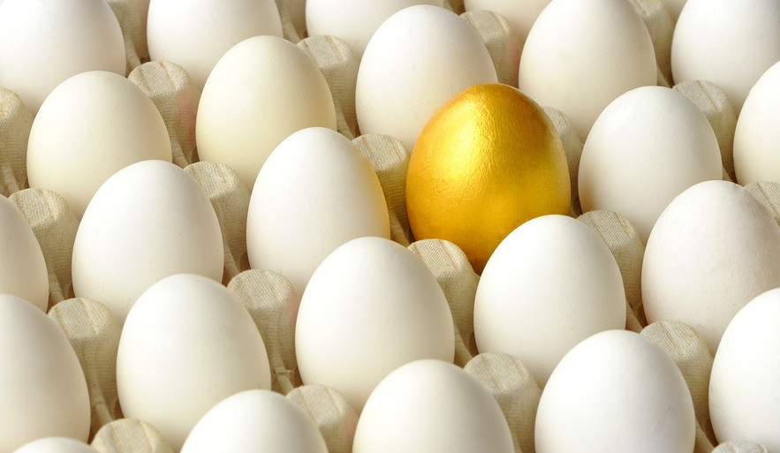
distinctive: (adj) clearly marking a person or thing as different from others.
If something is distinctive, it stands out from others.

Slide 15
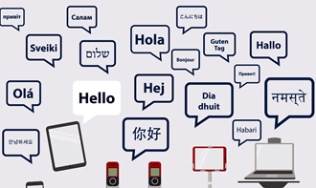
interpret:( v) to explain or translate.
A teacher can interpret a difficult Math problem.

Slide 16

precise: (adj) exact and correct in every details.
Can you give me a precise description of your favorite food?

Slide 17

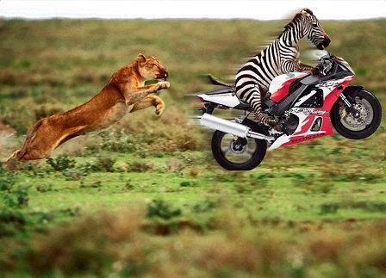
pursue: (v) to do an activity or try to achieve something; follow.
If you want to pursue a career in music, you should take lessons and practice a lot.

Slide 18
Practice. S. B. P. 140 Answer the questions. Try to include the bolded words in your answer.
What makes the place you grew up distinctive?
How would you interpret the following metaphor” A good teacher is sunshine to seedlings”?
Why do you think it is important to give precise directions to someone who is lost?
What career path do you want to pursue?

Slide 19
Possible answers:
My city is distinctive because it has a famous statue.
I interpret the metaphor” A good teacher is sunshine to seedlings” to mean that a good teacher helps the students grow.
It is important to give precise directions because otherwise, people won’t find their ways.
The career path I want to pursue is being a lawyer.

Slide 20
Page: 142 If/boldfaced words
Listen and repeat
keep your head
make allowance
imposter
bear
knaves
stoop
worn- out

Slide 21

keep your head: (phrase) to remain calm.
Try to Keep your head when others are panicking.

Slide 22
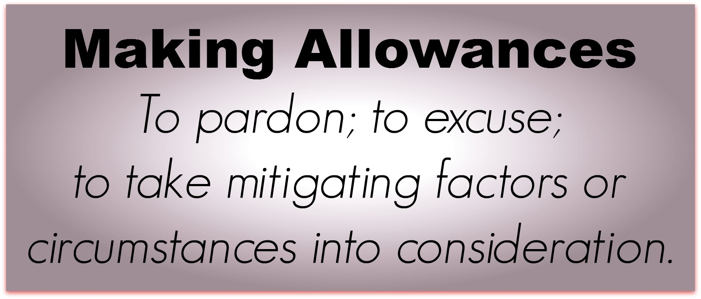
make allowance: (phrase) to consider the facts when judging something.
Remember my age and make allowance for it. I might forget some details of the incidents.

Slide 23

imposters: (n) people who pretend to be some one else to trick people
This person cheats others, he is a true imposter who always deceives people.

Slide 24
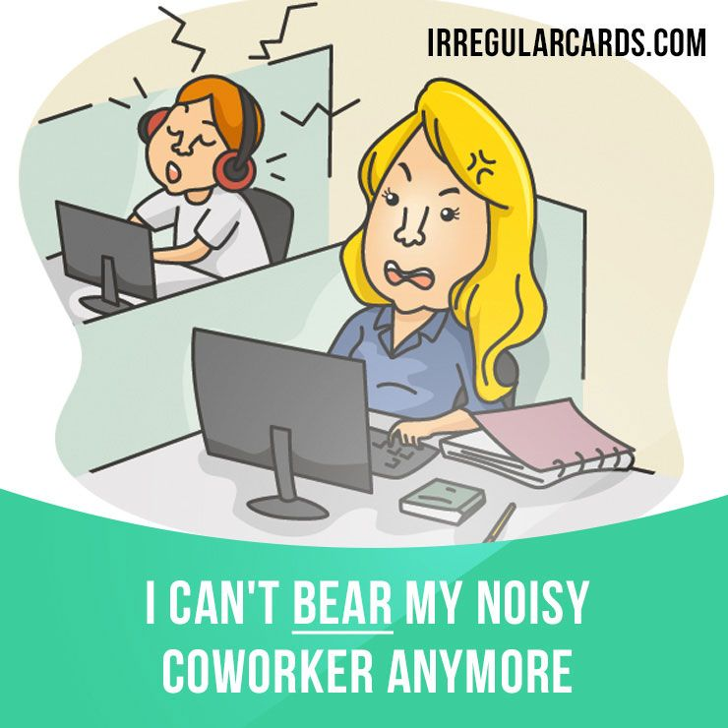
bear: (v) bravely accept an unpleasant situation.
Unlike other people, I can’t bear working in a quiet place

Slide 25
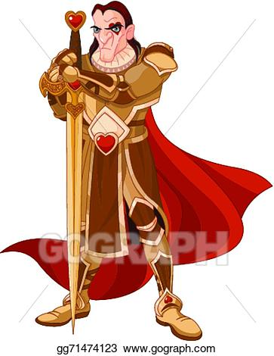
knaves: (n) dishonest men.
I am trying to avoid talking to knaves because they deteriorate the truth.

Slide 26
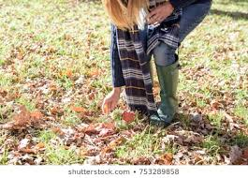
stoop: (v) bend your head and shoulders forward and down.
I will stoop to pick the small pieces of food from the floor.

Slide 27
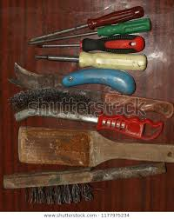
worn- out: (phrase) used and damaged.
Your blanket is worn out, you have to renew it.

Slide 28
Page: 143 If/ Boldfaced Words
Listen and repeat
pitch-and-toss
sinew
serve your turn
will
foes

Slide 29
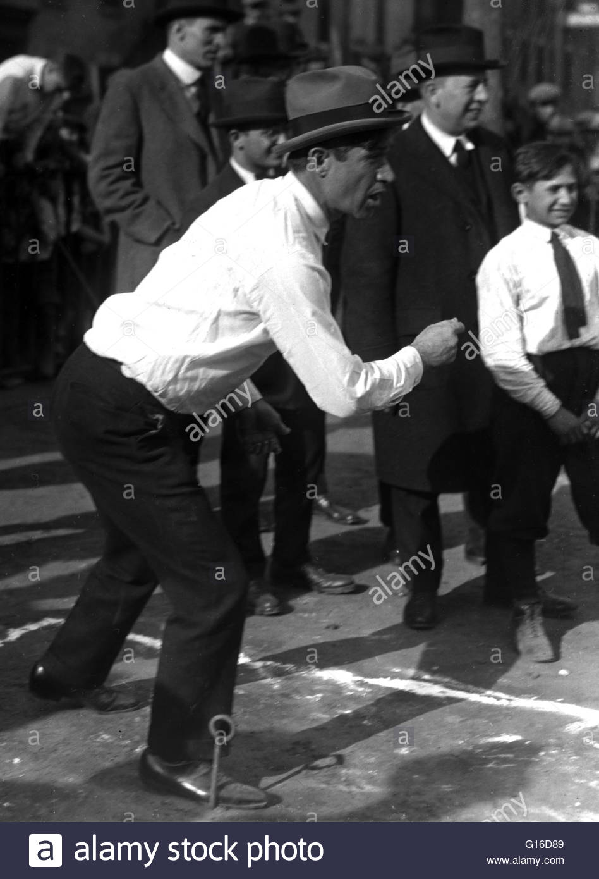
Pitch-and-toss: (phrase) a game of risk.
Life is like a game of pitch and toss, you should be willing to begin again if you lose everything.

Slide 30
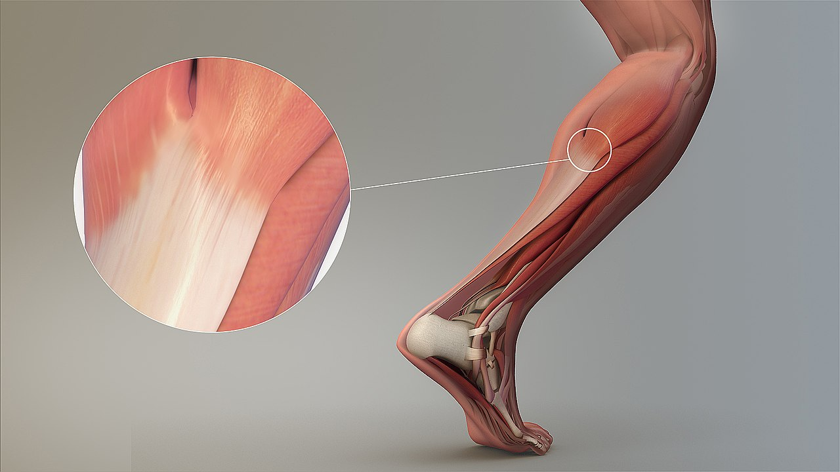
sinew: (n) part of the body that connects a muscle to a bone.
Collagen is the main protein of sinew, bone and skin.

Slide 31

serve your turn: (phrase) be helpful
I would serve my turn and be helpful if they said the truth.

Slide 32
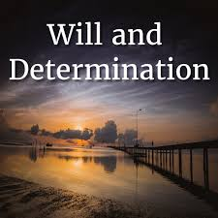
will: (n) determination to do what you have decided to do
Omar has a great will to succeed in the exam.

Slide 33
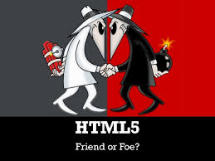
foes: (n) enemies.
She doesn’t like me and she treats me like a foe.

Slide 34
Fill in the spaces with the correct word from the list.
(will, foes, impostor, precise, sinew, stoop)
1. He claimed he was an experienced pilot, but he turned out to be an _____________.
2. Her ability was acknowledged by friend and _____________alike.
3. _____________means to bend your head and shoulders forward and down.
4. He’s got a strong _____________to win the competition.
5. The _____________connects the muscles with the bones in the body.
6. Your answers should be quite _____________when you answer the questions in the exam.

Slide 35
Here are the answers.
(will, foes, impostor, precise, sinew, stoop)
1. He claimed he was an experienced pilot, but he turned out to be an imposter.
2. Her ability was acknowledged by friends and foes alike.
3. Stoop means to bend your head and shoulders forward and down.
4. He’s got a strong will to win the competition.
5. The sinew connects the muscles with the bones in the body.
6. Your answers should be quite precise when you answer the questions in the exam.

Slide 36

The End

