Slide 1
Outcomes
Discuss the big question.
Differentiate between literary words.

Slide 2
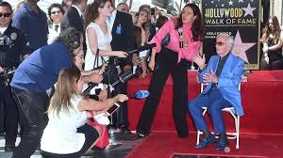

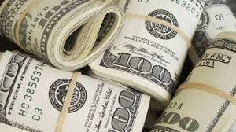
Big Question
What makes you happy?

Slide 3
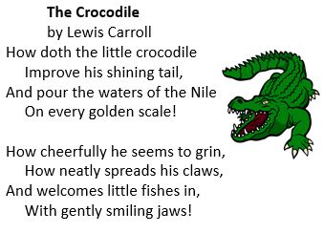
Stanza

Slide 4
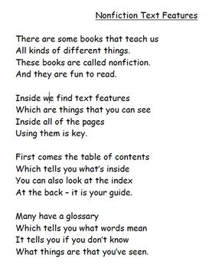

Slide 5
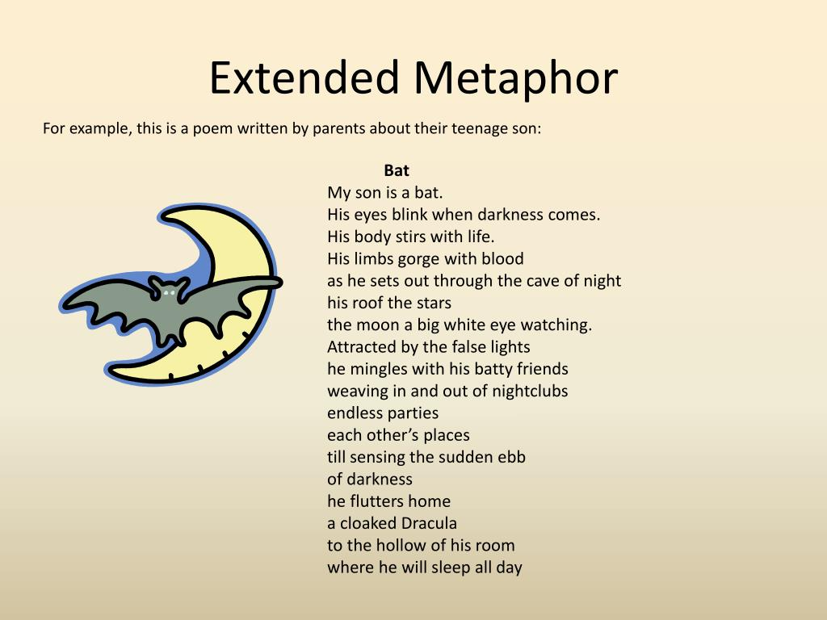
How is the son compared to in the following poem

Slide 6
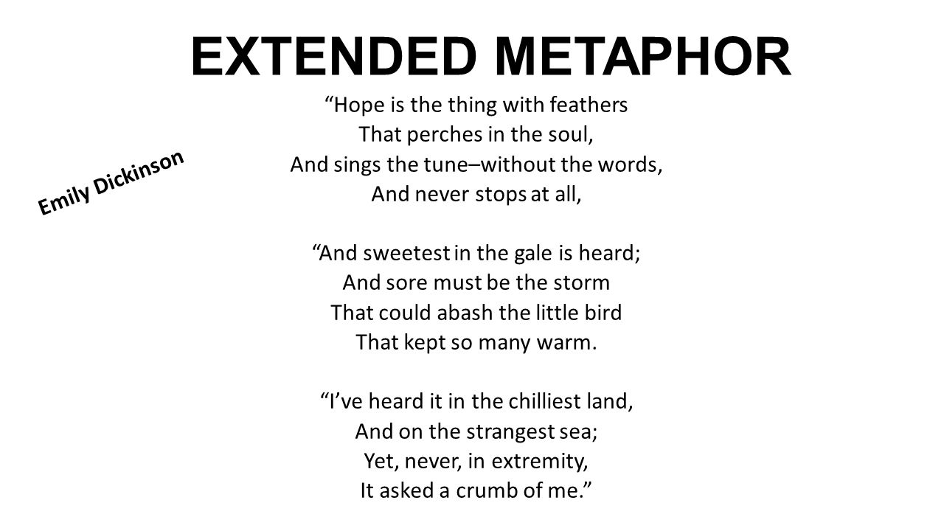

Slide 7
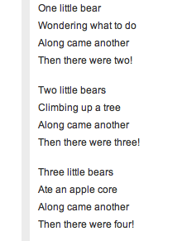

Slide 8
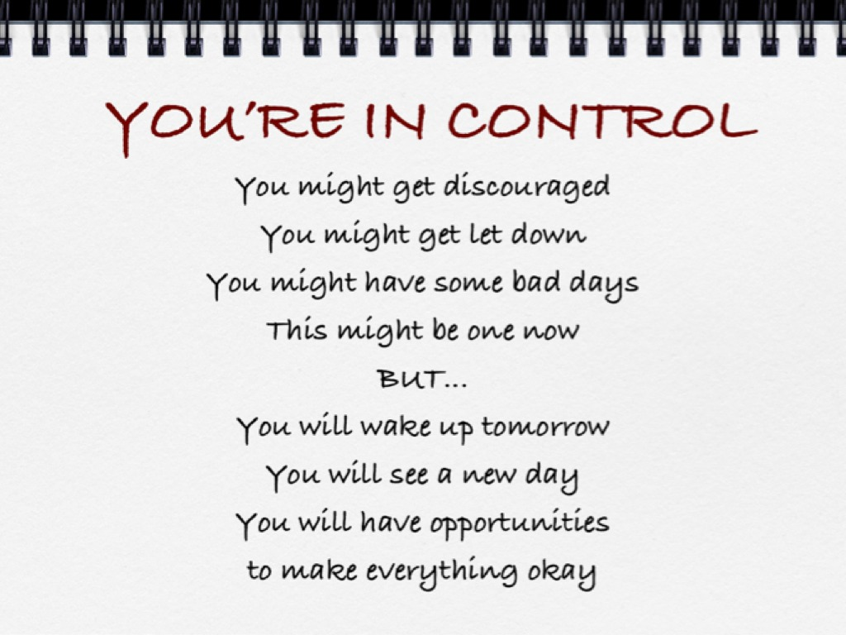
What do you notice in this poem

Slide 9
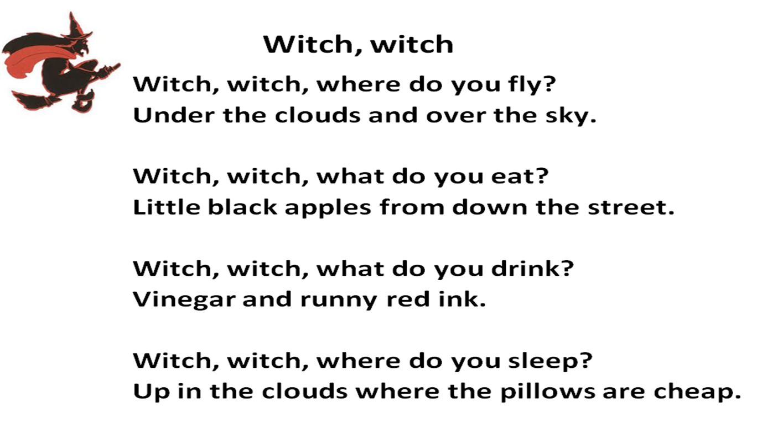
Tell about your feeling while watching this video?

Slide 10
Outcomes
Practice literary elements.
Task 1: Find the extended metaphor, repetition and how many stanzas in the poem.
Recognize the meanings of the new words.
Task 2: read the meanings and the examples in the book and write the words in context.

Slide 11
Outcomes
Differentiate between words with the same sound and different spelling and meaning.
Task 1: Us the words to write meaningful sentences.
2. Practice using the new words.
Task 2: Write the words correctly.

Slide 12
you’re/your
by/bye/buy

Slide 13
Guess the meanings of the bolded words( that are not English ) from the text. S.B. P. 140
1. A teacher can pepntiter a difficult Math problem.
2. Give me a ciperse direction.
3. My school has tesnidcitiv buildings.
4. I want to supuer my dream.

Slide 14
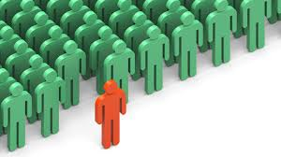
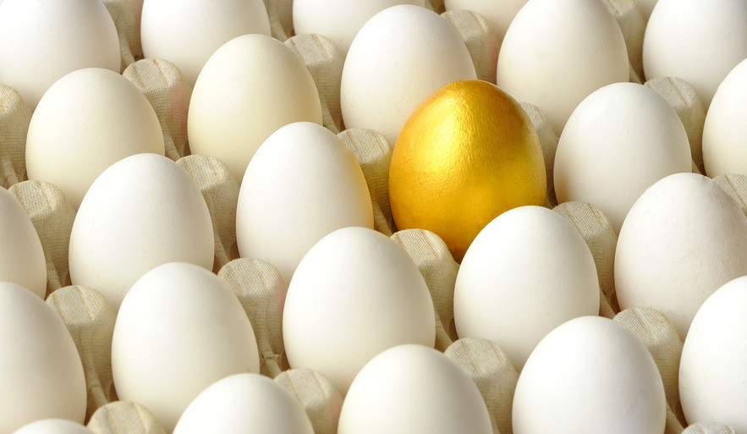

Slide 15
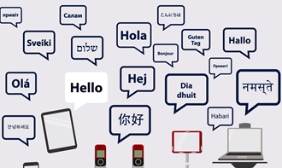

Slide 16
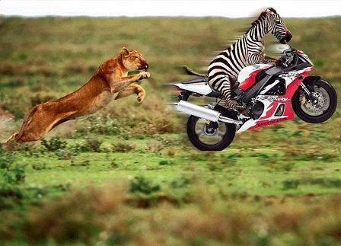
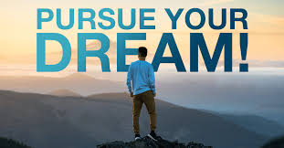

Slide 17


Slide 18
outcomes
Practice homophones
2. Revise key and academic words

Slide 19
blew: blue:
Ate:
eight:
Ate: past of eat
eight: the numeral 8
blew: past of blew
blue: color

Slide 20
one: won:
made:
maid:
Made: created
maid: woman who cleans
one: the numeral 1
won: succeeded

Slide 21
some: sum:
peace:
piece:
Peace: lack of war
piece: section
some: more than one
sum: result of addition

Slide 22
wood: would:
wear:
where:
wear: put on clothes
where: location
wood: tree product
would: past of will

Slide 23
Outcomes 9/12
Paraphrase the stanzas in a poem.
2. Recognize the meanings of the new words

Slide 24
Listen to the poem and try to tell what it is about.
Who is the poet?
How many stanzas are there in this poem?

Slide 25
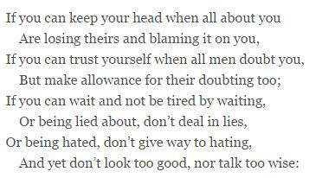

Slide 26
The poem is about a father who gives advice to his son. The speaker(father) outlines for his son the behaviors and attitudes it takes to become a man.

Slide 27
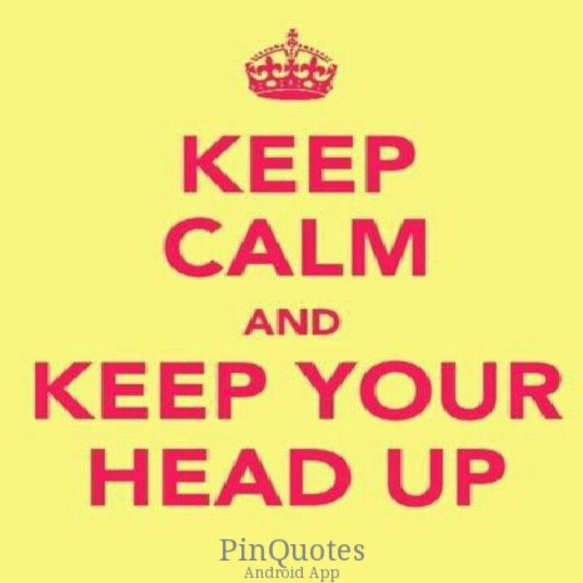
If you can keep your head when all about you
Are losing theirs and blaming it on you,
( The father advises his son to keep cool or keep chill when others around him are losing it.)

Slide 28
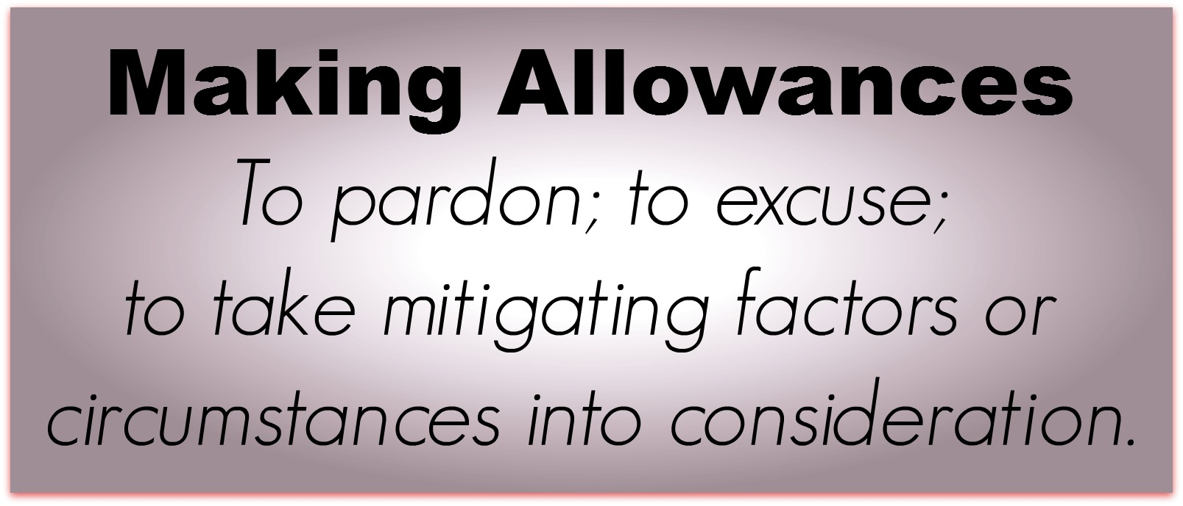
If you can trust yourself when all men doubt you
But make allowance for their doubting too:
( The speaker emphasizes two traits that most people must possess: self trust and the ability to understand the thoughts and feelings of others)

Slide 29
If you can wait and not be tired by waiting,
Or being lied about, don’t deal in lies
Or being hated, don’t give way to hating,
And yet don’t look too good, nor talk too wise:
( The speaker is telling the reader to work hard and to have patience for the results, we should not get tired by waiting. We should always remain truthful and should not indulge ourselves in lies. Don’t respond lies with lies. When people show their hatred toward us, we should not hate them.
The reader should not appear to be better than he actually is, nor should he talk in a manner that does not reflect who he is)

Slide 30
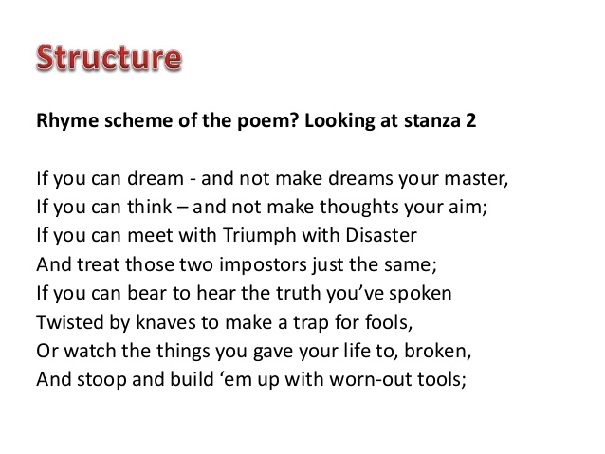

Slide 31
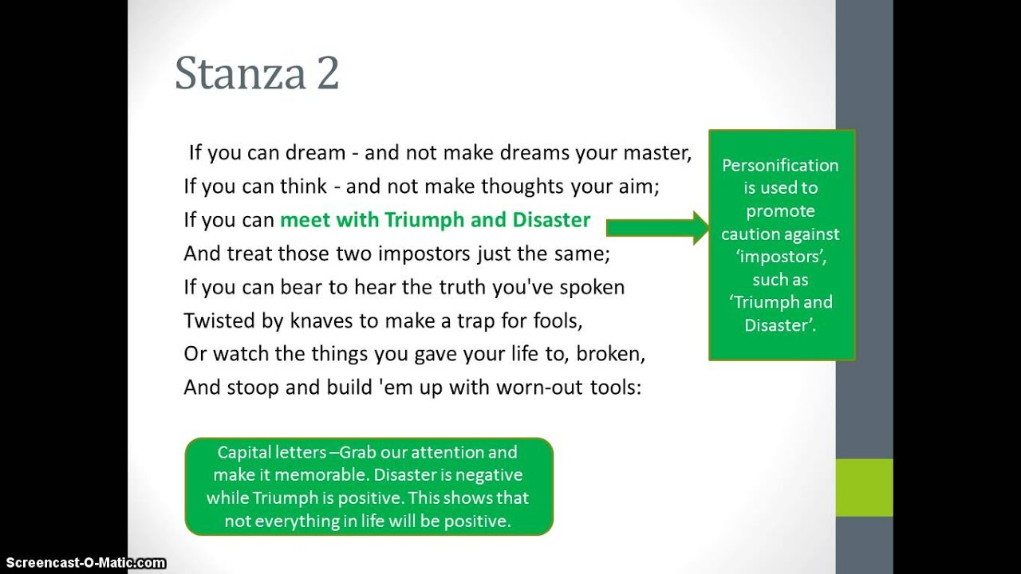

Slide 32
Theme of stanza 2
The speaker advises his son to develop self control, as well as an ability to hear the truth and avoid flattery and have grace under pressure.

Slide 33
If you can dream- and not make dreams your master;
If you can think-and not make your thoughts your aim;
( Kipling urges his reader to dream and think, but to not get so caught up in dreams and thoughts that might distract you from reality.) Our thinking shouldn’t be scattered misleading us from the target)

Slide 34
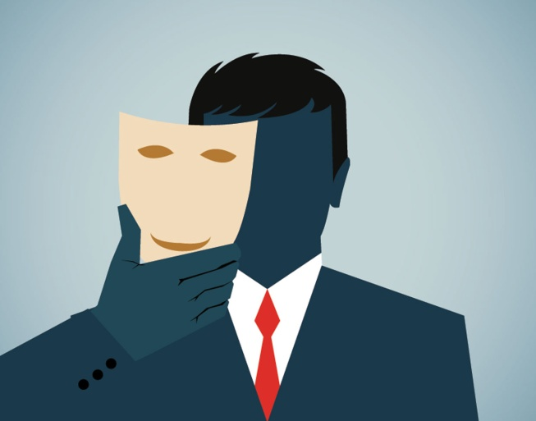
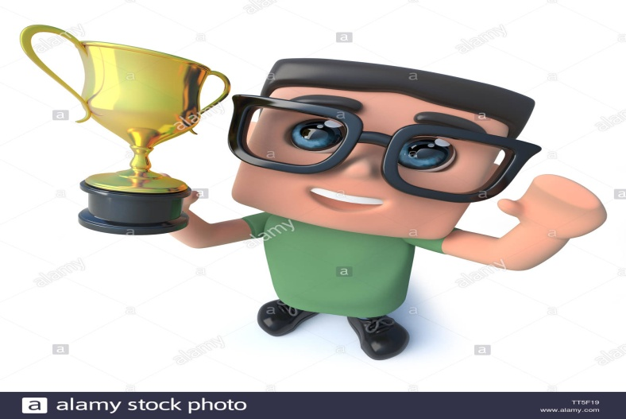
If you can meet with Triumph and Disaster
And treat those two imposters just the same
( The poet called triumph and disaster two imposters ( cheaters or deceivers or pretenders)
He asked us to treat these deceivers similarly with a smiling face. Don’t be too happy or too sad under any circumstances because they will soon disappear)

Slide 35

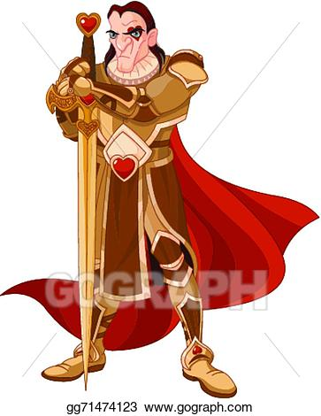
If you can bear to hear the truth you’ve spoken
Twisted by knaves to make a trap for fools,
( if people deliberately distort our words to use in their favor, we should not lose our temper hearing that, rather we should tolerate them, ensuring we have spoken the truth.)

Slide 36
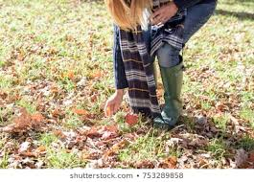
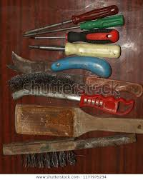
Or watch the things you gave your life to, broken,
And stoop and build’em up with worn-out tools:
( It is about the importance of being able to pick oneself up and start again if they fail_ even if the thing they’ve failed at took lots of efforts and time, you must always be prepared to start again.)

Slide 37
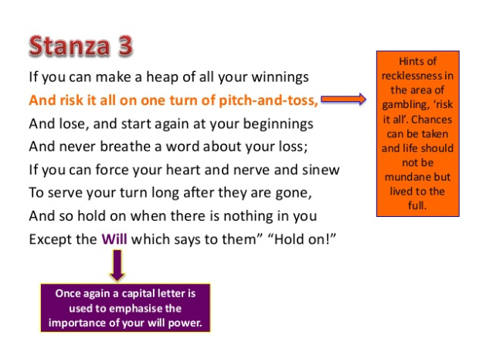

Slide 38
If you can make one heap of all your winnings
And risk it on one turn of one pitch- and-toss,
And lose, and start again at your beginnings,
And never breathe a word about your loss:
( If you lose everything, you must be willing to begin again. Not only that, but you must also be willing to forget about the loss and not dwell on it. We may lose the game and all our possessions, but we have to stay calm without uttering a word about the loss and rebuild it from the beginning.)

Slide 39
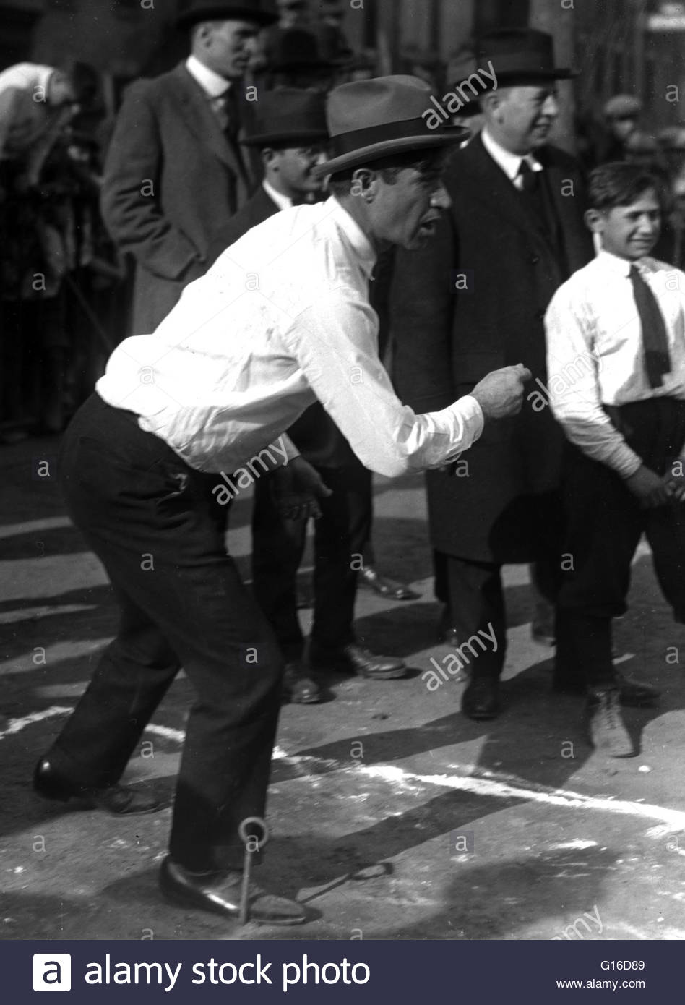
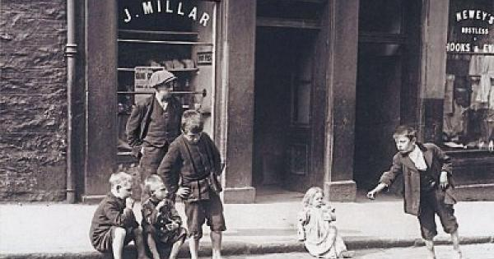

Slide 40
If you can force your heart and nerve and sinew
To serve your turn long after they are gone,
And so hold on when there is nothing in you
Except the Will which says to them:” Hold on!”
(The theme of mental strength and the power of will. We have to force our body( heart and nerve and sinew) to serve us even it has lost the strength due to old age or illness. If we want to do something great from our hearts, the will inside us would prevent the body from getting tired.)

Slide 41
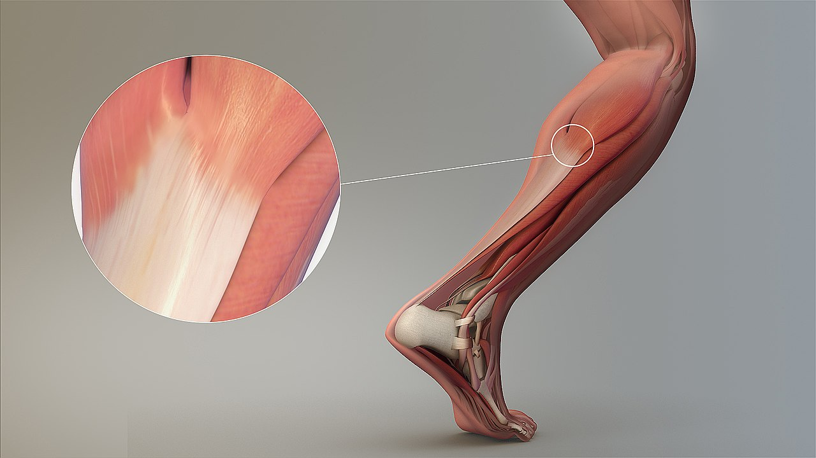

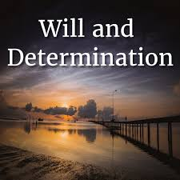

Slide 42
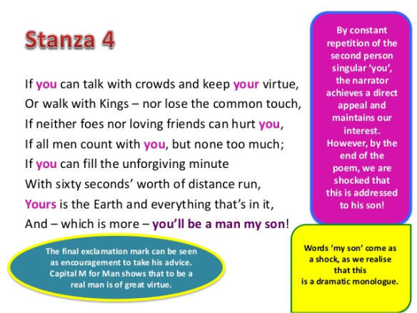

Slide 43
( We should stay in touch with people from every class in society. We should be able to talk with people without losing our moral values and we should be able to walk with kings without going beyond the reach of the common people. We should treat these two types of people the same: with kindness.)
If you can talk with crowds and keep your virtue
Or walk with kings-nor lose the common touch

Slide 44

If neither foes nor loving friends can hurt you,
If all men count with you, but non too much:
( We should build ourselves strong enough, so that neither enemies, nor loving friends can hurt us. Moreover, we should develop healthy relationships with others, and should not allow anyone to harm us.)

Slide 45
If you can fill the unforgiving minute
With sixty seconds’ worth of distance run,
(time is precious. Time (minute) is here called unforgiving as it doesn’t forgive you if you waste it. So never waist a single second of time. If you are given a minute, make sure you use all sixty seconds of it.)

Slide 46
Yours is the Earth and everything that’s in it,
And- whish is more-you’ll be a Man, my son!
( If you fulfill all the conditions mentioned so far, we can win this earth and everything in it. And you will be a complete and a perfect man)

Slide 47
2. The earth and everything that’s in it will be his, and he’ll be a man.
Before You Go On p. 143
1. Start again at the beginning

Slide 48
3. A calm. Honest, mature person; truly successful
Comprehension p. 146
1. Keep your head
5. We are responsible for our success. The word if is used to describe many possible scenarios.

