Slide 1

Unit 3 – Reading 1 Aguinaldo – Comprehension pages 130-137
Grade 8

Slide 2
Unit 3 – Big Question: How are relationships with others important?
When you meet new people, how do you decide if you would like to be friends with them?
• How have relationships with friends and family changed as you have grown up?
• What is the difference between a relationship with a good friend and one with an acquaintance?

Slide 3
When you help someone, you are really helping yourself.
Many schools require students to participate in community service to help them understand how other people live.
What can students learn from volunteering?
Do you believe schools should require community service projects? Why or why not?

Slide 4
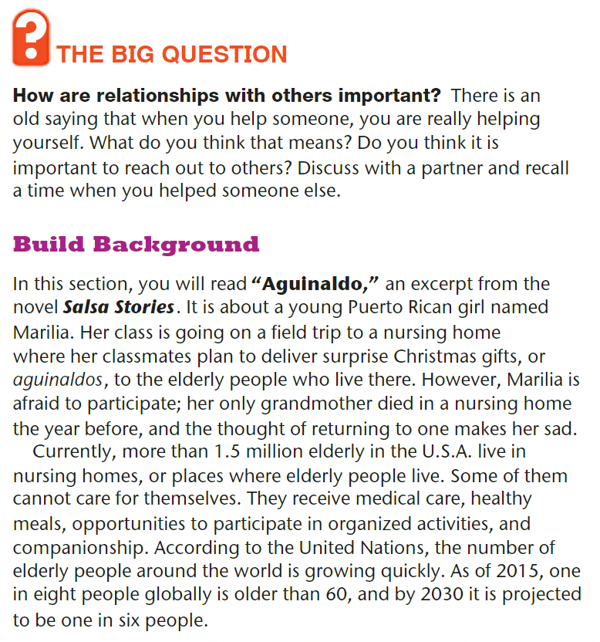
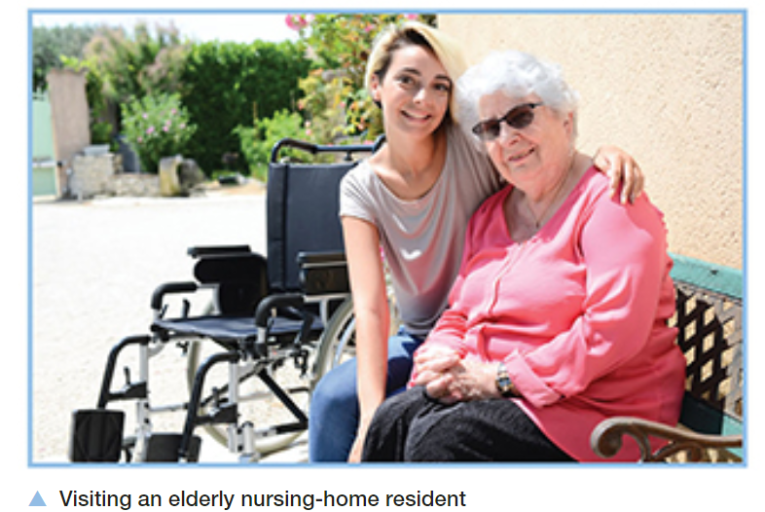
Student Book p.126

Slide 5
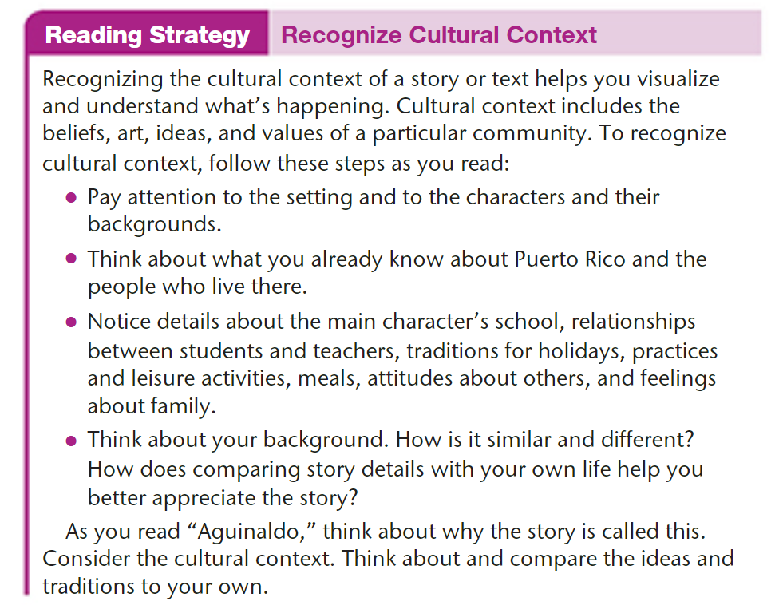
p.129

Slide 6
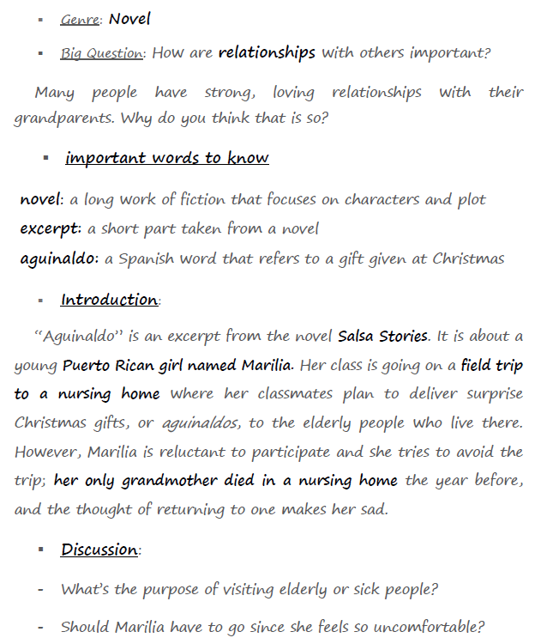
Aguinaldo – Introduction

Slide 7
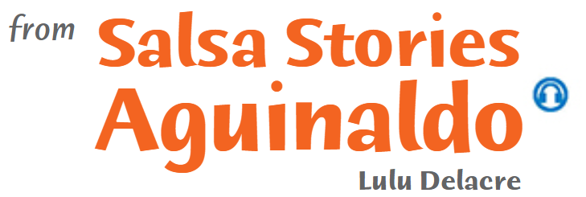
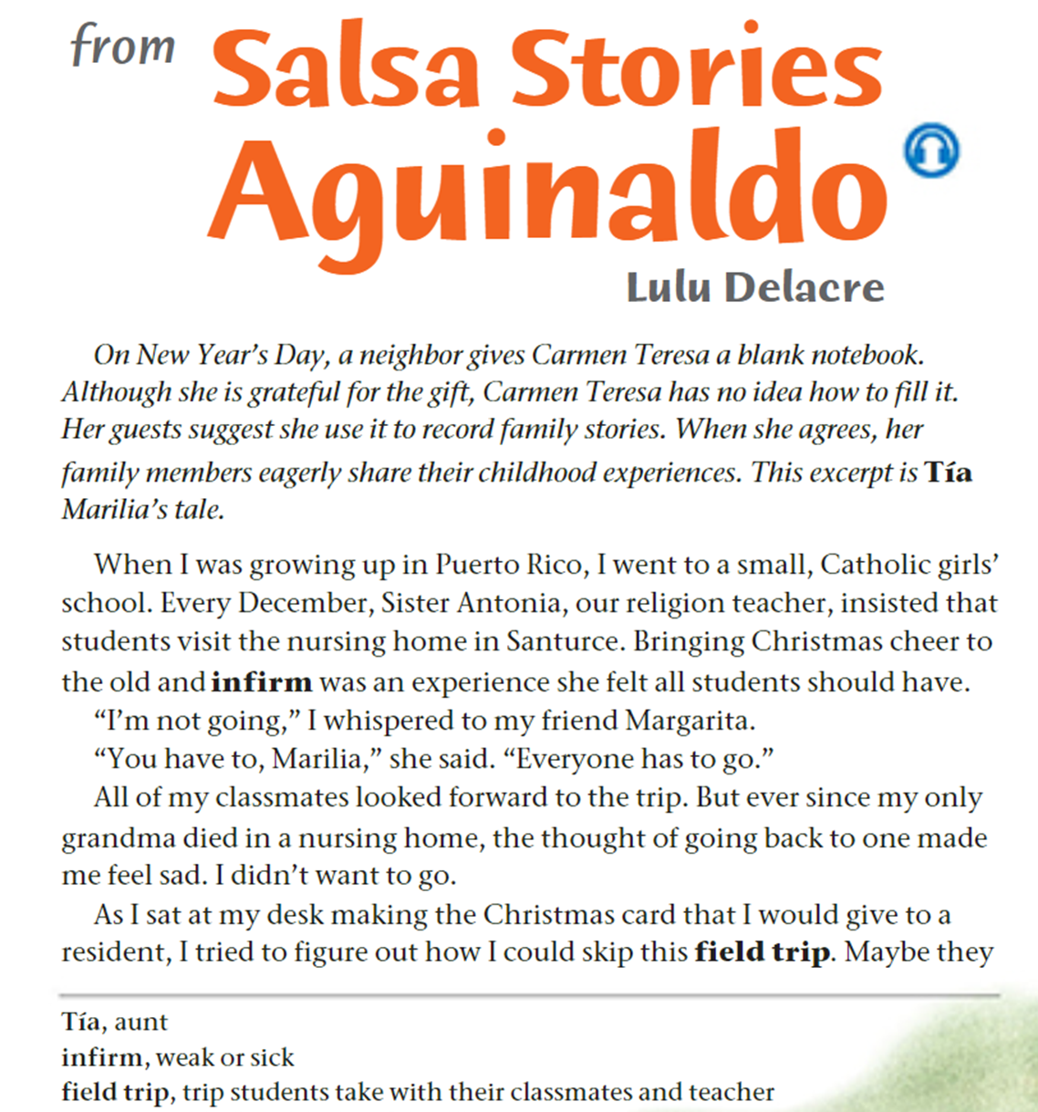


p.130

Slide 8
Questions on p.130
What gift does Carmen Teresa receive in New Year’s Day?
How does Carmen Teresa use the gift?
Whose childhood experience / tale is shared in this excerpt?
What is the relationship between Carmen Teresa and Marilia?
Where did Marilia grow up?
What type of school did she attend?
What was the annual December activity organized by Sister Antonia?
Why did Sister Antonia insist on this field trip?
How did Marilia feel about going to the nursing home? _________________________________
What personal experience made Marilia reluctant to visit the nursing home?
Why was Marilia making a Christmas card?
How does this filed trip reflect cultural values in the Puerto Rican community?
__________________________________________________________________________________________________________________________________________________________________

Slide 9
Feedback
What gift does Carmen Teresa receive in New Year’s Day?
How does Carmen Teresa use the gift?
Whose childhood experience / tale is shared in this excerpt?
What is the relationship between Carmen Teresa and Marilia?
Where did Marilia grow up?
What type of school did she attend?
What was the annual December activity organized by Sister Antonia?
Why did Sister Antonia insist on this field trip?
How did Marilia feel about going to the nursing home? reluctant; unwilling
What personal experience made Marilia reluctant to visit the nursing home?
Why was Marilia making a Christmas card?
Marilia is Carmen Teresa’s aunt.

Slide 10
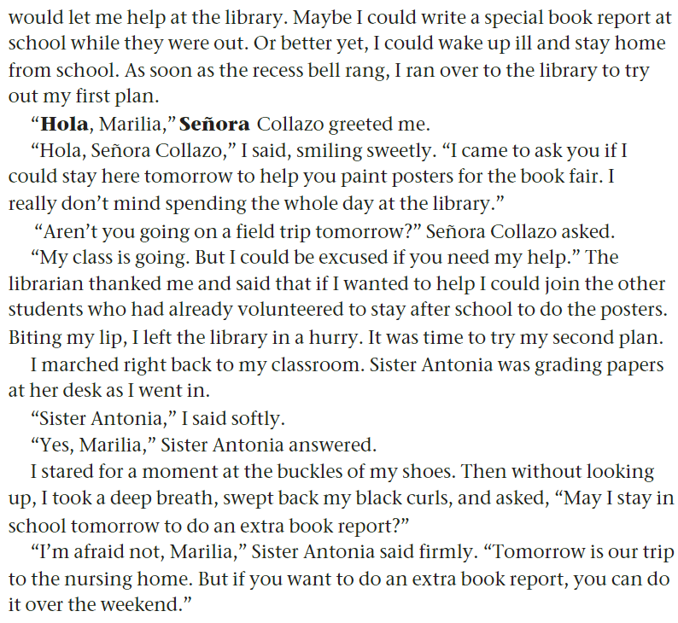
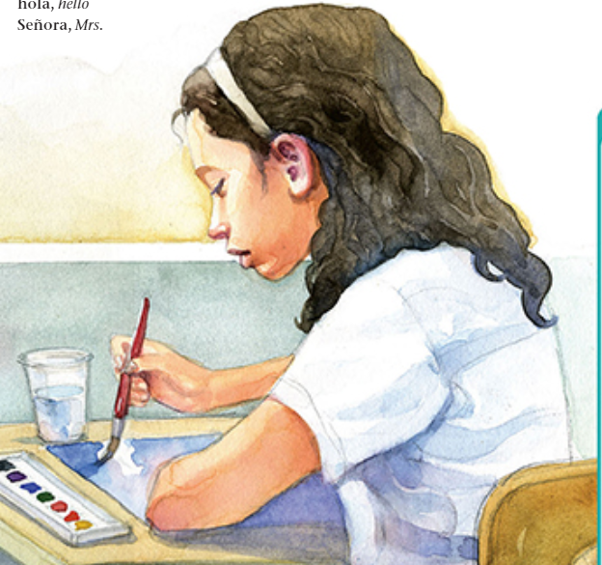
p.131

Slide 11
Questions on p.131
1. What were Marilia’s three plans to get out of the field trip?
2. How did Señora Collazo respond when Marilia asked to stay and help with the posters?
3. What did Marilia ask Sister Antonia?
4. Underline the details that show Marilia’s body language before asking, and explain what these details tell us about how she felt.
_________________________________________________________________________________
5. What was Sister Antonia’s response to Marilia’s request?
6. What does the word “firmly” suggest about how Sister Antonia responded to Marilia’s request? _________________________________________________________________________________
7. What happened to Marilia’s first and second plans? What do you think will happen next? _____________________________________________
________________________________________________________________________________

Slide 12
Feedback
1. What were Marilia’s three plans to get out of the field trip?
2. How did Señora Collazo respond when Marilia asked to stay and help with the posters?
3. What did Marilia ask Sister Antonia?
4. Underline the details that show Marilia’s body language before asking, and explain what these details tell us about how she felt.
Marilia’s body language shows that she felt nervous and unconfident.
5. What was Sister Antonia’s response to Marilia’s request?
6. What does the word “firmly” suggest about how Sister Antonia responded to Marilia’s request? The word “firmly” suggests that Sister Antonia was not going to change her mind.
7. What happened to Marilia’s first and second plans? What do you think will happen next? Both plans had failed. Marilia might pretend she’s sick to skip school and avoid going on the trip.

Slide 13
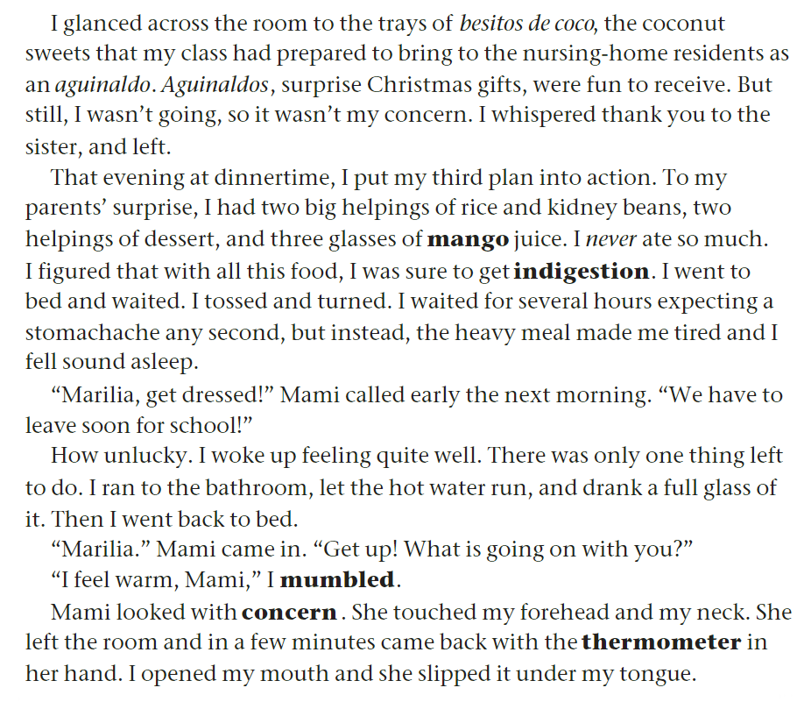
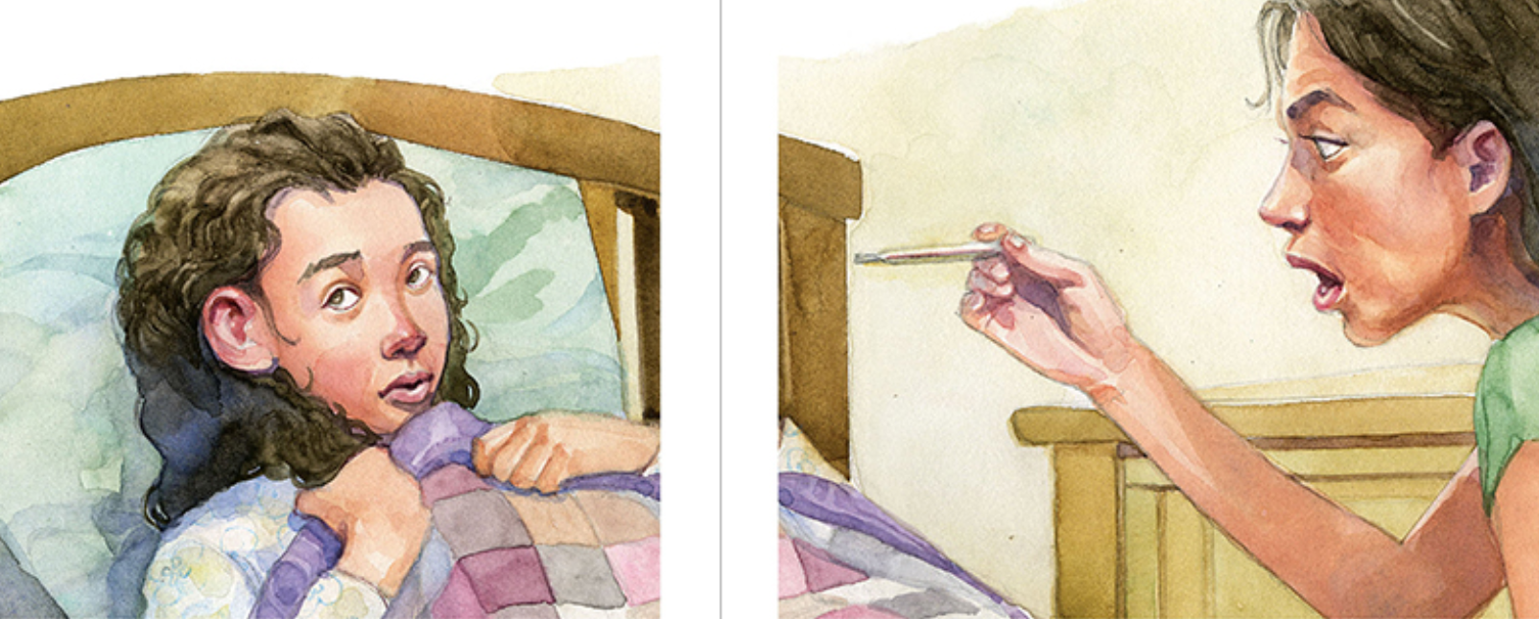
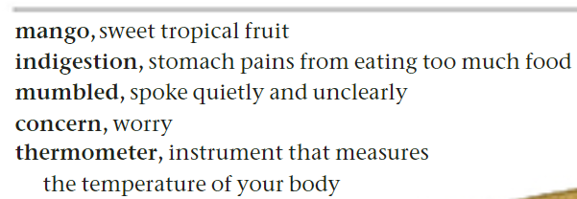
p.132

Slide 14
Questions on p.132
What were the trays of besitos de coco intended for?
What are aguinaldos?
How did Marilia start executing her third plan?
4. Why did Marilia eat a large amount of food for dinner?
5. What was Marilia expecting to feel after eating so much food?
6. How did Marilia actually feel after eating all that food.
7. What was Marilia’s final action to pretend she was unwell?
8. What did Mami do when she noticed that Marilia felt warm?
9. Find an example of irony and explain it.
________________________________________________________________________________
________________________________________________________________________________

Slide 15
Feedback
What were the trays of besitos de coco intended for?
What are aguinaldos?
How did Marilia start executing her third plan?
4. Why did Marilia eat a large amount of food for dinner?
5. What was Marilia expecting to feel after eating so much food?
6. How did Marilia actually feel after eating all that food.
7. What was Marilia’s final action to pretend she was unwell?
8. What did Mami do when she noticed that Marilia felt warm?
9. Find an example of irony and explain it.
The irony is that Marilia overeats, expecting to make herself sick, but instead, she feels fine and ends up sleeping, which is the opposite of her plan.

Slide 16
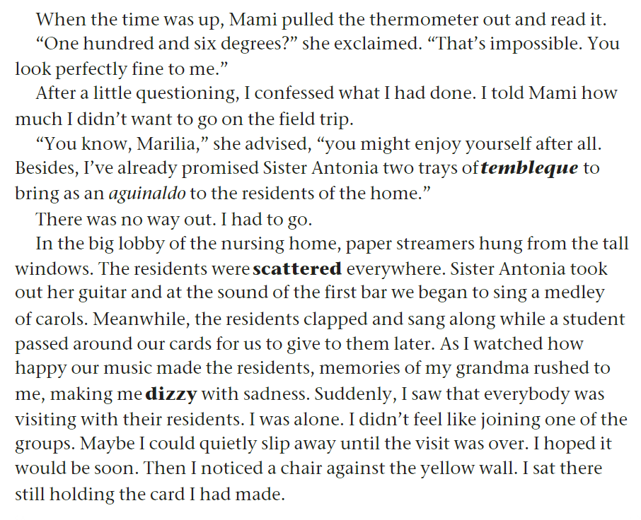
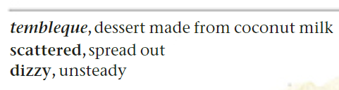
p.133

Slide 17
Questions on p.133
Why did Mami think the thermometer reading was impossible?
What did Marilia confess to her mother?
What were the aguinaldos Mami prepared for the residents?
What did the lobby of the nursing home look like?
What did Sister Antonia do when they arrived?
How did the residents react to the singing?
What made Marilia feel dizzy?
How would you feel about being at the nursing home if you were Marilia? Explain.
Find an example of foreshadowing and explain it.
____________________________________________________________________________________________________________________________________________________

Slide 18
Feedback
Why did Mami think the thermometer reading was impossible?
What did Marilia confess to her mother?
What were the aguinaldos Mami prepared for the residents?
What did the lobby of the nursing home look like?
What did Sister Antonia do when they arrived?
How did the residents react to the singing?
What made Marilia feel dizzy?
How would you feel about being at the nursing home if you were Marilia? Explain. (If I were Marilia, I would…)
Find an example of foreshadowing and explain it.
This hints that Marilia’s experience at the nursing home may change her feelings, suggesting that she might enjoy the trip.

Slide 19
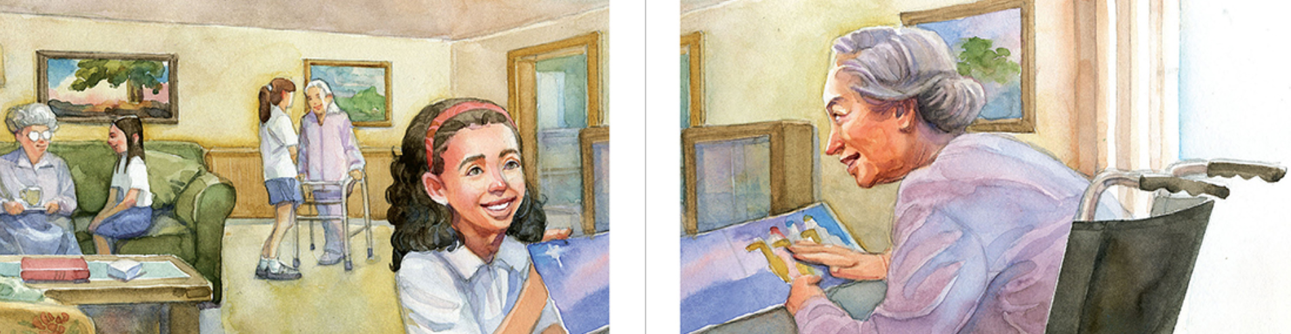
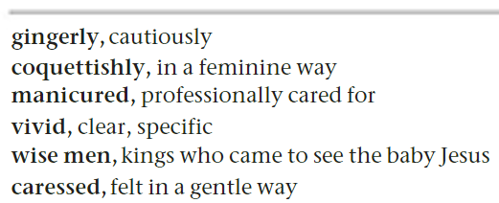
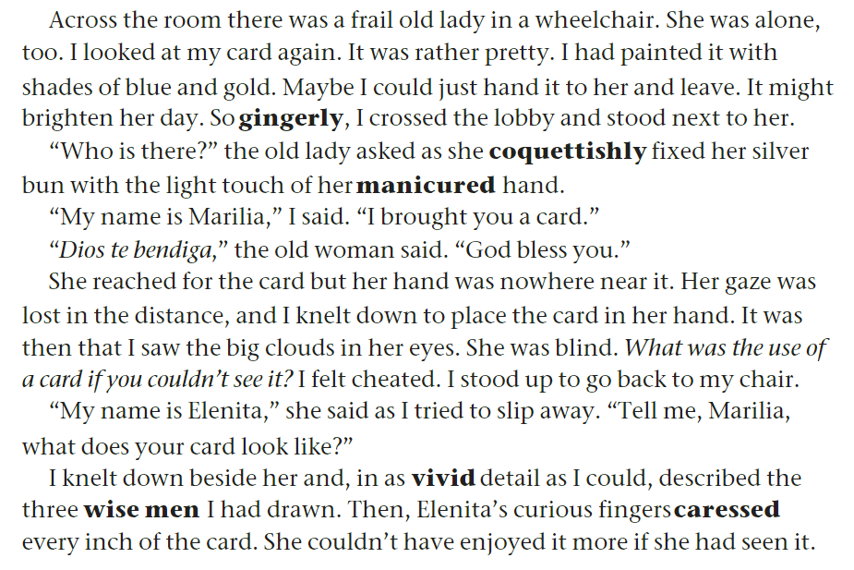
p. 134

Slide 20
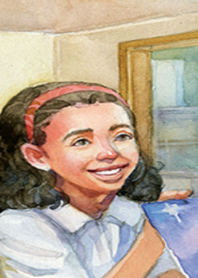
Questions on p.134
How is the lady in the wheelchair described?
What does Marilia decide to do with her card?
Why does Marilia decide to give the card to the old lady?
How does the old lady fix her hair? What does this say about her personality?
How does the old lady respond when Marilia gives her the card?
What does Marilia realize about the old lady ?
How does Marilia come to this realization?
How does Marilia feel after realizing the old lady is blind?
How does Marilia describe the card to Elenita?
What does Elenita do to "see" the card?
11. Find an example of irony and explain it.
___________________________________________________________________________________________________
12. What do the following pronouns refer to?
her (line 3) she (last line) it (last line)

Slide 21
Feedback
How is the lady in the wheelchair described?
What does Marilia decide to do with her card?
Why does Marilia decide to give the card to the old lady?
How does the old lady fix her hair? What does this say about her personality?
How does the old lady respond when Marilia gives her the card?
What does Marilia realize about the old lady ?
How does Marilia come to this realization?
How does Marilia feel after realizing the old lady is blind?
How does Marilia describe the card to Elenita?
What does Elenita do to "see" the card?
11. What do the following pronouns refer to?
her (line 3) frail old lady she (last line) Elenita it (last line) the card

Slide 22
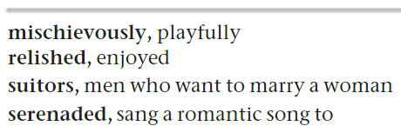
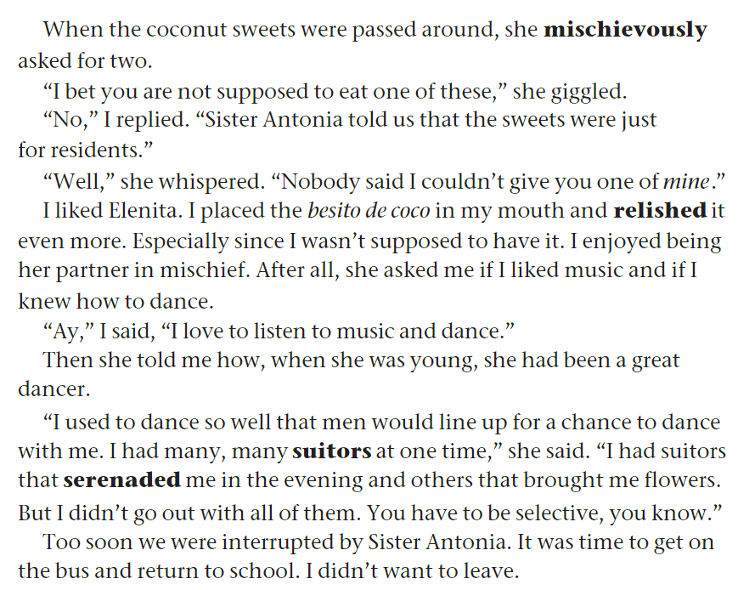
p. 135

Slide 23

Questions on p.135
1. What did Elenita do when the coconut sweets were passed around?
2. Why did Marilia say they were not supposed to eat the sweets?
3. Why did Marilia relish the besito de coco even more?
4. Why do you think people tend to enjoy things they’re not supposed to do?
________________________________________________________________________________________________
5. What common interest do Marilia and Elenita share?
6. What did some of the suitors do to show their affection for her?
7. What advice did Elenita give about dealing with suitors?
8. Who interrupted Marilia and Elenita’s conversation, and why?
9. How did Marilia feel about leaving? Explain the irony.
10. What do the following pronouns refer to? it (line 7) them (line17)

Slide 24
Feedback
1. What did Elenita do when the coconut sweets were passed around?
2. Why did Marilia say they were not supposed to eat the sweets?
3. Why did Marilia relish the besito de coco even more?
4. Why do you think people tend to enjoy things they’re not supposed to do?
It’s called reactance. People like to feel free and in control.
5. What common interest do Marilia and Elenita share?
6. What did some of the suitors do to show their affection for Eleinta?
7. What advice did Elenita give about dealing with suitors?
8. Who interrupted Marilia and Elenita’s conversation, and why?
9. How did Marilia feel about leaving? Explain the irony.
10. What do the following pronouns refer to?
it (line 7) besito de coco them (line17) suitors

Slide 25
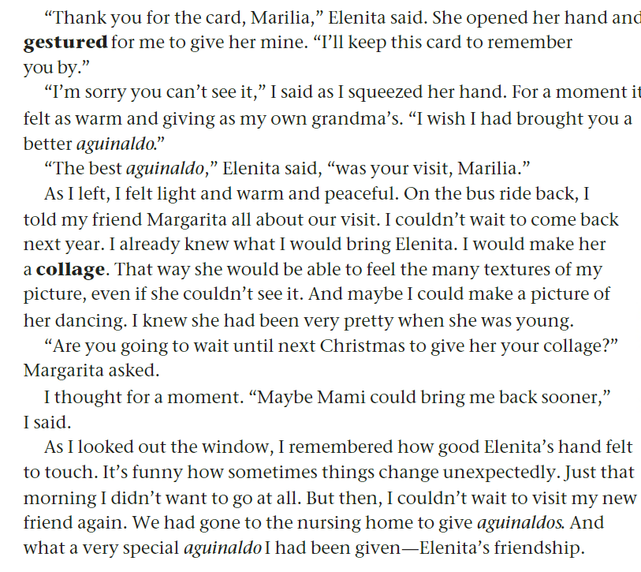
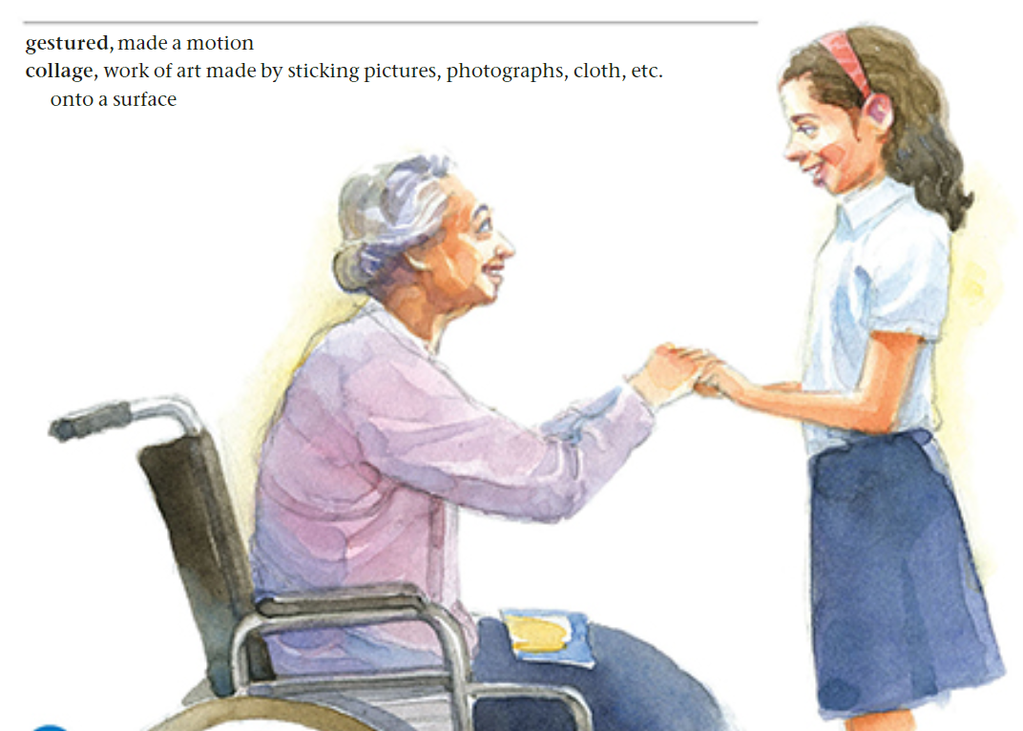
pp. 136

Slide 26
Questions on p.136
What does Elenita say she will do with the card Marilia gave her?
What does Marilia compare the feeling of Elenita’s hand to?
According to Elenita, what was the best aguinaldo?
Quote a sentence that shows that Marilia had positive feelings when she left the nursing home.
What idea did Marilia have for an aguinaldo for Elenita next time?
Why did Marilia think a collage would be special for Elenita?
What was the best part of the visit according to Marilia?
Underline the text that shows irony.
What aguinaldo did Marilia receive?
. How do you think Marilia’s experience at the nursing home might affect her the next time she is reluctant to do something?
__________________________________________________________________________________________________________________________________________________________________________

Slide 27
Feedback
What does Elenita say she will do with the card Marilia gave her?
What does Marilia compare the feeling of Elenita’s hand to?
According to Elenita, what was the best aguinaldo?
Quote a sentence that shows that Marilia had positive feelings when she left the nursing home.
What idea did Marilia have for an aguinaldo for Elenita next time?
Why did Marilia think a collage would be special for Elenita?
What was the best part of the visit according to Marilia?
Underline the text that shows irony.
What aguinaldo did Marilia receive?
How do you think Marilia’s experience at the nursing home might affect her the next time she is reluctant to do something?
When someone is afraid to do something but tries it anyway, it gets easier the second time, so Marilia will overcome her reluctance next time.

Slide 28
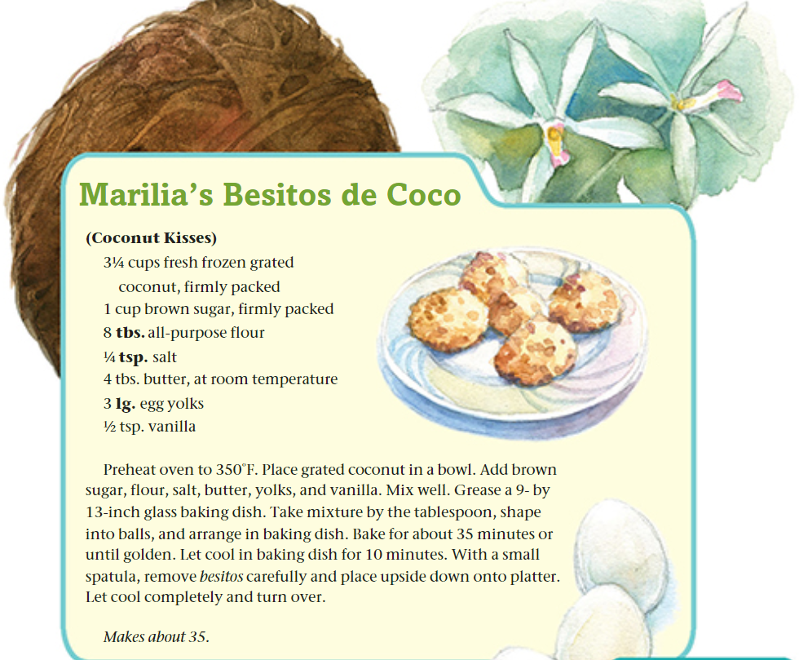
pp. 137
Describe a special recipe that you like to share with friends.

Slide 29
Across the Curriculum: Science
Like Elenita, many people around the world suffer from blindness (the inability to see). The leading causes of serious blindness include cataract, glaucoma, age-related degeneration, and eye conditions that occur in children, for example through a vitamin A deficiency. Age-related blindness is increasing throughout the world, as is blindness brought about by uncontrolled diabetes.
More than 82% of all people who are blind are aged 50 years or older, although they represent only 19% of the world’s total population. Blindness and other less serious forms of visual impairment can strike anyone, but over 90% of the visually-impaired live in developing countries.75% of all blindness can be prevented or treated.

