Slide 1
Dynamic and Stative Verbs
Teacher Mais Awad

Slide 2
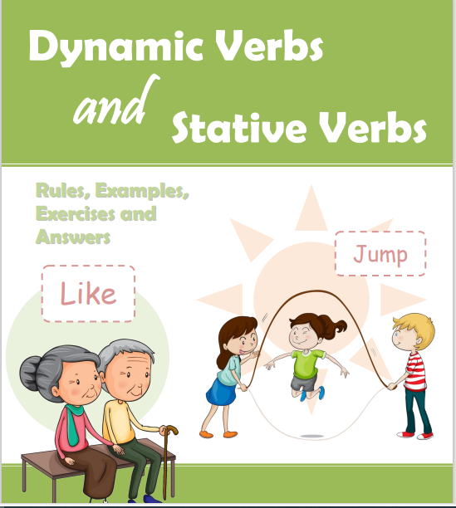
Lesson’s Objectives :
1- To realize the meaning of Dynamic verbs and State /stative verbs
2- To differentiate between Dynamic and Stative Verbs .

Slide 3

What is a dynamic verb and a stative verb ?

Slide 4
Stative
In English grammar a "stative verb" means that the verb describes a state rather than an action. Stative verbs are sometimes k nown as "state verbs.“
Dynamic
In English grammar a "dynamic verb" means that the verb describes an action rather than a state. Dynamic verbs are sometimes known as "action verbs."

Slide 5

Decide if the verbs in front of you are dynamic or stative .
2 minutes
https://www.liveworksheets.com/w/en/eso/356363

Slide 6
Dynamic Verbs
Simple present tense
Present Continuous

Slide 7
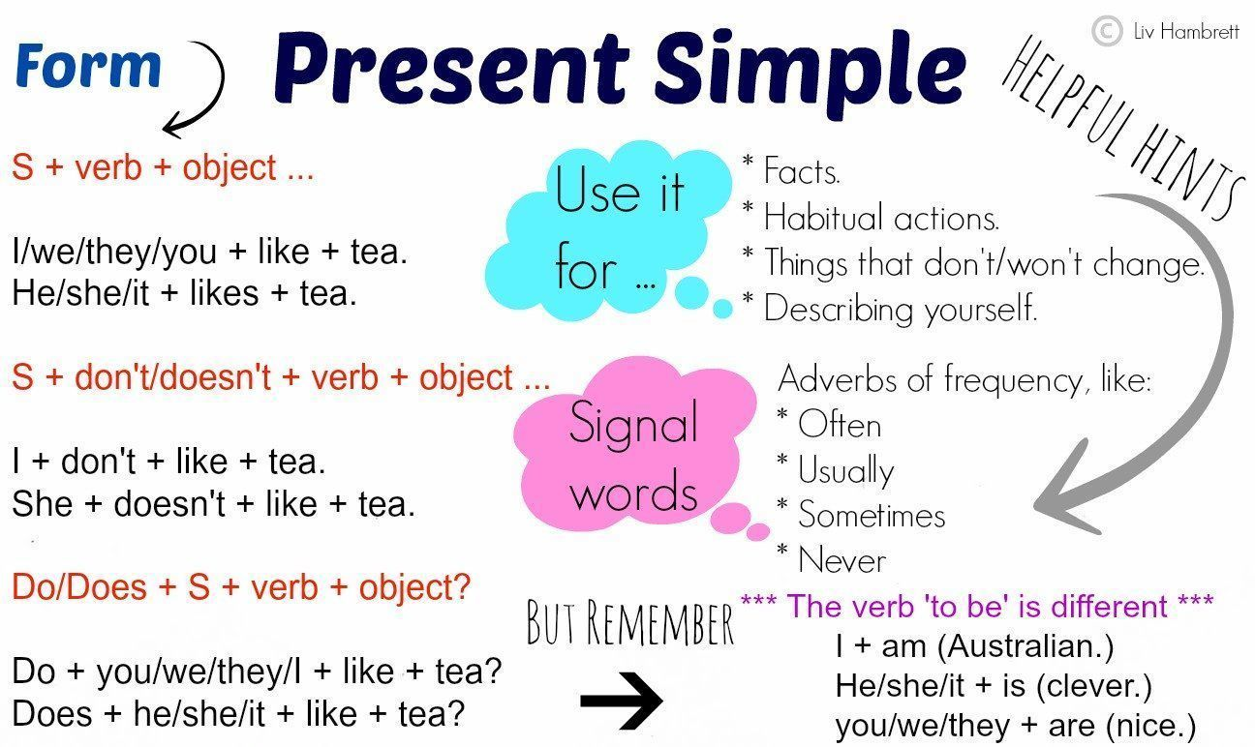

Slide 8
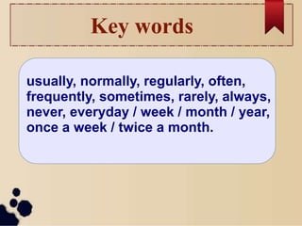
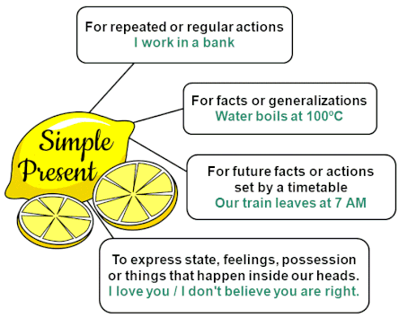

Slide 9
The present continuous tense is most often used for the following:
For actions happening now: * It is raining now .
For future arrangement : *I'm flying to Paris tomorrow .
To express an annoying or surprising behaviors : *She is always talking about people behind their backs !
Temporary situations : *He lives in Amman , but this week he is staying with his parents in Irbid .

Slide 10
How to form the present continuous affirmative sentence : is Subject + am + v-ing are
Time Expressions : now , at the moment , today , these days , this week / this month …etc. Tonight

Slide 11
https://www.liveworksheets.com/w/en/english-second-language-esl/1380240

Slide 12



Present Simple Vs Present Continuous
https://www.liveworksheets.com/w/en/english-second-language-esl/54587

Slide 13
Qs 1- 3 : 1. When we talk about a habit or an action someone does regularly we use : A) present simple B) Present continuous 2. When the situation is temporary an wont last for a long time we use : A) present simple B) Present contiguous

Slide 14
Qs 4-5 : We use the present continuous tense to talk about personal plans in the future : A) True B) False

Slide 15
Qs 6-7 is it ok to replace the questions with Is Betty Knowing about Marks plan ? How are you thinking Betty feels about Mark’s plans ?

Slide 16
State Verbs: Thoughts ,Mental Activities
, believe, consider, depend, doubt, forget,guess, hope, imagine, know, mean, prefer,
realize, remember, understand

Slide 17
Examples:
1. I know him very well.
(not I'm knowing him very well). 2. I believe you
(not I'm believing you). 3. I don't understand what you are saying
(not I'm not understanding what you are saying). 4. I agree with you
(not I'm agreeing with you).

Slide 18
Stative Verbs: Possession
Examples:
I have dark hair
(not I'm having dark hair). 2. I own a house
(not I'm owning a house). 3. This dog belongs to John
(not this dog is belonging to John). 4. He possesses at least four cars
(not he is possessing at least four cars).
belong to
have
owe
own
possess

Slide 19
State Verbs: Emotions
dislike
fear
hate
like
love
need
want
wish
Examples:
I love you.
(not I'm loving you). 2. I like going to the cinema
(not I'm liking going to the cinema). 3. He hates rainy days
(not He is hating rainy days). 4. I want to go.
(not I'm wanting to go).

Slide 20
Lesson’s Objectives
Differentiate between stative and Dynamic verbs .
Use the correct tenses with both types .

Slide 21
l\Warming up

Slide 22
Pre Assessment
https://www.liveworksheets.com/w/en/english-language/1980543

Slide 23
Differentiation
https://www.liveworksheets.com/w/en/english-second-language-esl/1040657

Slide 24
Mix of both
https://www.liveworksheets.com/w/en/english-second-language-esl/7145048

Slide 27
https://www.liveworksheets.com/w/en/english-second-language-esl/234403

