Slide 2
Present Perfect Lesson’s Objectives :
Recognize the uses of the present perfect tense.

Slide 3
Listening activity “ Differentiation
Students 1+4
Students 2+3
1- Read the questions .
2- Listen and write the correct answers .
3- Check your answers with your partner.
https://www.youtube.com/watch?v=K36nmEfs5l4

Slide 4

1+4
2+3

Slide 5
Pre assessment
IRS

Slide 6
1. Which sentence uses the present perfect correctly? a) She has lived here for three years. b) She is living here for three years. c) She lived here for three years.

Slide 7
2.Which sentence talks about an action that started in the past and is still continuing? a) I have known her since high school. b) I knew her since high school. c) I know her since high school.

Slide 8
3. Which sentence correctly uses the present perfect with "since"? a) She has worked here since 2018. b) She worked here since 2018. c) She has been working here for 2018.

Slide 9
4. Which sentence correctly uses the present perfect with "for"? a) They have lived in Paris since five years. b) They have lived in Paris for five years. c) They lived in Paris for five years.

Slide 10
Why is learning tenses important ?
Think
Clarity of Communication
Accuracy

Slide 11
Present Perfect : Subject +has/have+v3
When do we use the present perfect tense ?

Slide 12
1. Read the sentences . 2. Discuss the guided questions with your partner . 3. Based on your answers, try to figure out why we use the present perfect tense in these sentences.

Slide 13
"I have visited France three times."
"He has never been to Japan."
"They have traveled to Italy.“
Guided Questions:
When did these events happen?
Do we know the exact time these trips occurred?
Could these people travel there again in the future?
What do these sentences tell us — experience or exact time?
We use the Present Perfect to talk about life experiences without saying exactly when they happened.

Slide 14
I have lived in Amman for ten years.
She has worked at this school since 2020.
They have known each other for a long time.
Guided Questions:
When did the actions start?
Are these actions finished or still happening now?
Which words show the duration of time? (for / since)
What tense connects the past and the present?
We use the Present Perfect to describe actions that started in the past and continue to the present.

Slide 15
I have broken my glasses.
She has lost her keys.
We have finished our project.
Guided Questions:
Are these actions connected to the present moment?
Can you see or feel the result now?
Is the exact time of the action important?
What matters more — the action or its result?
We use the Present Perfect when the result of a past action is still important now.

Slide 16
Examples:
I have just eaten lunch.
She has already finished her homework.
They haven’t left yet.
Guided Questions:
Did these actions happen recently or long ago?
Which words show the recency of the action? (just / already / yet)
Is the action finished or still happening?
Why do we use Present Perfect instead of Past Simple here?
We use the Present Perfect for recent actions connected to now.

Slide 17
💡 Uses of the Present Perfect Tense
To talk about life experiences without mentioning when they happened.
To describe actions that started in the past and continue to the present.
To show past actions that have a present result or consequence.
To refer to recent actions connected to the present moment, often with just, already, or yet.

Slide 18


Feedback
* I know the uses of the present perfect .

Slide 19
Sentence Structure

Slide 20
Outcome 2 : Students will be able to recognize the difference in meaning between the past simple tense and the present perfect tense, explaining how each tense conveys different aspects of time and experience.

Slide 21
Pre assessment
IRS

Slide 22
Which sentence correctly expresses an action that has relevance to the present?
She has finished her homework, so she can go out.
b) She finished her homework yesterday.
c) She is finishing her homework right now.

Slide 23
Which of the following sentences correctly uses the present perfect tense for an action that has just occurred?
They just left the party.
b) They have just left the party.
c) They leave the party.

Slide 24
Which of the following sentences correctly uses the present perfect tense to express a negative experience?
He has never eaten sushi.
He never ate sushi.
He will never eat sushi.

Slide 25
Listening
Read the questions and the options.
Listen and choose the correct answers .

Slide 26
"Think of an unforgettable experience and share it with your partner.
Your Turn

Slide 27

1 minute
Have/has got
vs
have/has gotten

Slide 28

I have just eaten .

Slide 29

I have broken my arm.

Slide 30
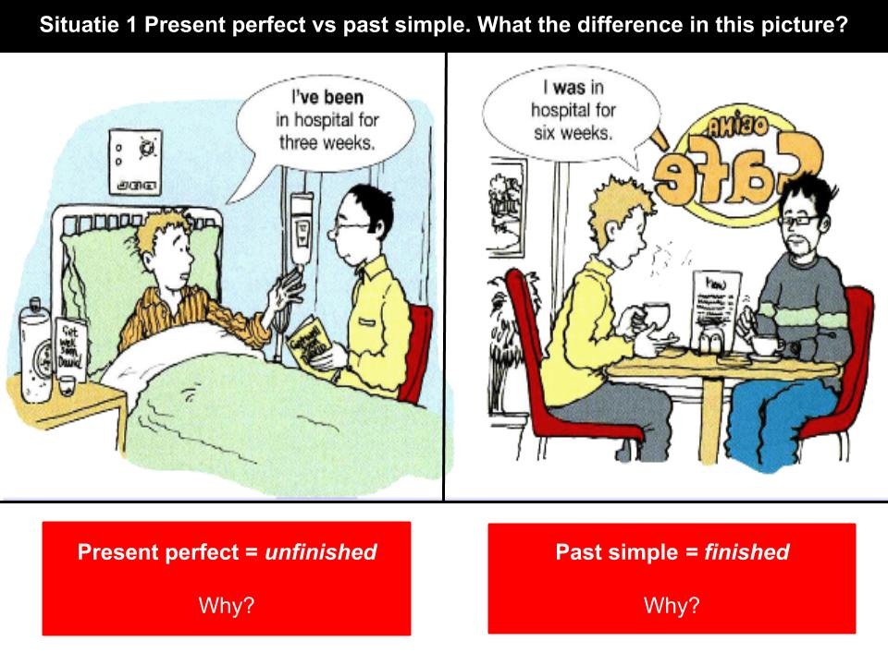

Slide 31

Formative Assessment

Slide 32
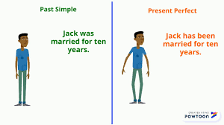
Which sentence shows that Jack is no longer married.
1

Slide 33
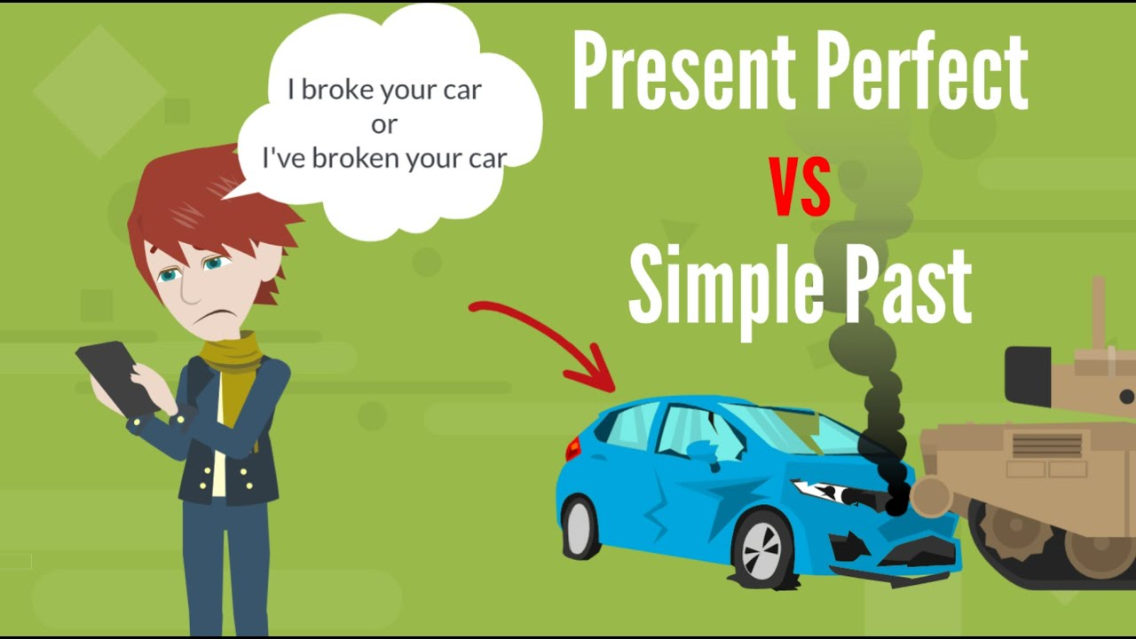

Slide 34
Question: Which sentence shows that the action is still ongoing?
She worked at the company for five years.
She has worked at the company for five years.

Slide 35
Question 2 : Which sentence shows that the speaker doesn’t live in London anymore : 1. I lived in London for three years.
2. I have lived in London for three years.

Slide 36
Question: Which sentence shows that the action might have relevance to the present?
They studied French in school.
2. They have studied French in school.

Slide 37
Feedback
2- I know the difference in meaning when I use the present perfect instead of the past simple.

Slide 38
Differentiation
S1: You will be a news reporter .Write a report about one of the latest events using the present perfect tense . Add the past tense if needed.
S2 : Read a letter and fill in the blanks with the correct forms of the verbs
S3: Write a letter to your friend, tell her about the best experiences you have just had using the present perfect and the past simple tense.
S4: Choose the correct answer

Slide 39
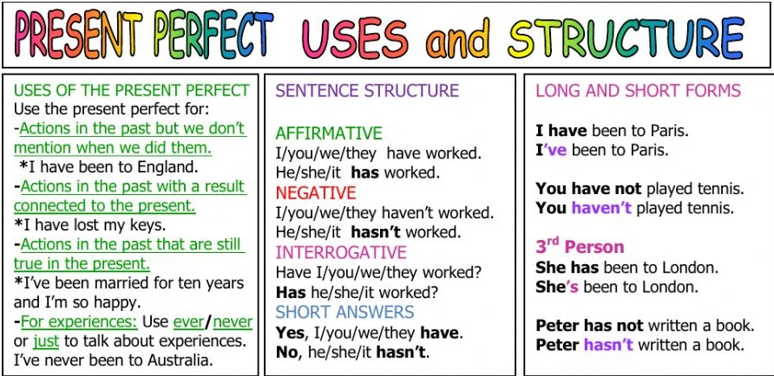
Present perfect

Slide 40
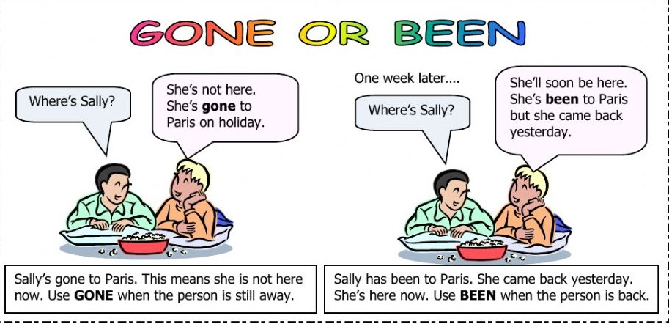

Slide 42
Formative Assessment
Mark has _________ to Italy for a business trip. He’s still there.
Sarah has ______ to the new coffee shop. She loved it!
The children have ______ to the park, but they’ll be back soon.
I have never ______ to Japan, but I would love to visit.
gone
been
gone
been

Slide 43
Feedback
1- I know how to structure a sentence using the present perfect .
2- I know the difference between gone and been.

Slide 44
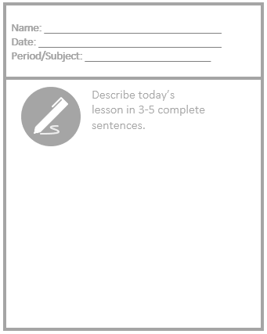

Slide 45
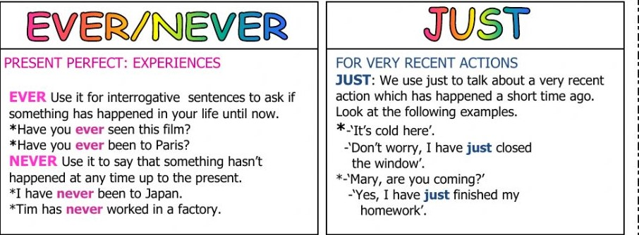
yet
Comes at the end of a negative sentence “
I haven't finished my homework yet
+ at the end of a question .

Slide 46
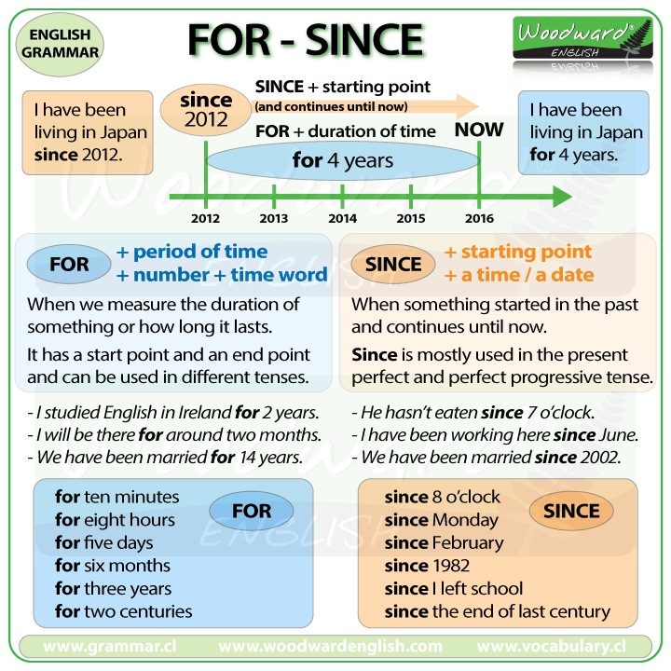

Slide 47
Task 2
https://www.liveworksheets.com/ik34850rs

Slide 48

https://www.liveworksheets.com/w/en/english-second-language-esl/538007
Performance : Pai work .*
Task : Choose since , for or yet .
Time : 5 minutes .

Slide 49
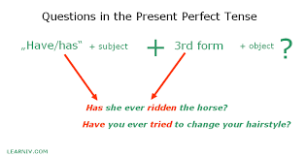

Slide 50
Reporting News:
Journalists use the present perfect to introduce recent events that are still relevant.
Example: "Scientists have discovered a new planet in our solar system."
Travel Experiences:
People use the present perfect to describe places they have visited, focusing on the experience itself, which is still relevant.
Example: "I have been to Paris twice, and each time I discovered something new."
Personal Growth:
Individuals use the present perfect to discuss how they’ve changed or developed over time.
Example: "I have become more confident in public speaking since attending the course."

Slide 51
https://learnenglish.britishcouncil.org/general-english/video-series/word-street/wots-jobs/jobs-scene-2-language-focus

