Slide 2




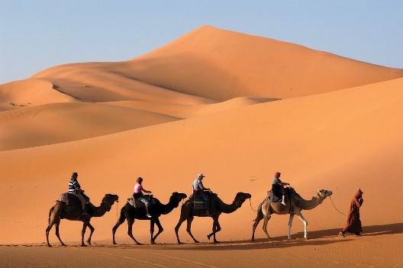

What do you think the lesson will be about ?

Slide 3


Slide 4
*Lesson’s objectives : 1- Realize the function of “used to” and used it correctly to form sentences , negarive sentences and to ask questions. 3- Value : the importance of adaptability .

Slide 5
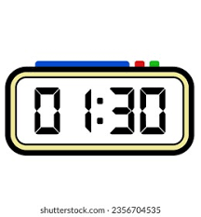
Warming Up
Listening
Read the questions and the options .
Listen and circle the correct option.
Check your answers with your partner.

Slide 6
Warm-up
Think of three things you did…
… last year.
…three years ago.
…when you were a child.
… last summer.

Slide 7
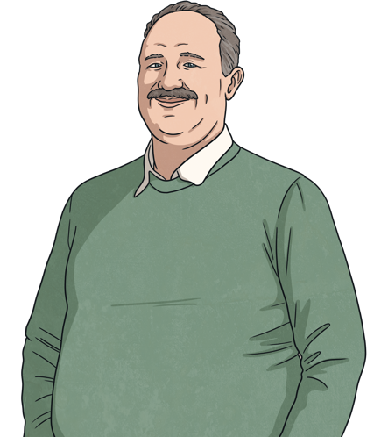
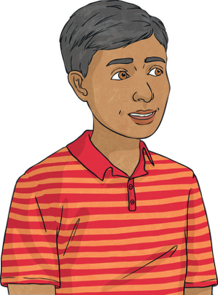
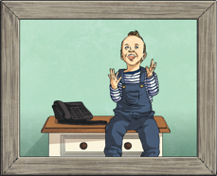
Read the conversation.
Hey dad! Are you this little boy in the picture?
Yes! I was five years old when my parents took that picture.
That’s sweet! What were you doing in the picture?
We used to go to a little house at the beach. My parents took that picture when I was playing. I used to climb all the furniture in the house!
Wow! I could never imagine that!
Of course! I don’t climb furniture now, I’m too old for that! But I had lots of fun as a child.

Slide 8
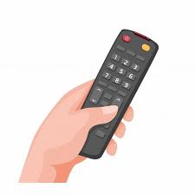
Pre assessment
IRS

Slide 9
I __________ to play soccer every weekend, but now I don’t have time.
1. use
2. used

Slide 10
2. The sentence which describes a single past event or action without the implication that it was a habit or regular activity is :
I played chess in the past.
I used to play chess in the past .

Slide 11
Which sentence is correct?
I use to go to the park every day when I was younger.
b) I used to go to the park every day when I was younger.
c) I used to went to the park every day when I was younger.

Slide 12
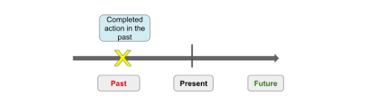
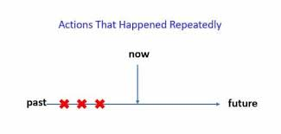

1- I travelled to Paris last year .
2- Ali wrote a book 2 years a go .
3- My parents gave me a car on my birthday.

Slide 13

Grammar Discovery
Look at the sentences.
We used to go to a little house at the beach.
Is this sentence about a present action , past action or future action ?
Past
Are they going to the house now?
No
Was this a specific action in the past or a habit?
A habit

Slide 14

Grammar Discovery
Look at the sentences.
My parents took that picture when I was playing.
Is this sentence about a present, past or future action?
Past
No/Don’t know
Do they take pictures of him now?
Was this a specific action in the past or a habit?
A specific action in the past

Slide 15
Used to vs. Past Simple
We use ‘used to’ to talk about past habits or states that are no longer true.
I used to play football every Sunday. (I don’t play anymore)
She used to live in Germany when she was a child. (She doesn’t live there now)
We use past simple to talk about completed actions or events in the past. They don’t need to express a habit.
We went to Paris eight years ago.
They took an exam yesterday.

Slide 16
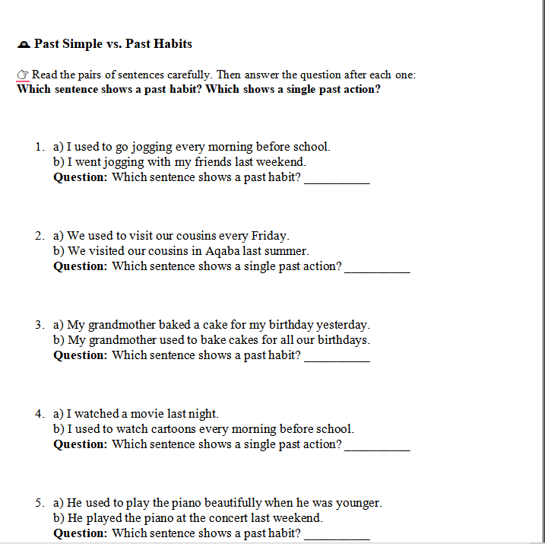



Slide 17
🕰️ Past Simple vs. Past Habits – Answers
Question: Which sentence shows a past habit? ✅ a) I used to go jogging every morning before school.
Question: Which sentence shows a single past action? ✅ b) We visited our cousins in Aqaba last summer.
Question: Which sentence shows a past habit? ✅ b) My grandmother used to bake cakes for all our birthdays.
Question: Which sentence shows a single past action? ✅ a) I watched a movie last night.
Question: Which sentence shows a past habit? ✅ a) He used to play the piano beautifully when he was younger.

Slide 18
Used to: Structure
Affirmative
Subject
used to
base form (infinitive without ‘to’)
She
used to
play
in a band.
Negative
Subject
didn’t
use to
base form (infinitive without ‘to’)
She
didn’t
use to
play
in a band.
Question
Did
subject
use to
base form (infinitive without ‘to’)
Did
she
use to
play
in a band?

Slide 19
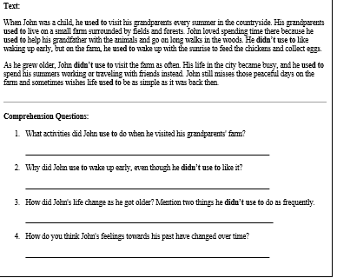
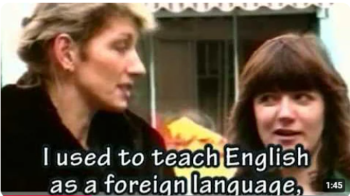

Differentiation
Differentiation
S1+4 : Listen to 4 conversations and answer the questions that follow .
S 2+3 : watch a video with the , then summarize the general idea with some examples from the video.

Slide 20
Can you find more examples of ‘used to’ and past simple?
Hey dad! Are you this little boy in the picture?
Yes! I was five years old when my parents took that picture.
Yes! I was five years old when my parents took that picture.
That’s sweet! What were you doing in the picture?
We used to go to a little house at the beach. My parents took that picture when I was playing. I used to climb all the furniture in the house!
We used to go to a little house at the beach. My parents took that picture when I was playing. I used to climb all the furniture in the house!
Wow! I could never imagine that!
Of course! I don’t climb furniture now, I’m too old for that! But I had lots of fun as a child.
Of course! I don’t climb furniture now, I’m too old for that! But I had lots of fun as a child.
Of course! I don’t climb furniture now, I’m too old for that! But I had lots of fun as a child.

Slide 21
Complete the sentences with ‘used to’.
1
I (play) football every weekend when I was a teenager.
used to play
2
She (not like) spicy food, but now she loves it.
didn't use to like
3
you (go) to summer camps when you were a child?
Did
use to go
4
We (live) in a small village before moving to the city.
used to live
5
He (not have) a beard, but now he does.
didn’t use to have
Reveal Answer

Slide 22
Complete the sentences with ‘used to’.
6
they (travel) abroad during the holidays?
Did use to travel
7
My grandparents (write) letters instead of using email.
used to write
Reveal Answer

Slide 23
Used to or Past Simple?
Read the sentence. Based on the context, decide if the sentence is with ‘used to’ or past simple.
When I was a child, I _________ (spend) every summer at my grandparents' house.
used to spend
used to spend
spent
Reveal Answer

Slide 24
Used to or Past Simple?
Read the sentence. Based on the context, decide if the sentence is with ‘used to’ or past simple.
Last weekend, we _________ (visit) the new art museum in town.
used to visit
visited
visited
Reveal Answer

Slide 25
Used to or Past Simple?
Read the sentence. Based on the context, decide if the sentence is with ‘used to’ or past simple.
Yesterday, I _________ (forget) my keys at home and had to call my friend for help.
used to forget
forgot
forgot
Reveal Answer

Slide 26
Used to or Past Simple?
Read the sentence. Based on the context, decide if the sentence is with ‘used to’ or past simple.
She _________ (watch) cartoons every morning before school when she was younger.
used to watch
used to watch
watched
Reveal Answer

Slide 27
Used to or Past Simple?
Read the sentence. Based on the context, decide if the sentence is with ‘used to’ or past simple.
He _________ (play) the guitar, but he stopped when he started university.
used to play
used to play
played
Reveal Answer

Slide 28
Time : 2 minutes .
Task : Read the statements and decide if each sentence is true or false based on what you have been working on. Discuss your answers together.

Slide 29

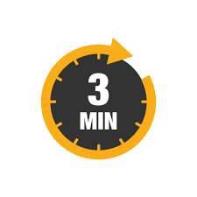
Decide if the verbs in front of you are dynamic or stative .
https://www.liveworksheets.com/w/en/eso/356363

Slide 30
Used to" is used for describing past habits or states that no longer happen or exist. (True/False)
Used to" can be used to talk about both past habits and permanent present situations. (True/False)
The negative form of "used to" is "didn't used to." (True/False)
We use "used to" when talking about things that happened regularly in the past but don’t happen anymore. (True/False)
Used to" is followed by a base form of the verb, not the past tense form. (True/False)
Used to" can only be used when talking about actions, not states or conditions. (True/False)

Slide 31
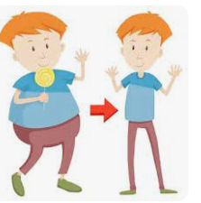
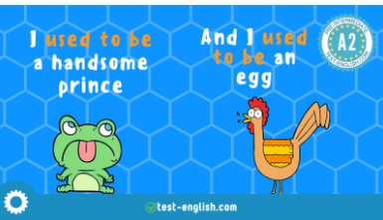
I didn’t use to be fat in the past , but now I’m fat.
I used to be fat in the past , but now
I’m slim.

Slide 32


Differentiation
Go to Padlet, write 3 affirmative , negative and questions using used to , didn’t use to and did ..uuse to ?Do the self assessment before you submit you answers.
Click on the link , do the quiz .
Do the self assessment before you submit you answers .

Slide 33
https://www.liveworksheets.com/fg1849834po
Questions
Performance : individual work .
Task :
S “2+ 3” : Put the words in the correct order .
S” 1+4 : use the map to form the questions.

Slide 34
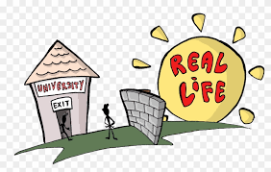

What do we gain from talking about things people used to do in the past?
1 minute Think
Share

Slide 35
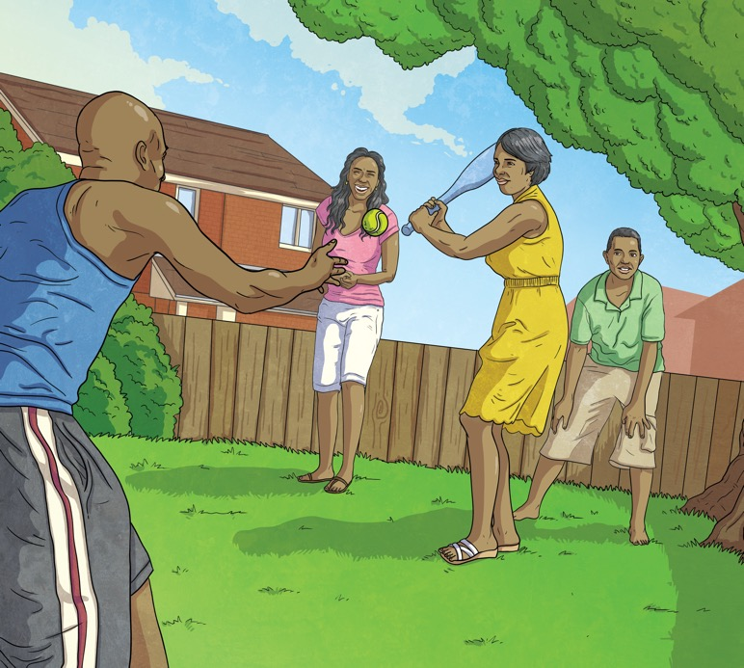
Look at the picture and the information. Make sentences using ‘used to’.
When I was a child.
Affirmative.
Suggested Answer: We used to play outside when I was a child.
Reveal Answer

Slide 36
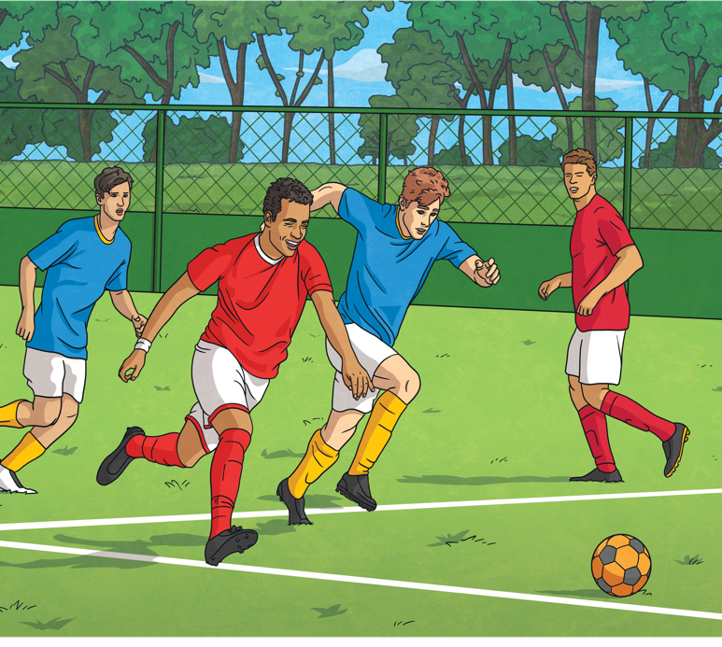
Look at the picture and the information. Make sentences using ‘used to’.
Last year.
Negative.
Suggested Answer: I didn’t use to play football last year.
Reveal Answer

Slide 37
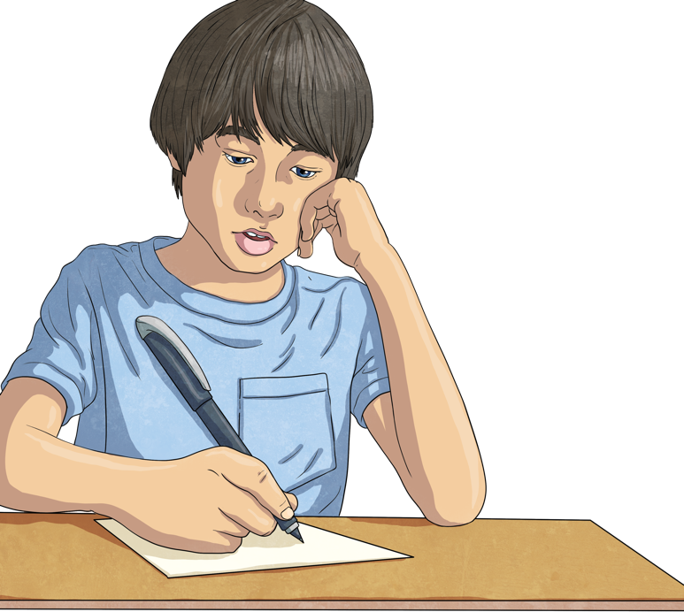
Look at the picture and the information. Make sentences using ‘used to’.
When you were at school.
Interrogative.
Suggested Answer: Did you use to do your homework when you were at school?
Reveal Answer

Slide 38
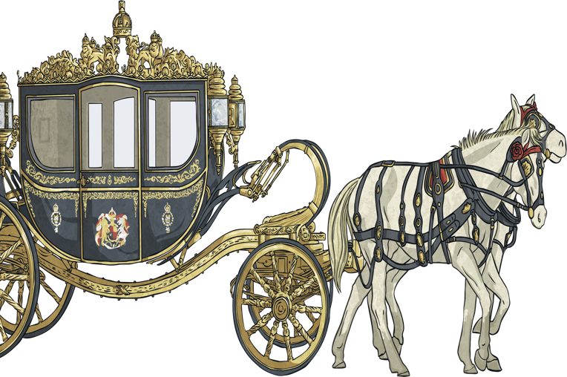
Look at the picture and the information. Make sentences using ‘used to’.
Many years ago.
Affirmative.
Suggested Answer: People used to travel by horse many years ago.
Reveal Answer

Slide 39
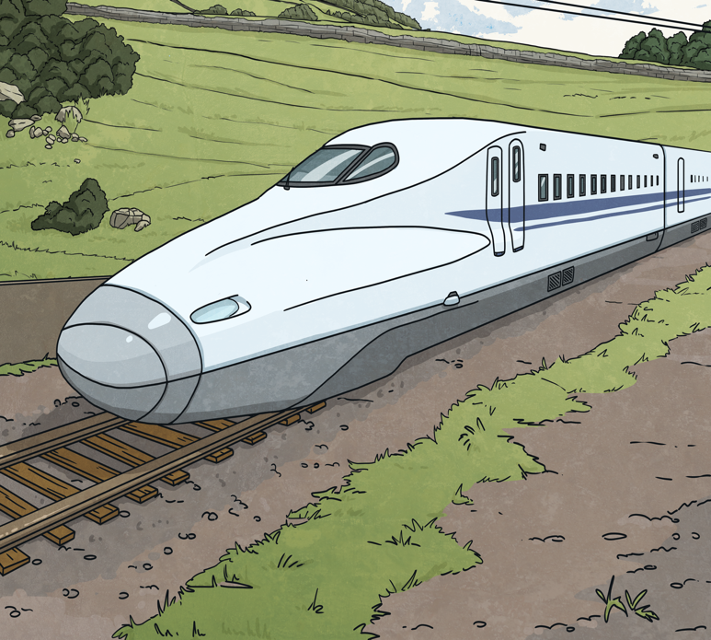
Look at the picture and the information. Make sentences using ‘used to’.
When my grandparents were young.
Negative.
Suggested Answer: Trains didn’t use to be so fast when my grandparents were young.
Reveal Answer

Slide 40
Discussion Questions
1
What kind of hobbies did you use to have when you were younger?
2
Did your family use to go on holiday somewhere special every year? Where?
3
What kind of food did you use to dislike, but now you enjoy eating?
4
Did you use to have a favourite TV show or movie when you were a child? What was it?
5
How did people in your city use to live 20 years ago?

Slide 41
Let’s Wrap Up!
We use used to to talk about past habits or states that no longer happen or exist.
The past simple is used to talk about completed actions or events in the past.
In negative and interrogative sentences with ‘used to’, we say didn't/did + use to.
‘Used to’ is not used for specific actions in the past. We use the past simple instead.

Slide 42
Stative
In English grammar a "stative verb" means that the verb describes a state rather than an action. Stative verbs are sometimes k nown as "state verbs.“
Dynamic
In English grammar a "dynamic verb" means that the verb describes an action rather than a state. Dynamic verbs are sometimes known as "action verbs."

Slide 43
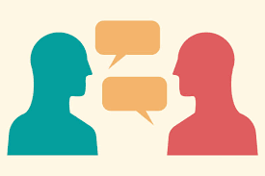
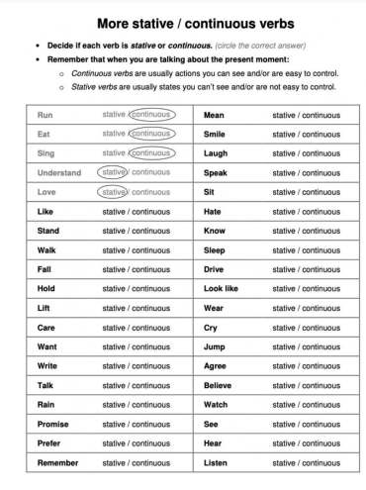
Decide with your partner if the verbs in front of you are dynamic or stative .
2 minutes

Slide 44
Stative Verbs
🧠 1. Verbs of Thinking, Knowing, and Believing
These describe mental states — not actions. Examples:
know
believe
understand
remember
forget
imagine
mean
realize
suppose
doubt

Slide 45
❤️ 2. Verbs of Emotions and Feelings
These express how someone feels — not what they do. Examples:
love
like
hate
prefer
dislike
adore
appreciate
care
want
need

Slide 46
. Verbs of Possession and Relationship
Show ownership or connections. Examples:
have
own
belong
possess
include
consist of
contain

Slide 47
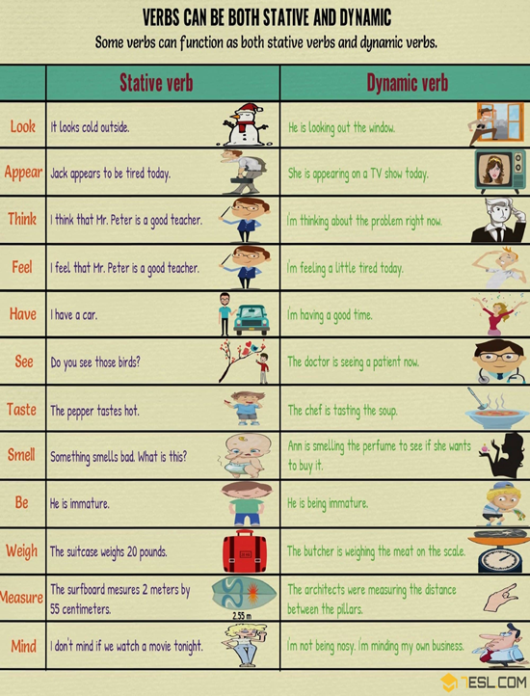
Performance : Group Work .
Time : 5 minutes .
Task : Read the sentences in each row and then write the meaning of the verb in each sentence .
These verbs are sometime satives and sometime dynamic . It depends on the meaning

