Slide 1
Dynamic and Stative Verbs

Slide 2
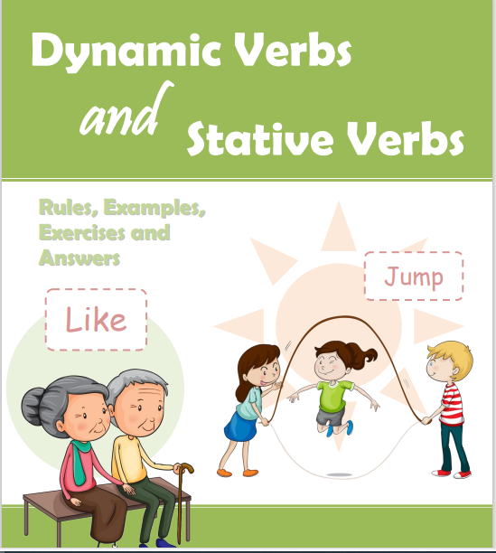
Lesson’s Objectives :
1- To realize the meaning of Dynamic verbs and State /stative verbs
2- To differentiate between Dynamic and Stative Verbs .

Slide 3
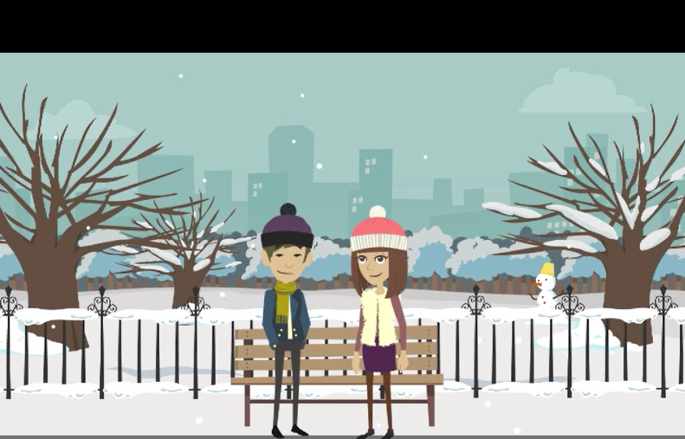
Warming Up
Listen to the video and then chose the correct answers .

Slide 4
Pre assessment
IRS

Slide 5
Choose the correct answer for each sentence:
I _______________ my keys at home yesterday.
a) lost
b) am
c) feel

Slide 6
He _______________ many tasks at work every day.
is doing
loves
has

Slide 7
Choose the sentence with the incorrect use of a stative verb.
a) I am thinking that the homework is difficult. b) She knows the answer. c) I believe in magic. d) They own a house in the city.

Slide 8

What are dynamic verbs and stative verbs?

Slide 9
Stative
In English grammar a "stative verb" means that the verb describes a state rather than an action. Stative verbs are sometimes k nown as "state verbs.“
Dynamic
In English grammar a "dynamic verb" means that the verb describes an action rather than a state. Dynamic verbs are sometimes known as "action verbs."

Slide 10
Guiding Points for Identifying Dynamic and Stative Verbs.
Dynamic Verbs:
These verbs describe actions or processes.
They can describe something that is happening at the moment (e.g., "She is running").
They often have different tenses, such as present continuous or past continuous

Slide 11
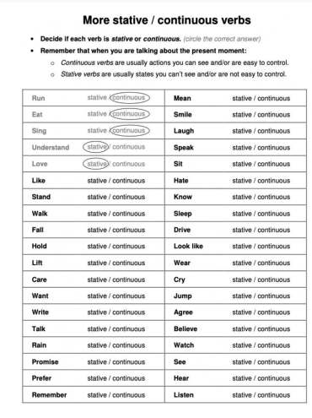


Decide with your partner if the verbs in front of you are dynamic or stative .
2 minutes

Slide 12

Check your answers with the rest of your group.

Slide 13
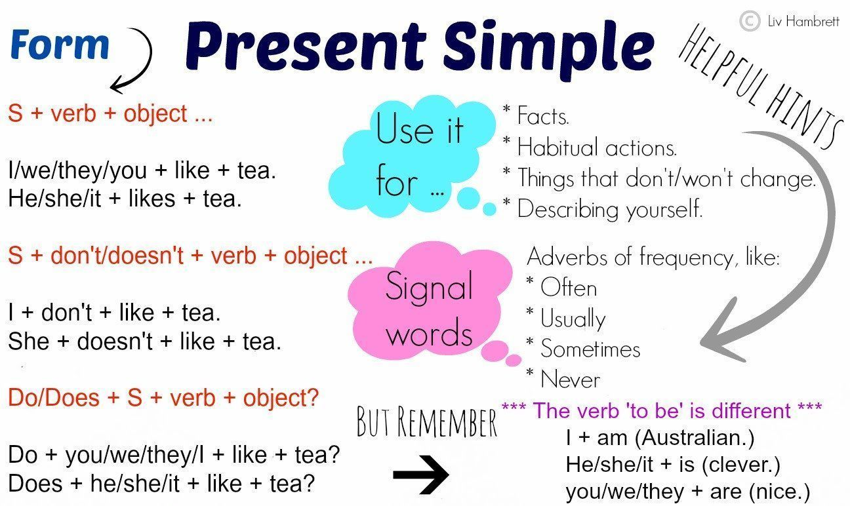

Slide 14
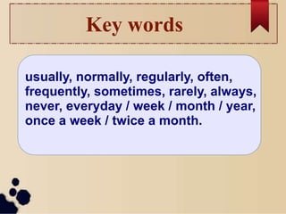
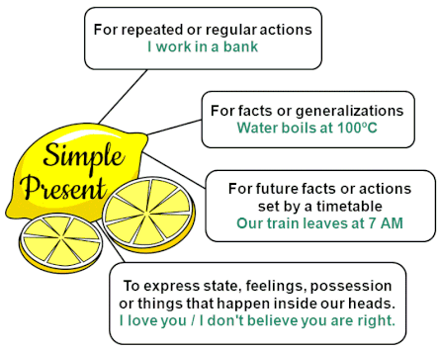

Slide 15
The present continuous tense is most often used for the following:
For actions happening now: * It is raining now .
For future arrangement : *I'm flying to Paris tomorrow .
To express an annoying or surprising behaviors : *She is always talking about people behind their backs !
Temporary situations : *He lives in Amman , but this week he is staying with his parents in Irbid .

Slide 16
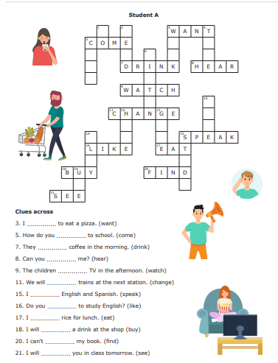
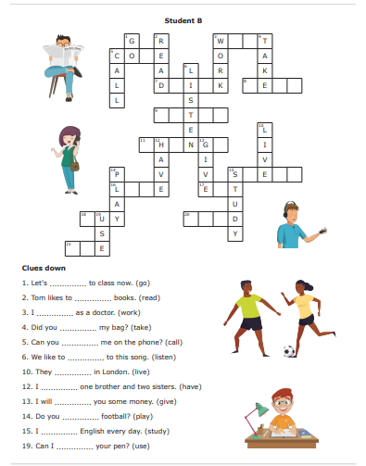
Formative Assessment
Students 1+2
Do the task for students A
Students 3+4
Do the task for students B

Slide 17
How to form the present continuous affirmative sentence : is Subject + am + v-ing are
Time Expressions : now , at the moment , today , these days , this week / this month …etc. Tonight

Slide 18
Qs 1- 3 : 1. When we talk about a habit or an action someone does regularly we use : A) present simple B) Present continuous 2. When the situation is temporary an wont last for a long time we use : A) present simple B) Present contiguous

Slide 19
Qs 4-5 : We use the present continuous tense to talk about personal plans in the future : A) True B) False

Slide 20
Qs 6-7 is it ok to replace the questions with Is Betty Knowing about Marks plan ? How are you thinking Betty feels about Mark’s plans ?

Slide 21
State Verbs: Thoughts ,Mental Activities
Think , believe, consider, depend, doubt, forget,guess, hope, imagine, know, mean, prefer,
realize, remember, understand

Slide 22
Examples:
1. I know him very well.
(not I'm knowing him very well). 2. I believe you
(not I'm believing you). 3. I don't understand what you are saying
(not I'm not understanding what you are saying). 4. I agree with you
(not I'm agreeing with you).

Slide 23
Stative Verbs: Possession
Examples:
I have dark hair
(not I'm having dark hair). 2. I own a house
(not I'm owning a house). 3. This dog belongs to John
(not this dog is belonging to John). 4. He possesses at least four cars
(not he is possessing at least four cars).
belong to
have
owe
own
possess

Slide 24
State Verbs: Emotions
dislike
fear
hate
like
love
need
want
wish
Examples:
I love you.
(not I'm loving you). 2. I like going to the cinema
(not I'm liking going to the cinema). 3. He hates rainy days
(not He is hating rainy days). 4. I want to go.
(not I'm wanting to go).

Slide 25
Stative or Dynamic ?

Slide 26
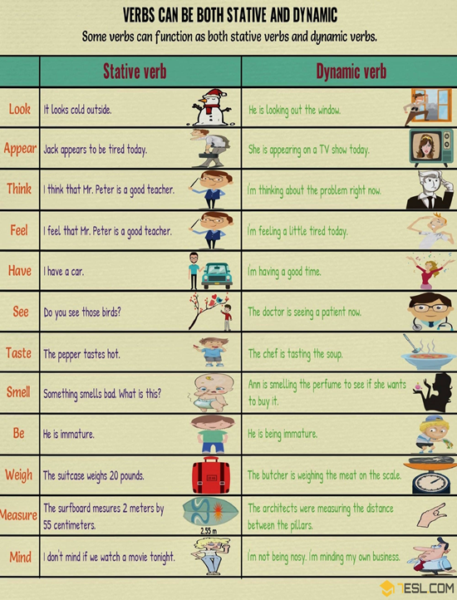
Performance : Group Work .
Time : 5 minutes .
Task : Read the sentences in each row and then write the meaning of the verb in each sentence .

Slide 27
Summative Assessment
https://wordwall.net/resource/26248610/stative-dynamic-verbs

