Slide 1
Unit 3-Reading 2 A Robot’s Smile Vocabulary
Grade 5

Slide 2
Outcomes By the end of this lesson, students should be able to
01
02
03
04
recognize and define the new words.
spell the new words correctly.
pronounce the new words correctly.
use the new words in complete and meaningful sentences.

Slide 3
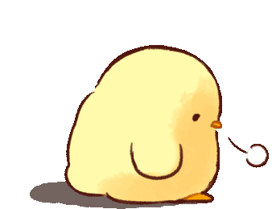

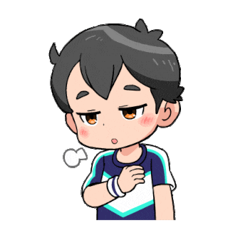
sighed

Slide 4

part of speech
pronunciation
verb
01
sighed
definition
example
let out a deep breath because you’re sad, tired, bored, or relieved
The students sighed when the teacher gave them more homework.

Slide 5
When do YOU sigh?
I sigh when …

Slide 6
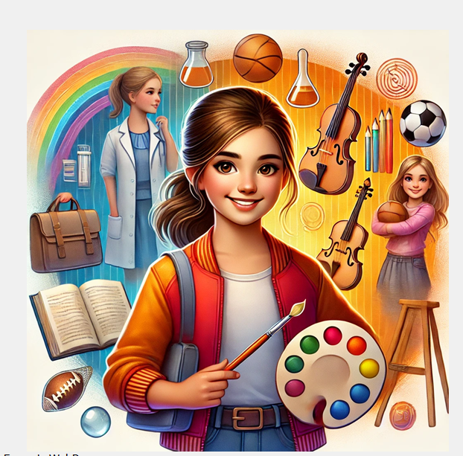

capable

Slide 7
part of speech
pronunciation
adjective
02
capable
definition
example
able to do something
I am capable of getting
better grades in English

Slide 8
What are YOU capable of doing well?
I am capable of (verb + ing)

Slide 9
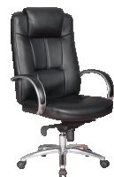
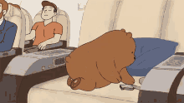
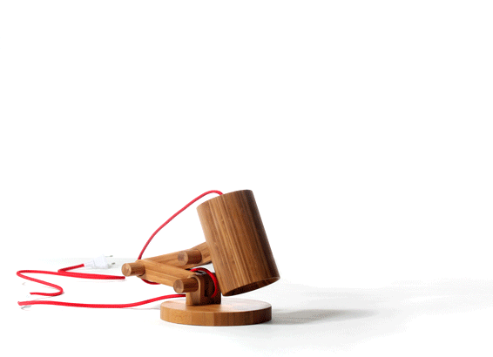
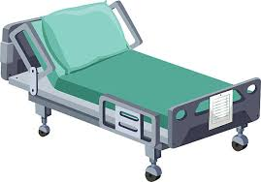
adjustable

Slide 10
part of speech
pronunciation
adjective
03
adjustable
can be changed or moved to fit better
definition
example
This chair is adjustable. You can move it up and down.

Slide 11
Give an example of one adjustable thing you have.
I have an adjustable …

Slide 12






emotions

Slide 13
part of speech
pronunciation
noun
04
emotions
definition
example
strong feelings like love, hate, sadness, happiness, fear, anger, …
The emotions I feel on my birthday are happiness and excitement.

Slide 14
What emotion do you feel when …
- you try a new activity
- your best friend lies to you
- you see someone cheating
- you do a presentation
- you receive a gift
- you face a new challenge

Slide 15
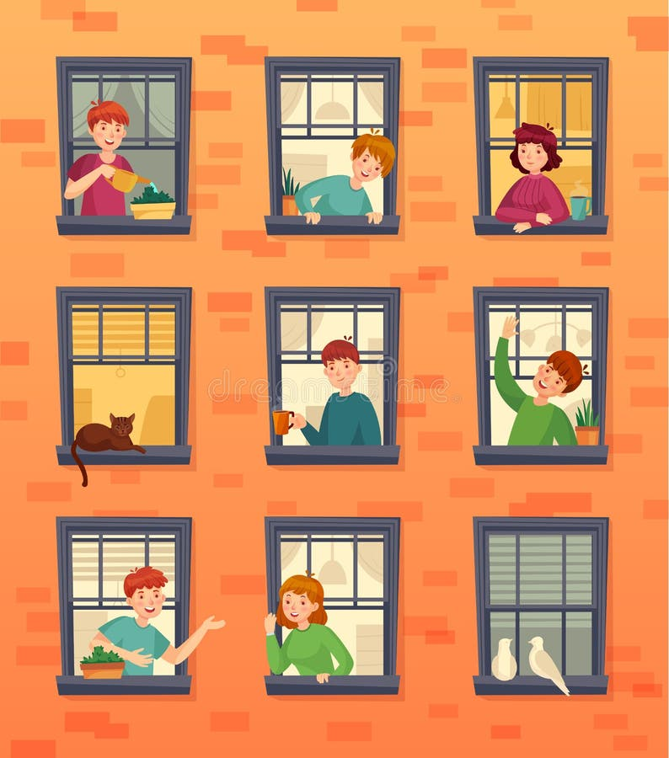
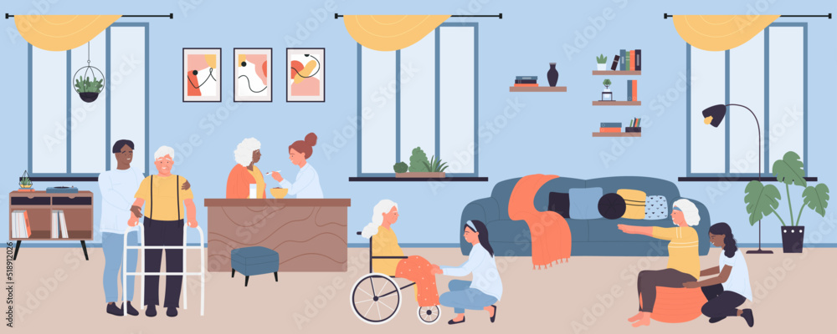
residents

Slide 16
part of speech
pronunciation
noun
05
residents
definition
example
people who live or stay in a place
The residents in our
building are quiet and friendly.

Slide 17
Describe the residents in your building or neighborhood.
The residents in my building are …

Slide 18
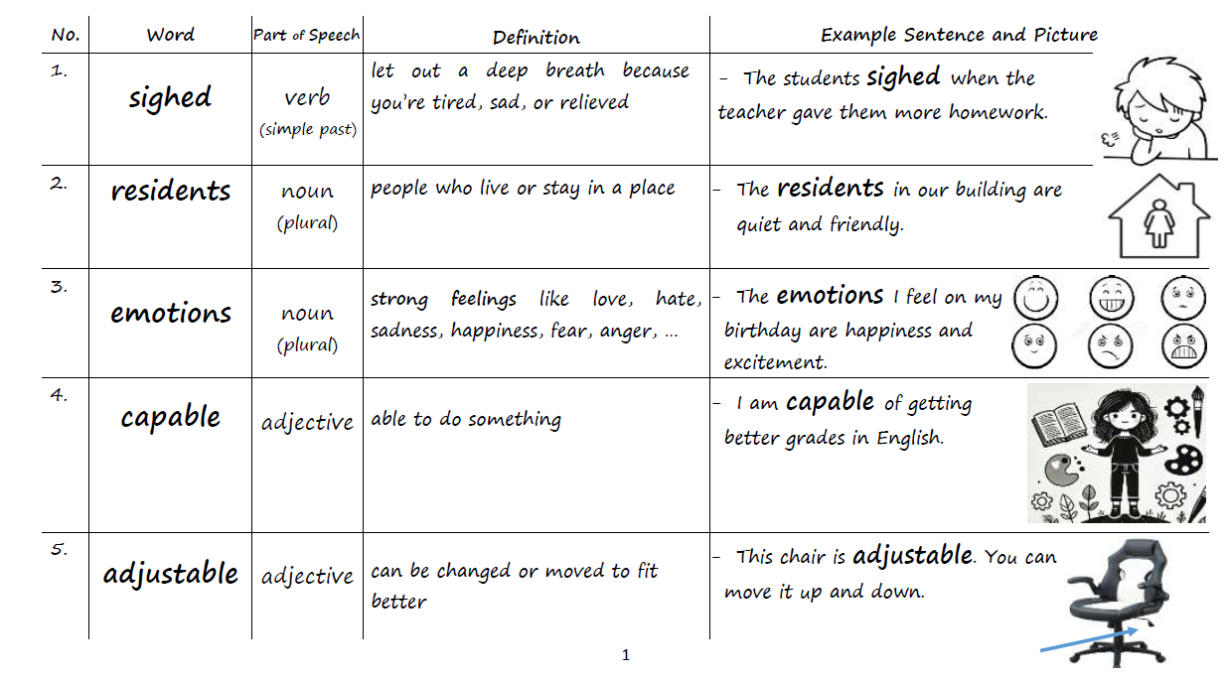
Vocabulary Worksheet p.1

Slide 19
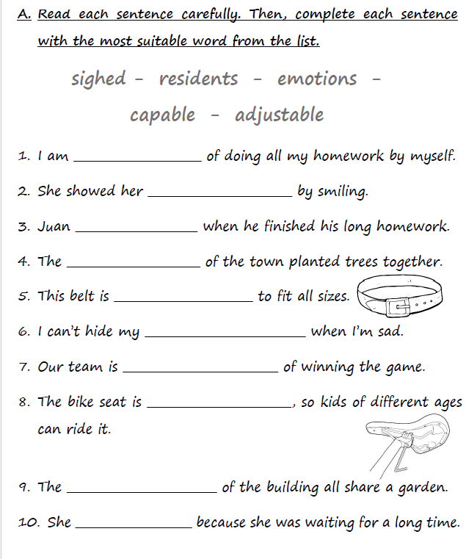
Vocabulary Worksheet p.2 – Practice A

Slide 20
Vocabulary Worksheet p.2 – Practice A - Feedback
capable
emotions
sighed
residents
adjustable
emotions
capable
adjustable
residents
sighed

Slide 21
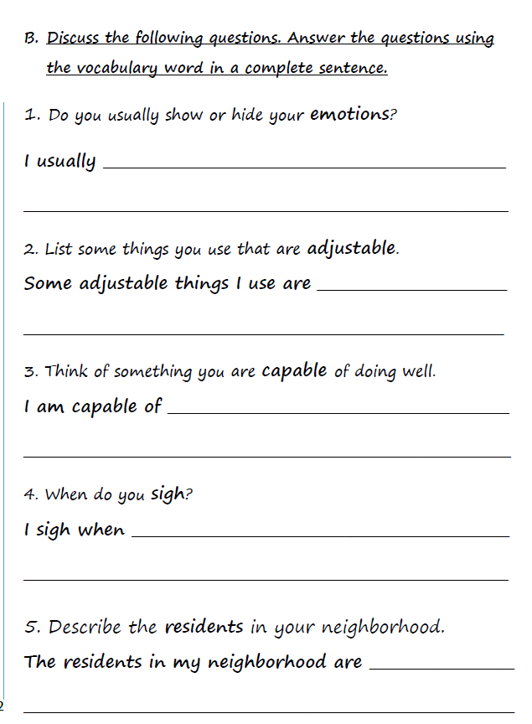
Vocabulary Worksheet p.2 – Practice B

Slide 22
Vocabulary Worksheet p.2 – Practice B - Feedback
show my emotions. For example, I smile
when I’m happy or excited.
backpack straps,
watches, desk chairs, desk lamps, headphones, belts,…
reading books, using technology, riding
a bike, solving math problems, swimming, drawing, …
I lose a game, I have to eat something I
don’t like, I have to clean my room, I have a lot of
homework.
helpful, kind,
respectful, quiet, friendly, social,…

Slide 23



Warm up
What does a pencil do?
What is special about this pencil?

Slide 24
Warm up
A pencil writes, draws, help us take notes,…
This pencil is yellow. It’s sharp. It has an eraser.

Slide 25
Warm up
A pencil writes, draws, help us take notes,…
This pencil is yellow. It’s sharp. It has an eraser.
These are the _______ of the pencil.
These are the _______ of this pencil.

Slide 26
Warm up
A pencil writes, draws, help us take notes,…
This pencil is yellow. It’s sharp. It has an eraser.
functions
features
These are the _______ of the pencil.
These are the _______ of this pencil.

Slide 27


Choose two items and write their functions (what they do).
The function of the ___ is to ___.

Slide 28

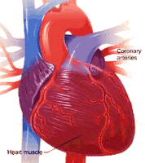
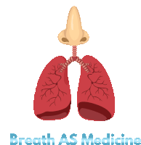




The function of the ____ is to ____.

Slide 29
Choose two items and write special features they have.
_____ is _____.
_____ has _____.

Slide 30
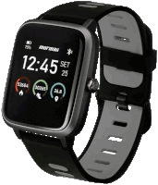

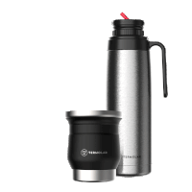
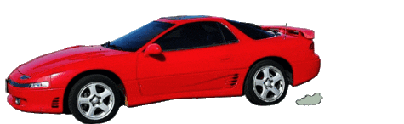
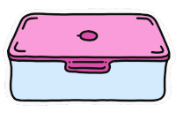
Choose two items and write special features they have.
_____ is _____.
_____ has _____.

Slide 31
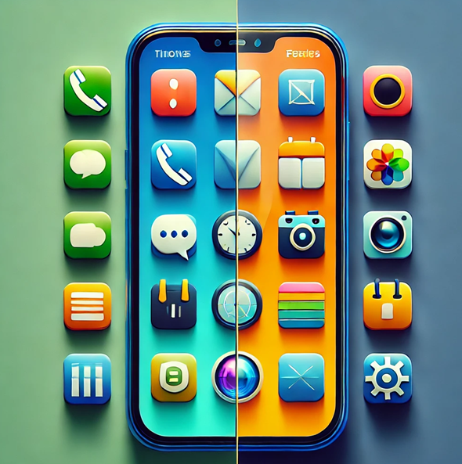
functions
what smartphones do
features
special things some smartphones have

Slide 32
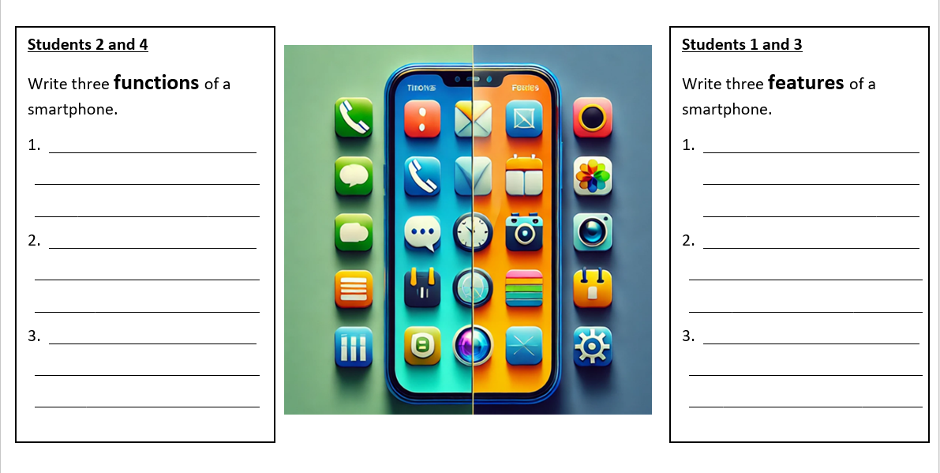

Slide 33
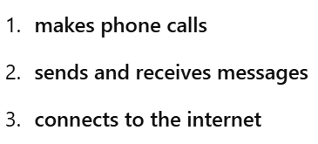
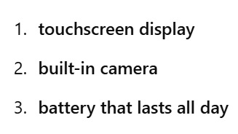

Slide 34
part of speech
pronunciation
noun
06
function
definition
example
the purpose or job of something
The function of a phone is to make and receive calls.

Slide 35
part of speech
pronunciation
noun
07
features
definition
example
special parts or qualities that something has
My new phone has many new features like a great camera and wireless charging.

Slide 36
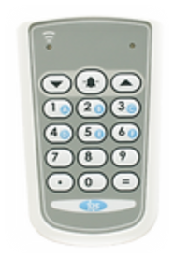
IRS

Slide 37
The ___ of something is what it does.
1. function
2. feature

Slide 38
The ___ of something is what it does.
1. function
2. feature

Slide 39
My phones has an amazing _____.
It has a high quality camera.
1. function
2. feature

Slide 40
My phones has an amazing _____.
It has a high quality camera.
1. function
2. feature

Slide 41
0ne ______ of a smartwatch is to tell time.
1. function
2. feature

Slide 42
0ne ______ of a smartwatch is to tell time.
1. function
2. feature

Slide 43
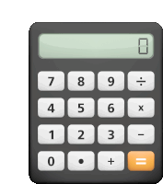
0ne ______ of my calculator is that it has large buttons.
1. function
2. feature

Slide 44
0ne ______ of my calculator is that it has large buttons.
1. function
2. feature

Slide 45







program

Slide 46
What computer programs do you use?
The computer programs I use are …

Slide 47
part of speech
pronunciation
noun
06
program
definition
example
a set of instructions given to a computer
Computer programs like Word and PowerPoint can teach new things.

Slide 48
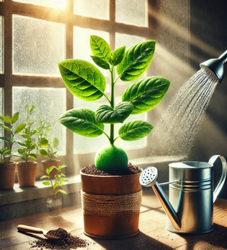
Describe the circumstances plants need to live in.

Slide 49
part of speech
pronunciation
noun
09
circumstances
definition
example
things that happen around you that can change what you do
The trip was canceled because of the circumstances.

Slide 50
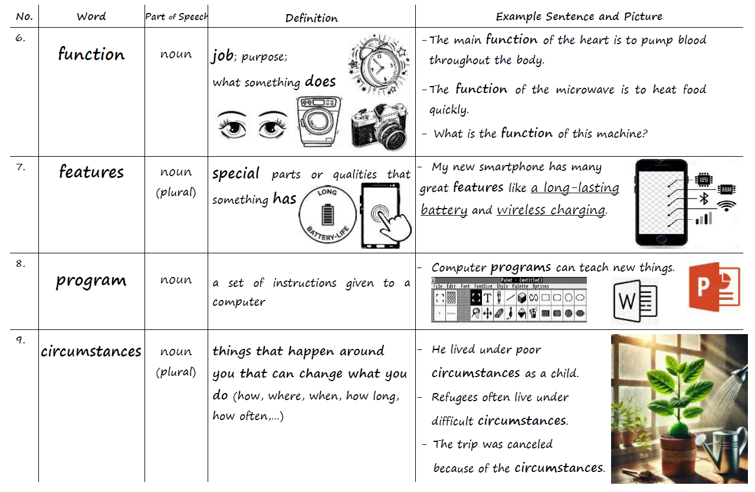
Vocabulary Worksheet p.3

Slide 51
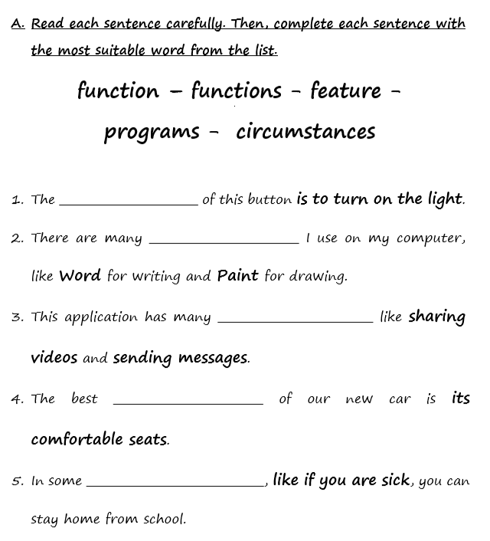
Vocabulary Worksheet p.4 – Practice A

Slide 52
Feedback

Slide 53
Feedback
function
programs
functions
feature
circumstances

Slide 54
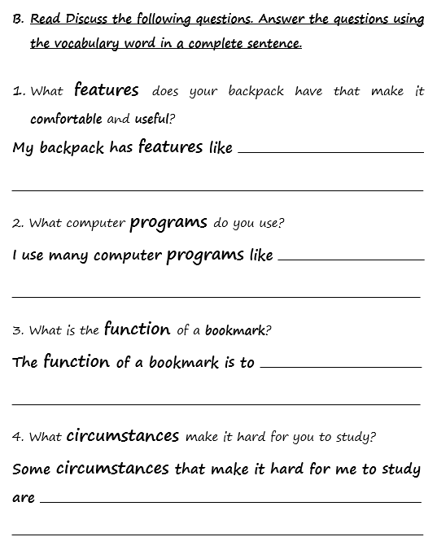
Vocabulary Worksheet p.4 – Practice B

Slide 55
Feedback
adjustable straps,
lots of pockets, and a water bottle holder.
Smoothy, Paint,
PowerPoint, and Hello Code.
help you remember
where you stopped reading.
noise, feeling tired, and not understanding
the topic.

Slide 56
Group Work sighed, emotions, residents, capable, adjustable, program, function, features, circumstances
1. Choose five words and act them out in a skit.
2. Choose five words and use them in a paragraph.

Slide 57
Kahoot!
https://kahoot.it/solo/?quizId=847f97fd-09c0-4834-9603-7ed3937bd883

