Slide 1
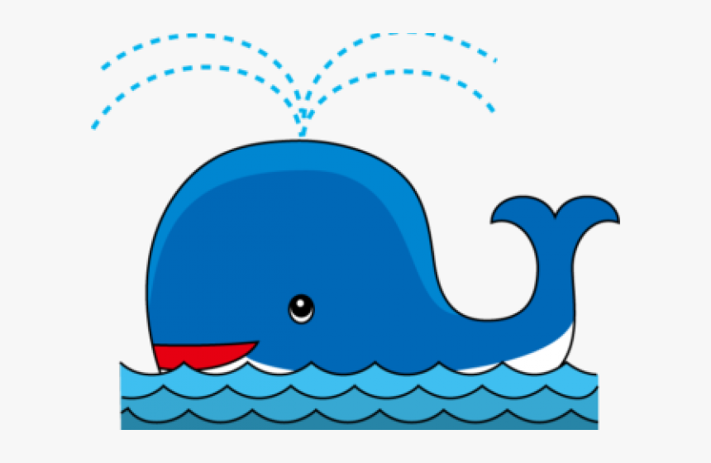

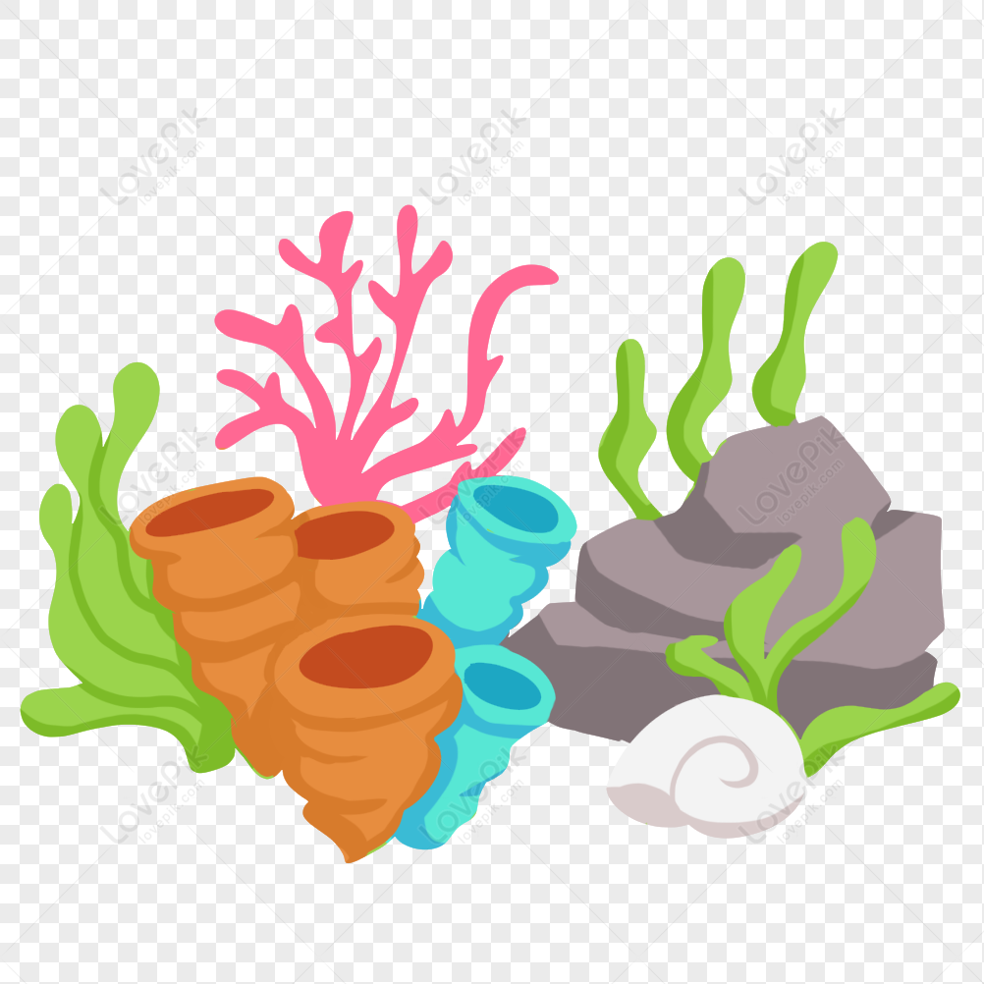
Page 101
1. How are plants and animals alike or similar?
2. What is the fastest growing animal in the world?
3. How fast can newborns grow?
4. How long are blue whales when they are born?
5. How much do adults weigh?
6. Give examples that show how long and big blue whales are.
7. Where do some corals live?
8. (T/ F) These animals grow very rapidly.
9. What do they build?
10. In what way are bristlecone pines and corals the same?
11. What is the average weight of human babies when they are born?
12. How fast we grow depends on __________.
13. We grow really fast during __________.
14. “We’re slow growers compared to other primates.” Explain.

