Slide 1
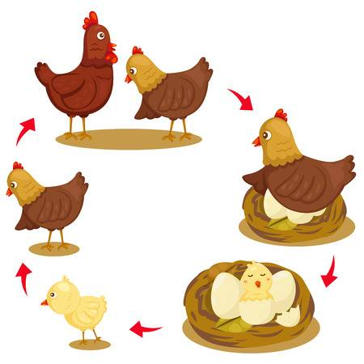
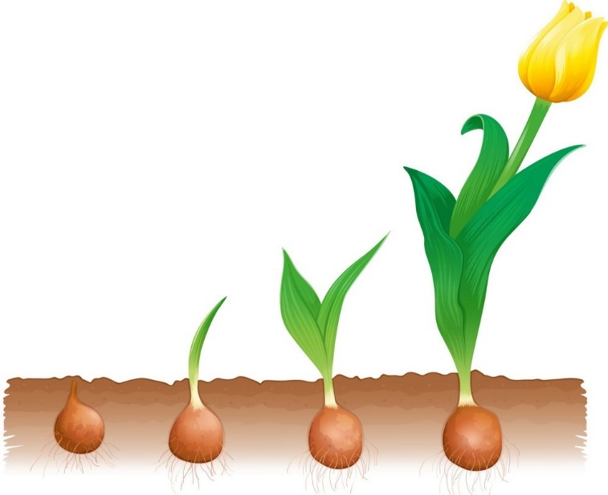
1. How do plants and animals start out?
2. Do we notice the movement of plants and animals when they grow?
3. Give an example of a plant that grows very fast.
4. What do some people call it?
5. How long does it grow each/ per day?
6. Where did this plant originally come from?
‏7. Can we find it all around the world?
8. What is it considered to be in many places? Why?
9. What is the fastest growing tree in the world?
10. Where is it from?
11. How long does it grow each year?
12. How is this tree different from the other trees?
13. Give an example of a tree that grows at a very slow rate.
14. What is the maximum height it reaches in the mountains of California?
15. Compare bristlecone pines with coastal redwoods and most pine trees.

