Slide 1

OBJECTIVES
WARM UP
Unit: Two
Lesson: Writing
Subject: The Opinion essay
Grade: Nine
PREASSESSMENT
PRESENTATION
FORMATIVE ASSESSMENT
FEEDBACK
DIFFERENTIATION
REAL LIFE APPLICATION
CRITICAL THINKING
EXIT TICKET

Slide 2

ISLAMIC EDUCATIONAL COLLEGE DATE:
SUBJECT: English
GRADE:9
UNIT:1
LESSON:2
Objectives
01:00 minutes
Lesson Objective:
Students should be able to:
1. Students will identify the components of a strong writing piece and practice brainstorming ideas for writing.

Slide 3
ISLAMIC EDUCATIONAL COLLEGE DATE:
SUBJECT: English
GRADE:9
UNIT:1
LESSON :2
WARM UP
05:00 minutes
(Think-Pair-Share) [5 min]
"What makes a piece of writing interesting to read?"
Think: reflect silently and jot down 2-3 ideas.
Pair: Pair up with a partner and discuss.
Share: A few pairs share responses with the class.

Slide 4

ISLAMIC EDUCATIONAL COLLEGE DATE:
SUBJECT: English
GRADE:9
UNIT:1
LESSON:2
PREASSESSMENT
3:00 minutes
Which of the following is NOT a part of a paragraph?
Topic sentence
b) Supporting details
c) Plot twist
D) Closing sentence
IRS

Slide 5
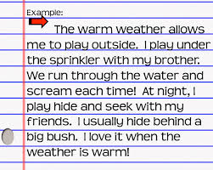
ISLAMIC EDUCATIONAL COLLEGE DATE:
SUBJECT
GR ADE
UNIT
LESSON
Pre-assessment
This is a --------
sentence
essay
paragraph
OUTCOMES
02:00 minutes
WARM UP
PREASSESSMENT
PRESENTATION
FORMATIVE ASSESSMENT
FEEDBACK
DIFFERENTIATION
REAL LIFE APPLICATION
CRITICAL THINKING
EXIT TICKET

Slide 6
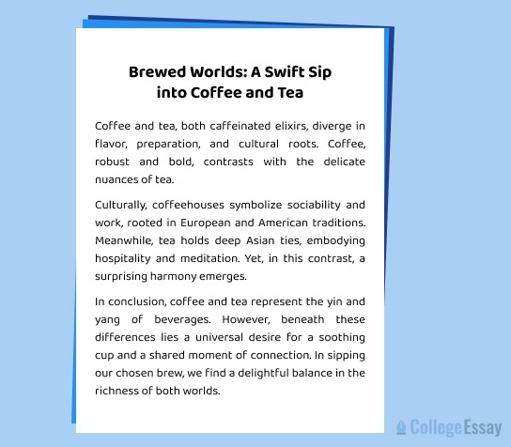
ISLAMIC EDUCATIONAL COLLEGE DATE:
SUBJECT
GR ADE
UNIT
LESSON
Pre-assessment
2.This is a(n)
paragraph
sentence
essay
OUTCOMES
02:00 minutes
WARM UP
PREASSESSMENT
PRESENTATION
FORMATIVE ASSESSMENT
FEEDBACK
DIFFERENTIATION
REAL LIFE APPLICATION
CRITICAL THINKING
EXIT TICKET

Slide 7
ISLAMIC EDUCATIONAL COLLEGE DATE:
SUBJECT: English
GRADE:9
UNIT:1
LESSON:2
PREASSESSMENT
3:00 minutes
2. Brainstorming is helpful in writing because:
  a) It helps organize thoughts before writing
  b) It replaces editing
  c) It’s optional and unnecessary
  d) It helps correct grammar
IRS

Slide 8
ISLAMIC EDUCATIONAL COLLEGE DATE:
SUBJECT: English
GRADE:9
UNIT:1
LESSON:2
PREASSESSMENT
3:00 minutes
Which part of an essay introduces the topic of the essay?
  a) Conclusion
  b) topic
  c) Introduction
IRS

Slide 9
ISLAMIC EDUCATIONAL COLLEGE DATE:
SUBJECT: English
GRADE:9
UNIT:1
LESSON:2
PREASSESSMENT
3:00 minutes
4. What is the purpose of a closing sentence?
  a) To add a new topic
  b) To confuse the reader
  c) To summarize the paragraph
  d) To explain grammar rules
IRS

Slide 10
ISLAMIC EDUCATIONAL COLLEGE DATE:
SUBJECT
GR ADE
UNIT
LESSON
Pre-assessment
3. What is an essay?
A. A list of random ideas with no structure
B. A piece of writing that has an introduction, body, and conclusion
C. A group of sentences without a clear topic
D. A short poem about any subject
OUTCOMES
02:00 minutes
WARM UP
PREASSESSMENT
PRESENTATION
FORMATIVE ASSESSMENT
FEEDBACK
DIFFERENTIATION
REAL LIFE APPLICATION
CRITICAL THINKING
EXIT TICKET

Slide 11
ISLAMIC EDUCATIONAL COLLEGE DATE:
SUBJECT: English
GRADE: 9
UNIT:1
LESSON:2
PRESENTATION
05:00 minutes
The Introduction
The Body Paragraphs
The Conclusion

Slide 12
ISLAMIC EDUCATIONAL COLLEGE DATE:
SUBJECT: English
GRADE: 9
UNIT:1
LESSON:2
PRESENTATION
08:00 minutes
The Introduction
Attention grabber (hook) : you can start with a question, fact to grab the readers attention.
1.Over 90% of schools in Japan require uniforms, and they report fewer discipline issues as a result.
2.Would students focus more on learning if they didn’t have to worry about what to wear every day?

Slide 13
ISLAMIC EDUCATIONAL COLLEGE DATE:
SUBJECT: English
GRADE: 9
UNIT:1
LESSON:2
PRESENTATION
08:00 minutes
The Introduction
2. Background Statement
Definition:
This sentence gives general information about the topic. It helps the reader understand what the essay will be about and prepares them for the writer’s opinion.
Example:
"School uniforms have been a tradition in many countries, and some believe they help promote discipline and equality in schools."

Slide 14
ISLAMIC EDUCATIONAL COLLEGE DATE:
SUBJECT: English
GRADE: 9
UNIT:1
LESSON:2
PRESENTATION
08:00 minutes
The Introduction
Thesis Statement
Definition:
The thesis statement is the most important sentence in the introduction. It clearly states the writer’s opinion and outlines the main reasons that will be discussed in the body paragraphs.
Example:
"However, I believe that students should not be required to wear school uniforms because they limit self-expression, add unnecessary costs, and do not improve academic performance."

Slide 15
ISLAMIC EDUCATIONAL COLLEGE DATE:
SUBJECT: English
GRADE: 9
UNIT:1
LESSON:2
PRESENTATION
08:00 minutes
(Identify hook/ background information) and thesis statement
Many people argue about whether schools should offer free lunch to all students, regardless of their financial background. I am of the opinion that schools should provide free meals to every student. This policy would promote equality, improve students’ health, and support academic success.

Slide 16
ISLAMIC EDUCATIONAL COLLEGE DATE:
SUBJECT: English
GRADE: 9
UNIT:1
LESSON:2
PRESENTATION
Body( How many reasons/ Is it enough to mention the reason/ find linking words/ what tense is used in writing
08:00 minutes
One significant reason is that free school meals help reduce the gap between students from different economic backgrounds. When every student receives the same lunch, no one feels embarrassed or left out due to their financial situation. This is due to the fact that food insecurity is a common issue in many communities, and offering free lunch ensures that all students have access to at least one nutritious meal during the day. Furthermore, students who eat healthy meals are more likely to stay focused and perform better in class. A hungry child cannot concentrate or participate actively in learning activities. A clear example of this is seen in schools that have already implemented free lunch programs and noticed a rise in attendance and academic performance. In addition, providing free lunch can encourage better eating habits among young people. When schools serve balanced meals, students are more likely to eat vegetables, fruits, and whole grains. Not only that, but it also relieves parents of the stress of preparing lunch every day, especially for those working long hours.

Slide 17
ISLAMIC EDUCATIONAL COLLEGE DATE:
SUBJECT: English
GRADE: 9
UNIT:1
LESSON:2
PRESENTATION
08:00 minutes
What Does a Conclusion Include? /What Does a Conclusion Include?
A strong conclusion usually has:
Restated Thesis – Reword your main argument or point.
Summary of Key Points – Briefly mention the main ideas (but don’t repeat everything).
Final Thought/Reflection – A closing sentence that might give insight, a call to action, or a broader implication.
In conclusion, providing free lunch to all students is a valuable step toward equality and improved education. It supports students’ health, boosts learning, and creates a more inclusive school environment. For these reasons, I firmly believe that free school meals should be available to every student, every day.

Slide 18

ISLAMIC EDUCATIONAL COLLEGE DATE:
SUBJECT: English
GRADE: 9
UNIT:1
LESSON:2
PRESENTATION
The Body Paragraphs

Slide 19
ISLAMIC EDUCATIONAL COLLEGE DATE:
SUBJECT: English
GRADE: 9
UNIT:1
LESSON:2
PRESENTATION
08:00 minutes
What Does a Conclusion Include?
A strong conclusion usually has:
Restated Thesis – Reword your main argument or point.
Summary of Key Points – Briefly mention the main ideas (but don’t repeat everything).
Final Thought/Reflection – A closing sentence that might give insight, a call to action, or a broader implication.
In conclusion, students should have the freedom to choose what they wear to school. Allowing them to express their individuality through clothing can boost confidence and creativity, while also reducing financial pressure on families. Since uniforms do not directly influence how well students learn, schools should focus instead on creating a positive and inclusive environment where students can be themselves.

Slide 20
ISLAMIC EDUCATIONAL COLLEGE DATE:
SUBJECT: English
GRADE: 9
UNIT:1
LESSON:2
PRESENTATION
08:00 minutes
I believe that school uniforms should be required in all schools. Uniforms help reduce peer pressure because students don’t have to worry about wearing trendy or expensive clothes. They also promote a sense of school pride and unity among students. In addition, uniforms can save time in the morning since students don’t have to decide what to wear. Overall, school uniforms create a more focused and equal learning environment for everyone.
1. The topic sentence : Should be clear and specific
2. Supporting details : support your opinion with reasons and examples
3. Closing sentence : You can paraphrase the topic sentence.

Slide 21

ISLAMIC EDUCATIONAL COLLEGE DATE:
SUBJECT: English
GRADE: 9
UNIT:1
LESSON:2
FORMATIVE ASSESSMENT:
04:00 minutes

Slide 22
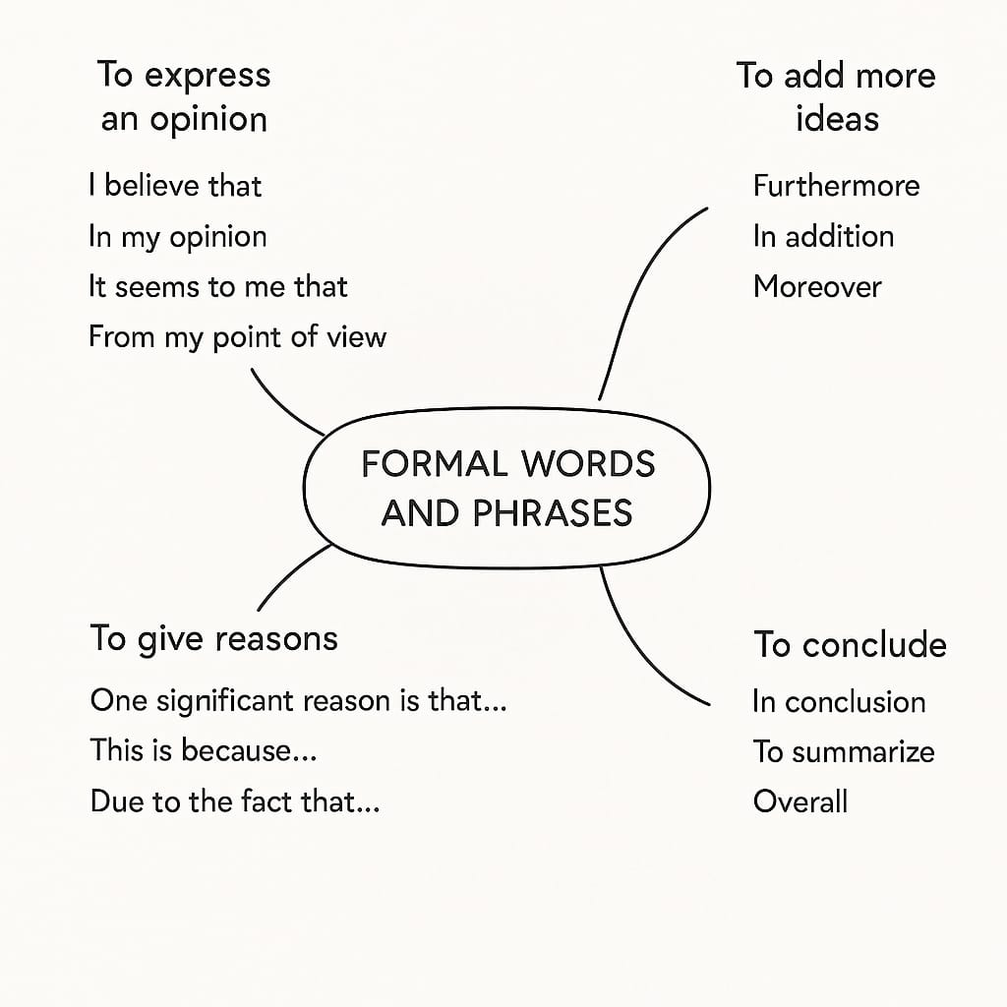
ISLAMIC EDUCATIONAL COLLEGE DATE:
SUBJECT: English
GRADE: 9
UNIT:1
LESSON:2
PRESENTATION
08:00 minutes

Slide 23

ISLAMIC EDUCATIONAL COLLEGE DATE:
SUBJECT: English
GRADE: 9
UNIT:1
LESSON:2
FORMATIVE ASSESSMENT:
04:00 minutes

Slide 24
ISLAMIC EDUCATIONAL COLLEGE DATE:
SUBJECT: English
GRADE:9
UNIT:2
LESSON:3
DIFFERENTIATION
05:00 minutes
Students 1+3 Students 2+4
Match the sentence with the correct component
Should kids have homework every day?
Introduction
One reason
A conclusion

Slide 25
ISLAMIC EDUCATIONAL COLLEGE DATE:
SUBJECT: English
GRADE:9
UNIT:1
LESSON:2
REAL LIFE APPLICATION
02:00 minutes
.
“Should we use robots at school?”
Students stand up, hand up, find a partner.
Share their answers, switch partners if time allows.
(Stand Up, Hand Up, Pair Up)

Slide 26
ISLAMIC EDUCATIONAL COLLEGE DATE:
SUBJECT: English
GRADE:9
UNIT:1
LESSON:2
CRITICAL THINKING
02:00 minutes
“Why do you think professional writers brainstorm before they write?”
Write a 1-sentence response on a sticky note and stick it on the board.

Slide 27
ISLAMIC EDUCATIONAL COLLEGE DATE:
SUBJECT: English
GRADE :9
UNIT:1
LESSON:2
EXIT TICKET
03:00 minutes
*
Wrap up:
✅ “Today we explored how brainstorming helps organize our ideas, and we learned the key components of writing. Tomorrow, we’ll start turning our brainstorms into real writing!”

Slide 28
ISLAMIC EDUCATIONAL COLLEGE DATE:
SUBJECT: English
GRADE :9
UNIT:1
LESSON:2
EXIT TICKET
03:00 minutes
*
Social Media sites are never popular because people invent more sites that are more interesting.
Do you agree?
Write your opinion essay.

Slide 29
It is widely known that social media has become part of everyday life. Social media sites are very popular. However, I believe that their popularity does not last for long because people keep inventing new sites that are more fun and interesting.
Although there are many social media platforms used by different types of people, some users move to other sites because people always create new technology that attracts many users, especially those who are interested in technology and enjoy trying new designs. Moreover, it is part of human nature to get bored with things that are used for a long time, so when new features are added to another site, many people immediately become curious to try something new. In addition, new inventions and new technology often make people leave old sites, even though social media platforms can stay popular for a while.
Overall, technology is always developing and updating to meet the needs of its users, so it is not surprising that social media sites become less popular over time.

