Slide 1
Opinion

Slide 2
Lesson’s Objectives
1- Recognize what an opinion essay is .
2- Realize the parts of the essay and what each part contains.

Slide 3


What is an opinion essay ?
a formal piece of writing where the author expresses and supports their personal viewpoint on a specific topic, using logical reasoning, evidence, and examples to persuade the reader.

Slide 4


Warming Up
Listen to the audio then choose the correct answers.

Slide 5

Critical Thinking
1
What is the difference between an opinion based on evidence and an opinion based only on personal feelings? Which one is more convincing, and why?
2
What is the difference between an opinion based on evidence and an opinion based only on personal feelings? Which one is more convincing, and why?
3
If people didn’t know how to write opinion essays, what impact could that have on communication, decision-making, or even leadership?
4
Some people believe everyone has a right to an opinion, but not all opinions are equally valuable. Do you agree? Why or why not?

Slide 6



Slide 7
📝 Pre-Assessment: Opinion Essay
1. What is the main purpose of an opinion essay? A) To tell a story B) To describe a person or place C) To express your viewpoint and support it with reasons D) To list facts without explanation

Slide 8
2. Which of the following sentences is an example of an opinion? A) Water freezes at 0°C. B) Many people think reading books is more enjoyable than watching movies. C) The sun rises in the east. D) Oxygen is necessary for breathing.

Slide 9
3. What should an opinion essay include to make it convincing? A) Only personal feelings B) Reasons and supporting examples C) Only long sentences D) Questions without answers

Slide 10
4. Which part of an opinion essay should clearly state the writer’s opinion? A) The conclusion B) The introduction C) The body paragraph D) The title

Slide 11
5. Which linking word is often used to show an opinion? A) Because B) For example C) I believe D) As a result

Slide 12
Take off – Touch down
Take of if you know the parts of any essay .
Touch down if you know what a hook sentence is .
Take off if you know what the thesis statement is .

Slide 13
Ethos
What it is: The appeal to the speaker's credibility, character, and authority.
How it works: It establishes trustworthiness and ethical appeal, encouraging the audience to believe the speaker. This can be achieved by highlighting expertise, qualifications, or experience.
Example: A doctor discussing a medical issue by referencing their years of experience and medical background.
Pathos
What it is: The appeal to the audience's emotions.
How it works: It creates an emotional connection by using vivid language, stories, and imagery that evoke feelings like sympathy, anger, or joy.
Example: A non-profit's advertisement showing images of suffering animals to evoke sadness and a desire to donate.
Logos
What it is: The appeal to logic and reason.
How it works: It relies on facts, statistics, research, and a clear, well-structured argument to persuade the audience.
Example: An argument for a new policy that uses statistics to show the problem and presents logical data to support the proposed solution.

Slide 14
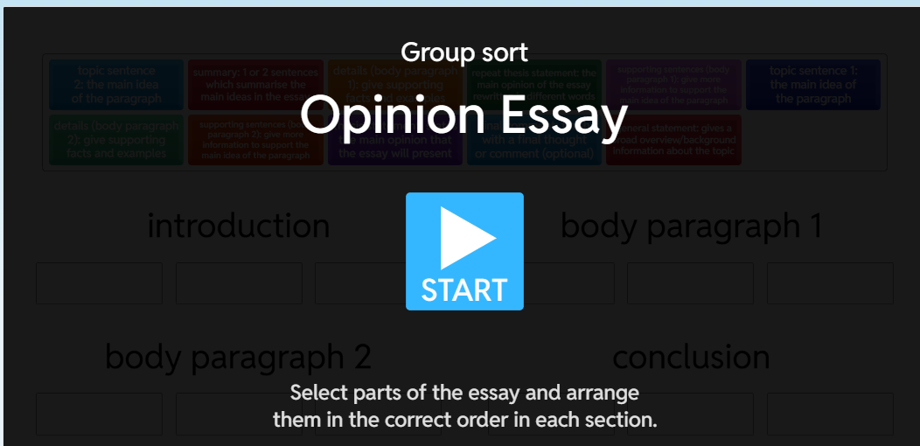
PRE ASSESSMENT

Slide 15
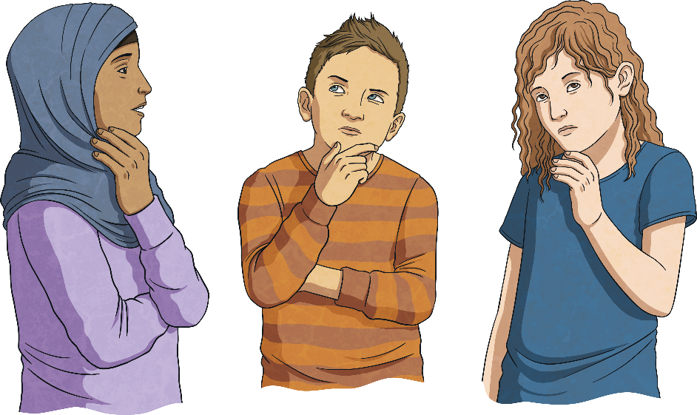
How do we write an opinion essay?
📝 Opinion Essay
Topic: Should students wear school uniforms?

Slide 16
1. Understand the Question/Topic
Read the prompt carefully.
Decide what your opinion is. (Agree/Disagree, or choosing one side).
2. Plan Your Essay
Brainstorm ideas: reasons, examples, experiences, facts.
Make an outline: Introduction – Body – Conclusion.

Slide 17
School Uniform
Equality
School identity
Reducing Distractions
How
How
How
Examples, facts , experiences
Examples, facts , experiences
Examples, facts , experiences

Slide 18

Introduction
Start with a hook (interesting sentence to grab attention).
Paraphrase the question/topic.
State your opinion clearly (your thesis).

Slide 19
👀 Hook: Imagine walking into a classroom where every student is dressed differently—some in fashionable clothes, others in casual wear, and some who cannot afford expensive outfits. 🎯 Thesis Statement: In my opinion, students should wear school uniforms because uniforms promote equality, reduce distractions, and build a sense of school identity.

Slide 20
Body Paragraphs
🟢 Body Paragraphs (3 )
Each paragraph = one reason.
Start with a clear topic sentence.
Add explanation + examples.

Slide 21
Body Paragraph 1 – Equality
Firstly, uniforms create a sense of equality among students. When everyone wears the same outfit, there is less focus on who can afford expensive clothes. This prevents bullying or teasing based on appearance and ensures all students feel included.

Slide 22
Body Paragraph 2 – Reducing Distractions
Secondly, uniforms help reduce distractions in the classroom. Instead of worrying about fashion trends or what their classmates are wearing, students can concentrate more on their studies. Uniforms keep the focus on learning rather than appearance.

Slide 23
Body Paragraph 3 – School Identity
Moreover, uniforms build a sense of school identity and pride. Wearing the same uniform makes students feel like part of a team. It strengthens school spirit and helps students represent their school in a positive way, both inside and outside the classroom.

Slide 24
🔗 Linking Words to Introduce New Ideas
Firstly, school uniforms create equality among students.
To begin with, junk food is harmful to students’ health.
In the first place, writing essays builds critical thinking.
Secondly, it improves focus in class.
Another point is, uniforms reduce bullying.
In addition, they help families save money.
Moreover, they create a sense of school pride.
What is more, they prepare students for real-life dress codes.
Also, uniforms make students look more professional.
Besides, they save time in the morning.
Finally, uniforms reduce distractions in class.

Slide 25
🟢 Counterargument + Refutation
Show the other side briefly.
Explain why your opinion is stronger.

Slide 26
Counterargument + Refutation
Some people argue that school uniforms take away students’ freedom of expression. However, students can still express themselves through their ideas, talents, and personalities. Clothes are only one way to show identity, and schools can provide other opportunities—such as art, music, or clubs—for self-expression

Slide 27
🔗 Linking Words for Introducing a Counterargument
On the other hand,
Some people argue that,
It is often said that,
Opponents of this idea claim that,
A common argument against this is that,
However, some believe that,

Slide 28
🔗 Linking Words for Refuting (Showing Your Opinion Is Stronger)
However,
Nevertheless,
Yet,
But in reality,
This view is weak because,
In fact,
The truth is that,
On the contrary,

Slide 29

Conclusion
🟢 Conclusion
Summarize your main points.
Restate your opinion clearly.
End with a strong closing thought.

Slide 30
Conclusion
In conclusion, school uniforms should be required because they promote equality, reduce distractions, and create a strong school identity. Even though some worry about limiting freedom, the benefits of uniforms clearly outweigh the drawbacks.

Slide 31
🔗 Linking Words for the Conclusion
In conclusion,
To sum up,
In summary,
All in all,
To conclude,
In short,
Overall,
As a result,

Slide 32
📝 Opinion Essay Parts & Feedback
In the opinion essay we have:
A hook to catch the reader’s attention. 👍 / 👎
A clear thesis statement that shows your opinion. 👍 / 👎
Three reasons explained with examples. 👍 / 👎
A counterargument (the opposite opinion). 👍 / 👎
A refutation that shows why your opinion is stronger. 👍 / 👎
A conclusion that restates your opinion and gives a final thought. 👍 / 👎

Slide 34
https://wordwall.net/resource/13905712/key-phrases-opinion-essay
📝 Instructions – Heads Together Strategy
Form groups of 4.
Put your heads together and discuss the correct answers as a team.
On your screen, click on the line and drag & drop the correct answer to the right place.
Work quickly but carefully — the winner is the group that gets all answers correct in the shortest time!
When you finish, raise your hand and say “Done!”

Slide 35
Differentiation
Students 2+3 : Read the first part and fill in the blanks with the suitable missing word.
Students 1+4 : Read the first part and fill in the blanks with the suitable missing word.
Switch your phones/ papers and check for your colleagues.

Slide 36

Example
Should Students Be Banned from Using Their Phones at School?
Imagine sitting in class, ready to learn, while the student next to you is busy scrolling through social media instead of paying attention. In my opinion, students should be banned from using their phones at school because phones cause distractions, affect social interaction, and increase the risk of cheating.
Phones are one of the main sources of distraction in the classroom. Instead of listening to the teacher, many students check messages or play games. This not only lowers their own performance but also disrupts others around them. Banning phones also helps students focus on face-to-face communication. When phones are constantly used, students tend to talk less with their classmates and teachers. Without phones, they can build stronger relationships and improve their social skills.

Slide 37
Example Continued
Moreover, phones make it easier for students to cheat during exams or copy homework answers. If phones are banned, it becomes harder for students to rely on unfair methods, which encourages honesty and hard work. Some people argue that phones should be allowed because they can be useful for research or emergencies. However, schools already provide computers, libraries, and staff to help students with learning. In emergencies, teachers and administrators can handle communication with parents. Therefore, the disadvantages of phones at school outweigh the benefits.
In conclusion, students should not be allowed to use their phones at school because they cause distractions, reduce real social interaction, and encourage cheating. Banning phones helps create a focused, fair, and healthy learning environment.

