Slide 1
Five New Words
Pages 83-85

Slide 2


PREASSESSMENT
Spend one minute searching online to find a real-life example of someone who achieved success through persistence. This could be an athlete, inventor, artist, or anyone who faced challenges and kept trying.
It’s okay to make mistakes we are still learning

Slide 3
P. 156
My family came to America in 1985. No one spoke a word of English. In school, I was in an English as a Second Language class with other foreign-born children. My class was so overcrowded that it was impossible for the teacher to teach English properly. I dreaded going to school each morning because of the fear of not understanding what people were saying and the fear of being laughed at.At that time, my mother, Tai-Chih, worked part time in a Chinese restaurant from late afternoon till late in the night. It was her unfamiliarity with the English language that forced her to work in a Chinese-speaking environment. Although her job exhausted her, my mother still woke up early in the morning to cook breakfast for my brother and me. Like a hen guarding her chicks, she never neglected us because of her fatigue. So it was not surprising that very soon my mother noticed something was troubling me. When I said nothing was wrong, my mother answered, “You are my daughter. When something is bothering you, I feel it too.” The next day in her neon-tanged eyes made me burst into tears I had held back for so long. I explained to her my fear I had of going to school and that “learning English is too impossible,” my mother said. She carefully suggested that the two of us work together to learn the language at home with books. The confidence and determination in my mother’s eyes thrilled me because English was as new to her as it was to me. That afternoon I saw my mother in a different light as she waited for the bus to go to work. Although she was the shortest of all the mothers there, her face with its worn but smiling and big, black eyes was the most promising. The afternoon sun shone bright on her long, black hair, creating an aura that distinguished my mother from others. My mother and I immediately began reading together and studying five new words a day. My mother with her encouraging attitude made reading fun and interesting. The fact that she was facing the same learning struggles gave me confidence to work so that I could learn English and see the strength she possessed. It made me admire my mother even more.

Slide 4
1. Because she couldn’t understand what people were saying and was afraid of being laughed at.
1. Why did Yu-Lan dread going to school every morning?
2. What problem did the teacher face in Yu-Lan’s English class?
3. Why was Yu-Lan’s mother forced to work in a Chinese-speaking environment?
4. How did Yu-Lan’s mother react when she noticed something was wrong with her daughter?
5. What did Yu-Lan’s mother suggest to help her daughter learn English?
6. How did Yu-Lan’s feelings about her mother change after that afternoon?
7. What daily goal did Yu-Lan and her mother set for themselves?
8. How did studying together affect Yu-Lan’s attitude toward learning English?
2. The class was overcrowded, making it impossible for the teacher to teach English properly.
3. Because she didn’t know enough English to work in an English-speaking place.
4. She showed concern, comforted her, and encouraged her to talk about her feelings.
5. She suggested that they study English together at home using books.
6. She began to admire her mother more and saw her as strong, brave, and inspiring.
7. To learn five new English words every day.
8. It made learning fun, gave her confidence, and helped her believe she could succeed

Slide 5
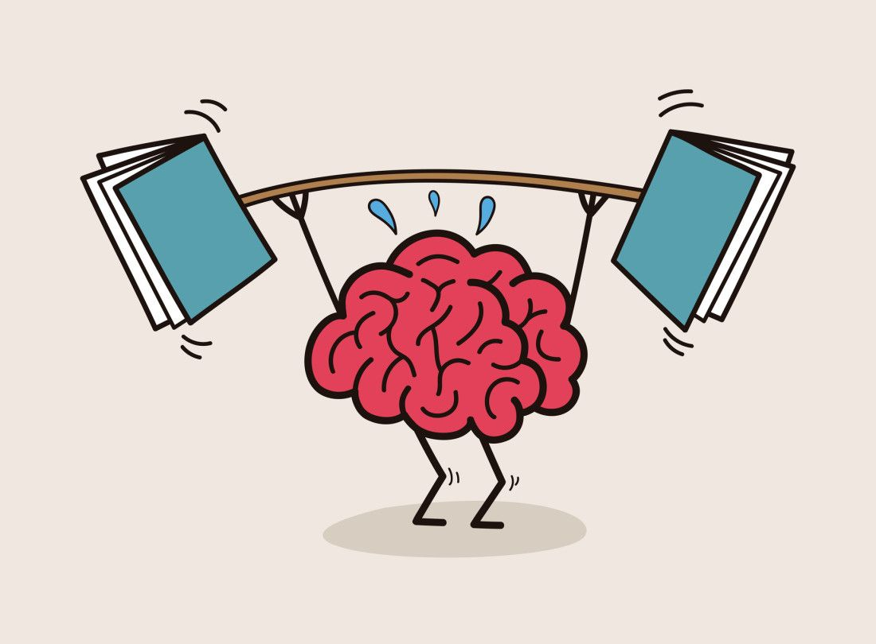
“How does the author use her personal experience to show that emotional strength can be more powerful than language skills in overcoming challenges?”
Challenge Yourself- Buzz IN
Possible Answer
“The author shows that emotional strength can be more powerful than language skills through her mother’s actions and attitude. Although Yu-Lan’s mother could not speak English, her determination, love, and confidence gave her daughter the courage to keep trying. Her mother’s emotional strength replaced fear with hope and helped Yu-Lan believe that learning English was possible. This shows that courage and persistence can overcome barriers that knowledge alone cannot.”

Slide 6
“How can Yu-Lan and her mother’s determination help you face your own challenges in life?
Real Life Application- Buzz IN
Possible Answer
“Their determination teaches me to keep trying, stay patient, and never give up, even when something feels difficult.

Slide 7


✅ True or ❌ False
The narrator’s mother immediately solved all her daughter’s fears about learning English by giving her strict lessons.
(F) The mother encouraged and studied together with her daughter, but she did not “immediately solve” her fears; she supported her patiently.

Slide 8
Check Your Understanding - IRS
Formative Assessment
Why did the narrator dread going to school each morning?
A) The classrooms were too small and uncomfortable.
B) The narrator was afraid of not understanding English and being laughed at.
C) The narrator did not like the subjects taught at school.
D) The narrator had conflicts with other children.

Slide 9
Check Your Understanding - IRS
Formative Assessment
2. How did the mother’s attitude impact the narrator’s learning experience?
A) She pressured the narrator to learn quickly without support.
B) She taught only basic words, which limited progress.
C) Her shared struggle with English and encouragement motivated the narrator.
D) She hired a tutor to take over the teaching at home.

Slide 10
Check Your Understanding - IRS
Formative Assessment
3. What literary device is most evident in the description: “Like a hen guarding her chicks, she never neglected us because of her fatigue”?
A) Simile
B) Metaphor
C) Personification
D) Hyperbole

Slide 11




POSTASSESSMENT
https://create.kahoot.it/details/f4cd95a8-2996-46f5-a6e0-0f6fa46cfb86?drawer=

Slide 12
Five New Words
Page 86

Slide 13
PREASSESSMENT
Google one famous mother who inspired her children or community through education, hard work, or guidance.
Name: Malala Yousafzai’s mother, Tor Pekai Yousafzai
Achievement: Supported Malala’s education despite challenges
Inspiration: Showed how believing in your child’s potential can change lives
It’s okay to make mistakes we are still learning

Slide 14
Very soon, I began to comprehend what everyone was saying and people could understand me. The person solely responsible for my accomplishment and happiness was my mother. The reading also helped my mother learn English so that she was able to pass the postal entrance exam. It has been seven years since that reading experience with my mother. She is now forty-three and in her second year at college. My brother and I have a strong sense of who we are because of the strong values my mother established for herself and her children. My admiration and gratitude for her are endless. That is why my mother is truly the guiding light of my life.

Slide 15
1. The narrator’s mother.
2. It helped her learn English so she could pass the postal entrance exam.
3. Seven years.
4. Strong values for herself and her children.
5. Because of her guidance, hard work, and the values she taught.
6. The guiding light of their life.
7. They began to comprehend what everyone was saying and people could understand them.
8. It gave the narrator a strong sense of who they are.
1. Who was responsible for the narrator’s success in learning English?
2. How did reading help the narrator’s mother?
3. How long has it been since the reading experience with the mother?
4. What values did the mother establish for her children?
5. Why does the narrator admire their mother?
6. What does the narrator call their mother at the end of the passage?
7.How did learning English affect the narrator?
8. How did the mother’s achievements influence the narrator’s sense of self?

Slide 16
How would the family’s life be different if the mother hadn’t learned English?
Challenge Yourself- Buzz IN
Possible Answer
If the mother hadn’t learned English, the family might have faced more difficulties communicating and accessing opportunities. The narrator may not have learned English as quickly, and the strong values and sense of identity shaped by the mother’s example might have been weaker.

Slide 17
How can you support a family member or friend in learning a new skill, just like the narrator’s mother supported them in learning English?
Real Life Application- Buzz IN
Possible Answer
You can help by practicing together, encouraging them, sharing resources, and celebrating their progress to make learning easier and motivating, similar to how the mother guided the narrator.

Slide 18
✅ True or ❌ False
The narrator’s sense of identity and values were shaped more by school experiences than by the guidance of their mother.
False. The narrator’s sense of identity and values were shaped primarily by their mother’s guidance.

Slide 19
Check Your Understanding - IRS
Formative Assessment
What is the main reason the narrator admires their mother?
A) She helped them learn English and guided their personal growth
B) She passed the postal entrance exam
C) She is attending college
D) She worked outside the home

Slide 20
Check Your Understanding - IRS
Formative Assessment
How did reading together affect the narrator and their mother?
A) Only the narrator improved in English
B) Only the mother passed the postal exam
C) Both improved their English and strengthened their bond
D) It caused disagreements between them

Slide 21
Check Your Understanding - IRS
Formative Assessment
What does the phrase “guiding light of my life” most likely mean?
A) The mother literally gave them light at home
B) The mother inspired and directed them in life
C) The mother worked as a teacher
D) The mother controlled their daily schedule

Slide 22
POSTASSESSMENT
https://create.kahoot.it/share/five-new-words-pages-86/f63a5dfd-c940-403e-862d-0ff91865b6c2

Slide 23
Five New Words
Page 87

Slide 24
PREASSESSMENT
Search the question below on Google. Read a short explanation or image result, then be ready to share what you found.
Question to search:
👉 “What does a quilt symbolize in literature?”
In literature, a quilt often symbolizes family, unity, love, and memories. Each piece or patch can represent a different person, story, or experience, all joined together to make something whole and beautiful.
It’s okay to make mistakes we are still learning

Slide 25
Quilt
Janet S. Wong
Our family
is a quilt
of odd remnants
patched together
in a strange
pattern,
threads fraying,
fabric wearing thin—
but made to keep
its warmth
even in bitter
cold.

Slide 26
1. “Our family / is a quilt”
➡️ The poet compares her family to a quilt. This means her family is made up of many different parts (people), just like a quilt is made from many pieces of fabric.
2. “of odd remnants / patched together”
➡️ “Odd remnants” means leftover or different pieces of cloth. Her family members are different from each other, maybe in looks, behavior, or background, but they are “patched together” — connected by love and relationships.
3. “in a strange / pattern,”
➡️ The family’s way of living or being together may seem unusual to others, but it is still their own unique pattern. Every family has its own way of working and understanding each other.
4. “threads fraying, / fabric wearing thin—”
➡️ The “fraying threads” and “thin fabric” show that the family is not perfect. They face problems, conflicts, or difficulties that weaken them, just like old fabric wears out.
5. “but made to keep / its warmth”
➡️ Despite their flaws and struggles, the family still provides love, care, and emotional warmth to one another.
6. “even in bitter / cold.”
➡️ This means that during hard times — sadness, challenges, or loneliness — the family remains close and comforting, like a quilt that keeps you warm in cold weather.

Slide 27
In the poem “Quilt” by Janet S. Wong, the speaker compares her family to a quilt. A quilt is made from many different pieces of fabric, often from old or leftover materials. Each piece is unique, but when they are sewn together, they form something strong, warm, and beautiful.
This image represents a family — every family member is different, with their own personality, background, and experiences (like the odd pieces of cloth). Sometimes, families may have problems or “fraying threads,” but even with those imperfections, they stay connected and support one another.
So, the quilt symbolizes love, unity, and strength through diversity and hardship. It shows that even when life is difficult (“in bitter cold”), the family can still provide warmth and comfort.

Slide 28
What object does the poet compare her family to?
How does the poet describe the family’s differences?
3. What does the quilt symbolize in the poem?
4. What feeling does the phrase “bitter cold” express?
5. Why do you think the poet chose a quilt instead of another object to describe family?
The poet compares her family to a quilt.
Although the family may have problems and weaknesses, shown by the “threads fraying” and “fabric wearing thin,” they stay together and keep their love strong.
The quilt symbolizes family unity, love, and warmth even during difficult times.
The phrase “bitter cold” expresses hard moments in life, but the family’s care helps them stay close.
The poet chose a quilt because it is made of many pieces sewn together, just like a family is formed by different individuals joined by love.

Slide 29
How does the quilt metaphor show both the strengths and flaws of a family?
Challenge Yourself- Buzz IN
Possible Answer
The quilt metaphor shows that a family can have flaws—like fraying threads and worn fabric—but still provide warmth and support, highlighting that unity and love matter more than perfection.

Slide 30
How can the idea of a family as a “quilt” help you appreciate your own family’s differences and imperfections?
Real Life Application- Buzz IN
Possible Answer
The idea of a family as a “quilt” can help you see that everyone’s differences and imperfections are part of what makes the family strong and supportive, encouraging appreciation and patience for each member.

Slide 31
✅ True or ❌ False
A family must be perfect to provide warmth and support like a quilt.
False. The statement is false because, like the poem says, a family can have “fraying threads” and “fabric wearing thin” yet still provide warmth and support. Imperfections do not prevent a family from being loving and strong.

Slide 32
Check Your Understanding - IRS
Formative Assessment
1. What do “threads fraying” and “fabric wearing thin” symbolize?
A) Family members are physically weak
B) Family relationships can face challenges and imperfections
C) The quilt is old and useless
D) Family members are strangers

Slide 33
Check Your Understanding - IRS
Formative Assessment
2. What is the poet suggesting about the family despite its flaws?
A) It is cold and unwelcoming
B) It loses its purpose
C) It still provides warmth and support
D) It should be replaced

Slide 34
Check Your Understanding - IRS
Formative Assessment
5. Which of the following best describes the tone of the poem?
A) Bitter and angry
B) Warm and accepting
C) Humorous and playful
D) Sad and hopeless

Slide 35
POSTASSESSMENT
https://create.kahoot.it/share/the-quilt/57372673-0e3c-4c88-b46c-adb6a3e2e17a

