Slide 1

Main Idea and Details
Grade 5

Slide 2

Warm up
1. What is the picture mostly about?
2. What small things do you notice?

Slide 3
Main idea
is the most important thing the text is about.
Details
give more information about the main idea.

Slide 4
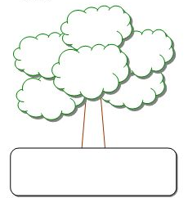
detail
detail
detail
detail
detail
detail
Main Idea

Slide 5
We had a fun day at the park.

Slide 6
We played card games.
We had a picnic.
We flew a kite.
We played football.
We ate ice cream.
We rode our bicycles.
We had a fun day at the park.

Slide 7
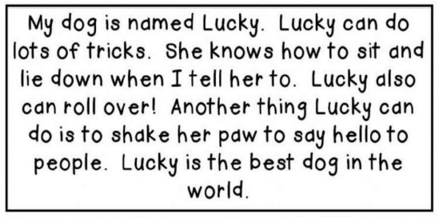
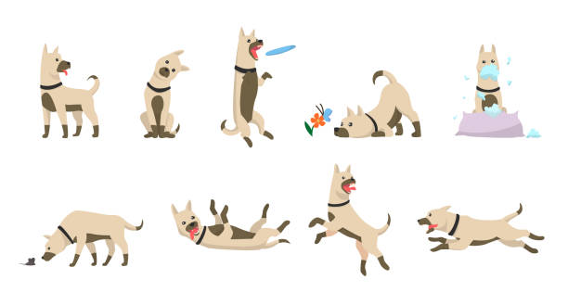

Slide 8
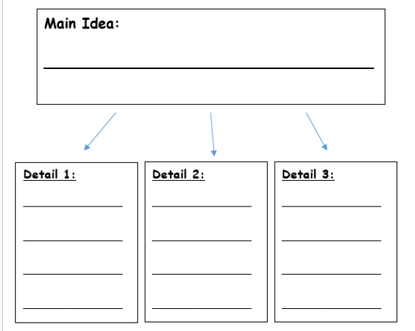

Slide 9
Lucky can do lots of tricks.
Lucky can shake her paw to say hello.
Lucky can sit and lie down.
Lucky can roll over.

Slide 10
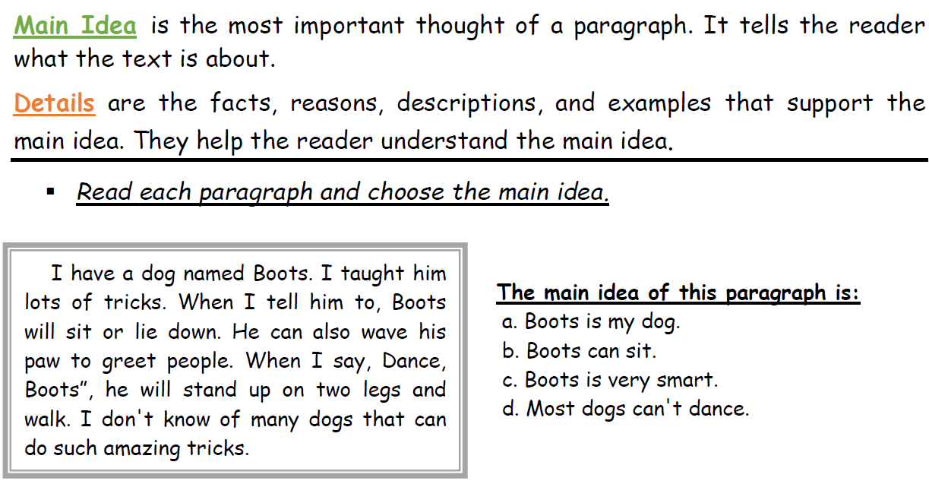
the practice in the notebook

Slide 11
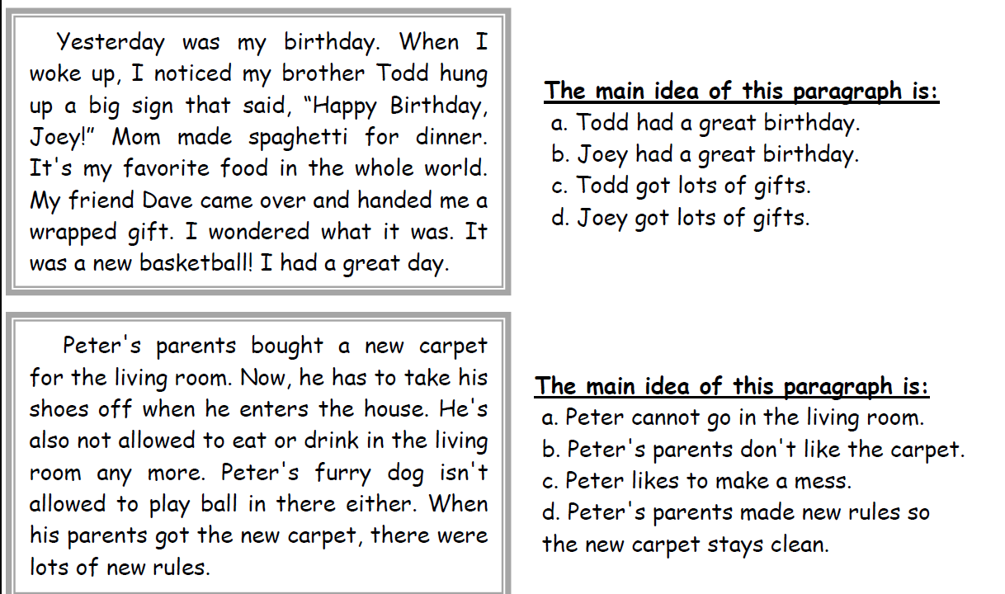

Slide 13
For More Practice
https://www.liveworksheets.com/w/en/comprehension/654100
https://www.liveworksheets.com/w/en/english-language-arts-ela/1884503
https://www.liveworksheets.com/w/en/comprehension/502632
https://www.liveworksheets.com/w/en/english-language/700362

